Slide 1

Comparison of Online Social Relations in terms of Volume vs. Interaction:
A Case Study of Cyworld
Hyunwoo Chun+
Haewoon Kwak+
Young-Ho Eom*
Yong-Yeol Ahn#
Sue Moon+
Hawoong Jeong*
+ KAIST CS. Dept. *KAIST Physics Dept. #CCNR, Boston
ACM SIGCOMM Internet Measurement Conference 2008
Notes:
Welcome. I’m Haewoon Kwak,
Today I’m gonna talk about online social relations by comparing friends relation and user interaction.
Our interests are comparison between declared online friendship relation and actual user interaction.
We do a case study of Cyworld, the most popular online social networks in Korea.
Korea population is 48 millions, but Cyworld userbase is over 22M.
This is joint work, cowork with Hyunwoo Chun, Yong-Ho Eom, Yong-Yeol Ahn, Sue Moon, and Hawoon Jeong.

Slide 2

Online social network in our life
“37% of adult Internet users in the U.S.
use social networking sites regularly…”
September 18, 2008 “Making Money from Social Ties”
Notes:
In the last month, MIT techreview reported that 37% of Internet adult users in United stated use social networking sites regularly.
Online social networks are really prevalent today

Slide 3
In online social networks,
Social relations are useful for
  Recommendation
  Security
  Search …
But do “friendship” in social networks represent meaningful social relations?
Notes:
If we can extract social relations from these user groups,
Those relations are key to recommendation, security, search, and contents propagation.
Fortunately, all we know that ~

Slide 4
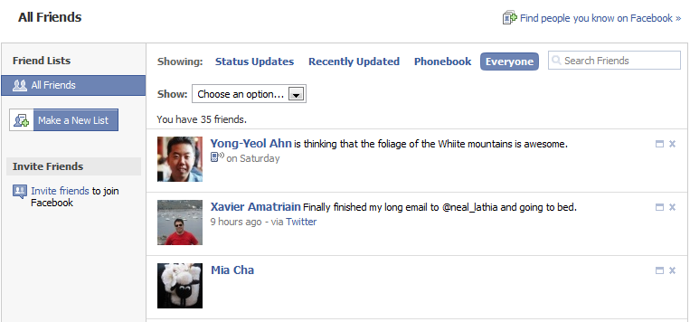
Characteristics of online friendship
It needs no more cost once established
My friends do not drop me off,
even if I don’t do anything (hopefully)
Notes:
Declared online friendship has some limitations to reflect user relations.
Once online friendship established, it needs no more cost.
For example, in Facebook, even if I don’t do anything, my friends do not abandon me, Hopefully.

Slide 5

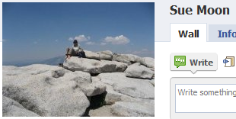
Characteristics of online friendship
It is bi-directional
Haewoon is a friend of Sue
It is not one-sided
Sue is a friend of Haewoon
Notes:
And, online friendship is mutual in most cases.
If I’m Sue’s friend, Sue is my friend.

Slide 6
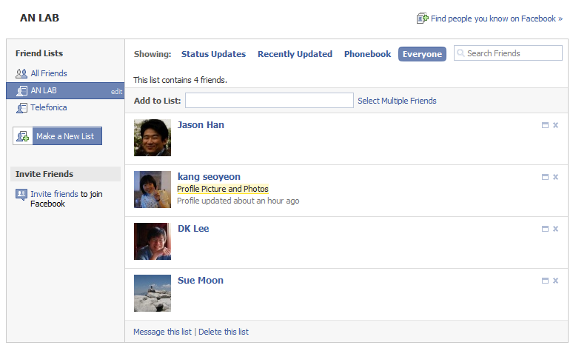
Characteristics of online friendship
All online friends are created equal
Ranks of friends are not explicit
Notes:
And, In online social networks, all online friends are considered equally.
Ranks of friends are not explicit

Slide 7
Declared online friendship
Does not always represent meaningful social relations
We need other informative features that represent user relations in online social networks.
Notes:
So, declared online friendship is not enough to represent social relations.
With declared online friendship, we can’t distinguish the most friendly one among friends at that time.
We should find more informative source to reflect user relations in online social network.

Slide 8
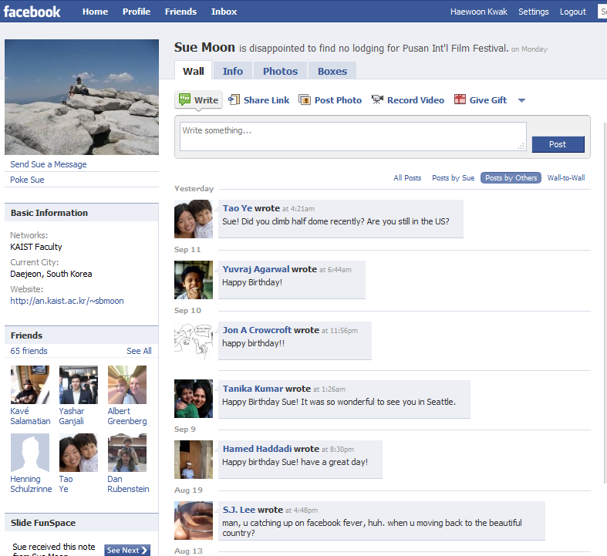
User interactions
Notes:
We were interested in user activities such as writing a msg.

Slide 9
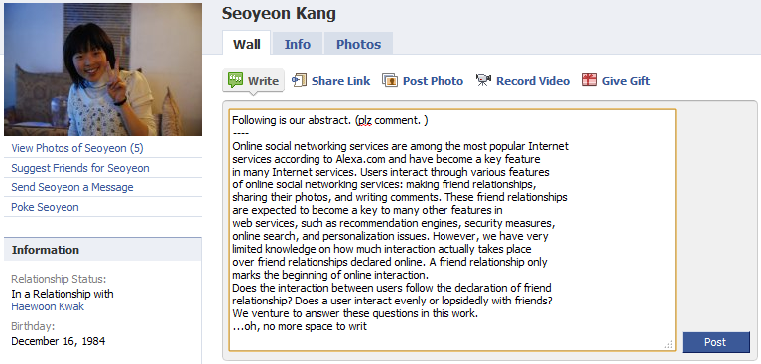
User interaction in OSN
Requires time & effort
Leaving a message needs time
Notes:
User interaction needs time & effort.
Consider the activities such as writing a msg, you know that our effort is essential.

Slide 10

User interaction in OSN
Is directional
Your friend may not reply back
But, I’ve been only thinking about what to write
for two weeks
Notes:
And, user interaction is directional.
We do not always receive replies.

Slide 11



User interaction in OSN
Has different strength of ties
3 msg
10 msg
There are close friends and acquaintances
0 msg yet
Notes:
And the volume of interactions are different over all friends.
You can infer the strongest tie from this slide.
It is impossible with friends relations.

Slide 12
Our goal
User interactions (direction and volume of messages) reveal meaningful social relations
→ We compare declared friendship relations with actual user interactions
→ We analyze user interaction patterns
Notes:
Since user interactions in online SNS have direction and volume,
Interactions can be more informative source to reflect social relations rather than online friendship relation
Therefore, we shift our focus from declared online friendship relations to actual user interactions
And, in this talk, we use the word, ‘interaction’ and ‘activity’ interchangeably

Slide 13
Outline
Introduction to Cyworld
User activity analysis
  Topological characteristics
  Microscopic interaction pattern
  Other interesting observations
Summary
Notes:
The outline of today’s talk is like this.
We first introduce our dataset, and next, explain our analysis result.

Slide 14

Cyworld http://www.cyworld.com
Most popular OSN in Korea (22M users)
Guestbook is the most popular feature
Each guestbook message has 3 attributes
  < From, To, When >
We analyze 8 billion guestbook msgs of 2.5yrs
http://www.cyworld.com
Notes:
Cyworld is the most popular online SNS in Korea.
Cyworld manages their users by social security number and real name, therefore, people have only one account.
Users can find anyone with name and birth year. So, pop-star’s fan can easily find their stars.
It is one of the reason Cyworld gain popularity for offering the way between star and fan.
Anyway, In Cyworld, guestbook is the most prevalent feature.
The log of each guestbook message is 3 column tuples, sender, receiver, and written time.

Slide 15
Three types of analyses
Topological characteristics
  Degree distribution
  Clustering coefficient
  Degree correlation
Microscopic interaction pattern
Other interesting observations
Notes:
The analysis with guestbook logs of Cyworld is divided into three categories.
First, let’s look at topological characteristics.
This gives us a macroscopic view of network structure.

Slide 16
Activity network
< From, To, When >
<A, C, 20040103T1103>
<B, C, 20040103T1106>
<C, B, 20040104T1201>
<B, C, 20040104T0159>
Guestbook logs
1
A
C
Graph
construction
2
1
B
Directed &
weighted network
Notes:
Prior to analysis, we define activity network.
We map a user to a node, an action writing a message to directional edge,
and the number of written messages to the weight of the edge.
From this way, we get directed and weighted network.

Slide 17
Definition of Degree distribution
Degree of a node, k
  #(connections) it has to other nodes
Degree distribution, P(k)
  Fraction of nodes in the network with degree k
http://en.wikipedia.org/wiki/Degree_distribution
Notes:
The first topological characteristics we are interested in is the degree distribution.
Degree distribution is the distribution of the number of neighbors.

Slide 18
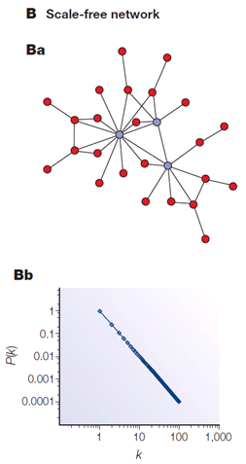
Most social networks
Have power-law P(k)
  A few number of high-degree nodes
  A large number of low-degree nodes
Have common characteristics
  Short diameter
  Fault tolerant
Nature Reviews Genetics 5, 101-113, 2004
Notes:
It is well known that in most real networks, degree distribution follows a power-law
Simply, it means that there are a few number of high-degree nodes and a large number of low-degree nodes.
These networks have common characteristics,
So, the fact that a network’s degree distribution follows power-law is the same that the network has common characteristics.
That is the reason degree distribution is important.

Slide 19
Degree in activity network
can be defined as
  #(out-edges)
  #(in-edges)
  #(mutual-edges)
i
  #(in-edges): 3
  #(out-edges): 2
  #(mutual-edges): 1
Notes:
Since activity network is directed network, degree can be defined in 3 ways.
The number of out-edges, in-edges, and mutual-edges.

Slide 20
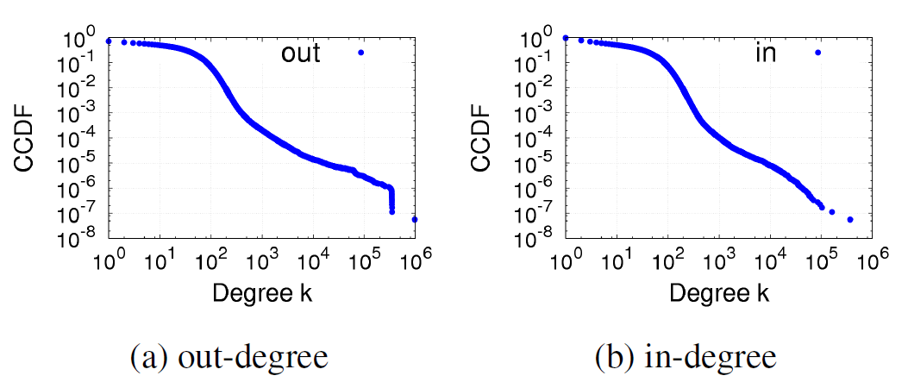
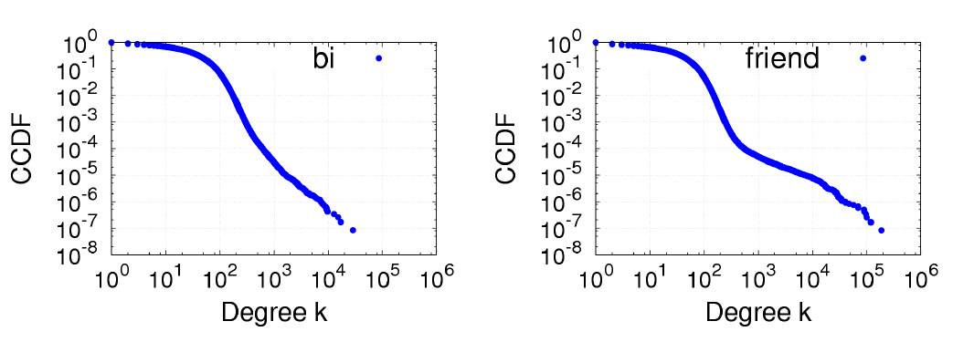
#(out-edges)
#(in-edges)
#(mutual-edges)
#(friends)
Notes:
We get three different activity network, and compare them with friend network.

Slide 21
0.01
200
Users with degree > 200 is 1% of all users
Notes:
We get three different activity network, and compare them with friend network.

Slide 22
Rapid drop represents the limitation of writing capability
Notes:
In out-degree distribution, rapid drop represents the limitation of writing capability.

Slide 23
The gap between #(out edges) and #(mutual edges)
represent partners who do not write back
Notes:
Between #(out-edges) and #(mutual-edges), we find a gap.
The gap shows the proportion of msg without replies.
It can be interpreted as spammers.

Slide 24
Multi-scaling behavior implies heterogeneous relations
Notes:
And, these four graphs show multi-scaling behavior.
It means that there are heterogeneous relations in user activities.
We expect that these heterogeneous relations will be observed
in the other large scale networks that recommend new online friends and assist to find offline friends simultaneously.

Slide 25
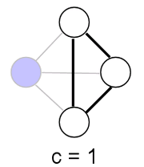
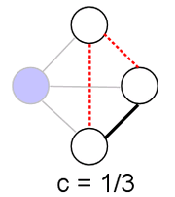
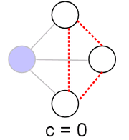
Clustering coefficient
i
i
i
C_{i}
C_{i}
C_{i}
C_{i} is the probability that
neighbors of node i are connected
http://en.wikipedia.org/wiki/Clustering_coefficient
Notes:
The next topological characteristic is clustering coefficient.
Clustering coefficient of node i is defined as the probability that neighbors of node i are connected.

Slide 26
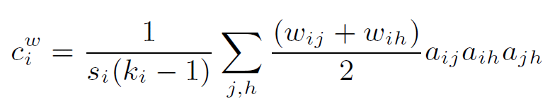
Weighted clustering coefficient
PNAS, 101(11):3747–3752, 2004
Notes:
In activity network, we use weighted version of clustering coefficient.
To understand the implication of weighted clustering coefficient, we prepare toy examples.
The left one’s high weight edge participate in one triad, while the right one’s high weight edge participates in two triads.
A. Barrat, M. Barthelemy, R. Pastor-Satorras, and
A. Vespignani. The architecture of complex weighted
networks. Proceedings of National Academy of Sciences,
101(11):3747–3752, March 16 2004

Slide 27
Weighted clustering coefficient
w = 10
i1
i2
w = 1
PNAS, 101(11):3747–3752, 2004
Notes:
In activity network, we use weighted version of clustering coefficient.
To understand the implication of weighted clustering coefficient, we prepare toy examples.
The left one’s high weight edge participate in one triad, while the right one’s high weight edge participates in two triads.
A. Barrat, M. Barthelemy, R. Pastor-Satorras, and
A. Vespignani. The architecture of complex weighted
networks. Proceedings of National Academy of Sciences,
101(11):3747–3752, March 16 2004

Slide 28
Weighted clustering coefficient
w = 10
i1
i2
w = 1
If edges with large weights are more likely to form a triad,
C_{i}^{w} becomes larger
PNAS, 101(11):3747–3752, 2004
Notes:
The weighted clustering coefficient of right network is larger than that of left one.
If edges with larger weights are more likely to be a triad, the weighted clustering coefficient becomes larger.
A. Barrat, M. Barthelemy, R. Pastor-Satorras, and
A. Vespignani. The architecture of complex weighted
networks. Proceedings of National Academy of Sciences,
101(11):3747–3752, March 16 2004

Slide 29
Weighted clustering coefficient
In activity network C^{w}=0.0965 < C=0.1665
Edges with large weights are less likely to form a triad
i1
i2
Notes:
In our activity network, weighted clustering coefficient is not large.
It shows that edges with larger weights are less likely to be a triad

Slide 30
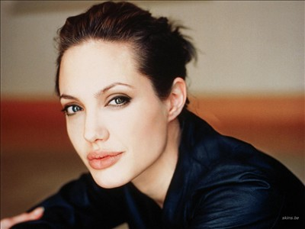



Degree correlation
Is correlation between
  #(neighbors) and avg. of #(neighbors’ neighbor)
Do hubs interact with other hubs?
Notes:
The last topological characteristic is degree correlation.
This is correlation between degree and neighbor’s degree.
This tells us whether hubs are likely to connect other hubs or not
M.E.J. Newman. Assortative mixing in networks. Phys. Rev. Lett. 89, 208701 (2002).

Slide 31






Degree correlation of social network
Social network
avg.
degree
of
neighbors
“Assortative mixing”
degree
Phys. Rev. Lett. 89, 208701 (2002).
Notes:
Social network is known that degree correlation shows positive correlation.
Its phenomena is called as assortative mixing.
M.E.J. Newman. Assortative mixing in networks. Phys. Rev. Lett. 89, 208701 (2002).

Slide 32
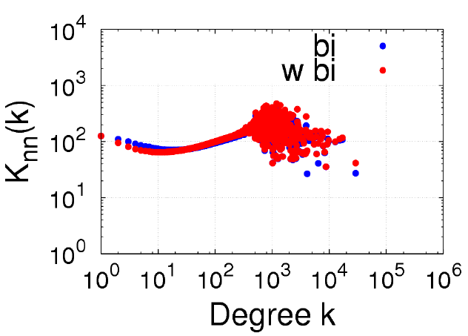
Degree correlation of activity network
We find positive correlation
Notes:
In our activity network, positive correlation emerges.
In the last slide I mentioned, it is unique characteristic of social network

Slide 33
From the topological structure
We find
  There are heterogeneous user relations
  Edges with large weight are less likely to be a triad
  Assortative mixing pattern appears
Notes:
So far, we looked at topological characteristics.
Now we know the structure of activity network.

Slide 34
Our analysis
Topological characteristics
Microscopic interaction pattern
  Reciprocity
  Disparity
  Network motif
Other interesting observations
Notes:
Then, we focus on microscopic interaction pattern in user activities

Slide 35
Reciprocity
Quantitative measure of reciprocal interaction
#(sent msgs) vs. #(received msgs)
Notes:
First we want to know whether user interactions are reciprocal or not.
So, we compare the number of sent messages and the number of received messages.

Slide 36
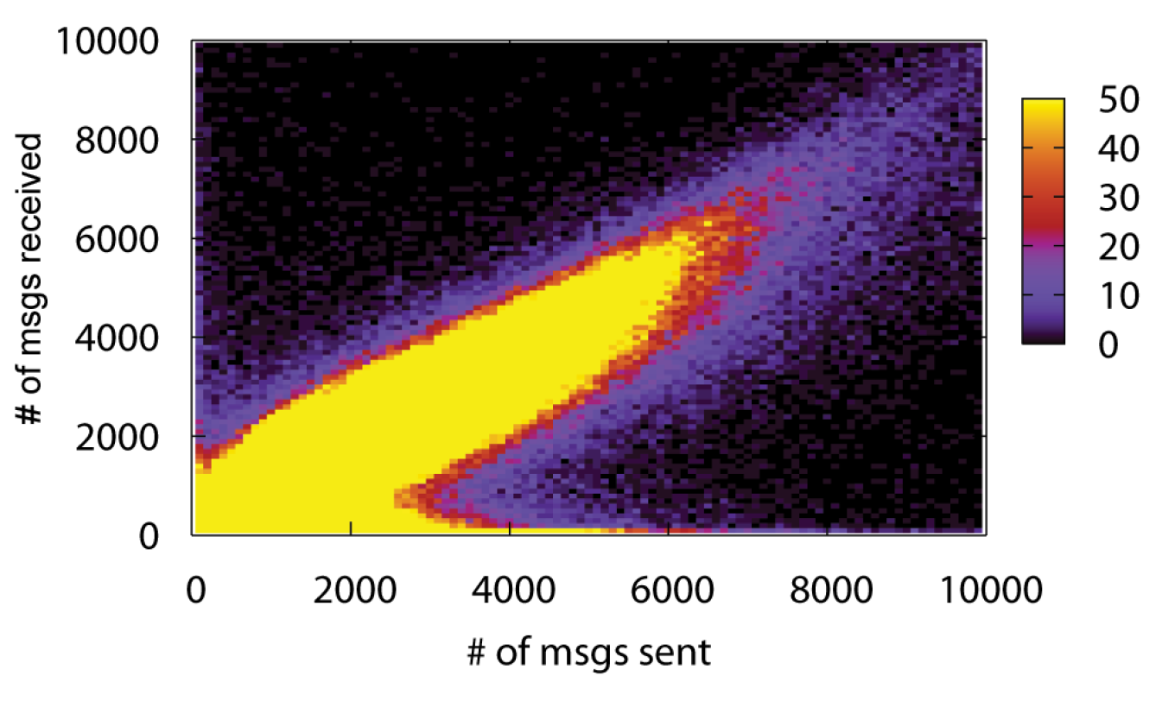
Reciprocity in user activities
y=x
Notes:
This is a kind of scatter plot.
We plot all points those x value is the number of sent msgs, and y value is the number of received msgs.
Because of many points, we make one hundred by one hundred grids,
And we count the points in each grid.
By the number of points containing in those grids, we paint each grid.
Yellow color means a large number of points in that grid.
In this graph, highlighted regions following the line y=x are users whose sent and received messages are almost the same.
It means that user interactions are highly reciprocal.
The region following x-axis are users whose sent many messages, but receive a few messages.
It represents either the star-fan relation or spammers.

Slide 37
Reciprocity in user activities
#(sent msgs) ≈ #(received msgs)
y=x
Notes:
This is a kind of scatter plot.
We plot all points those x value is the number of sent msgs, and y value is the number of received msgs.
Because of many points, we make one hundred by one hundred grids,
And we count the points in each grid.
By the number of points containing in those grids, we paint each grid.
Yellow color means a large number of points in that grid.
In this graph, highlighted regions following the line y=x are users whose sent and received messages are almost the same.
It means that user interactions are highly reciprocal.
The region following x-axis are users whose sent many messages, but receive a few messages.
It represents either the star-fan relation or spammers.

Slide 38
Reciprocity in user activities
y=x
#(sent msgs) >> #(received msgs)
Notes:
This is a kind of scatter plot.
We plot all points those x value is the number of sent msgs, and y value is the number of received msgs.
Because of many points, we make one hundred by one hundred grids,
And we count the points in each grid.
By the number of points containing in those grids, we paint each grid.
Yellow color means a large number of points in that grid.
In this graph, highlighted regions following the line y=x are users whose sent and received messages are almost the same.
It means that user interactions are highly reciprocal.
The region following x-axis are users whose sent many messages, but receive a few messages.
It represents either the star-fan relation or spammers.

Slide 39
Reciprocity in user activities
#(sent msgs) << #(received msgs)
y=x
Notes:
This is a kind of scatter plot.
We plot all points those x value is the number of sent msgs, and y value is the number of received msgs.
Because of many points, we make one hundred by one hundred grids,
And we count the points in each grid.
By the number of points containing in those grids, we paint each grid.
Yellow color means a large number of points in that grid.
In this graph, highlighted regions following the line y=x are users whose sent and received messages are almost the same.
It means that user interactions are highly reciprocal.
The region following x-axis are users whose sent many messages, but receive a few messages.
It represents either the star-fan relation or spammers.

Slide 40
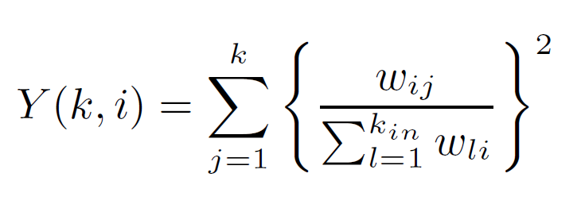
Disparity
Do users interact evenly with all friends?
For node i,
Y(k) is average over all nodes of degree k
Journal of Physics A: Mathematical and General, 20:5273–5288, 1987.
Notes:
From the reciprocity, we know that user interactions highly reciprocal.
Now, we look at those interactions are evenly distributed or not.
Disparity is a quantitative measure that a user interacts evenly with all friends.
This is calculated by the square sum of proportions of each conversation.
B. Derrida and H. Flyvbjerg. Statistical properties of
randomly broken objects and of multivalley structures in
disordered systems. Journal of Physics A: Mathematical and
General, 20:5273–5288, 1987.

Slide 41
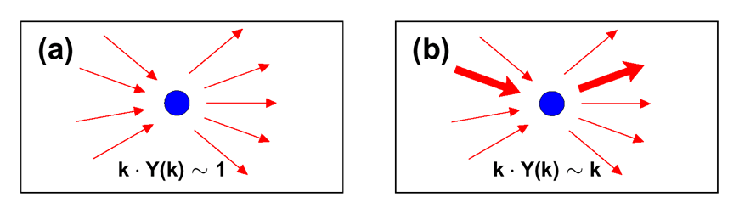
Interpretation of Y(k)
Communicate evenly
Have dominant partner
Nature 427, 839 – 843, 2004
Notes:
If kY(k) is proportional to 1, it means that users communicate evenly.
And, If kY(k) is proportional to k, users have dominant partners.

Slide 42
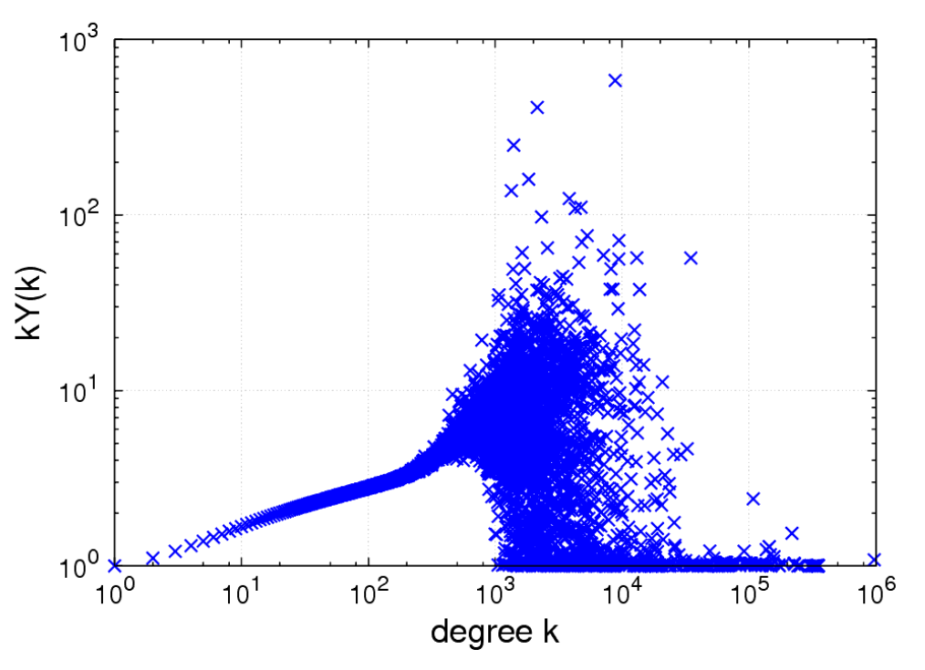
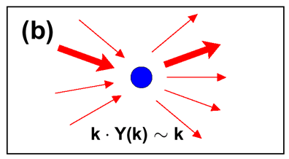
Disparity in user activities
Users of degree < 200 have a dominant partner in communication
Notes:
In user activities, Disparity shows a mixture of two different trends.
Up to user degree 200, users have dominant partners in communication.

Slide 43
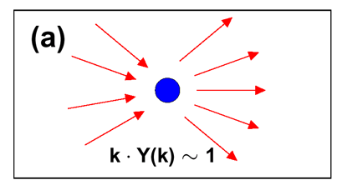
Disparity in user activities
Users of degree > 1000
communicate with partners evenly
Notes:
And, users having many communication partners, they communicate with partners evenly.

Slide 44
Disparity in user activities
Communication pattern changes by #(partners)
Notes:
So, we know that users communication pattern changes by the number of partners.
This result helps to model or simulate information flow

Slide 45

Network Motifs
All possible interaction patterns with 3 users
Proportions of each pattern (motif) determine the characteristic of the entire network
Science, Vol. 298, 824-827
Notes:
The last microscopic interaction analysis is network motif.
Network motif analysis focus on small subgraphs whose node are 3 or 4.
These subgraphs are called as motif.
This slide shows all possible 13 motifs with three nodes.
The proportion of each motif represent unique characteristics of entire network

Slide 46
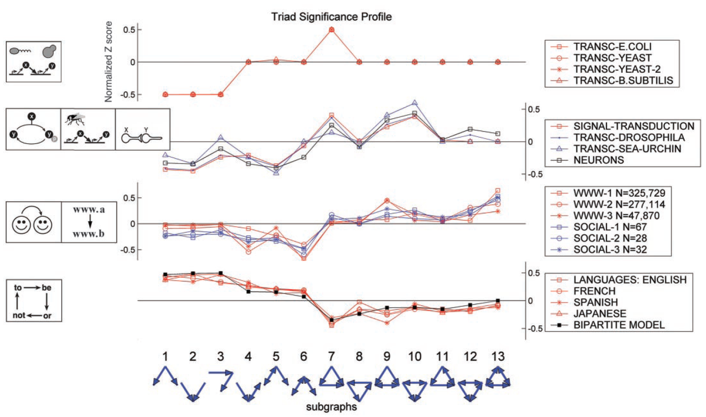
Motif analysis in complex networks
Transcription
in bacteria
Neuron
WWW & Social network
Language
Science, Vol. 303, no. 5663, pp 1538-1542, 2004
Notes:
For example, it is reported that in social networks, triad are likely to be oberseved.
Superfamilies of Evolved and Designed Networks
Ron Milo, Shalev Itzkovitz, Nadav Kashtan, Reuven Levitt, Shai Shen-Orr, Inbal Ayzenshtat,Michal Sheffer, Uri Alon*
Science 5 March 2004:
Vol. 303. no. 5663, pp. 1538 - 1542
DOI: 10.1126/science.1089167

Slide 47
Motif analysis in complex networks
In social networks,
triads are more likely to be observed
Science, Vol. 303, no. 5663, pp 1538-1542, 2004
Notes:
For example, it is reported that in social networks, triad are likely to be oberseved.
Superfamilies of Evolved and Designed Networks
Ron Milo, Shalev Itzkovitz, Nadav Kashtan, Reuven Levitt, Shai Shen-Orr, Inbal Ayzenshtat,Michal Sheffer, Uri Alon*
Science 5 March 2004:
Vol. 303. no. 5663, pp. 1538 - 1542
DOI: 10.1126/science.1089167

Slide 48
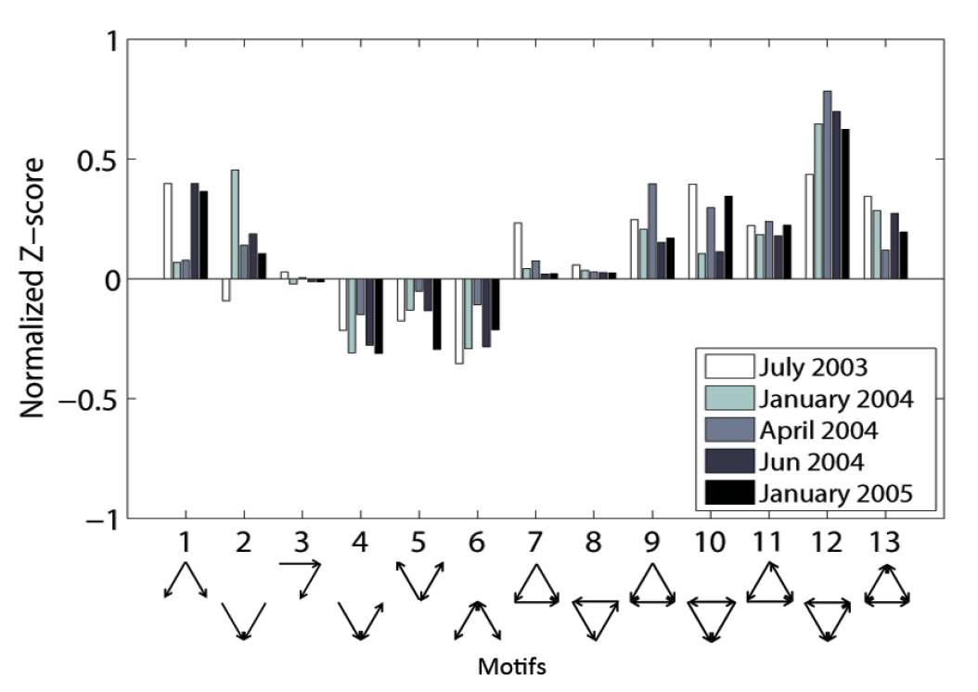
Network motifs in user activities
As previously predicted, triads were also common in Cyworld
Notes:
Similarly, in user activities, triads are likely to observed.

Slide 49
Network motifs in user activities
Motifs 1 and 2 are also common
Notes:
Interestingly, in user activities, triads 1 and 2 are also likely to be observed.
We conjecture that this comes from the automatic script and celebrities.
This is the characteristic of ONLINE social network.

Slide 50
From microscopic interaction pattern
We find
  User interactions are highly reciprocal
  Users with <200 friends have a dominant partner, while users with >1000 friends communicate evenly
  Triads are often observed
Notes:
So far we looked at microscopic interaction pattern of user activities
User interaction have the characteristics like this.

Slide 51
Our analysis
Topological characteristics
Microscopic interaction pattern
Other interesting observations
  Inflation of #(friends)
  Time interval between msg
Notes:
As a final piece of our analysis, we report two interesting observations here.

Slide 52
Inflation of #(friends) in OSN
Some social scientists mention the possibility of wrong interpretation of #(friends)
In Facebook,
  46% of survey respondents have neutral feelings, or even feel disconnected
Do online friends encourage activities?
Journal of Computer-Mediated Communication, Volume 13 Issue 3, Pages 531 – 549
Notes:
The first is inflation of the number of friends.
In 2006 social scientist reported that 46% of survey respondents have neutral feelings to their friends.
And, rejecting a friend request is socially inappropriate.
Therefore, friends in online may be different from friends in offline.
So, we compare the number of friends and the volume of activities.
That shows the answer for the question,
Vanden Boogart, 2006
approximately 46% of survey respondents had either neutral feelings or felt disconnected from their friends on Facebook
boyd, 2007
it is socially inappropriate to refuse a friend request from someone who is familiar

Slide 53
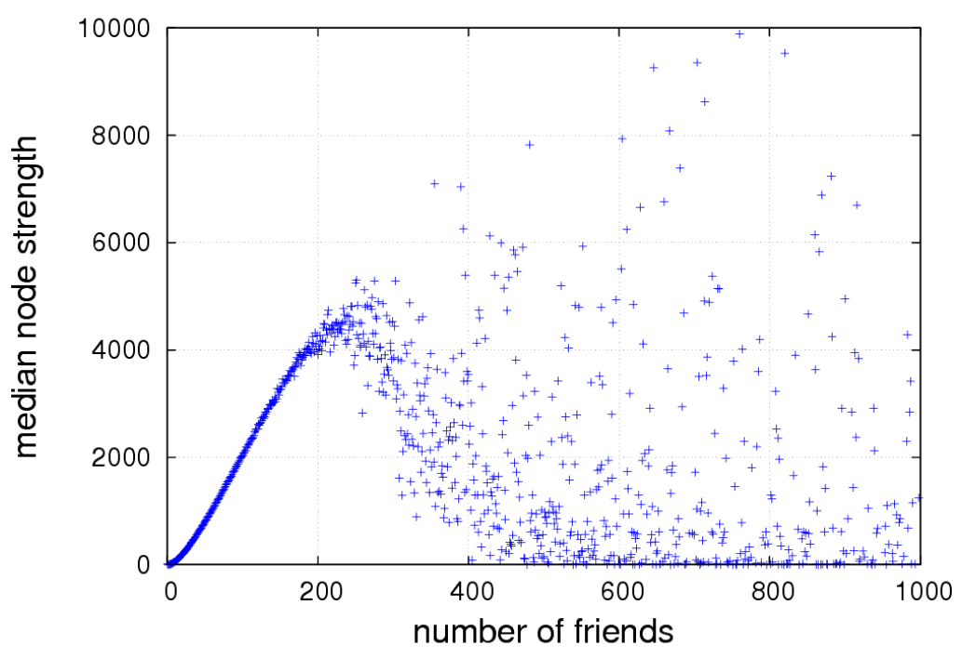
#(friends) stimulate interaction?
The more friends one has (up to 200),
the more active one is.
Median
#(sent msgs)
Notes:
In this graph, we can observe the clear trend.
Up to 200, the more friends one has, the more active one is.

Slide 54
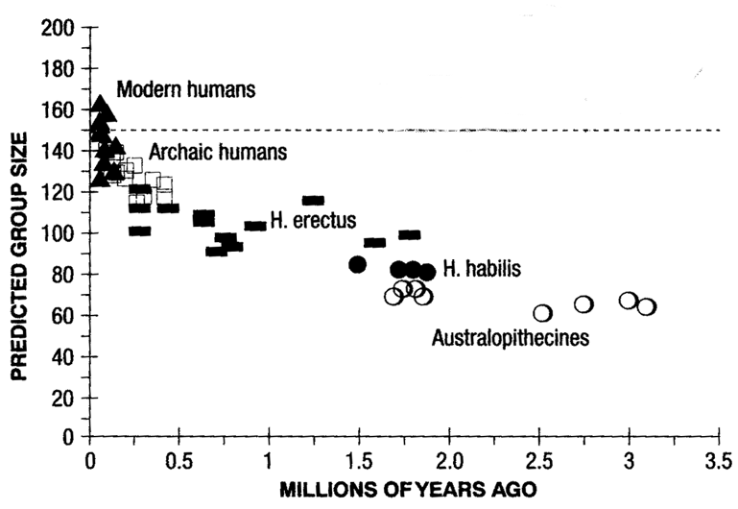

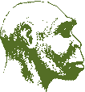


Dunbar’s number
The maximum number of social relations managed by modern human is 150.
Behavioral and brain scineces, 16(4):681–735, 1993
Notes:
Robin dunbar’s assume that the maximum number of social relations managed by modern human is 150.

Slide 55
Cyworld 200 vs. Dunbar’s 150
Has human networking capacity really grown?
  Yes, technology helps users to manage relations
  No, it is only an inflated number
Notes:
There is a gap, 50.
Does human’s capacity really enlarge?
The answer is yes or no.
Technology help users to manage relations, so it might enlarge human capacity.
But, the enlargement comes from only inflation #(friends)
This is open question.

Slide 56
Time interval between msgs
Is there a particular temporal pattern in writing a msg?
Bursts in human dynamics
  e-mail
  MSN messenger
Nature, 435:207–211, 2005
Proceedings of WWW2008, 2008
Notes:
Finally, we looked at time interval between message.
Burstiness in human’s activity is reported from e-mail or MSN messenger.

Slide 57
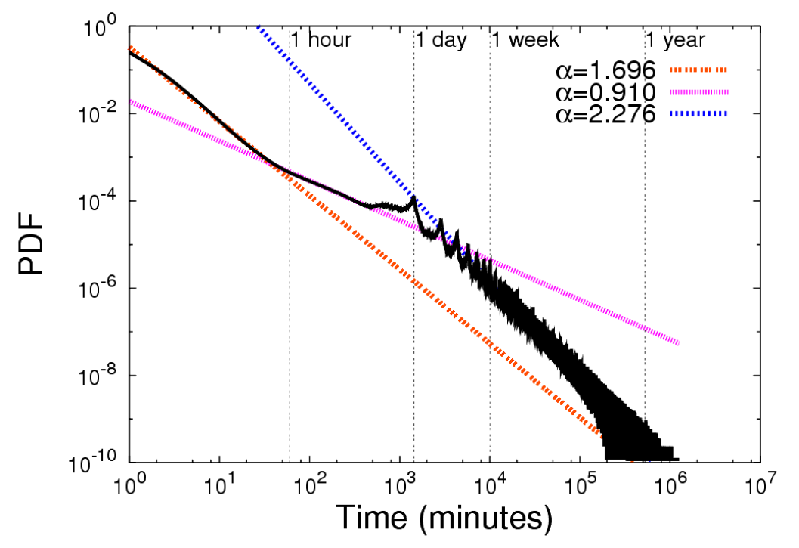
Time interval between msgs
inter-session
intra-session
daily-peak
Nature, 435:207–211, 2005
Proceedings of WWW2008, 2008
Notes:
In Cyworld,
Burstness is observed, and the daily peak pattern emerges.
The daily peak pattern is consistent with the Facebook by S. Golder.

Slide 58
Summary
The structure of activity network
  There are heterogeneous social relations
  Edges with larger weights are less likely to form a triad
  Assortative mixing emerges
Notes:
In this work, we focus on user interaction data. It has direction and weight.
We know the structure of activity network.

Slide 59
Summary
Microscopic analysis of user interaction
  Interaction is highly reciprocal
  Communication pattern is changed by #(partners)
  Triads are likely to be observed
Other observations
  More friends, more activities (up to 200 friends)
  Daily-peak pattern in writing msgs
Notes:
From microscopic interaction analysis, we understand the nature of human interactions.
Finally, we mention the phenomena of number of friends inflation.
Thank you.

Slide 61
Backup slides

Slide 62
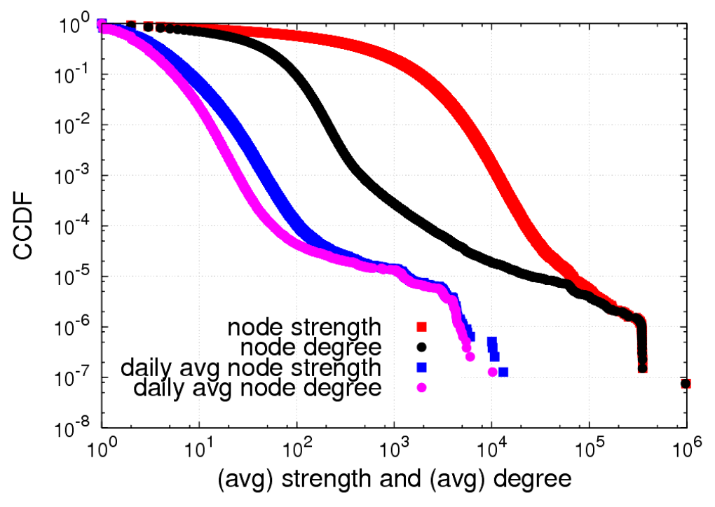

Slide 63
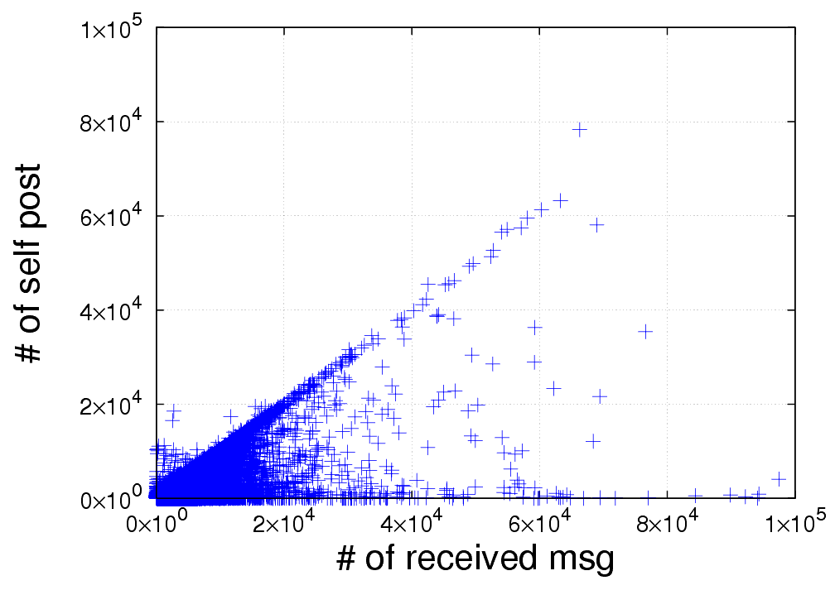

Slide 64
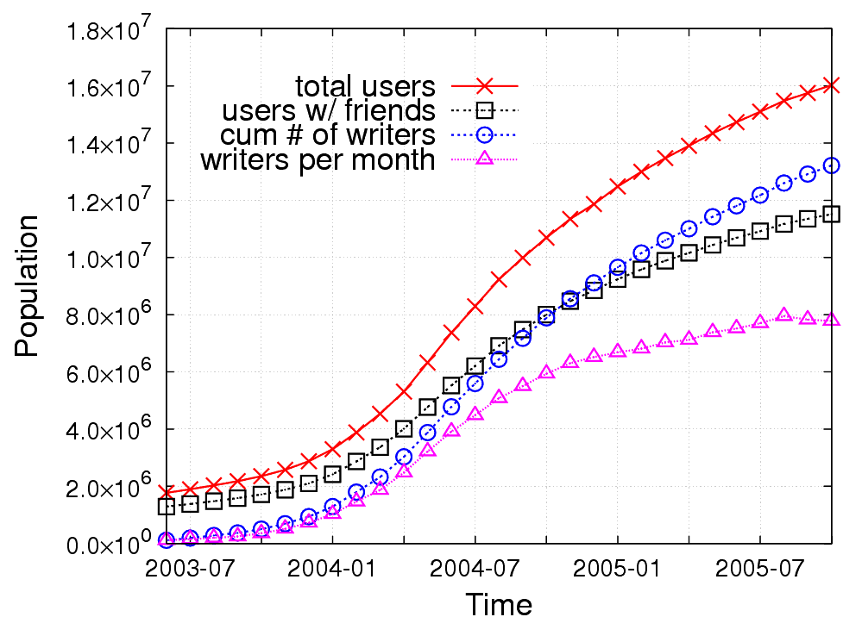
16M
12M
8M
4M
Notes:
Writing a msg in guestbook is prevailed

Slide 65
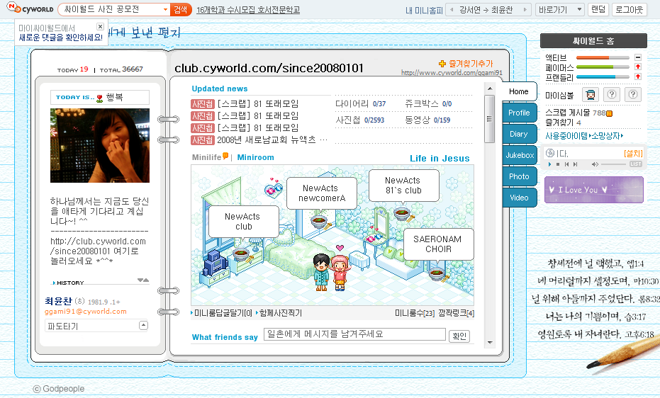
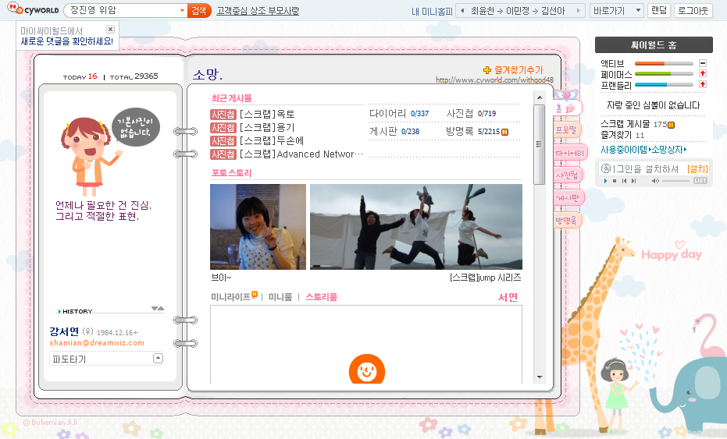
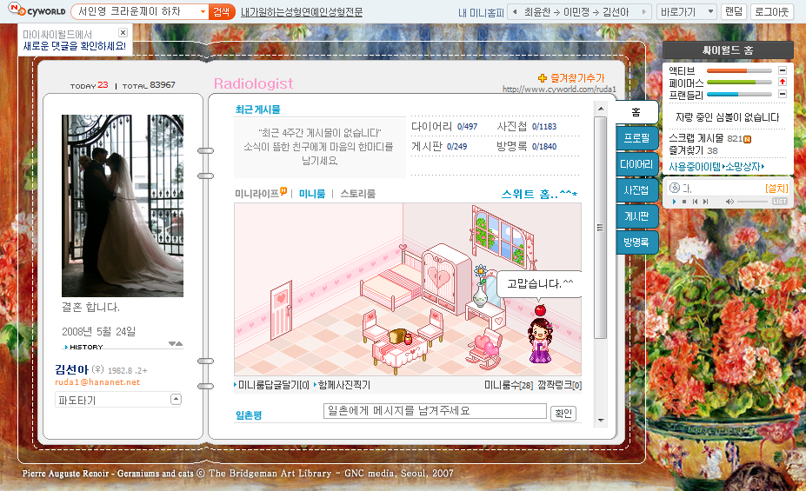
Notes:
Users can customize skin, menu, music, and so on.

Slide 66
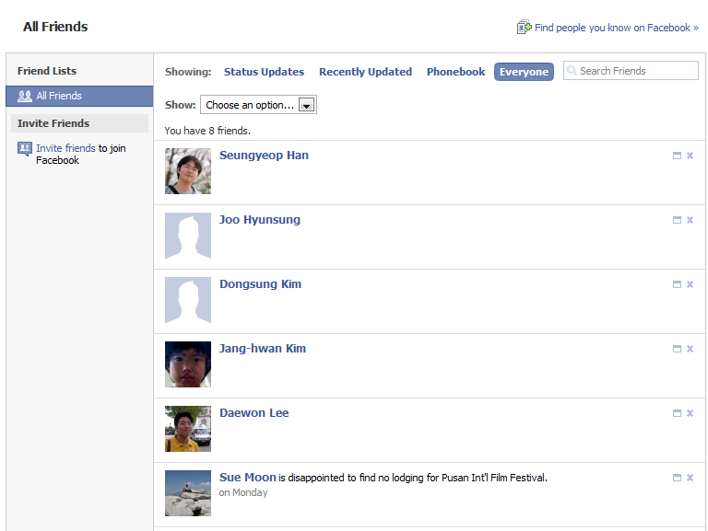
Notes:
Intuitive & Explicit feature to reflect user relation is “friend”

Slide 67
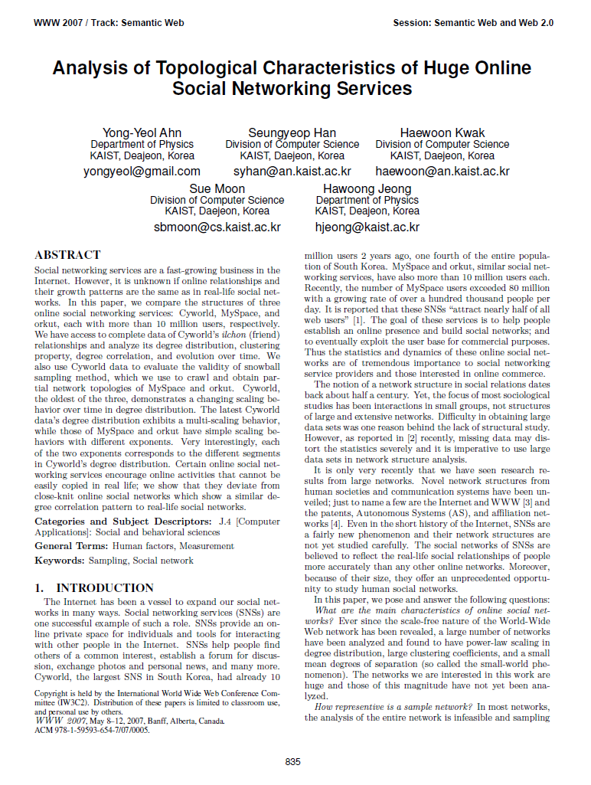
Notes:
Including our previous work, many previous literatures focuses on friends relation.

Slide 68
Notes:
Like Facebook, Cyworld offers photo, music, diary, wall, and guestbook features.

Slide 69
Strong points
Complete data
Huge OSN
No contents
No user profiles
(Potential) spam msgs
Limitations
Notes:
Our dataset is complete one. not sampled one.
It is very strong point of our dataset.
On the other hands, our dataset may contain spam message.

Slide 70
Why didn’t we filter spam?
Q: Are all msgs by automatic script spam?
A: No. Some users say hello to friends by script.
We confirmed that
some users writing 100,000 msgs in a month
are not spammers but active users…
Notes:
In Cyworld, some users write guestbook msgs by automatic script.
Further, Cyworld confirmed that some users writing 100,000 messages in a month are not spammers
But only active users.
This is why we didn’t filter spam.

Slide 71
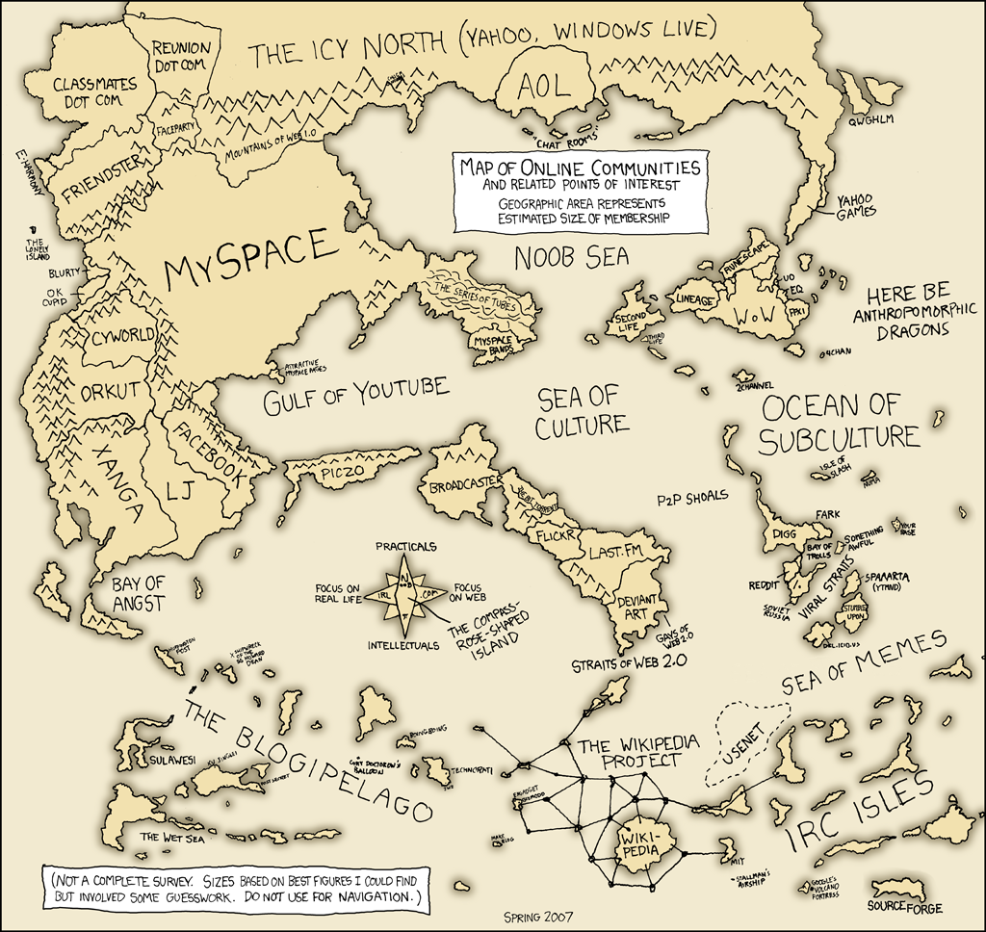
http://www.xkcd.com/256/
Notes:
We actually live in the world of online social network.

Slide 72
Dataset statistics
Period | 2003. 6 ~ 2005.10
# of msgs | 8.4B
# of users | 17M
Notes:
Cyworld guestbook logs span two and half years long.
It contains 8 billions messages.

Slide 73
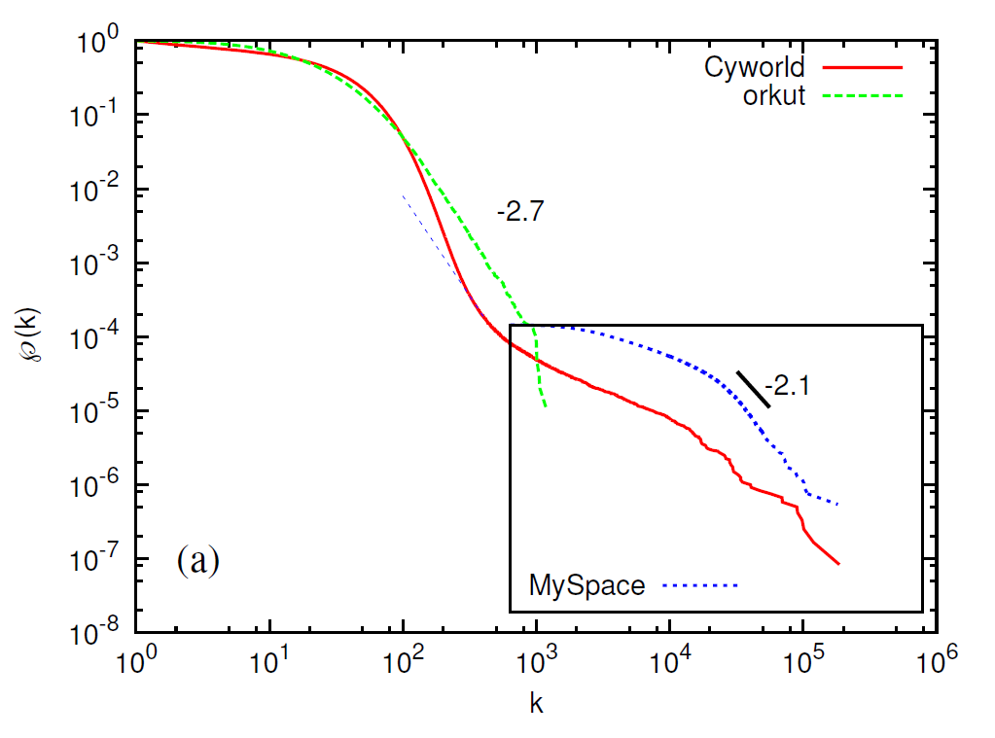
P(k) of Cyworld friends network
Multi-scaling behavior represents heterogeneous user relations
Proceedings of WWW2007, 835-844, 2007
Notes:
In our previous work,
Cyworld friends network shows a multi-scaling behavior in degree distribution.
We conjecture that it comes from heterogeneous relations.

