Slide 1
Earthquake Shakes Twitter User:
Analyzing Tweets for Real-Time Event Detection
Takehi Sakaki Makoto Okazaki Yutaka Matsuo
@tksakaki @okazaki117 @ymatsuo
the University of Tokyo
Notes:
Thank you chairperson.
Hello, Everyone
My name is Takeshi Sakaki. I’m a student at the University of Tokyo.
Today, I’d like to talk about our research using Twitter.
The title is “Earthquake Shakes Twitter User: Analyzing Tweets for Real-Time Event Detection”.
This research is a joint work with Makoto Okazaki and Yutaka Matsuo from the University of Tokyo.
These are our twitter accounts.

Slide 2
Outline
Introduction
Event Detection
Model
Experiments And Evaluation
Application
Conclusions
Notes:
OK.
Today, I’d like to talk our system and methods to detect real-time events, such as earthquakes.
At first , I’ll show you today’s outline.
First, I’ll talk about the introduction of our research.
Second, I’ll explain the overview of the proposed methods for event detection.
Third, I’ll talk in detail about our proposed models those are applied in the system.
Fourth, I’ll show you results of experimentation to demonstrate effectiveness of our system.
Finally, I’ll talk about future works and summarize today’s presentation.

Slide 3
Outline
Introduction
Notes:
OK.
Today, I’d like to talk our system and methods to detect real-time events, such as earthquakes.
At first , I’ll show you today’s outline.
First, I’ll talk about the introduction of our research.
Second, I’ll explain the overview of the proposed methods for event detection.
Third, I’ll talk in detail about our proposed models those are applied in the system.
Fourth, I’ll show you results of experimentation to demonstrate effectiveness of our system.
Finally, I’ll talk about future works and summarize today’s presentation.

Slide 4
What’s happening?
Twitter
  is one of the most popular microblogging services
  has received much attention recently
Microblogging
  is a form of blogging
    that allows users to send brief text updates
  is a form of micromedia
    that allows users to send photographs or audio clips
In this research, we focus on an important characteristic
real-time nature
Notes:
Twitter is one of the most popular microblogging services, and has received much attention recently.
Twitter has received much attention recently.
And, Microblogging is a form of blogging that allows user to send brief text updates.
and also is a form of micromedia.
users can post photographs or audio clips similar to text.
This research focus on an important characteristics of microblogging service
Real –time nature.

Slide 5
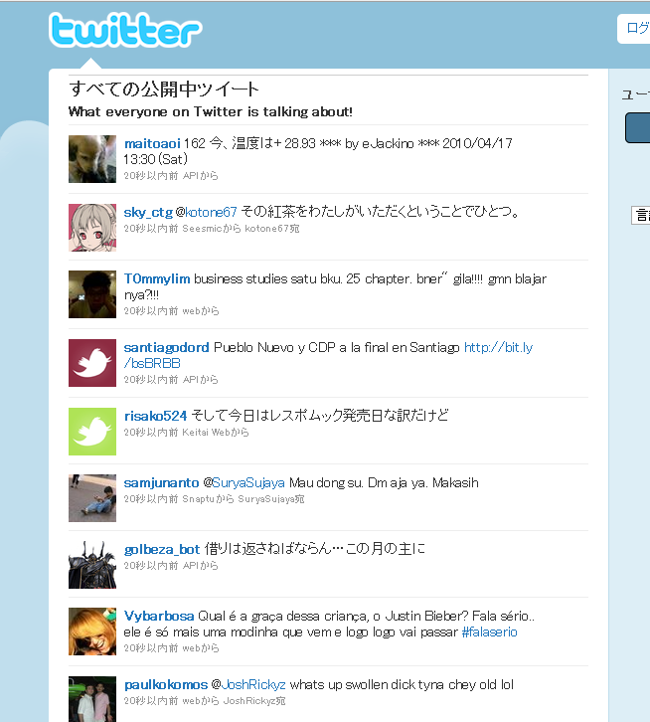
Real-time Nature of Microblogging
disastrous events
storms
fires
traffic jams
riots
heavy rain-falls
earthquakes
social events
parties
baseball games
presidential campaign
  Twitter users write tweets several times in a single day.
  There is a large number of tweets, which results in many reports related to events
  We can know how other users are doing in real-time
  We can know what happens around other users in real-time.
Notes:
Well, what do you know “real-time nature” of microblogging is?
I’d like to explain it.
This is the screenshot of Twitter Public Time.
Twitter users write tweets several times in a single day.
So,there is the large number of tweets, which results in many reports related to events.
For example, they include social events such as parties, baseball games and presidential campaigns.
And they also include disastrous events, such as storms, traffic jams riots , heavy rain-fall and earthquakes.
reading these tweets, users can know how other users are doing.
and often what the are thinking about and what’s happening around other users.
for example, if earthquakes happened near a users, we can know the fact from his tweets.
this is “real-time nature” of microblogging, Twitter.

Slide 6
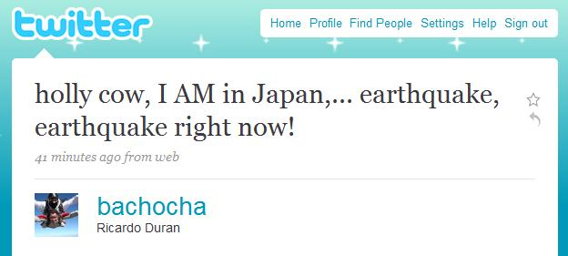
Our motivation
Adam Ostrow, an Editor in Chief at Mashable wrote the possibility to detect earthquakes from tweets in his blog
Japan Earthquake Shakes Twitter Users ... And Beyonce:
Earthquakes are one thing you can bet on being covered on Twitter first, because, quite frankly, if the ground is shaking, you’re going to tweet about it before it even registers with the USGS* and long before it gets reported by the media.
That seems to be the case again today, as the third earthquake in a week has hit Japan and its surrounding islands, about an hour ago.
The first user we can find that tweeted about it was Ricardo Duran of Scottsdale, AZ, who, judging from his Twitter feed, has been traveling the world, arriving in Japan yesterday.
we can know earthquake occurrences from tweets
=the motivation of our research
*USGS : United States Geological Survey
Notes:
About “real-time nature” of Twitter
Mr. Adam Ostrow , an Editor in Chief at Mashable.com wrote the possibility to detect earthquakes from tweets in his blog.
OK. I read out his article now.
And this is the tweet by Ricardo Duran.
If we find such kinds of tweets in timeline, we can know that an earthquake has happened in Japan.
the possibility to detect real-time event from tweets is the motivation of our research.
So, we focused on earthquakes.

Slide 7
Our Goals
propose an algorithm to detect a target event
  do semantic analysis on Tweet
    to obtain tweets on the target event precisely
  regard Twitter user as a sensor
    to detect the target event
    to estimate location of the target
produce a probabilistic spatio-temporal model for
  event detection
  location estimation
propose Earthquake Reporting System using Japanese tweets
Notes:
SO, These are our goals of Research:
We propose an algorithm to detect a target event.
it do semantic analysis on tweet to obtain tweets on the target event precisely
and regard Twitter user as a sensor to estimate location of the target event.
These algorithms are followed by spatiotemporal model we produced.
And then we proposed earthquake reporting system using Japanese tweets.

Slide 8
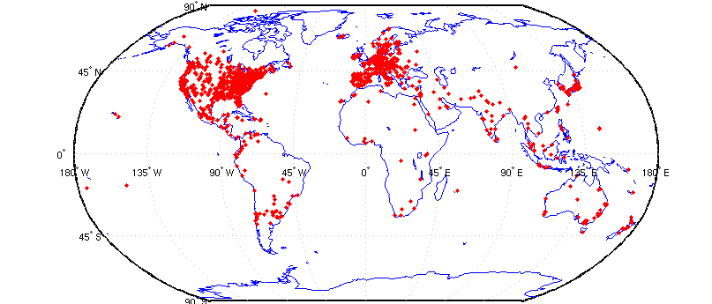
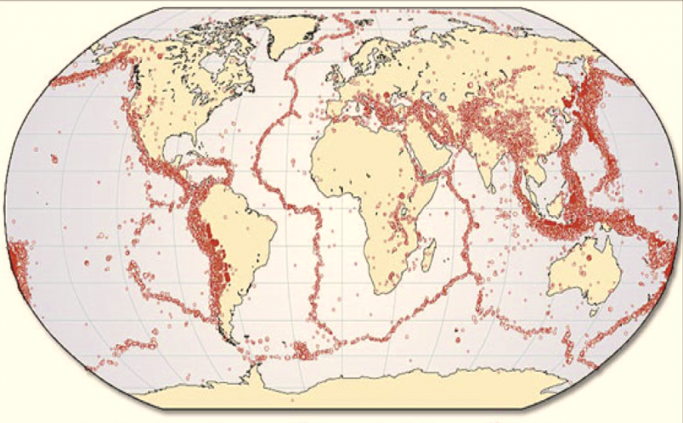
Twitter and Earthquakes in Japan
a map of Twitter user
world wide
a map of earthquake occurrences world wide
The intersection is regions with many earthquakes and large twitter users.
Notes:
Then, why we focus on earthquakes in Japan?
Please look at the picture on the upper-left.
This shows a map of Twitter users worldwide.
And please show the picture on the lower-right.
This depicts a map of earthquake occurrences worldwide.
Then at these red regions, there is the large number of Twitter users.
And, at these blue regions, there are many earthquake occurrences
The intersections of these two figures are regions with many earthquakes and large twitter users.
It’s Japan!
So we choose earthquakes in Japan for a target.

Slide 9
Twitter and Earthquakes in Japan
Other regions:
Indonesia, Turkey, Iran, Italy, and Pacific coastal US cities

Slide 10
Outline
Event Detection

Slide 11
Event detection algorithms
do semantic analysis on Tweet
  to obtain tweets on the target event precisely
regard Twitter user as a sensor
  to detect the target event
  to estimate location of the target
Notes:
Our proposed method. has two steps.
First, it does semantic analysis on tweet to extract tweets referring the target event.
We search from Twitter and find useful tweets for detection.
Second, we treat twitter users as sensors (and tweets as sensory values of sensors, )
and process them to detect an event and estimate location based on temporal model and spatial model.
Here, I’d like to explain these two steps in detail except temporal model and spatial model.
I’ll explain these two models later.

Slide 12
Semantic Analysis on Tweet
Search tweets including keywords related to a target event
  Example: In the case of earthquakes
    “shaking”, “earthquake”
Classify tweets into a positive class or a negative class
  Example:
    “Earthquake right now!!” ---positive
    “Someone is shaking hands with my boss” --- negative
  Create a classifier
Notes:
To detect a target event from Twitter,
we search from Twitter and find tweets.
This step has two small steps.
First, we search tweets including keywords, related to the target event.
For example, in the case of the earthquake detection, we use “shaking” “earthquake” for keywords.
Second , we have to classify tweets into a positive class or negative class.
because we want to get only just referred to a target event.
There are example. If we get a tweet “Earthquakes right now”, which is a tweet tells an earthquake really.
we want to classify this tweet into a positive class
However, if we get another tweet, “someone is shaking with my boss”
we want to classify this tweet , into negative class.
To classify, we create classifier for tweets using a machine learning method.

Slide 13
Semantic Analysis on Tweet
Create classifier for tweets
  use Support Vector Machine(SVM)
Features (Example: I am in Japan, earthquake right now!)
  Statistical features (7 words, the 5th word)
  the number of words in a tweet message and the position of the query within a tweet
  Keyword features ( I, am, in, Japan, earthquake, right, now)
  the words in a tweet
  Word context features (Japan, right)
  the words before and after the query word
Notes:
This slide shows how to create classifier.
we use Support Vector Machine to create classifier
And we use the following three features for machine learning
First, Statistical Features , it means the number of words in a tweet message and the position of the query within a tweet
In the case of this example, “I am in Japan, Earthquake right now” the number of words is 7words, and the position of the query “earthquake” is 5th.
Second, Keyword features, it means the words in a tweet
In the case of the example, we use I, am , in , Japan , earthquake , right now, all words for features.
Third, Word Context Features, means the words before and after the query word
In the case of the example, we use Japan and right for features.
Thus ,, we apply Support Vector Machine with these three features to the creation of a classifier for tweets..

Slide 14






Tweet as a Sensory Value
Event detection from twitter
Object detection in
ubiquitous environment
Probabilistic model
Probabilistic model
Classifier
values
tweets
・・・
・・・
・・・
・・・
・・・
observation by twitter users
observation by sensors
target event
target object
the correspondence between tweets processing and
sensory data detection
Notes:
Next, I talk about that we treat tweets as Sensory value.
This slide presents an illustration of the correspondence between sensory data detection and tweets processing.
The day before yesterday, at the opening Talk , Google talked about the importance of sensory networks,.
Thus, an Observation by sensors corresponds to an observation by Twitter users.
For example, In the step of event detection,
if a user posts tweets “earthquake right now”, We can search the tweet and classify it into a positive class
We can compare this process to a process in sensory data detection that “an earthquake sensor responses positive value”
In other words, the user function as a sensor of event.
Thinking like this, we can apply methods for sensory data detection to tweets processing

Slide 15
Tweet as a Sensory Value
Event detection from twitter
Object detection in
ubiquitous environment
detect an earthquake
detect an earthquake
search and classify them into positive class
some earthquake sensors responses positive value
Probabilistic model
Probabilistic model
Classifier
values
tweets
・・・
・・・
・・・
・・・
・・・
some users posts
“earthquake right now!!”
observation by twitter users
observation by sensors
earthquake occurrence
target event
target object
We can apply methods for sensory data detection to tweets processing
Notes:
Next, I talk about that we treat tweets as Sensory value.
This slide presents an illustration of the correspondence between sensory data detection and tweets processing.
The day before yesterday, at the opening Talk , Google talked about the importance of sensory networks,.
Thus, an Observation by sensors corresponds to an observation by Twitter users.
For example, In the step of event detection,
if a user posts tweets “earthquake right now”, We can search the tweet and classify it into a positive class
We can compare this process to a process in sensory data detection that “an earthquake sensor responses positive value”
In other words, the user function as a sensor of event.
Thinking like this, we can apply methods for sensory data detection to tweets processing

Slide 16
Tweet as a Sensory Value
We make two assumptions to apply methods for observation by sensors
Assumption 1: Each Twitter user is regarded as a sensor
  a tweet →a sensor reading
  a sensor detects a target event and makes a report probabilistically
  Example:
    make a tweet about an earthquake occurrence
    “earthquake sensor” return a positive value
Assumption 2: Each tweet is associated with a time and location
  a time : post time
  location : GPS data or location information in user’s profile
Processing time information and location information, we can detect target events and estimate location of target events
Notes:
To realize event detection and location estimation and using Twitter,
we make two assumptions.
Assumption 1 is that each twitter is regarded as a sensor.
For example, if a user makes a tweet about an earthquake occurrence,
then it can be considered that she return a positive value, as an “earthquake sensor”.
Second, we assume that each tweet is associated with a time and location.
It’s quite natural because each tweet has these two kind of information.
each tweet has post time, this is a time.
And some of tweets have GPS data or users have location information in their profile, .

Slide 17
Outline
Model
Notes:
OK.
Today, I’d like to talk our system and methods to detect real-time events, such as earthquakes.
At first , I’ll show you today’s outline.
First, I’ll talk about the introduction of our research.
Second, I’ll explain the overview of the proposed methods for event detection.
Third, I’ll talk in detail about our proposed models those are applied in the system.
Fourth, I’ll show you results of experimentation to demonstrate effectiveness of our system.
Finally, I’ll talk about future works and summarize today’s presentation.

Slide 18
Probabilistic Model
Why we need probabilistic models?
  Sensor values are noisy and sometimes sensors work incorrectly
  We cannot judge whether a target event occurred or not from one tweets
  We have to calculate the probability of an event occurrence from a series of data
We propose probabilistic models for
  event detection from time-series data
  location estimation from a series of spatial information

Slide 19
Temporal Model
We must calculate the probability of an event occurrence from multiple sensor values
We examine the actual time-series data to create a temporal model

Slide 20
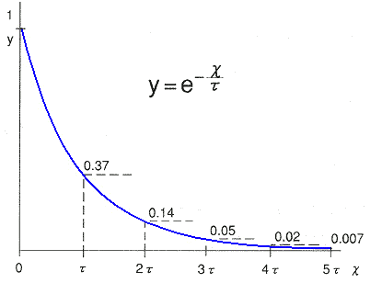
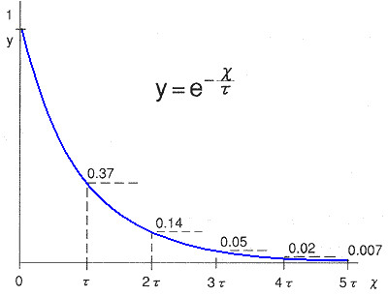
Temporal Model
Notes:
Please look at this graphs.
This graph presents the number of tweets related to “earthquakes”.
At this point, an earthquake happened, and at this point another earthquake happened.
And Please look at this graph.
The second graph presents the number of tweets related to “typhoon”
At this point, Japan’s main population was hit by a typhoon.
These distribution looks apparently an exponential distribution.
So we try to fit the data to an exponential distribution.

Slide 21
Temporal Model
the data fits very well to an exponential function
design the alarm of the target event probabilistically ,which was based on an exponential distribution
Notes:
Actually, the distribution of the number of tweets fit very well to a exponential distribution, expressed by this equation.
we get ramda =0.3r
To assess an alarm, we must calculate the reliability of multiple sensor values
We design the alarm probabilistically using the following two facts.
First the false-positive ratio of a sensor Pf is approximately 0.35 this figure is calculated from result of experiments.
Second, sensor assumed to be independent identically distributed

Slide 22
Temporal Model
the probability of an event occurrence at time t
  the false positive ratio of a sensor
  the probability of all n sensors returning a false alarm
  the probability of event occurrence
  sensors at time 0 → sensors at time t
  the number of sensors at time t
expected wait time to deliver notification
  parameter
Notes:
And we calculate the probability of an event occurrence at time t
the false positive ratio of a sensor is equal to pf
the probability of all n sensors returning a false alarm is equal to pf to the power of n
the probability of event occurrence is equal to 1-pf to the power of n
Given n0 sensors at time 0 and n0 times e to the power of –ramda times t sensors at time t
so, the number of sensor at time t equal n0 times (1- e to the power of – ramda times t+1 divided by 1 – e to the power of –ramda
and assign ramda, pf, and poccurr we can calculate expected time t wait to deliver notification

Slide 23
Spatial Model
We must calculate the probability distribution of location of a target
We apply Bayes filters to this problem which are often used in location estimation by sensors
  Kalman Filers
  Particle Filters
Notes:
Next I explain Spatial Model we used
we cannot estimate location from sensor readings, because sensor readings are noisy
and a target is moving depending on a target

Slide 24
Bayesian Filters for Location Estimation
Kalman Filters
  are the most widely used variant of Bayes filters
  approximate the probability distribution which is virtually identical to a uni-modal Gaussian representation
  advantages: the computational efficiency
  disadvantages: being limited to accurate sensors or sensors
  with high update rates

Slide 25
Bayesian Filters for Location Estimation
Particle Filters
  represent the probability distribution by sets of samples, or particles
  advantages: the ability to represent arbitrary probability
  densities
    particle filters can converge to the true posterior even in non-Gaussian, nonlinear dynamic systems.
  disadvantages: the difficulty in applying to
  high-dimensional estimation problems
Notes:
These are methods we used for location estimation.

Slide 26
Information Diffusion Related to Real-time Events
Proposed spatiotemporal models need to meet one condition that
  Sensors are assumed to be independent
We check if information diffusions about target events happen because
  if an information diffusion happened among users, Twitter user sensors are not independent . They affect each other
Notes:
We proposed two models, a temporal model and a spatial model, but proposed models need to meet one condition that
sensor assumed to be independent and identically distribuited(i.i.d)

Slide 27
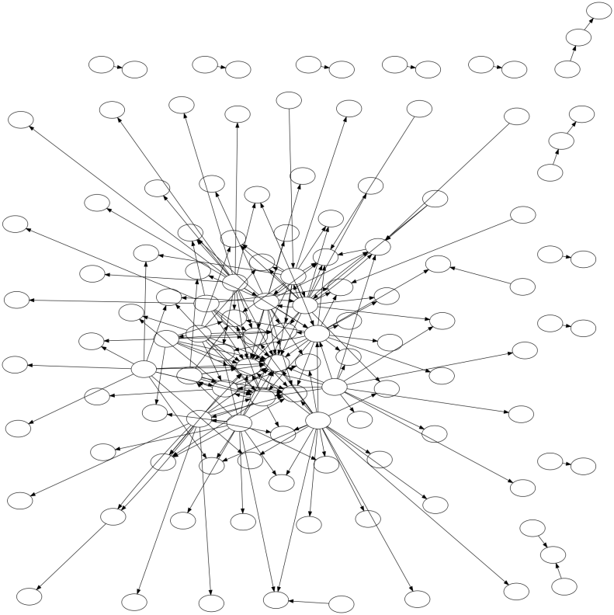
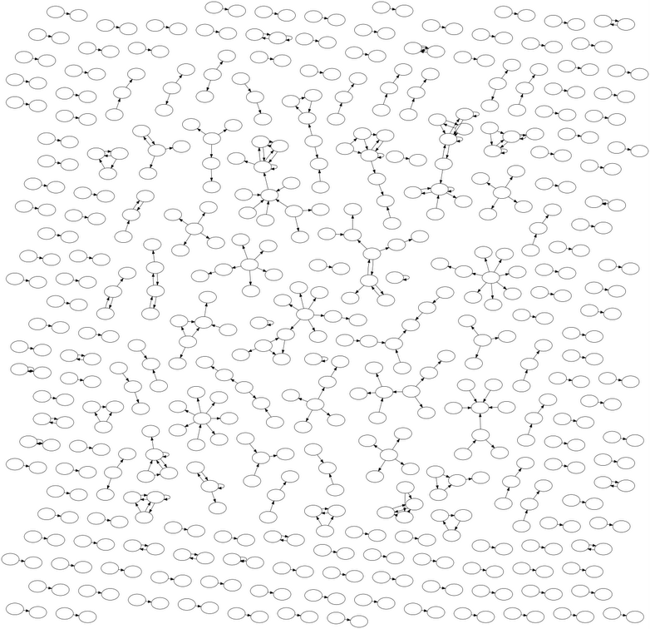
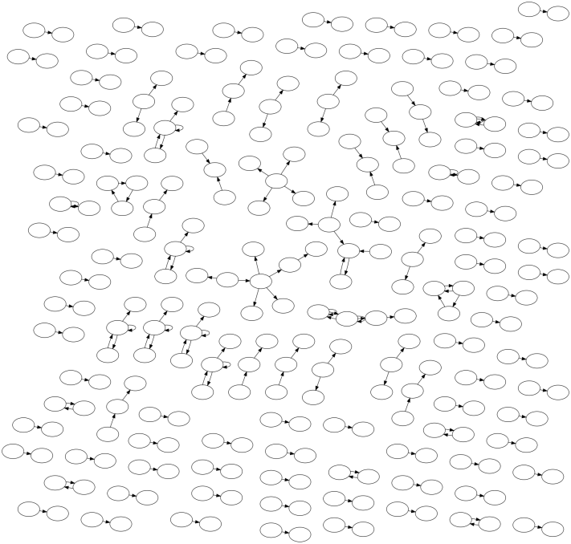
Information Diffusion Related to Real-time Events
Information Flow Networks on Twitter
Nintendo DS Game
an earthquake
a typhoon
In the case of an earthquakes and a typhoons, very little information diffusion takes place on Twitter, compared to Nintendo DS Game
→ We assume that Twitter user sensors are independent about earthquakes and typhoons
Notes:
These are pictures of information flow networks of an earthquake, a typhoon and Nintendo DS Game on Twitter
From this picture,in the case of an earthquake
and a typhoon

Slide 28
Outline
Experiments And Evaluation
Notes:
So Next, I show results of Experiments.

Slide 29
Experiments And Evaluation
We demonstrate performances of
  tweet classification
  event detection from time-series data
  → show this results in “application”
  location estimation from a series of spatial information
Notes:
Here we demonstrate performance of

Slide 30
Evaluation of Semantic Analysis
Queries
  Earthquake query: “shaking” and “earthquake”
  Typhoon query:”typhoon”
Examples to create classifier
  597 positive examples
Notes:
First we talk about experiments of tweet classification.
These are conditions of the experiment of semantic analysis.
We prepare a set of Queries for a target event.
We choose “earthquake” and “typhoon” for target events.
In the earthquake case, we use “shaking” and “earthquake” for queries
In the typhoon case, we use “typhoon” and for queries.
And we prepared 597 positive examples as a training set.

Slide 31
Evaluation of Semantic Analysis
“earthquake” query
“shaking” query
Features | Recall | Precision | F-Value
Statistical | 87.50% | 63.64% | 73.69%
Keywords | 87.50% | 38.89% | 53.85%
Context | 50.00% | 66.67% | 57.14%
All | 87.50% | 63.64% | 73.69%
Features | Recall | Precision | F-Value
Statistical | 66.67% | 68.57% | 67.61%
Keywords | 86.11% | 57.41% | 68.89%
Context | 52.78% | 86.36% | 68.20%
All | 80.56% | 65.91% | 72.50%
Notes:
The classification performance is presented in these tables.
We obtain highest F-value when we use feature A and all features.
Surprisingly, feature B and feature C don’t contribute much to the classification performance
When an earthquake occurs, a user becomes surprised and might produce a very short tweet.
and It’s apparent that the precision is not so high as the recall.

Slide 32
Discussions of Semantic Analysis
Features | Recall | Precision | F-Value
Statistical | 87.50% | 63.64% | 73.69%
Keywords | 87.50% | 38.89% | 53.85%
Context | 50.00% | 66.67% | 57.14%
All | 87.50% | 63.64% | 73.69%
We obtain highest F-value when we use Statistical features and all features.
Keyword features and Word Context features don’t contribute much to the classification performance
A user becomes surprised and might produce a very short tweet
It’s apparent that the precision is not so high as the recall

Slide 33
Experiments And Evaluation
We demonstrate performances of
  tweet classification
  event detection from time-series data
  → show this results in “application”
  location estimation from a series of spatial information
Notes:
Here we demonstrate performance of

Slide 34
Evaluation of Spatial Estimation
Target events
  earthquakes
    25 earthquakes from August.2009 to October 2009
  typhoons
    name: Melor
Baseline methods
  weighed average
    simply takes the average of latitudes and longitudes
  the median
    simply takes the median of latitudes and longitudes
We evaluate methods by distances from actual centers
  a distance from an actual center is smaller, a method works better
Notes:
Next we show experiments of location estimation
These are conditions of the experiment of location estimation
We estimate location of 25 earthquakes in August, September and October 2009
And we estimate trajectory a typhoon, named Melor, which hit Japan October 18th
And we prepare two baseline methods, the weight average and the median.
the weighed average simply takes the average of latitude and longitude
the median simply takes their median.

Slide 35
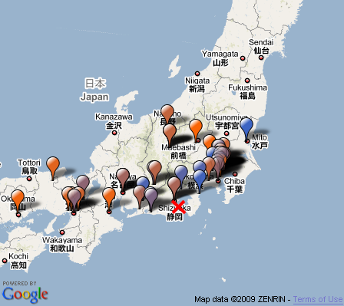
Evaluation of Spatial Estimation
balloon: each tweets
color : post time
Kyoto
Tokyo
estimation
by median
estimation
by particle filter
Osaka
actual earthquake center
Notes:
this picture presents the location estimation of earthquake on August 11th
Red balloon represents early tweets , posted in 5 minutes the earthquake happended
Blue balloon shows later tweets.
the red cross shows the earth quake center.
and green cross presents the estimation of the earth quake center.
We can know from this picture , particle filter works better than baseline methods.

Slide 36
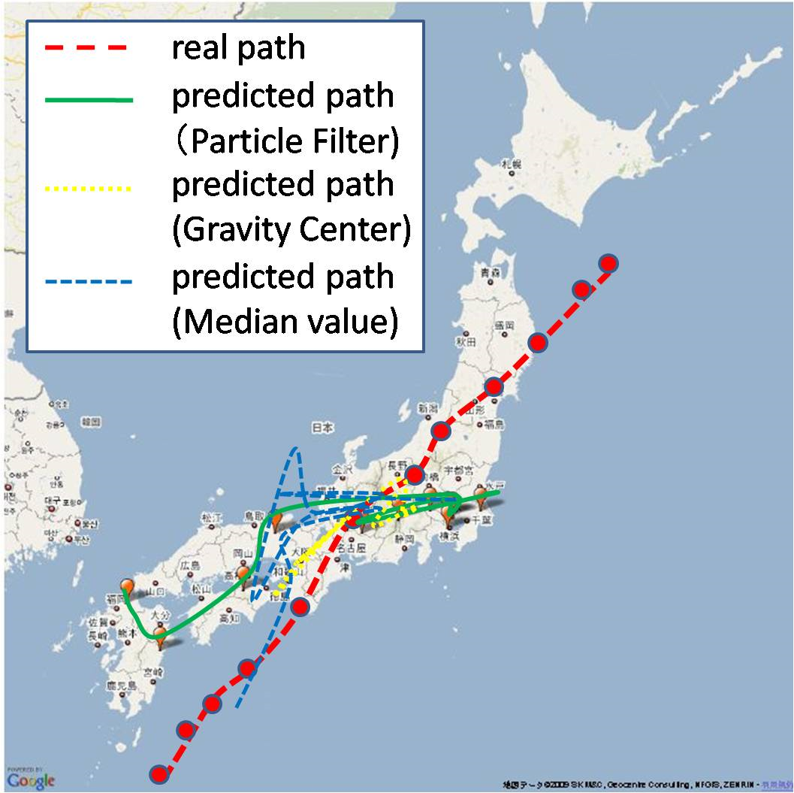
Evaluation of Spatial Estimation
Notes:
this picture presents a trajectory estimation of typhoon melor
Red line represents real path ,
Blue line shows the median
Yellow line represents the weighed average.
And green line shows particle filtering
We can know from this picture , particle filters outputs a trajectory resembling the actual trajectory

Slide 37
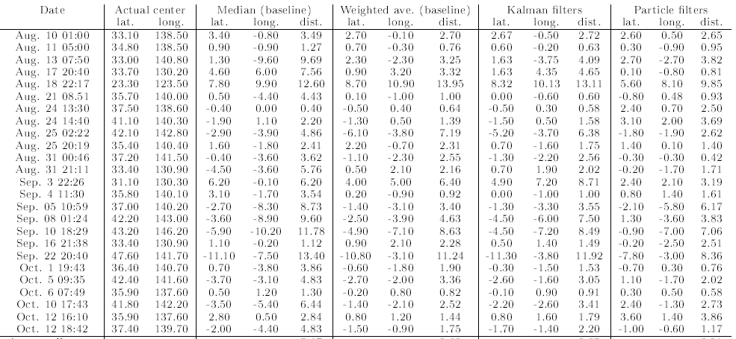
Evaluation of Spatial Estimation
Earthquakes
Date | Actual Center | Median | Weighed Average | Kalman Filter | Particle Filter
mean square errors of latitudes and longitude
Average | － | 5.47 | 3.62 | 3.85 | 3.01
Particle filters works better than other methods

Slide 38
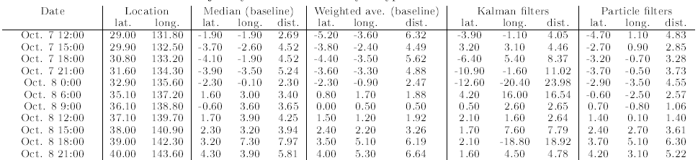
Evaluation of Spatial Estimation
A typhoon
Date | Actual Center | Median | Weighed Average | Kalman Filter | Particle Filter
mean square errors of latitudes and longitude
Average | － | 4.39 | 4.02 | 9.56 | 3.58
Particle Filters works better than other methods

Slide 39
Discussions of Experiments
Particle filters performs better than other methods
If the center of a target event is in an oceanic area, it’s more difficult to locate it precisely from tweets
It becomes more difficult to make good estimation in less populated areas
Notes:
These are facts that we can know from experiments

Slide 40
Outline
Application
Notes:
OK.
Today, I’d like to talk our system and methods to detect real-time events, such as earthquakes.
At first , I’ll show you today’s outline.
First, I’ll talk about the introduction of our research.
Second, I’ll explain the overview of the proposed methods for event detection.
Third, I’ll talk in detail about our proposed models those are applied in the system.
Fourth, I’ll show you results of experimentation to demonstrate effectiveness of our system.
Finally, I’ll talk about future works and summarize today’s presentation.

Slide 41
Earthquake Reporting System
Toretter ( http://toretter.com)
  Earthquake reporting system using the event detection algorithm
  All users can see the detection of past earthquakes
  Registered users can receive e-mails of earthquake detection reports
Dear Alice,
We have just detected an earthquake
around Chiba. Please take care.
Toretter Alert System

Slide 42
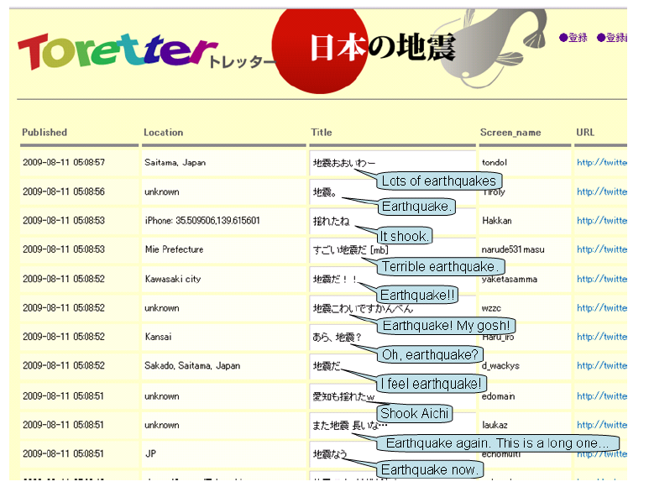
Screenshot of Toretter.com

Slide 43
Earthquake Reporting System
Effectiveness of alerts of this system
  Alert E-mails urges users to prepare for the earthquake if they are received by a user shortly before the earthquake actually arrives.
Is it possible to receive the e-mail before the earthquake actually arrives?
  An earthquake is transmitted through the earth's crust at about 3~7 km/s.
  a person has about 20~30 sec before its arrival at a point that is 100 km distant from an actual center
Notes:
SO It is possible

Slide 44
Results of Earthquake Detection
Date | Magnitude | Location | Time | E-mail sent time | time gap [sec] | # tweets within 10 minutes | Announce of JMA
Aug. 18 | 4.5 | Tochigi | 6:58:55 | 7:00:30 | 95 | 35 | 7:08
Aug. 18 | 3.1 | Suruga-wan | 19:22:48 | 19:23:14 | 26 | 17 | 19:28
Aug. 21 | 4.1 | Chiba | 8:51:16 | 8:51:35 | 19 | 52 | 8:56
Aug. 25 | 4.3 | Uraga-oki | 2:22:49 | 2:23:21 | 31 | 23 | 2:27
Aug.25 | 3.5 | Fukushima | 2:21:15 | 22:22:29 | 73 | 13 | 22:26
Aug. 27 | 3.9 | Wakayama | 17:47:30 | 17:48:11 | 41 | 16 | 1:7:53
Aug. 27 | 2.8 | Suruga-wan | 20:26:23 | 20:26:45 | 22 | 14 | 20:31
Ag. 31 | 4.5 | Fukushima | 00:45:54 | 00:46:24 | 30 | 32 | 00:51
Sep. 2 | 3.3 | Suruga-wan | 13:04:45 | 13:05:04 | 19 | 18 | 13:10
Sep. 2 | 3.6 | Bungo-suido | 17:37:53 | 17:38:27 | 34 | 3 | 17:43
In all cases, we sent E-mails before announces of JMA
In the earliest cases, we can sent E-mails in 19 sec.
Notes:
IN all cases, we sent E-mails before announces of Japan Meteorology Agency.
Max speedを述べる

Slide 45
Experiments And Evaluation
We demonstrate performances of
  tweet classification
  event detection from time-series data
  → show this results in “application”
  location estimation from a series of spatial information
Notes:
Here we demonstrate performance of

Slide 46
Results of Earthquake Detection
JMA intensity scale | 2 or more | 3 or more | 4 or more
Num of earthquakes | 78 | 25 | 3
Detected | 70(89.7%) | 24(96.0%) | 3(100.0%)
Promptly detected* | 53(67.9%) | 20(80.0%) | 3(100.0%)
Promptly detected: detected in a minutes
JMA intensity scale: the original scale of earthquakes by Japan Meteorology Agency
Period: Aug.2009 – Sep. 2009
Tweets analyzed : 49,314 tweets
Positive tweets : 6291 tweets by 4218 users
We detected 96% of earthquakes that were stronger than scale 3 or more during the period.
Notes:
This tables show the performance of our system.
The period is August 2009 to September2009.
It analyzed 49314 tweets.
and It obtained 6291 tweets.

Slide 47
Outline
Conclusions

Slide 48
Conclusions
We investigated the real-time nature of Twitter for event detection
Semantic analyses were applied to tweets classification
We consider each Twitter user as a sensor and set a problem to detect an event based on sensory observations
Location estimation methods such as Kaman filters and particle filters are used to estimate locations of events
We developed an earthquake reporting system, which is a novel approach to notify people promptly of an earthquake event
We plan to expand our system to detect events of various kinds such as rainbows, traffic jam etc.
Notes:
To summarize today’s presentation,
First, we investigated the real-time nature of Twitter
semantic analyses were applied to tweets classify them
second, we consider each Twitter user as a sensor and set a problem to detect an event based on sensory observations
location estimation methods such as particle filtering are used to estimate locations of events
Third, we developed an earthquake reporting system, which is a novel approach to notify people promptly of an earthquake event
What is the Contribution of this research?
we presented an example using the real-time nature of Twitter
It’s hoped that this research provides some insight into the future integration of semantic analysis with microblloggin data

Slide 49
Thank you for your paying attention and
tweeting on earthquakes.
http://toretter.com
Takeshi Sakaki(@tksakaki)
Notes:
OK，So→×
アドリブ
The figure, The graph,
These graphs looks an exponential distribution
This figure presents
Mashable.comは読まない

Slide 50
Notes:
台風のクエリ→We tried to use “rain” or “wind” for search queries, however, these tweets are very noisy and It’s difficult to
create a classifier with high presision.
information flow networkの作り方
We make links between user A and user B,
if user A follow user B, user B posted a tweet about a event. in later user A post a tweet about the event.
This is for visual quality. Of course, In this experiment we use Kalman filters and the weighed average.
But results by them are very closed to the result by the median.
So I don’t show them.
実システムに位置推定は表示されないのか？
虹検出システムtraffic jam情報とかも考えている。
なぜ地震→the impact is big, and it’s useful to many people, and it’s easy f or us to get information about earthquake occrrence
位置情報：
We use both geotag information or location information in users’ profile.
because when I did experiments at the last Oct 2009, not so many users used geotag function.
Then, we have a plan to use geotag information only for location estimation.
Temporal model
In actually, we calculate the probability of event occurrence from time-series data.
to know how many positive tweets we need to detect event precisely.
Wrong case:
it is difficult even for humans to judge whether a tweet is reporting an actual earthquake or
not. Some examples are that a user might write ”Is this an earthquake or a truck passing?”
the path by the median come and go many times
the scale of the earthquake in Cuba last year is 7

