Slide 1
Ubiquitous Computing
CS 6456 Lecture
Gabriel Reyes
CS-HCI PhD Student

Slide 2
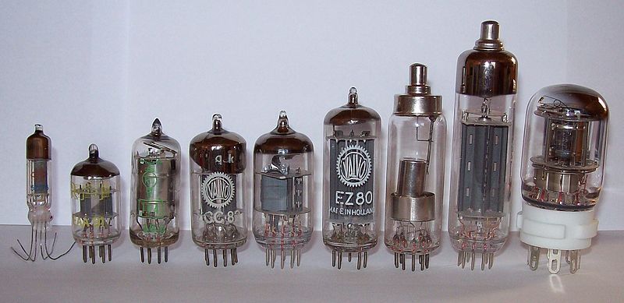
Evolution of Computer Hardware
First Generation (1940-1956)
Vacuum Tubes
Notes:
Before we dive into the future of computing, it’d be wise to look at the past.
The first computers used vacuum tubes for circuitry and were often enormous, taking up entire rooms. They were very expensive to operate and in addition to using a great deal of electricity, generated a lot of heat, which was often the cause of malfunctions. The basic functionality was electric current flowing through a vacuum in the sealed container.
---------------------------
vacuum tube, electron tube (in North America), thermionic valve, tube, or valve is a device controlling electric current through a vacuum in a sealed container. The container is often thin transparent glass in a roughly cylindrical shape. The simplest vacuum tube, the diode, is essentially an incandescent light bulb with an extra electrode inside. When the bulb's filament is heated white-hot, electrons are boiled off its surface and into the vacuum inside the bulb. If the extra electrode (also called a "plate" or "anode") is made more positive than the hot filament, a direct current flows through the vacuum to the anode (a demonstration of the Edison effect). As the current only flows in one direction, it makes it possible to convert from AC current applied to the filament to DC current.

Slide 3
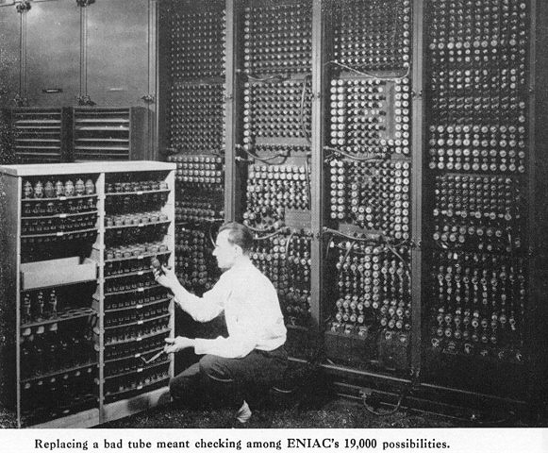
Notes:
The ENIAC is an example of 1st generation and in this case replacing a bad tube actually meant checking among over 19,000 possibilities to replace it

Slide 4
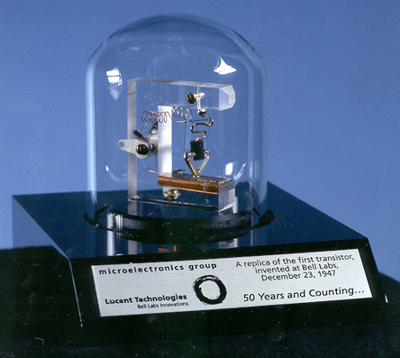
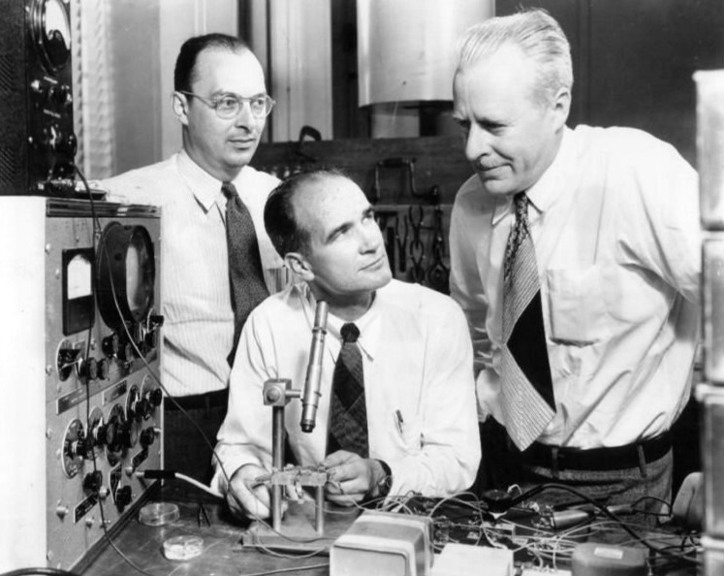
Evolution of Computer Hardware
Second Generation (1956-1963)
Transistors
A replica of the first working transistor.
John Bardeen, William Shockley and Walter Brattain, the inventors of the transistor, 1948
Notes:
Transistors replaced vacuum tubes and ushered in the second generation of computers.
The transistor was invented in 1947 but did not see widespread use in computers until the late 1950s.
The transistor was far superior to the vacuum tube, allowing computers to become smaller, faster, cheaper, more energy-efficient and more reliable than their first-generation predecessors. Relied on punched cards for input and printouts for output.
Many consider it to be one of the greatest inventions of the 20th century.

Slide 5
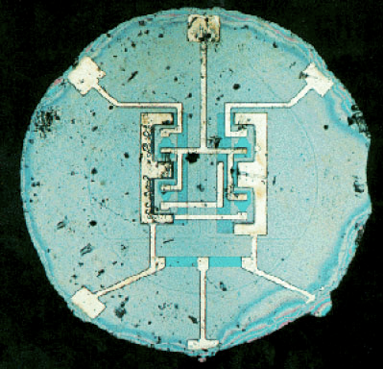
Evolution of Computer Hardware
Third Generation (1964-1971)
Integrated Circuits
What does “Intel” stand for?
Figure --- Original integrated circuit, with aluminum interconnections on silicon. (G. Moore, ISSCC '03, Intel Corp.)
Notes:
The IC was the hallmark of the third generation of computers. Transistors were miniaturized and placed on silicon chips which drastically increased the speed and efficiency of computers.
One of the companies that was during this third generation was Intel. Intel was founded in 1968 by Gordon Moore and Robert Noyce. Here’s a picture of the original IC.
????What does Intel stand for?

Slide 6
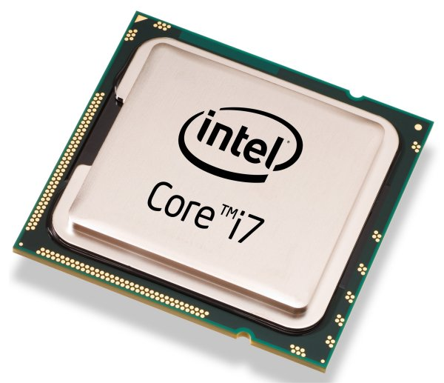
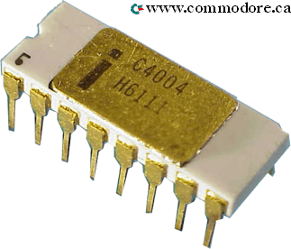
Evolution of Computer Hardware
Fourth Generation (1971-Present)
Microprocessors
Notes:
The microprocessor brought the fourth generation of computers, as thousands of integrated circuits were built onto a single silicon chip.
What in the first generation filled an entire room could now fit in the palm of the hand.
The Intel 4004 chip, developed in 1971, located all the components of the computer—from the CPU and memory to input/output controls—on a single chip.
The 4004 had only 2300 transistors. ???????How many transistors does Core i7 have?
Today, Core i7 has 731,000,000 transistors

Slide 7
Evolution of Computer Hardware
Fifth Generation (Present-Beyond)
Quantum computing
Bio-inspired computing
Heterogeneous computing
3D transistors
Beyond…........
Notes:
Many have predicted the demise of Moore’s Law for a number of years, but Intel still seems to be going strong. They recently moved to tri-gate transistor
These transistors employ a single gate stacked on top of two vertical gates allowing for essentially three times the surface area for electrons to travel. Intel reports that their tri-gate transistors reduce leakage and consume far less power than current transistors. This allows up to 37% higher speed, or a power consumption at under 50% of the previous type of transistors used by Intel.

Slide 8
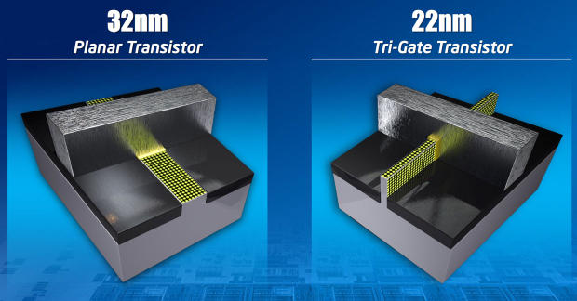
Evolution of Computer Hardware
Fifth Generation (Present-Beyond)
Quantum computing
Bio-inspired computing
Heterogeneous computing
3D transistors
Beyond…........
Notes:
Many have predicted the demise of Moore’s Law for a number of years, but Intel still seems to be going strong. They recently moved to tri-gate transistor
These transistors employ a single gate stacked on top of two vertical gates allowing for essentially three times the surface area for electrons to travel. Intel reports that their tri-gate transistors reduce leakage and consume far less power than current transistors. This allows up to 37% higher speed, or a power consumption at under 50% of the previous type of transistors used by Intel.

Slide 9
What is Ubiquitous Computing?
What comes to mind when someone says ubiquitous computing? What do ubiquitous computing researchers research?

Slide 10
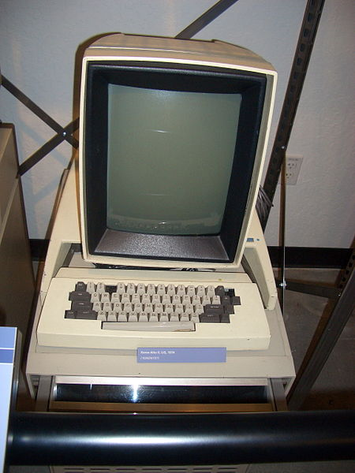
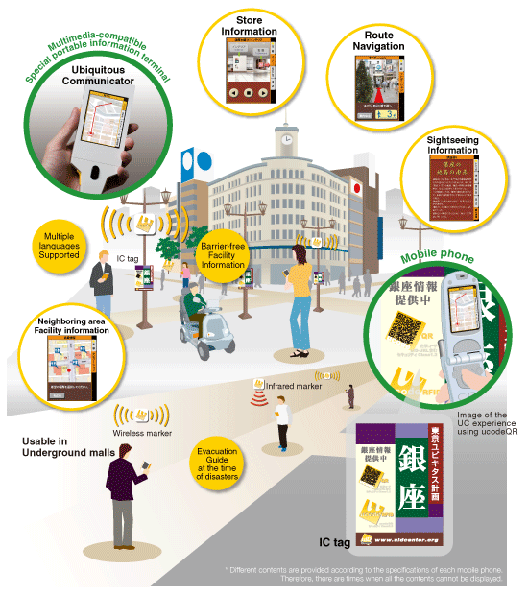
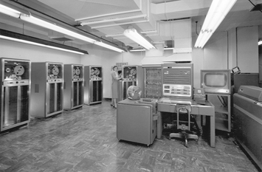
Evolution of Computing Eras
1st Generation
2nd Generation
3rd Generation
An IBM 704 mainframe (1964)
Xerox Alto (1973)
Mainframe Computing
(1 computer, many people)
Personal Computing
(1 computer, 1 person)
Ubiquitous Computing
(many computers, 1 person)

Slide 11
Vision of Ubiquitous Computing
Mark Weiser
Researcher at Xerox PARC
Hailed as “father of ubiquitous computing”
Landmark paper titled “The Computer for the 21st Century” in Scientific American, 1991
“The most profound technologies are those that disappear. They weave themselves into the fabric of everyday life until they are indistinguishable from it.”

Slide 12
Visions of Computing
Ubiquitous Computing at Xerox PARC circa 1991
http://youtu.be/b1w9_cob_zw
[9:50 min]
"The Computer for the 21st Century" - Scientific American Special Issue on Communications, Computers, and Networks, September, 1991

Slide 13
Ubiquitous Computing
3rd generation of computing
Computation embedded in the physical spaces around us – “ambient intelligence”
Appropriate & take advantage of naturally-occurring actions/activities in environment
Research topics: location-based services, context-awareness, privacy, user interfaces, sensing, actuation, connectivity, mobility

Slide 14
What’s Next Ubicomp?
Gregory D. Abowd. 2012. What next, ubicomp?: celebrating an intellectual disappearing act. In Proceedings of the 2012 ACM Conference on Ubiquitous Computing (UbiComp '12). ACM, New York, NY, USA, 31-40.
Current trends
Commoditization of computation and storage
Cloud computing
Crowdsourcing
Artificial intelligence
Fourth generation of computing?
1st, 2nd, and 3rd generations suggest divide between computing device and individual
Physical being and sense of identity become indistinguishable from elements of computing
Notes:
The coming decades will see us being inspired and challenged as our own physical being and our sense of identity is no longer easily distinguished from elements of computing. Twenty years ago, these ideas were part of the
wearable/cyborg movement. Today, this vision may have a greater chance of gaining traction.

Slide 15
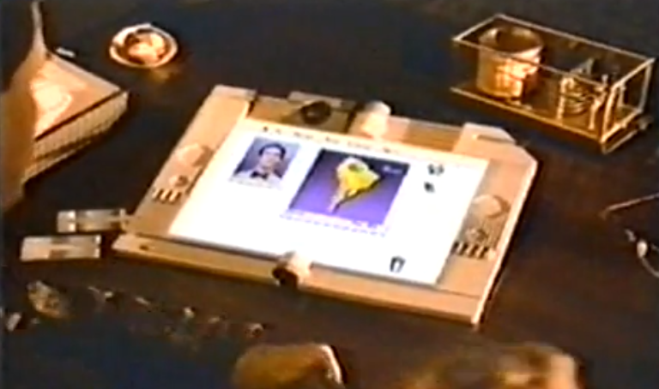
Apple’s 1987 Knowledge Navigator
http://youtu.be/HGYFEI6uLy0
[5:46 min]

Slide 16
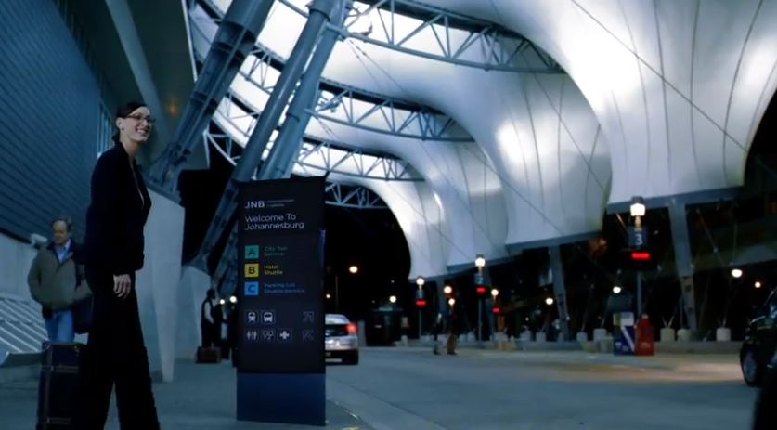
Productivity Future Vision (2011)
http://youtu.be/a6cNdhOKwi0
[6:18 min]

Slide 17
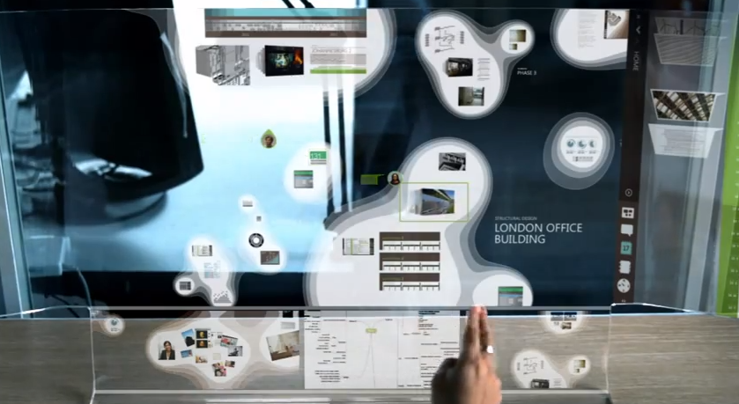
Productivity Future Vision (2009)
http://youtu.be/t5X2PxtvMsU
[5:46 min]

Slide 18
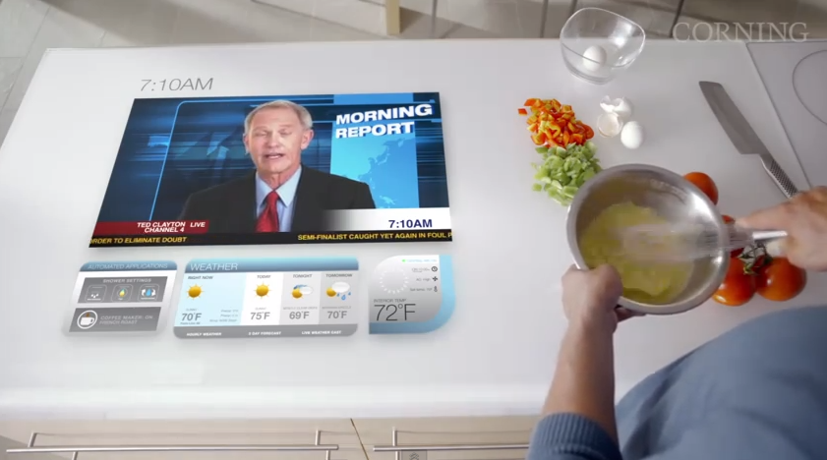
“A Day Made of Glass” by Corning
http://youtu.be/6Cf7IL_eZ38
[5:33 min]

Slide 19
Vision in the Interface
CS 6456 Lecture
Gabriel Reyes
CS-HCI PhD Student
Notes:
Now we’ve seen some ideas of what the future looks like and what people envision as the future of computing. Now I want to move into talking about the “vision in the interfafce”

Slide 20
Computer Vision
Goal to make computers understand images and video like humans
Vision is an amazing feat of natural intelligence
50% of human brain is directly or indirectly devoted to vision
Notes:
The goal is to make computers and robots understand images and video like humans

Slide 21
Computer Vision
Methods and algorithms for…
Acquiring
Processing > Images
Analyzing
Understanding
Wide range of applications where computer vision is critical and matters
Notes:
Currently, there are methods and algorithms for acquiring, processing, analyzing, and understanding images
And computer vision is used in a wide range of applications

Slide 22
Can you provide any examples of computer vision applied in the real world?

Slide 23
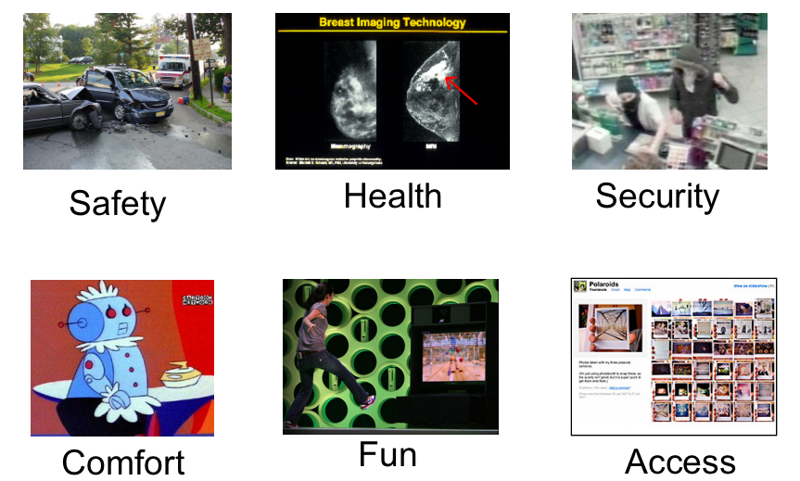
Credit: CS543/ECE549
University of Illinois

Slide 24
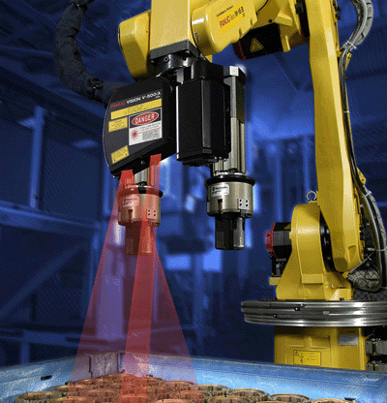
Industrial Robotics
Notes:
Controlling processes, e.g., an industrial robot;

Slide 25
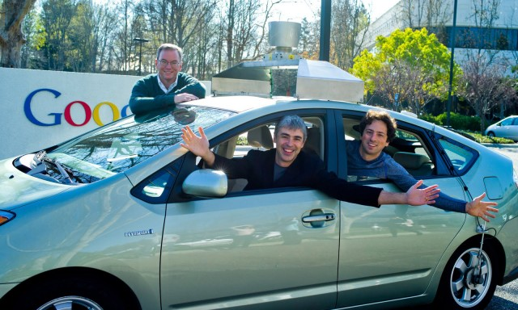
Autonomous Vehicles
Notes:
Navigation, e.g., by an autonomous vehicle or mobile robot;

Slide 26
Visual surveillance
Notes:
Detecting events, e.g., for visual surveillance or people counting;

Slide 27
Image databases
Notes:
Organizing information, e.g., for indexing databases of images and image sequences;

Slide 28
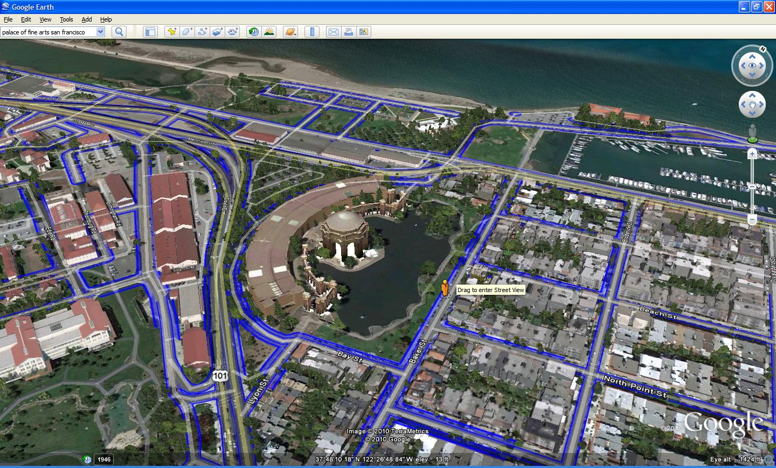
Modeling objects & environments
Notes:
Modeling objects or environments, e.g., medical image analysis or topographical modeling;

Slide 29
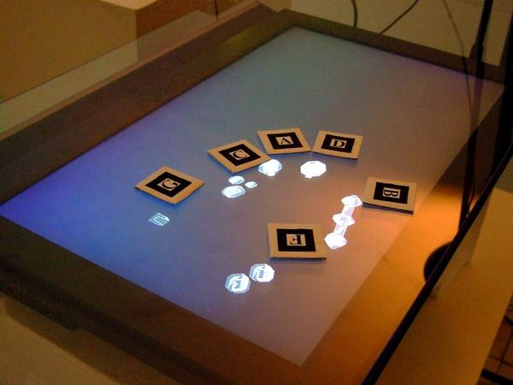
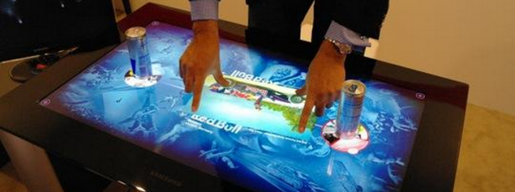
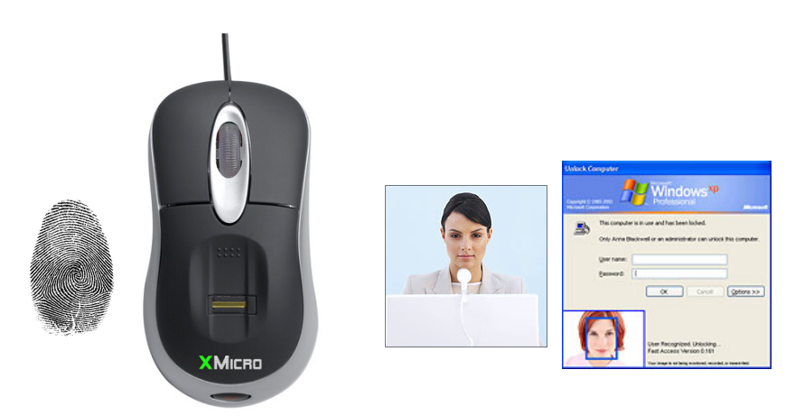
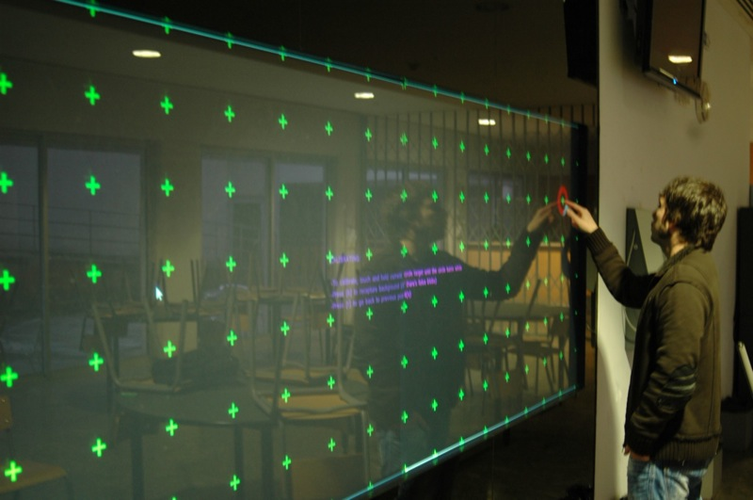
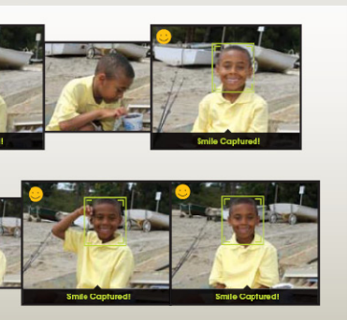
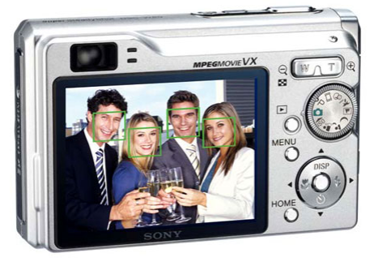
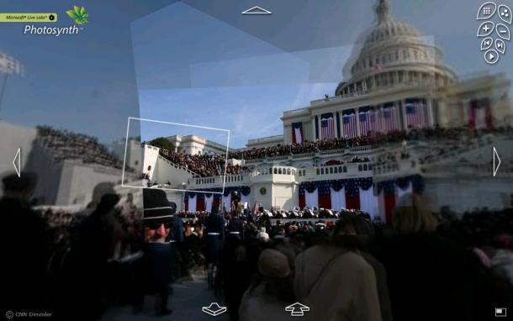
Interaction
Notes:
Interaction, e.g., as the input and output devices and software for computer-human interaction
Microsoft Surface
Community Core Vision
Photosynth TED Talk
Smile detection and face detection on consumer electronics
Biometrics for security and interacting with computers

Slide 30
Computer Vision Toolkits
VIPER Vision Toolkit
Toolkit of scripts and Java programs that enable the markup of visual data ground truth
http://viper-toolkit.sourceforge.net/
Java Media Framework
Enables audio and video media to be added and processed in applications and applets built on Java technology
http://www.oracle.com/technetwork/java/index.html

Slide 31
Computer Vision Toolkits
OpenCV Vision Toolkit
Open Source Computer Vision is a library of programming functions for real time computer vision
Free for both academic and commercial use
C++, C, Python and Java interfaces
Supports Windows, Linux, Android and Mac
Library has >2500 optimized algorithms
http://opencv.willowgarage.com/wiki/
Notes:
Open Source Computer Vision is a library of programming functions for real time computer vision
Free for both academic and commercial use
C++, C, Python and soon Java interfaces running on Windows, Linux, Android and Mac.
Library has >2500 optimized algorithms (see figure below).
Uses range from interactive art, to mine inspection, stitching maps on the web on through advanced robotics

Slide 32
Notes:
Library has >2500 optimized algorithms (see figure below).
Uses range from interactive art, to mine inspection, stitching maps on the web on through advanced robotics

Slide 33
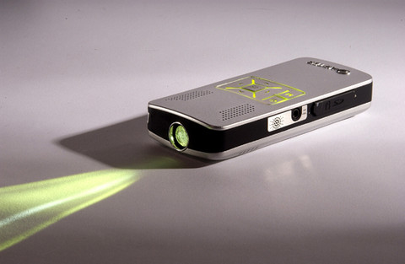
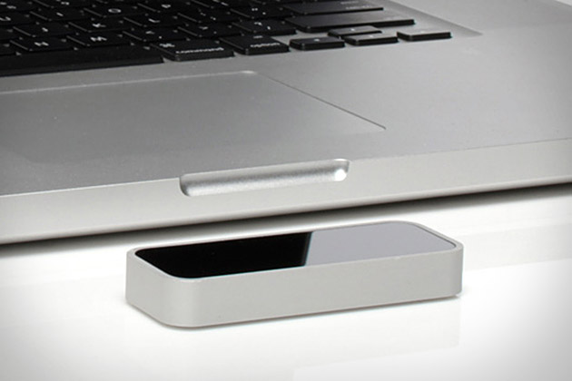
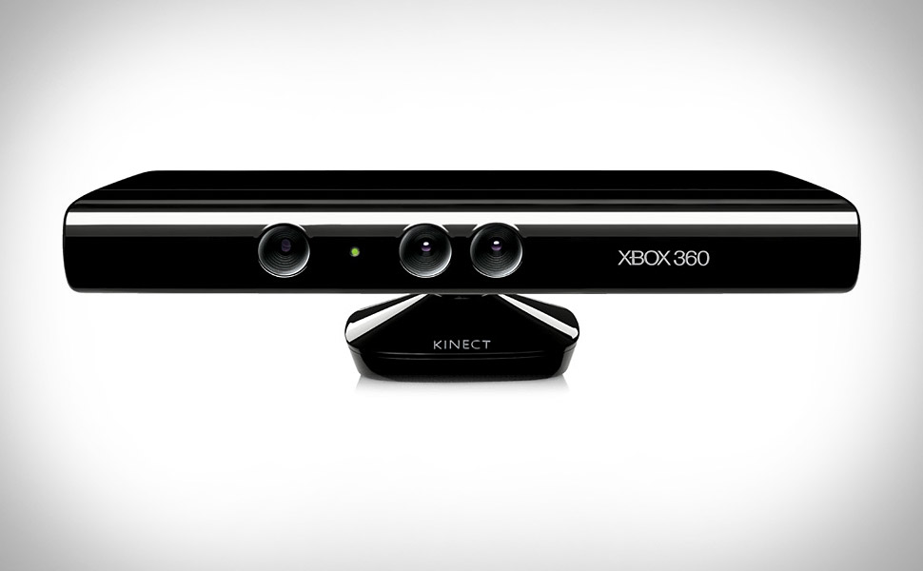
Vision-Based Interfaces
Computer vision in the context of user interfaces and human-computer interaction
Input and output devices and software used to interact with computers & environment
Notes:
This is not a computer vision course…..

Slide 34
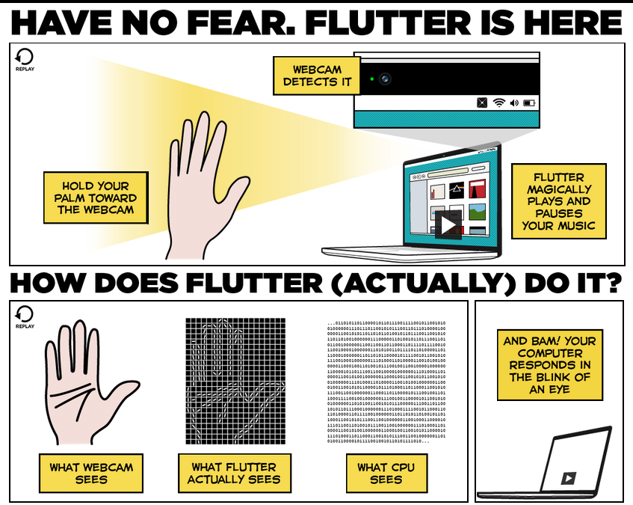
https://flutterapp.com/
Notes:
Flutterapp.com
Uses your webcam to detect your hand in front of your laptop
Allows for gestures to play and pause your music and movies
Simple functionality but could be expanded to wider range of functions

Slide 35
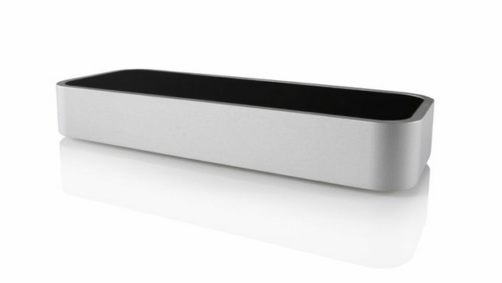
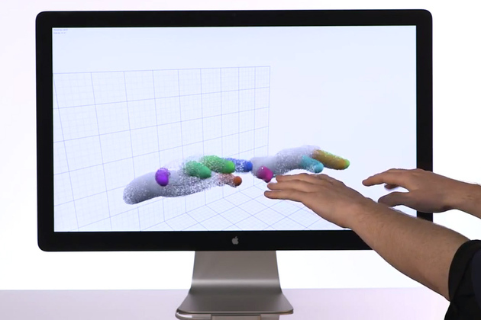
Leap Motion
http://youtu.be/_d6KuiuteIA
Notes:
Leap Motion is an interesting piece of technology, how many of you have heard of it or seen the video?
Released a few months ago under pre-order
They claim to be the only technology focused on bringing motion control to the desktop (and laptops)
Natural motions
Fine-grain finger tracking
Actual technology unknown?
“using a patented mathematical approach to 3D, touch-free motion sensing and motion control software that’s unlike anything that currently exists on the market or in academia”

Slide 36
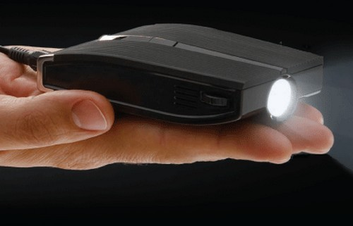
Projectors & Pico Projectors
(e.g. Ever Win’s EWP1000)
Notes:
Projectors are obviously used for display output
Pico Projectors are becoming more and more inexpensive
Smaller than regular sized projector
Embed within applications

Slide 37
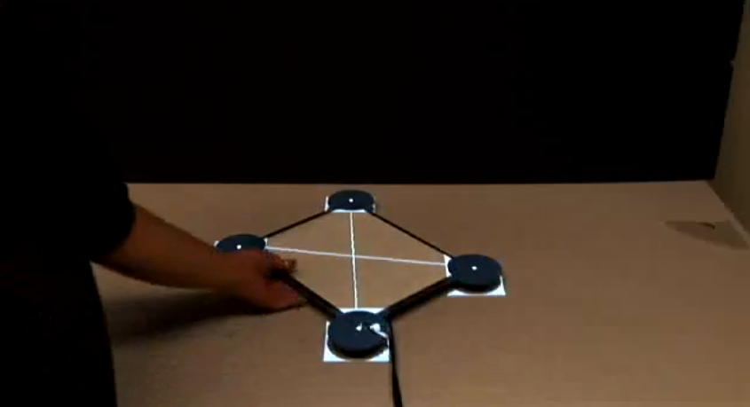
Moveable interactive projected displays using projector based tracking
Johnny C. Lee, Scott E. Hudson, Jay W. Summet, and Paul H. Dietz. 2005. In Proceedings of the 18th annual ACM symposium on User interface software and technology (UIST '05). ACM, New York, NY, USA, 63-72.
http://youtu.be/liMcMmaewig?t=24s
Notes:
Optical sensors embedded in devices to provide moveable interactive project surfaces

Slide 38
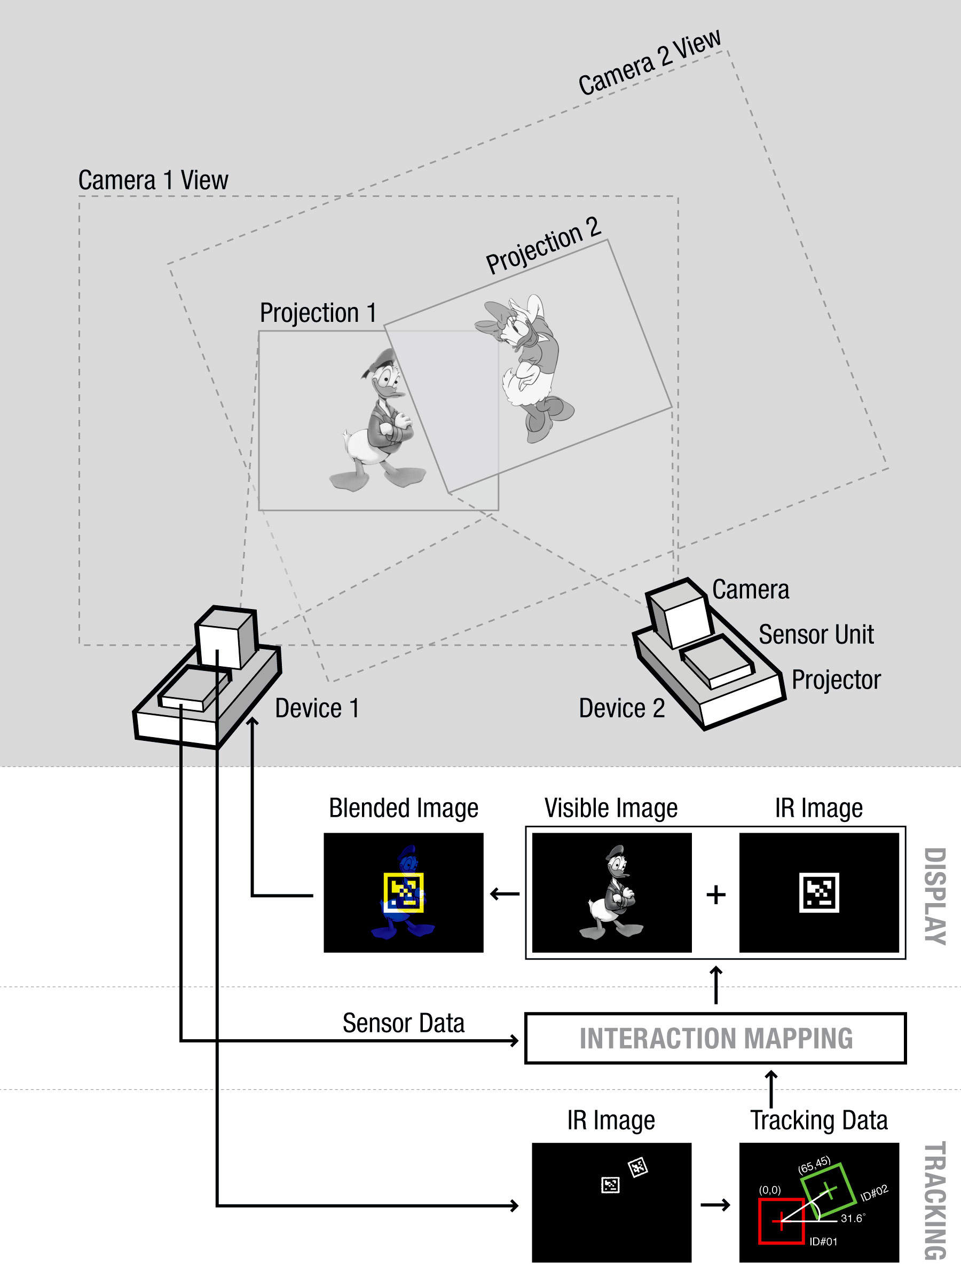
SideBySide: Ad-hoc Multi-user Interaction with Handheld Projectors
Willis, K. D.D., Poupyrev, I., Hudson, S. E., and Mahler, M. SideBySide: Ad-hoc Multi-user Interaction with Handheld Projectors. In Proc. ACM UIST (2011).
http://www.disneyresearch.com/project/sidebyside/
Notes:
SideBySide enables a new space of user interaction using picoprojectors combined with infrared cameras using fiducial markers for tracking

Slide 39
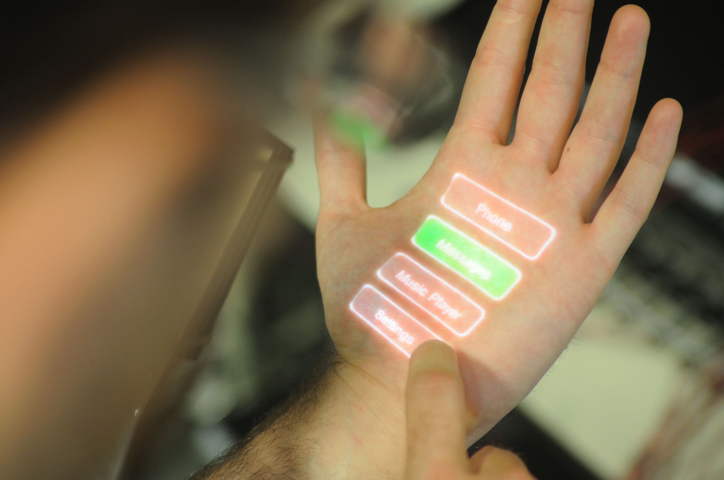
Skinput: Appropriating the Body as an Input Surface
Harrison, C., Tan, D. Morris, D. 2010. Skinput: Appropriating the Body as an Input Surface. In Proceedings of the 28th Annual SIGCHI Conference on Human Factors in Computing Systems (Atlanta, Georgia, April 10 - 15, 2010). CHI '10. ACM, New York, NY. 453-462.
http://youtu.be/g3XPUdW9Ryg?t=24s

Slide 40
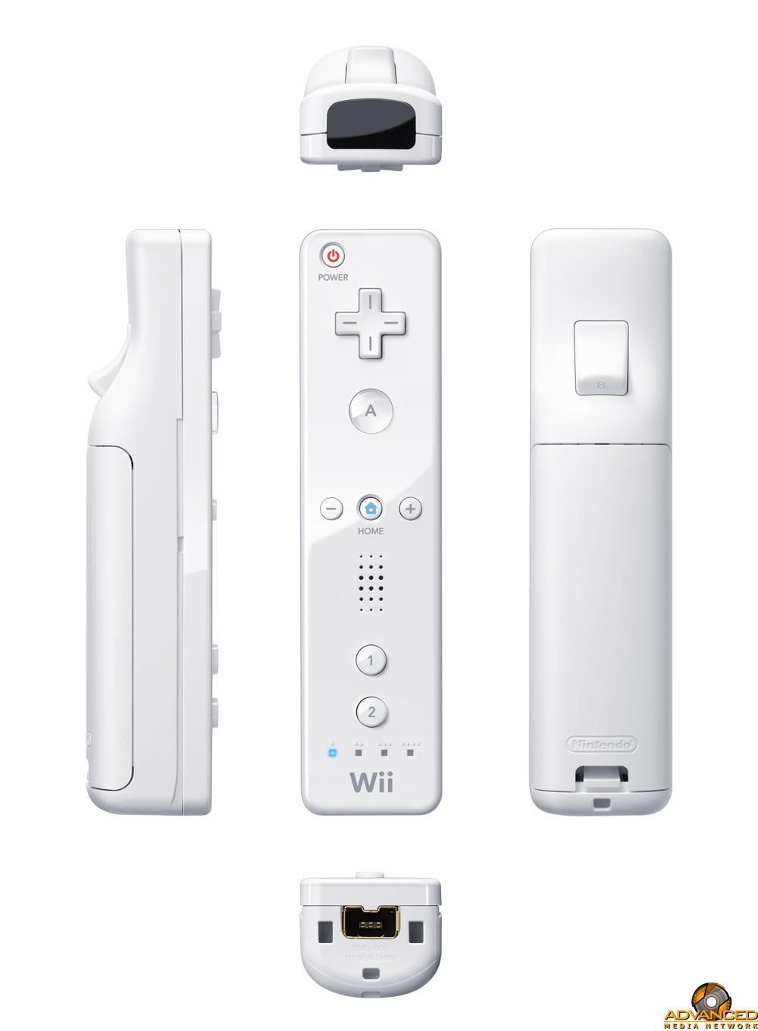
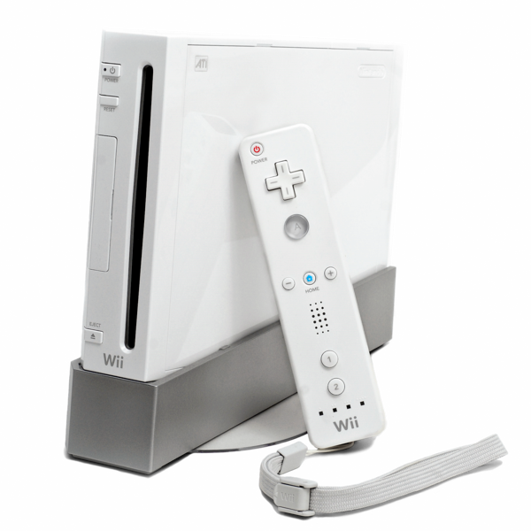
Notes:
Wii released by Nintendo in November 2006
Cool about the Wii is that it enabled a new way of interacting with your game console that hadn’t been seen before

Slide 41
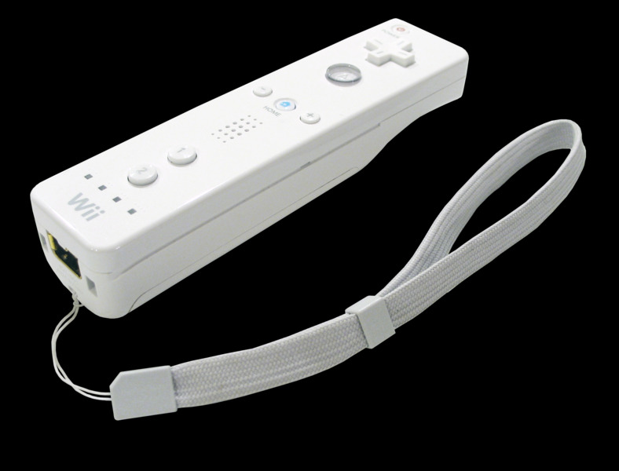
Nintendo Wii Remote
Primary controller for Nintendo Wii
Basic audio
Rumble feedback
ADXL330 accelerometer
Optical sensor
Motion sensing capability
Interact with and manipulate
objects on screen
Gesture recognition
Pointing
Notes:
Primary controller
With basic audio and rumble feedback
As well as 3-axis accelerometer
Optical sensor

Slide 42
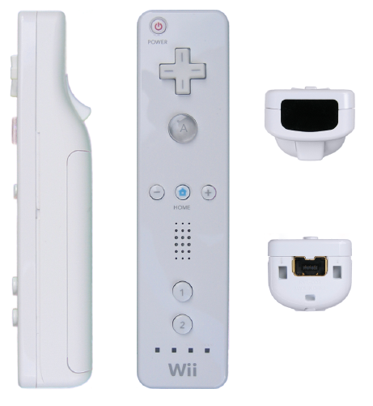
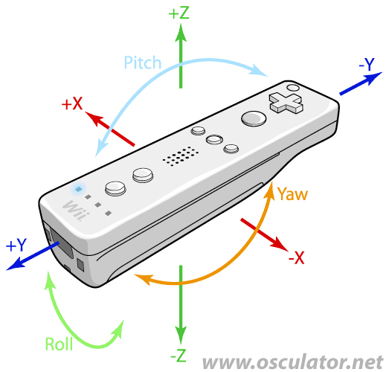
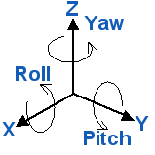
Nintendo Wii Remote (Wiimote)

Slide 43
Notes:
Look at area of controller circled in red
Visual IR tracking
What this is is an infrared camera in the remote

Slide 44
Wiimote Sensor Bar
Optical bar to determine location of controller using the visual IR tracking camera
Sensor Bar with 10 infrared LEDs placed on TV

Slide 45
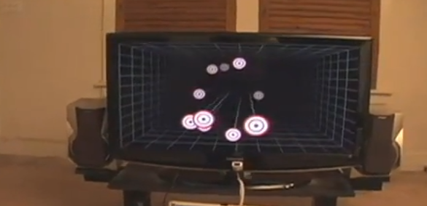
Head Tracking for Desktop Virtual Reality Displays using the Wii Remote
Johnny Chung Lee, Human-Computer Interaction Institute, Carnegie Mellon University, 2007
http://youtu.be/Jd3-eiid-Uw?t=57s
Notes:
Motion parallax
Shifts view based on head tracking

Slide 46
Tracking Fingers with the Wii Remote
Johnny Chung Lee, Human-Computer Interaction Institute, Carnegie Mellon University, 2007
http://youtu.be/0awjPUkBXOU?t=1m35s

Slide 47
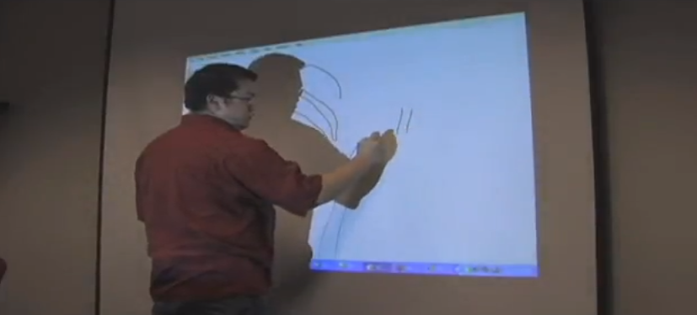
Low-Cost Multi-touch Whiteboard using the Wiimote
Johnny Chung Lee, Human-Computer Interaction Institute, Carnegie Mellon University, 2007
http://youtu.be/5s5EvhHy7eQ?t=2m1s

Slide 48
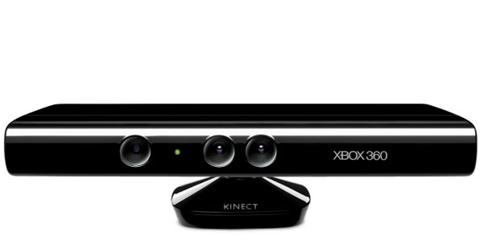

Slide 49
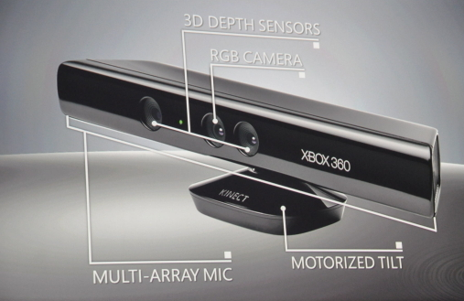
Microsoft Kinect
Full body motion sensing input device
Released by Microsoft in November 2010
Notes:
??????How many of you OWN a Kinect? How many have programmed with one?
2 depth sensors
1 RGB camera
Multiarray microphone

Slide 50
How does Kinect work?
Color VGA RGB camera
VGA resolution (640x480) with 8-bit resolution and a Bayer color filter
Operates at 30 FPS (frames per second)
Depth sensor
Infrared laser projector with monochrome CMOS sensor, used to capture video data in 3D in ambient light conditions
Video stream in VGA resolution (640×480) with 11-bit depth, which provides 2,048 levels of sensitivity
Notes:
Color VGA RGB camera to capture images in color
Depth sensor made up of an infrared laser project with a monochrome CMOS sensor

Slide 51
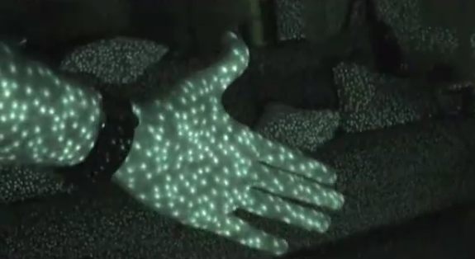
How does Kinect work?
IR VGA camera emits laser speckle across field of view, creating a ‘depth field’
Notes:
IR VGA camera emits laser unstructured laser speckle across field of view creating a depth field

Slide 52
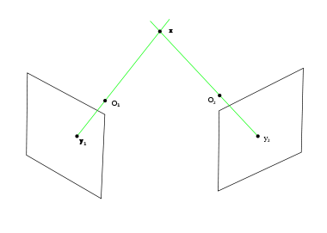
How does Kinect work?
The depth is computed from the difference between the speckle pattern that is observed and a reference pattern at a known depth.
Process is known as stereo triangulation.
Notes:
Then, the depth is computed from the difference between the speckle pattern observed and a reference pattern for known depths that are hard-coded in the device. Then, through a process called stereo triangulation the Kinect is able to process a depth image

Slide 53
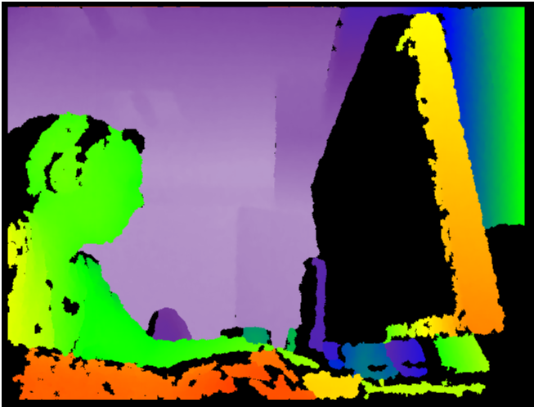
Notes:
That looks something like this…

Slide 54
How does Kinect work?
Skeleton is obtained using a pose estimation pipeline as follows here:
Capture depth image
Remove background
Infer body part per pixel
Cluster pixels to hypothesize joint location
Fit model and track skeleton
Notes:
Capture depth image
Remove background
Infer body part per pixel
Cluster pixels to get joint locations
Fit model and track skeleton

Slide 55
Notes:
Skeleton obtained using extensive machine learning and 1000s of skeleton models recorded by actual users

Slide 56
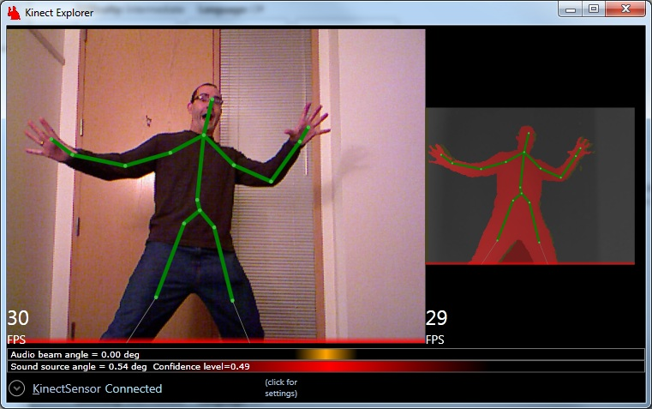
Notes:
In the end, you get something like this…..

Slide 57
Depth cameras became accessible at much lower price point ~$150
World record holder for…?
Notes:
One of the other cool things about Kinect is that it made technology accessible to the masses… and commoditized depth cameras to a price of about $150 when other depth cameras at the time were in the $3k-5k range
After selling a total of 8 million units in its first 60 days, the Kinect holds the Guinness World Record of being the "fastest selling consumer electronics device”

Slide 58
Opened up a large hacker community
5 months after launch…
http://youtu.be/8nlk6HhDpDw
Notes:
Let students browse video after class

Slide 59
OmniTouch: Wearable Multitouch Interaction Everywhere
Harrison, C., Benko, H., and Wilson, A. D. 2011. OmniTouch: Wearable Multitouch Interaction Everywhere. In Proceedings of the 24th Annual ACM Symposium on User interface Software and Technology (Santa Barbara, California, October 16 - 19, 2011). UIST '11. ACM, New York, NY. 441-450.
http://youtu.be/Pz17lbjOFn8

Slide 60
Next Generation Interfaces
Shahram Izadi, Microsoft Research Cambridge
Recent talk on next generation UIs and the future of HCI presented at ISMAR 2012
Transition from from traditional mouse/keyboard to natural user interfaces (NUI) requires:
Sensing spaces
Freeing pixels
Adding physicality
Notes:
Sensing spaces --- being able to detect your environment and create better models of your environment
Freeing pixels --- moving away from 2d gui and display technology and moving the interface into the real world
Adding physicality --- lettting your senses be part of the experience and providing natural movements and gestures to interfaces

Slide 61
Sensing Spaces
Shahram Izadi, David Kim, Otmar Hilliges, David Molyneaux, Richard Newcombe, Pushmeet Kohli, Jamie Shotton, Steve Hodges, Dustin Freeman, Andrew Davison, and Andrew Fitzgibbon. 2011. KinectFusion: real-time 3D reconstruction and interaction using a moving depth camera. In Proceedings of the 24th annual ACM symposium on User interface software and technology(UIST '11). ACM, New York, NY, USA, 559-568.
KinectFusion
Magic ---> 3D reconstruction of spaces
Allows for tracking and segmenting objects
Provides understanding foreground/background
Made available to public in next Kinect SDK
KinectFusion++
Using new cameras with combined RGB+infrared
Passive matching illumination allows outdoor use

Slide 62
http://youtu.be/quGhaggn3cQ
[7:47 min]
Notes:
Video is

Slide 63
Freeing Pixels
Otmar Hilliges, David Kim, Shahram Izadi, Malte Weiss, and Andrew Wilson. 2012. HoloDesk: direct 3d interactions with a situated see-through display. In Proceedings of the SIGCHI Conference on Human Factors in Computing Systems (CHI '12). ACM, New York, NY, USA, 2421-2430.
Holodesk
Novel interactive system that combines the physical with the virtual world
Combines an optical see-through display and Kinect camera to create the illusion that users are directly interacting with 3D graphics
A virtual image of a 3D scene is rendered through a half silvered mirror and spatially aligned with the real-world for the viewer
Users easily reach into an interaction volume displaying the virtual image. This allows the user to literally get their hands into the virtual display.

Slide 64
http://youtu.be/JHL5tJ9ja_w
[4:15 min]
Notes:
Video is

Slide 65
Adding Physicality
David Kim, Otmar Hilliges, Shahram Izadi, Alex D. Butler, Jiawen Chen, Iason Oikonomidis, and Patrick Olivier. 2012. Digits: freehand 3D interactions anywhere using a wrist-worn gloveless sensor. In Proceedings of the 25th annual ACM symposium on User interface software and technology (UIST '12). ACM, New York, NY, USA, 167-176.
Digits
Freehand 3D computer interaction without gloves
“Let your hands do the talking”
Hands are difficult to sense
Deforming surfaces
Occlusion
No wearables
Gripping
3D manipulation of world
Non-visual UI

Slide 66
http://youtu.be/Tm2IuVfNEGk
[2:35 min]

Slide 67
Questions?
greyes@gatech.edu
www.gareyes.com
@greyesgt

