Slide 1
CS 7643: Deep Learning
Topics:
Regularization
Neural Networks
Modular Design
Computing Gradients
Dhruv Batra
Georgia Tech

Slide 2
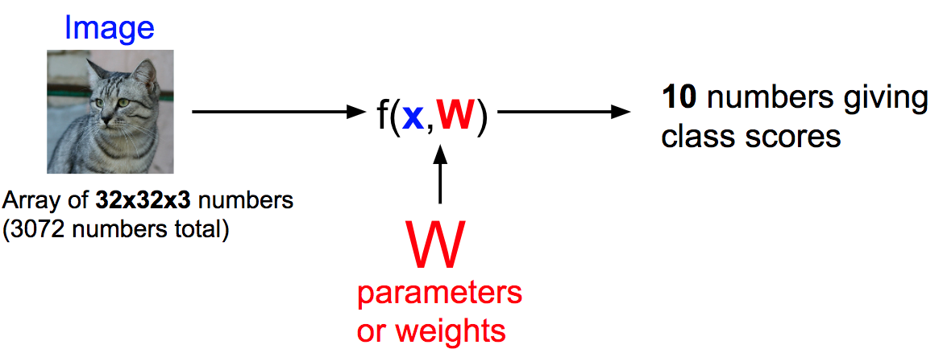
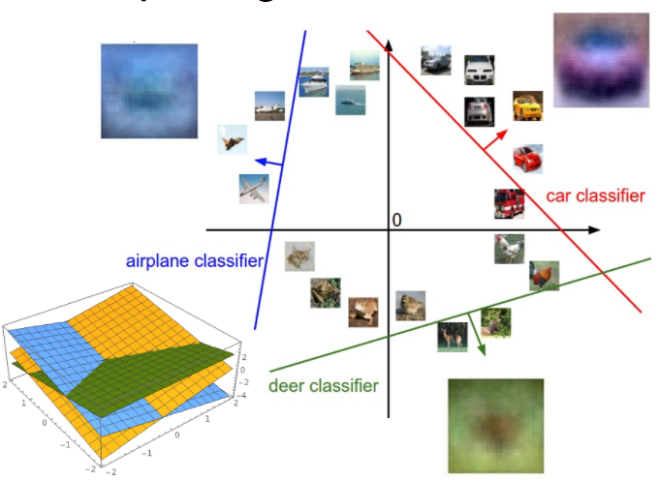
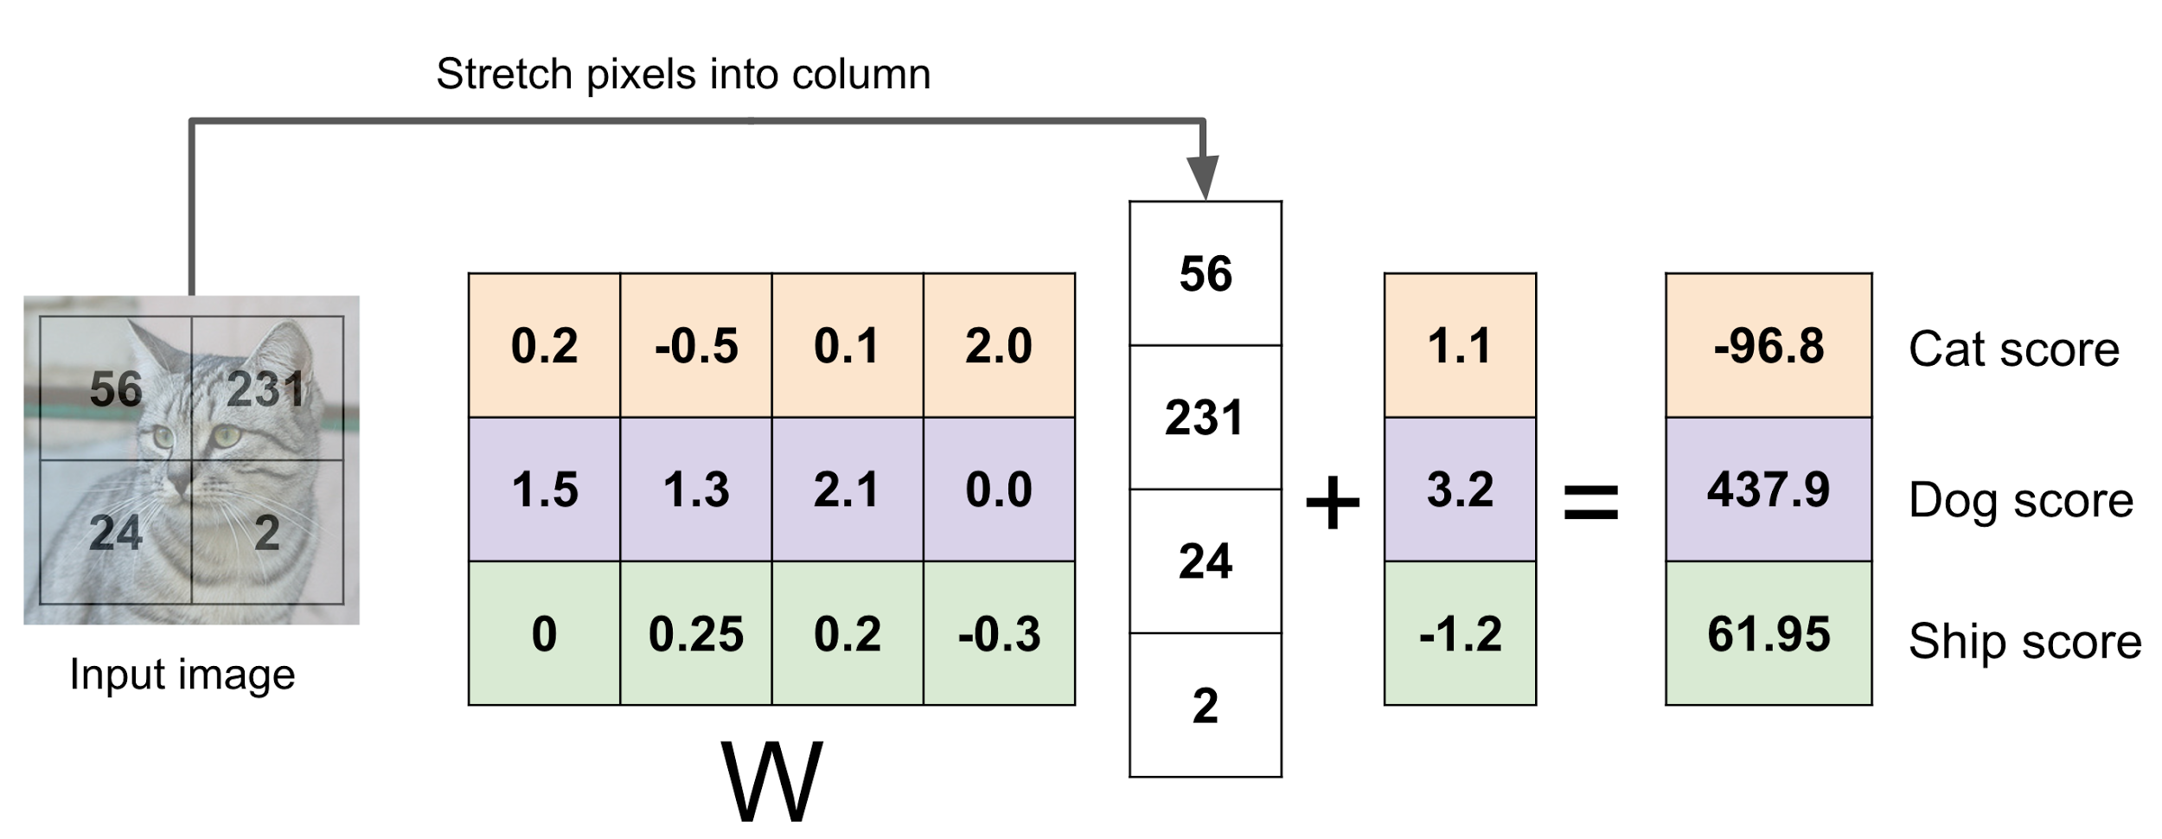
Recall from last time: Linear Classifier
f(x,W) = Wx + b
Slide Credit: Fei-Fei Li, Justin Johnson, Serena Yeung, CS 231n

Slide 3
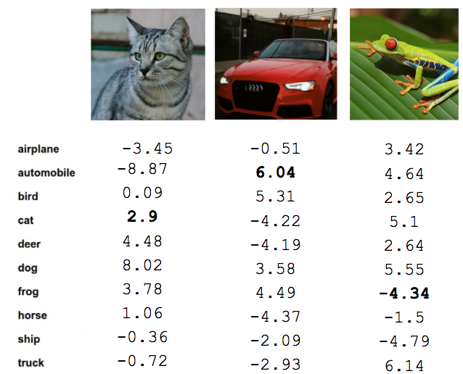
Recall from last time: Linear Classifier
TODO:
Define a loss function that quantifies our unhappiness with the scores across the training data.
Come up with a way of efficiently finding the parameters that minimize the loss function. (optimization)
Cat image by Nikita is licensed under CC-BY 2.0; Car image is CC0 1.0 public domain; Frog image is in the public domain
Slide Credit: Fei-Fei Li, Justin Johnson, Serena Yeung, CS 231n

Slide 4
Softmax vs. SVM
Slide Credit: Fei-Fei Li, Justin Johnson, Serena Yeung, CS 231n

Slide 5
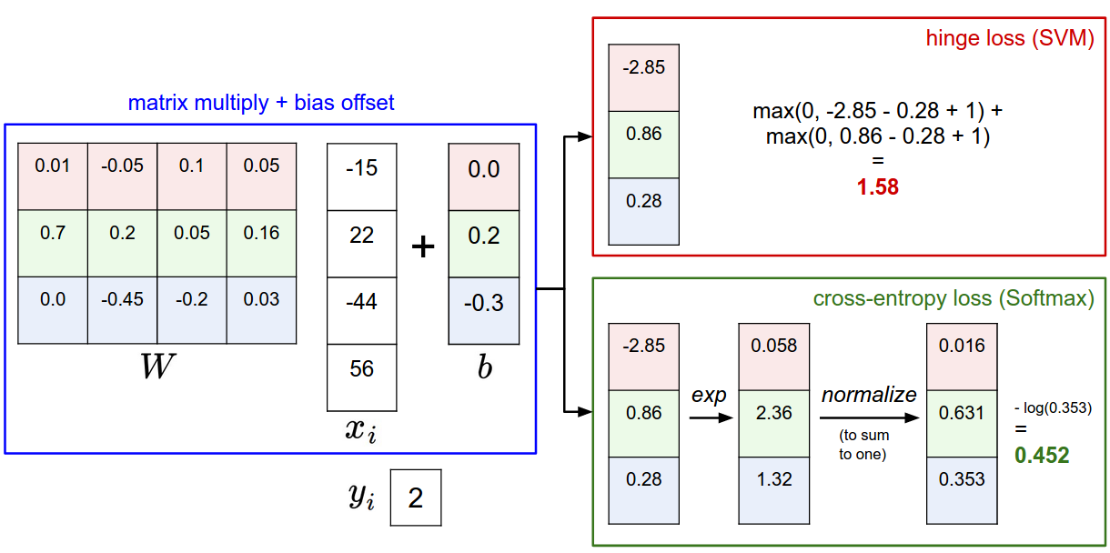
Slide Credit: Fei-Fei Li, Justin Johnson, Serena Yeung, CS 231n

Slide 6
Plan for Today
Regularization
Neural Networks
Modular Design
Computing Gradients

Slide 7
Data loss: Model predictions should match training data
Slide Credit: Fei-Fei Li, Justin Johnson, Serena Yeung, CS 231n

Slide 8
Data loss: Model predictions should match training data
Slide Credit: Fei-Fei Li, Justin Johnson, Serena Yeung, CS 231n

Slide 9
Data loss: Model predictions should match training data
Slide Credit: Fei-Fei Li, Justin Johnson, Serena Yeung, CS 231n

Slide 10
Data loss: Model predictions should match training data
Slide Credit: Fei-Fei Li, Justin Johnson, Serena Yeung, CS 231n

Slide 11
Data loss: Model predictions should match training data
Regularization: Model should be “simple”, so it works on test data
Slide Credit: Fei-Fei Li, Justin Johnson, Serena Yeung, CS 231n

Slide 12
Data loss: Model predictions should match training data
Regularization: Model should be “simple”, so it works on test data
Occam’s Razor:
“Among competing hypotheses, the simplest is the best”
William of Ockham, 1285 - 1347
Slide Credit: Fei-Fei Li, Justin Johnson, Serena Yeung, CS 231n
Notes:
William of Ockham (/ˈɒkəm/; also Occam, from Latin: Gulielmus Occamus;^{[1][2]} c. 1287 – 1347) was an EnglishFranciscan friar and scholastic philosopher and theologian, who is believed to have been born in Ockham, a small village in Surrey.^{[3]} He is considered to be one of the major figures of medieval thought and was at the centre of the major intellectual and political controversies of the fourteenth century. He is commonly known for Occam's razor, the methodological principle that bears his name, and also produced significant works on logic, physics, and theology. In the Church of England, his day of commemoration is 10 April.^{[4]}

Slide 13
Regularization
= regularization strength
(hyperparameter)
In common use:
L2 regularization
L1 regularization
Elastic net (L1 + L2)
Dropout (will see later)
Fancier: Batch normalization, stochastic depth
Slide Credit: Fei-Fei Li, Justin Johnson, Serena Yeung, CS 231n

Slide 14
L2 Regularization (Weight Decay)
Slide Credit: Fei-Fei Li, Justin Johnson, Serena Yeung, CS 231n
Notes:
Using L2 with SVM gives a nice max-margin interpretation; see 229 for details

Slide 15
L2 Regularization (Weight Decay)
(If you are a Bayesian: L2 regularization also corresponds MAP inference using a Gaussian prior on W)
Slide Credit: Fei-Fei Li, Justin Johnson, Serena Yeung, CS 231n

Slide 16
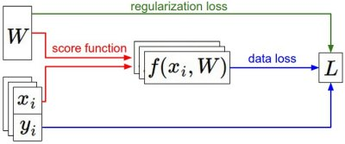
Recap
We have some dataset of (x,y)
We have a score function:
We have a loss function:
e.g.
Softmax
SVM
Full loss
Slide Credit: Fei-Fei Li, Justin Johnson, Serena Yeung, CS 231n

Slide 17
Recap
How do we find the best W?
We have some dataset of (x,y)
We have a score function:
We have a loss function:
e.g.
Softmax
SVM
Full loss
Slide Credit: Fei-Fei Li, Justin Johnson, Serena Yeung, CS 231n

Slide 18
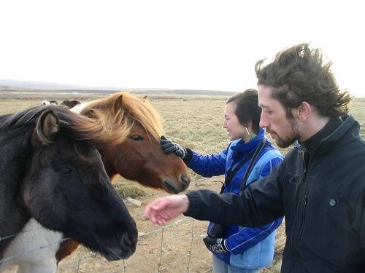
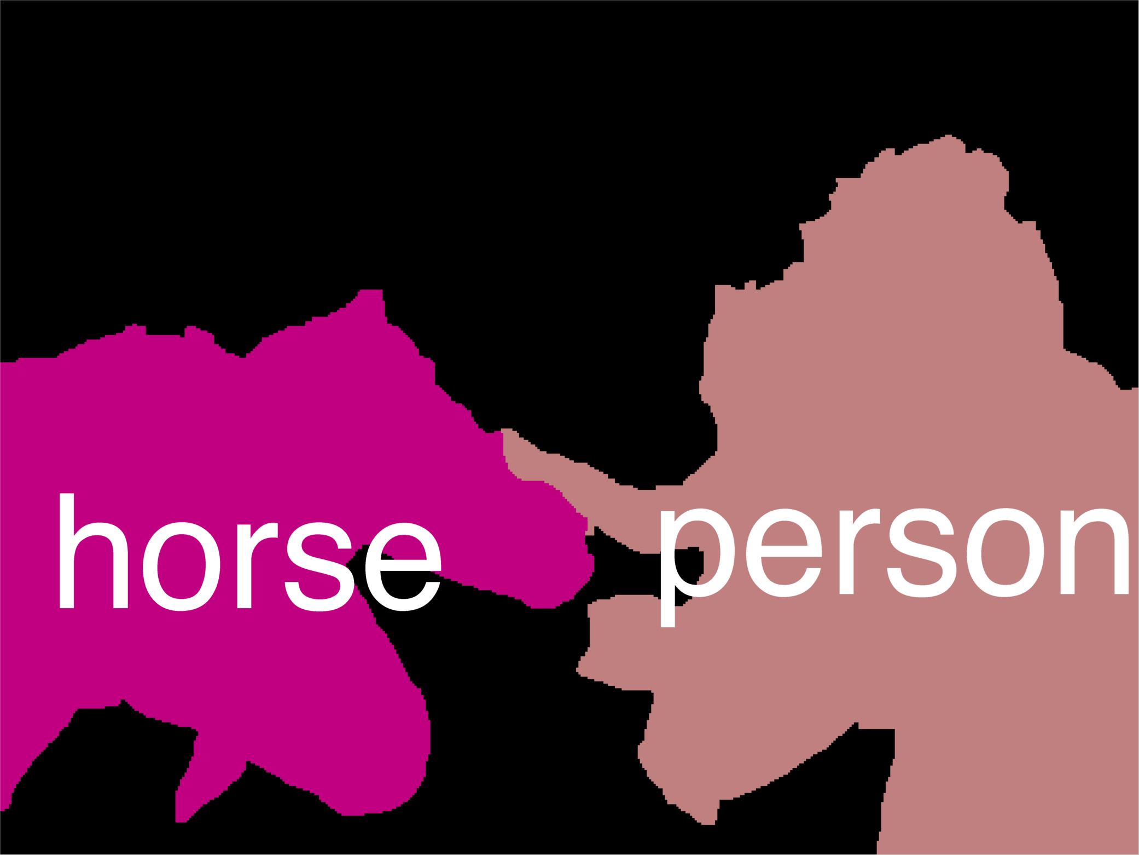
Error Decomposition
Reality
Multi-class Logistic Regression
Modeling Error
Softmax
FC HxWx3
Input
Estimation Error
Optimization Error = 0
model class

Slide 19
Next: Neural Networks
Slide Credit: Fei-Fei Li, Justin Johnson, Serena Yeung, CS 231n

Slide 20
Neural networks: without the brain stuff
(Before) Linear score function:
Slide Credit: Fei-Fei Li, Justin Johnson, Serena Yeung, CS 231n
Notes:
Have been using linear score function as running example of function to optimize

Slide 21
Neural networks: without the brain stuff
(Before) Linear score function:
(Now) 2-layer Neural Network
Slide Credit: Fei-Fei Li, Justin Johnson, Serena Yeung, CS 231n
Notes:
Instead of using single linear transformation, stack 2 together, get 2-layer network

Slide 22
Neural networks: without the brain stuff
(Before) Linear score function:
(Now) 2-layer Neural Network
x
h
W1
W2
s
3072
100
10
Slide Credit: Fei-Fei Li, Justin Johnson, Serena Yeung, CS 231n
Notes:
First have W1*x, then nonlinear function, then second linear layer
More broadly speaking, NN are class of functions where simpler functions are stacked on top of each other in a hierarchical way to make up a more complex, nonlinear function. Have multiple stages of hierarchical computation.

Slide 23
Neural networks: without the brain stuff
(Before) Linear score function:
(Now) 2-layer Neural Network
x
h
W1
W2
s
3072
100
10
Slide Credit: Fei-Fei Li, Justin Johnson, Serena Yeung, CS 231n
Notes:
Biological inspirations to neurons in brain that we’ll discuss later
Looking at it mathematically first, one thing this can help solve, is if we look back to our linear score function, each row of W corresponded to a template
Problem that there can be only one template per class, can’t look for multiple modes
Now intermediate layers can represent anonymous templates that later get recombined
Intermediate layers anonymous templates that get recombined. solves mode problems

Slide 24
Neural networks: without the brain stuff
(Before) Linear score function:
(Now) 2-layer Neural Network
or 3-layer Neural Network
Slide Credit: Fei-Fei Li, Justin Johnson, Serena Yeung, CS 231n
Notes:
Can stack more of these layers to get deeper networks, where the term deep NN comes from

Slide 25
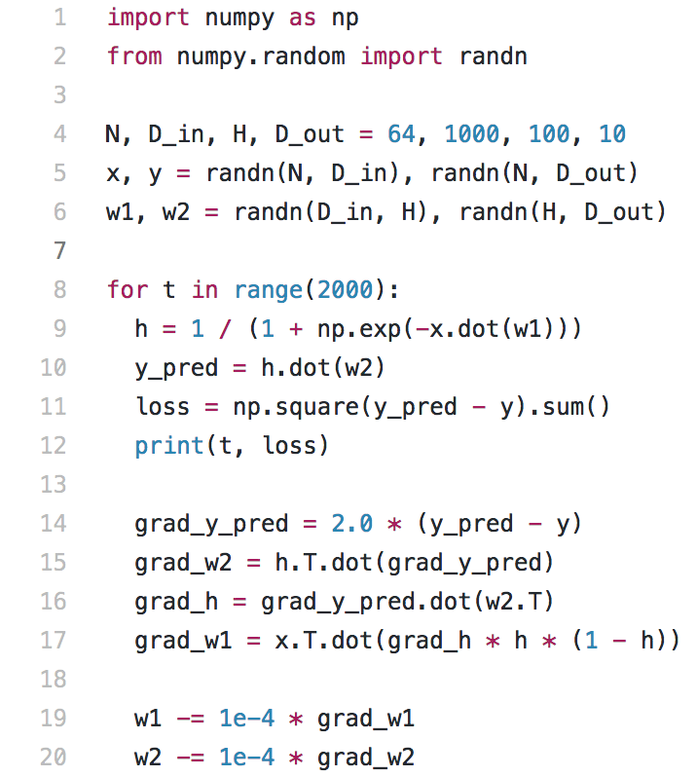
Full implementation of training a 2-layer Neural Network needs ~20 lines:
Slide Credit: Fei-Fei Li, Justin Johnson, Serena Yeung, CS 231n

Slide 26
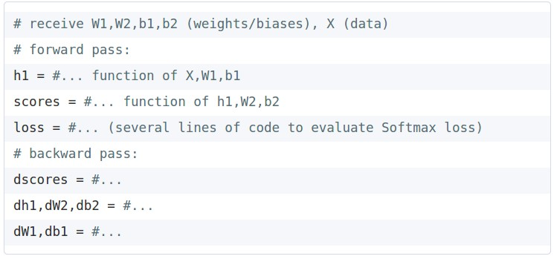
In Assignment 2: Writing a 2-layer net
Slide Credit: Fei-Fei Li, Justin Johnson, Serena Yeung, CS 231n

Slide 27
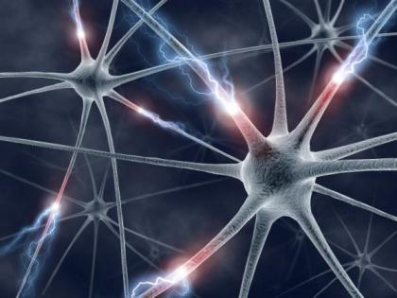
This image by Fotis Bobolas is licensed under CC-BY 2.0
Slide Credit: Fei-Fei Li, Justin Johnson, Serena Yeung, CS 231n
Notes:
Even though… still loosely inspired by brain, still interesting to understand where this comes from

Slide 28
Impulses carried toward cell body
dendrite
presynaptic
terminal
axon
cell body
Impulses carried away from cell body
This image by Felipe Perucho
is licensed under CC-BY 3.0
Slide Credit: Fei-Fei Li, Justin Johnson, Serena Yeung, CS 231n

Slide 29
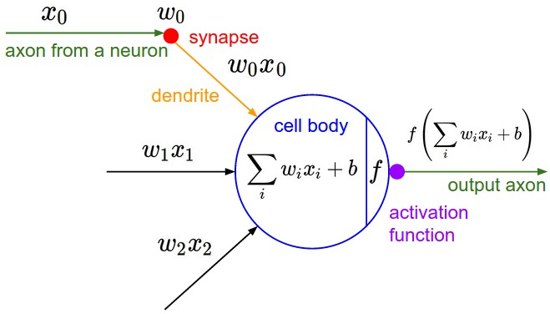
Impulses carried toward cell body
dendrite
presynaptic
terminal
axon
cell body
Impulses carried away from cell body
This image by Felipe Perucho
is licensed under CC-BY 3.0
Slide Credit: Fei-Fei Li, Justin Johnson, Serena Yeung, CS 231n

Slide 30
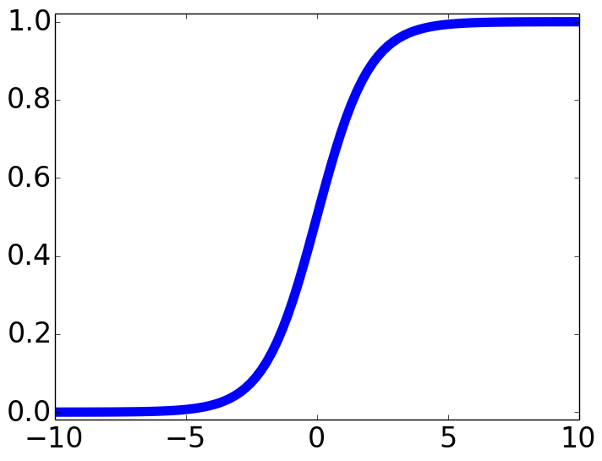
Impulses carried toward cell body
dendrite
presynaptic
terminal
axon
cell body
Impulses carried away from cell body
This image by Felipe Perucho
is licensed under CC-BY 3.0
sigmoid activation function
Slide Credit: Fei-Fei Li, Justin Johnson, Serena Yeung, CS 231n

Slide 31
Impulses carried toward cell body
dendrite
presynaptic
terminal
axon
cell body
Impulses carried away from cell body
This image by Felipe Perucho
is licensed under CC-BY 3.0
Slide Credit: Fei-Fei Li, Justin Johnson, Serena Yeung, CS 231n

Slide 32
Be very careful with your brain analogies!
Biological Neurons:
Many different types
Dendrites can perform complex non-linear computations
Synapses are not a single weight but a complex non-linear dynamical system
Rate code may not be adequate
[Dendritic Computation. London and Hausser]
Slide Credit: Fei-Fei Li, Justin Johnson, Serena Yeung, CS 231n

Slide 33
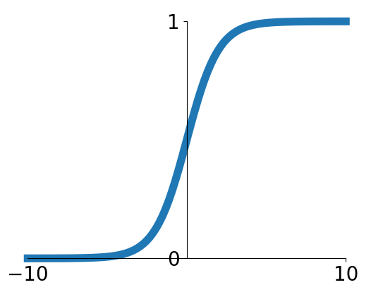
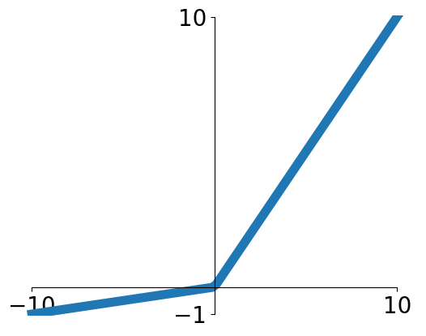
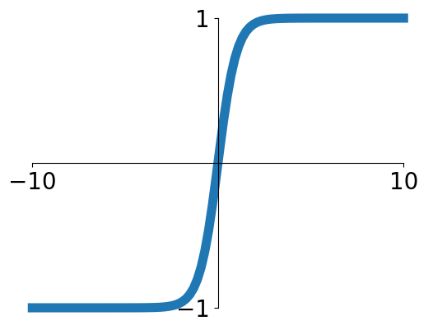
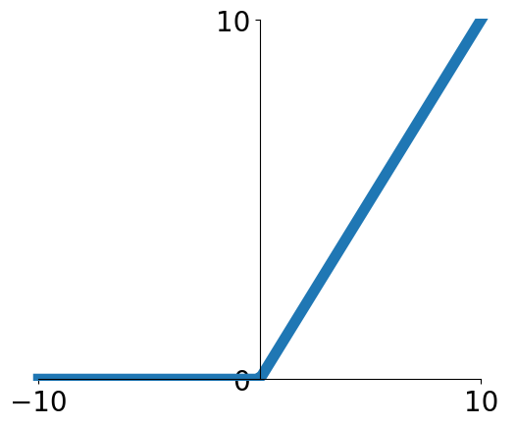
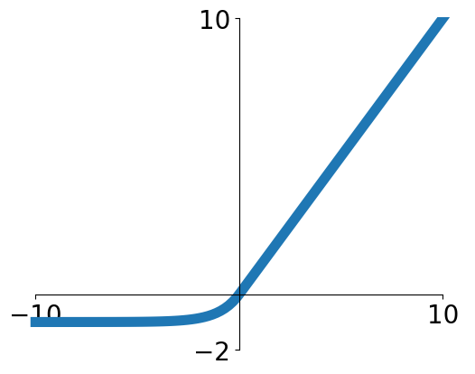
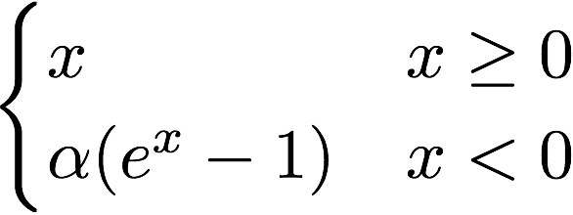
Activation functions
Sigmoid
Leaky ReLU
tanh
Maxout
ReLU
ELU
Slide Credit: Fei-Fei Li, Justin Johnson, Serena Yeung, CS 231n

Slide 34
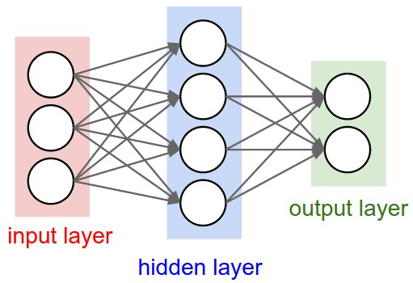
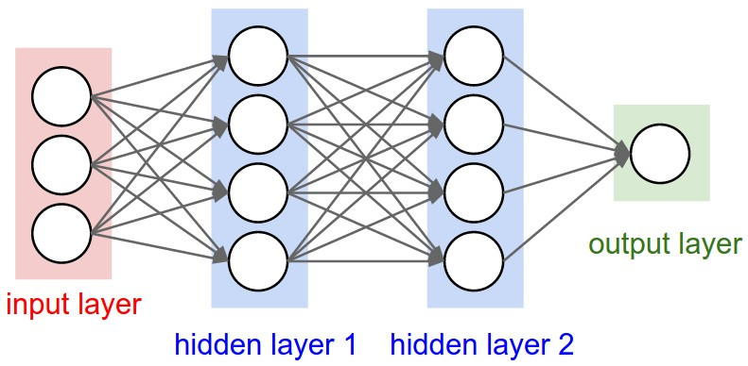
Neural networks: Architectures
“3-layer Neural Net”, or
“2-hidden-layer Neural Net”
“2-layer Neural Net”, or
“1-hidden-layer Neural Net”
“Fully-connected” layers
Slide Credit: Fei-Fei Li, Justin Johnson, Serena Yeung, CS 231n

Slide 35
Example feed-forward computation of a neural network
We can efficiently evaluate an entire layer of neurons.
Slide Credit: Fei-Fei Li, Justin Johnson, Serena Yeung, CS 231n

Slide 36
Example feed-forward computation of a neural network
Slide Credit: Fei-Fei Li, Justin Johnson, Serena Yeung, CS 231n

Slide 37
Optimization

Slide 38
This image is CC0 1.0 public domain
Slide Credit: Fei-Fei Li, Justin Johnson, Serena Yeung, CS 231n

Slide 39
Strategy: Follow the slope
Slide Credit: Fei-Fei Li, Justin Johnson, Serena Yeung, CS 231n

Slide 40
Strategy: Follow the slope
In 1-dimension, the derivative of a function:
In multiple dimensions, the gradient is the vector of (partial derivatives) along each dimension
The slope in any direction is the dot product of the direction with the gradient
The direction of steepest descent is the negative gradient
Slide Credit: Fei-Fei Li, Justin Johnson, Serena Yeung, CS 231n

Slide 41
Gradient Descent
Slide Credit: Fei-Fei Li, Justin Johnson, Serena Yeung, CS 231n

Slide 42
W_2
original W
W_1
negative gradient direction
Slide Credit: Fei-Fei Li, Justin Johnson, Serena Yeung, CS 231n

Slide 43
Slide Credit: Fei-Fei Li, Justin Johnson, Serena Yeung, CS 231n

Slide 44
Stochastic Gradient Descent (SGD)
Full sum expensive when N is large!
Approximate sum using a minibatch of examples
32 / 64 / 128 common
Slide Credit: Fei-Fei Li, Justin Johnson, Serena Yeung, CS 231n

Slide 45
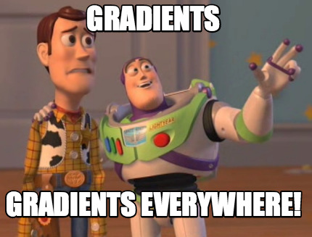

Slide 46
How do we compute gradients?
Manual Differentiation
Symbolic Differentiation
Numerical Differentiation
Automatic Differentiation
Forward mode AD
Reverse mode AD
aka “backprop”

Slide 48
How do we compute gradients?
Manual Differentiation
Symbolic Differentiation
Numerical Differentiation
Automatic Differentiation
Forward mode AD
Reverse mode AD
aka “backprop”

Slide 49
Matrix/Vector Derivatives Notation

Slide 50
Matrix/Vector Derivatives Notation

Slide 51
Vector Derivative Example

Slide 52
Extension to Tensors

Slide 53
Chain Rule: Composite Functions

Slide 54
Chain Rule: Scalar Case

Slide 55
Chain Rule: Vector Case

Slide 56
Chain Rule: Jacobian view

Slide 57
Chain Rule: Tensors

