Slide 1
CS 4803 / 7643: Deep Learning
Topics:
  Visualizing CNNs
Dhruv Batra
Georgia Tech

Slide 2
Recap from last time

Slide 3
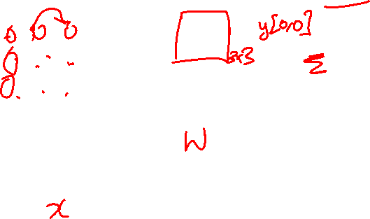
Learnable Upsampling: Transpose Convolution
Recall: Normal 3 x 3 convolution, stride 1 pad 1
Dot product between filter and input
Input: 4 x 4
Output: 4 x 4
Slide Credit: Fei-Fei Li, Justin Johnson, Serena Yeung, CS 231n

Slide 4
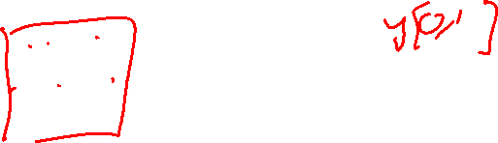
Learnable Upsampling: Transpose Convolution
Recall: Normal 3 x 3 convolution, stride 1 pad 1
Dot product between filter and input
Input: 4 x 4
Output: 4 x 4
Slide Credit: Fei-Fei Li, Justin Johnson, Serena Yeung, CS 231n

Slide 5
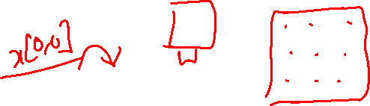
Learnable Upsampling: Transpose Convolution
3 x 3 transpose convolution, stride 2 pad 1
Input gives weight for filter
Input: 2 x 2
Output: 4 x 4
Slide Credit: Fei-Fei Li, Justin Johnson, Serena Yeung, CS 231n

Slide 6
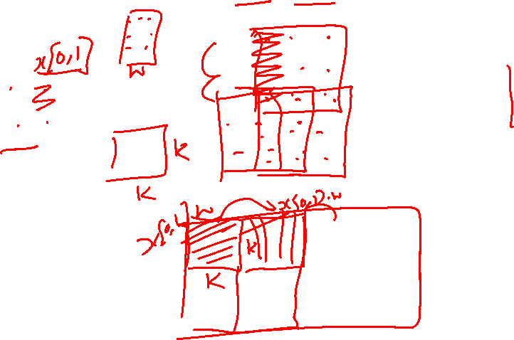
Learnable Upsampling: Transpose Convolution
3 x 3 transpose convolution, stride 2 pad 1
Sum where output overlaps
Filter moves 2 pixels in the output for every one pixel in the input
Stride gives ratio between movement in output and input
Input gives weight for filter
Input: 2 x 2
Output: 4 x 4
Slide Credit: Fei-Fei Li, Justin Johnson, Serena Yeung, CS 231n

Slide 7
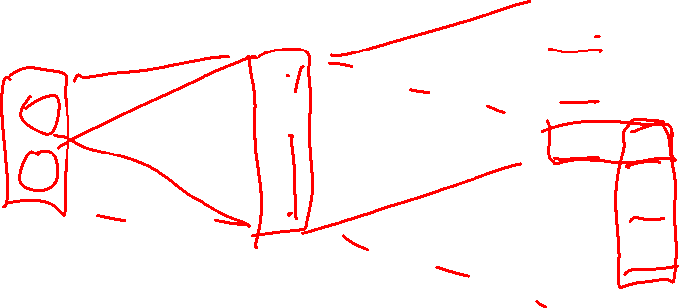
Transpose Convolution: 1D Example
Output
Input
Filter
ax
ay
az + bx
by
bz
Output contains copies of the filter weighted by the input, summing at where at overlaps in the output
Need to crop one pixel from output to make output exactly 2x input
x
y
z
a
b
Slide Credit: Fei-Fei Li, Justin Johnson, Serena Yeung, CS 231n

Slide 8
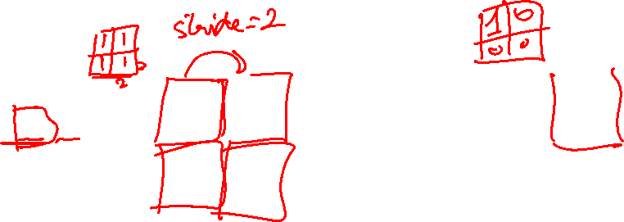
In-Network upsampling: “Unpooling”
Nearest Neighbor
“Bed of Nails”
1 | 0 | 2 | 0
0 | 0 | 0 | 0
3 | 0 | 4 | 0
0 | 0 | 0 | 0
1 | 1 | 2 | 2
1 | 1 | 2 | 2
3 | 3 | 4 | 4
3 | 3 | 4 | 4
1 | 2
3 | 4
1 | 2
3 | 4
Input: 2 x 2
Output: 4 x 4
Input: 2 x 2
Output: 4 x 4
Slide Credit: Fei-Fei Li, Justin Johnson, Serena Yeung, CS 231n

Slide 9
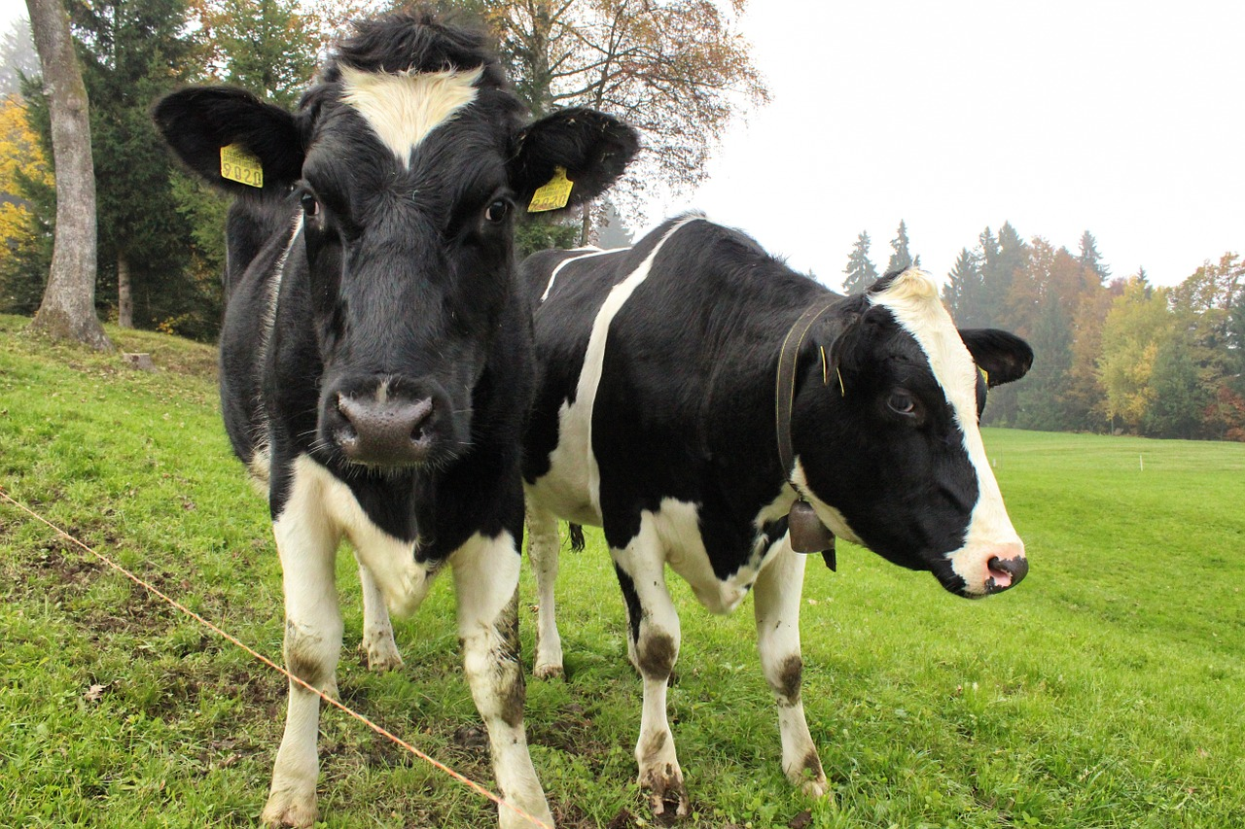
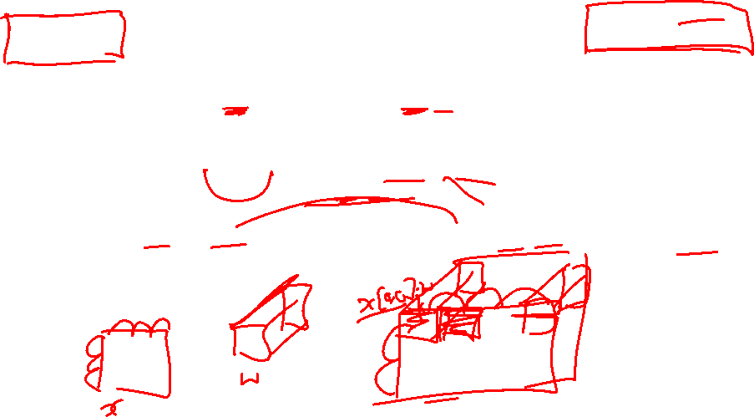
Semantic Segmentation Idea: Fully Convolutional
Downsampling:
Pooling, strided convolution
Design network as a bunch of convolutional layers, with downsampling and upsampling inside the network!
Upsampling:
Unpooling or strided transpose convolution
Med-res:
D₂ x H/4 x W/4
Med-res:
D₂ x H/4 x W/4
Low-res:
D₃ x H/4 x W/4
Input:
3 x H x W
High-res:
D₁ x H/2 x W/2
High-res:
D₁ x H/2 x W/2
Predictions:
H x W
Long, Shelhamer, and Darrell, “Fully Convolutional Networks for Semantic Segmentation”, CVPR 2015
Noh et al, “Learning Deconvolution Network for Semantic Segmentation”, ICCV 2015
Slide Credit: Fei-Fei Li, Justin Johnson, Serena Yeung, CS 231n

Slide 10
Why this operation?

Slide 11
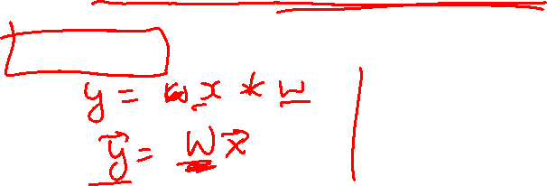
What is deconvolution?
(Non-blind) Deconvolution

Slide 12
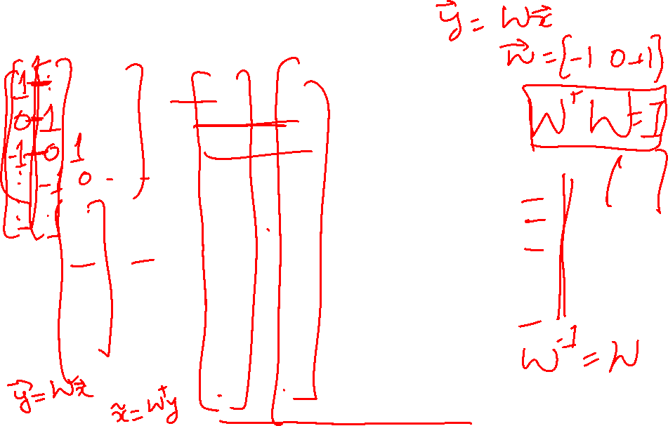
What is deconvolution?
(Non-blind) Deconvolution

Slide 13
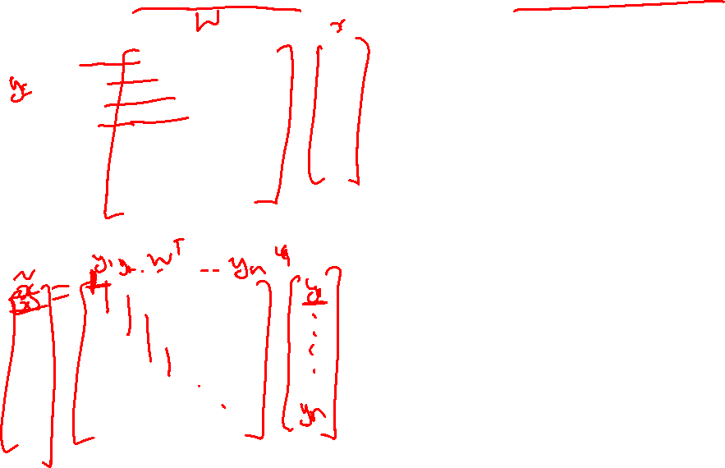
What does “deconvolution” have to do with “transposed convolution”?

Slide 14

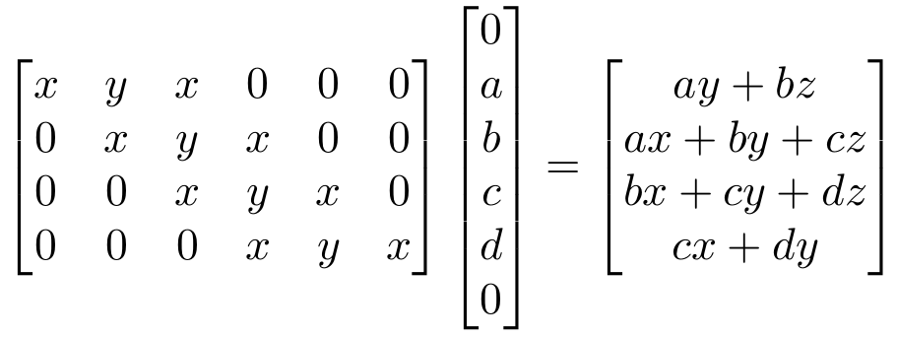

“transposed convolution” is a convolution!
We can express convolution in terms of a matrix multiplication
Example: 1D conv, kernel size=3, stride=1, padding=1
Slide Credit: Fei-Fei Li, Justin Johnson, Serena Yeung, CS 231n

Slide 15

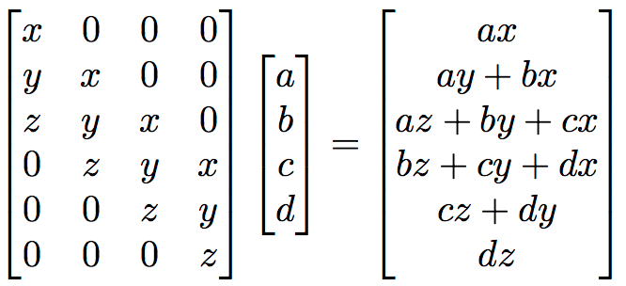
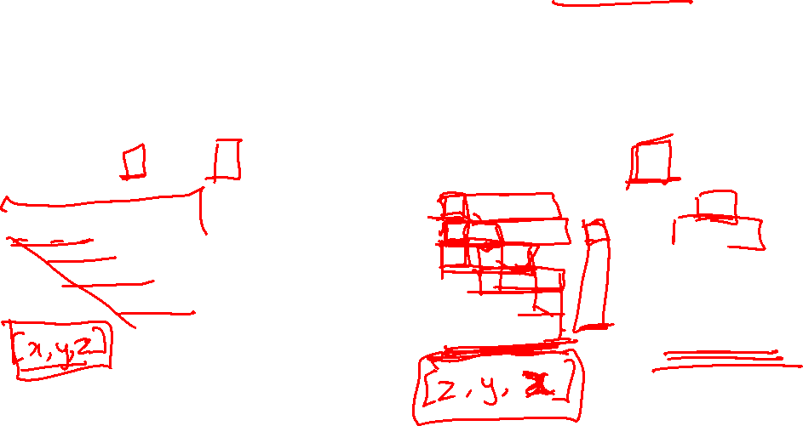
“transposed convolution” is a convolution!
We can express convolution in terms of a matrix multiplication
Convolution transpose multiplies by the transpose of the same matrix:
Example: 1D conv, kernel size=3, stride=1, padding=1
Slide Credit: Fei-Fei Li, Justin Johnson, Serena Yeung, CS 231n

Slide 16
“transposed convolution” is a convolution!
We can express convolution in terms of a matrix multiplication
Convolution transpose multiplies by the transpose of the same matrix:
Example: 1D conv, kernel size=3, stride=1, padding=1
When stride=1, convolution transpose is just a regular convolution (with different padding rules)
Slide Credit: Fei-Fei Li, Justin Johnson, Serena Yeung, CS 231n

Slide 17
Plan for Today
Visualizing CNNs
  Visualizing filters
  Last layer embeddings
  Visualizing activations
  Maximally activating patches
  Occlusion maps
  Salient or “important” pixels
    Gradient-based visualizations
  How to evaluate visualizations?
  Creating “prototypical” images for a class
  Creating adversarial images
  Deep dream
  Feature inversion

Slide 18
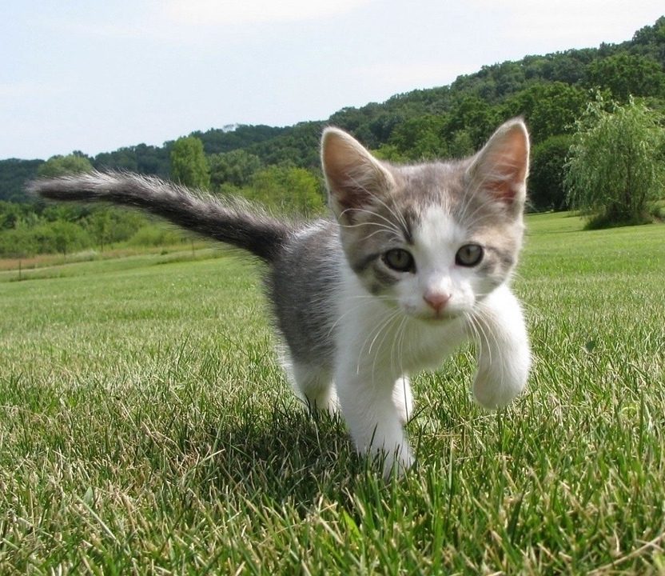
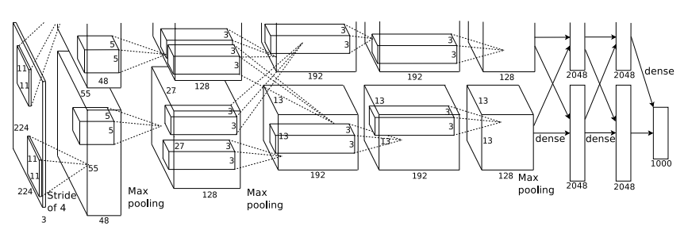
What’s going on inside ConvNets?
This image is CC0 public domain
Class Scores:
1000 numbers
Input Image:
3 x 224 x 224
What are the intermediate features looking for?
Krizhevsky et al, “ImageNet Classification with Deep Convolutional Neural Networks”, NIPS 2012.
Figure reproduced with permission.
Slide Credit: Fei-Fei Li, Justin Johnson, Serena Yeung, CS 231n

Slide 19
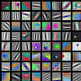



First Layer: Visualize Filters
ResNet-18:
64 x 3 x 7 x 7
ResNet-101:
64 x 3 x 7 x 7
DenseNet-121:
64 x 3 x 7 x 7
AlexNet:
64 x 3 x 11 x 11
Krizhevsky, “One weird trick for parallelizing convolutional neural networks”, arXiv 2014
He et al, “Deep Residual Learning for Image Recognition”, CVPR 2016
Huang et al, “Densely Connected Convolutional Networks”, CVPR 2017
Slide Credit: Fei-Fei Li, Justin Johnson, Serena Yeung, CS 231n

Slide 20

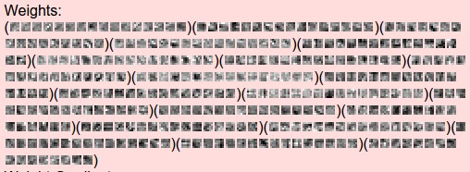
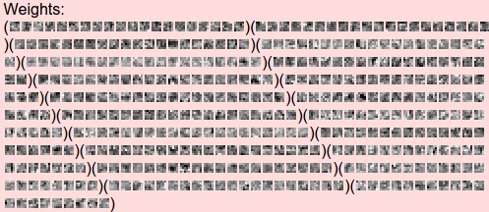
Visualize the
filters/kernels
(raw weights)
layer 1 weights
16 x 3 x 7 x 7
We can visualize filters at higher layers, but not that interesting
(these are taken from ConvNetJS CIFAR-10 demo)
layer 2 weights
20 x 16 x 7 x 7
layer 3 weights
20 x 20 x 7 x 7
Slide Credit: Fei-Fei Li, Justin Johnson, Serena Yeung, CS 231n

Slide 21
Last Layer
FC7 layer
4096-dimensional feature vector for an image
(layer immediately before the classifier)
Run the network on many images, collect the feature vectors
Slide Credit: Fei-Fei Li, Justin Johnson, Serena Yeung, CS 231n

Slide 22
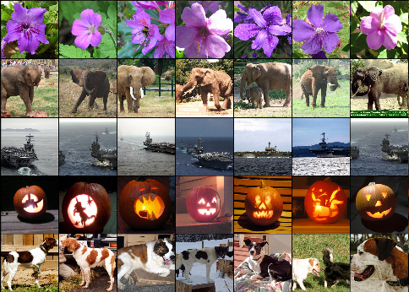
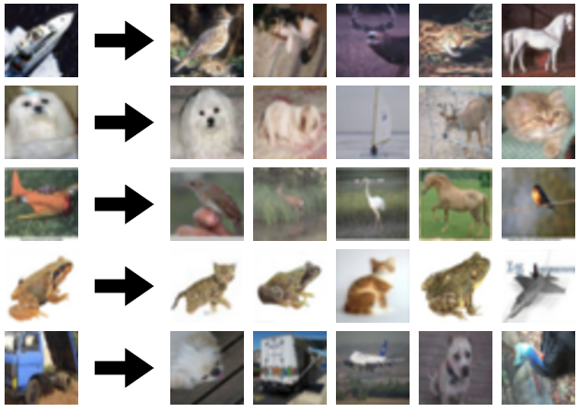
Last Layer: Nearest Neighbors
4096-dim vector
Test image
L2 Nearest neighbors in feature space
Recall: Nearest neighbors in pixel space
Krizhevsky et al, “ImageNet Classification with Deep Convolutional Neural Networks”, NIPS 2012.
Figures reproduced with permission.
Slide Credit: Fei-Fei Li, Justin Johnson, Serena Yeung, CS 231n

Slide 23
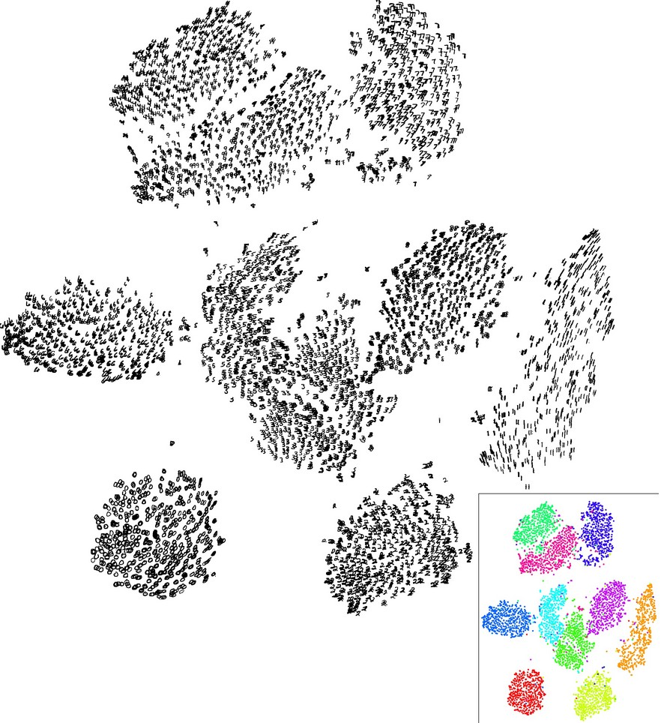
Last Layer: Dimensionality Reduction
Visualize the “space” of FC7 feature vectors by reducing dimensionality of vectors from 4096 to 2 dimensions
Simple algorithm: Principal Component Analysis (PCA)
More complex: t-SNE
Van der Maaten and Hinton, “Visualizing Data using t-SNE”, JMLR 2008
Figure copyright Laurens van der Maaten and Geoff Hinton, 2008. Reproduced with permission.
Slide Credit: Fei-Fei Li, Justin Johnson, Serena Yeung, CS 231n

Slide 24
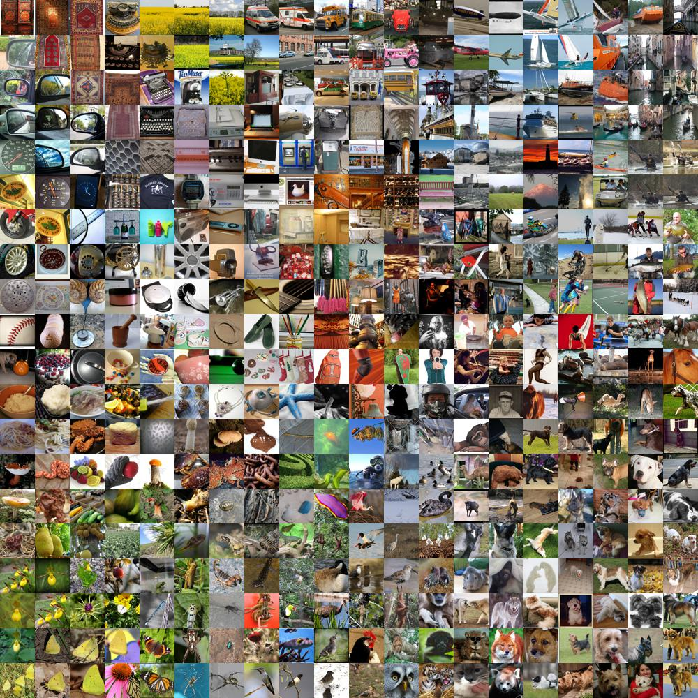
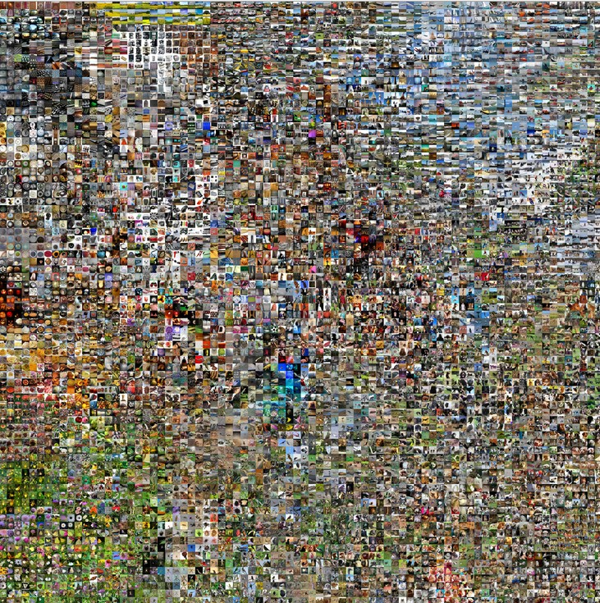
Last Layer: Dimensionality Reduction
Van der Maaten and Hinton, “Visualizing Data using t-SNE”, JMLR 2008
Krizhevsky et al, “ImageNet Classification with Deep Convolutional Neural Networks”, NIPS 2012.
Figure reproduced with permission.
See high-resolution versions at
http://cs.stanford.edu/people/karpathy/cnnembed/
Slide Credit: Fei-Fei Li, Justin Johnson, Serena Yeung, CS 231n

Slide 25
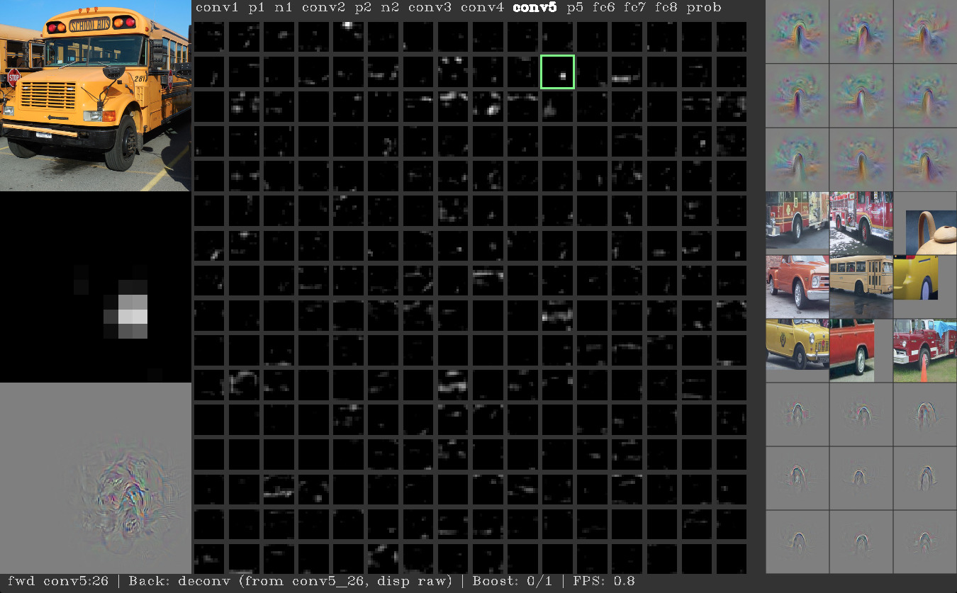
Visualizing Activations
Yosinski et al, “Understanding Neural Networks Through Deep Visualization”, ICML DL Workshop 2014.
Figure copyright Jason Yosinski, 2014. Reproduced with permission.

Slide 26
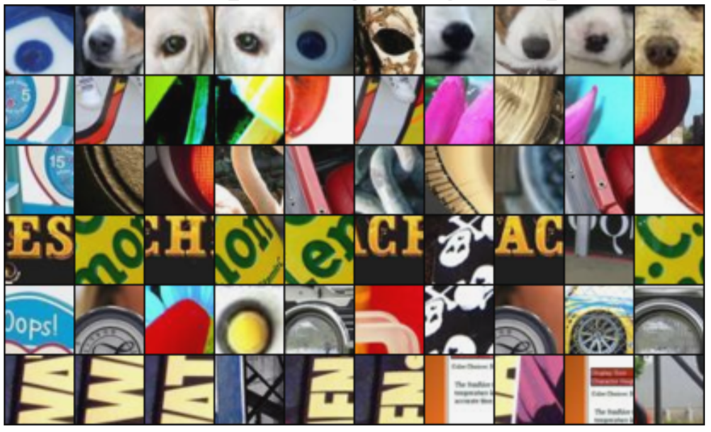
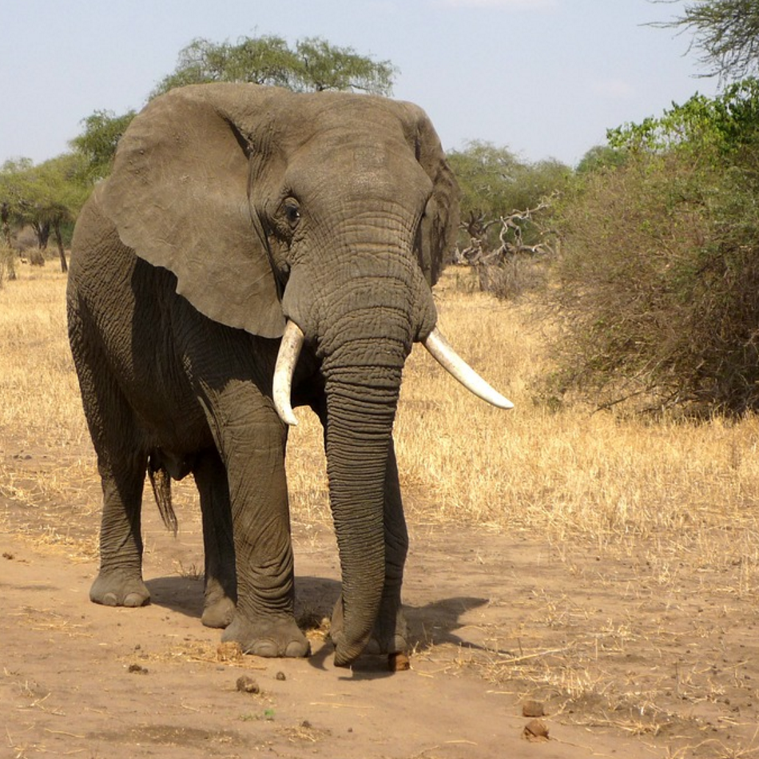
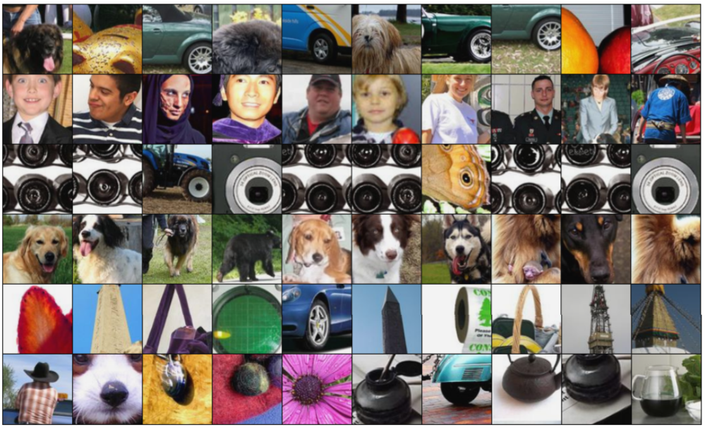
Maximally Activating Patches
Pick a layer and a channel; e.g. conv5 is 128 x 13 x 13, pick channel 17/128
Run many images through the network, record values of chosen channel
Visualize image patches that correspond to maximal activations
Springenberg et al, “Striving for Simplicity: The All Convolutional Net”, ICLR Workshop 2015
Figure copyright Jost Tobias Springenberg, Alexey Dosovitskiy, Thomas Brox, Martin Riedmiller, 2015; reproduced with permission.
Slide Credit: Fei-Fei Li, Justin Johnson, Serena Yeung, CS 231n

Slide 27
Plan for Today
Visualizing CNNs
  Visualizing filters
  Last layer embeddings
  Visualizing activations
  Maximally activating patches
  Occlusion maps
  Salient or “important” pixels
    Gradient-based visualizations
  How to evaluate visualizations?
  Creating “prototypical” images for a class
  Creating adversarial images
  Deep dream
  Feature inversion

Slide 28
Visual Explanations
Where does an intelligent system
“look” to make its predictions?

Slide 29
Which pixels matter: Occlusion Maps
Mask part of the image before feeding to CNN, check how much predicted probabilities change
P(elephant) = 0.95
P(elephant) = 0.75
Zeiler and Fergus, “Visualizing and Understanding Convolutional Networks”, ECCV 2014
Boat image is CC0 public domain
Elephant image is CC0 public domain
Go-Karts image is CC0 public domain
Slide Credit: Fei-Fei Li, Justin Johnson, Serena Yeung, CS 231n

Slide 30
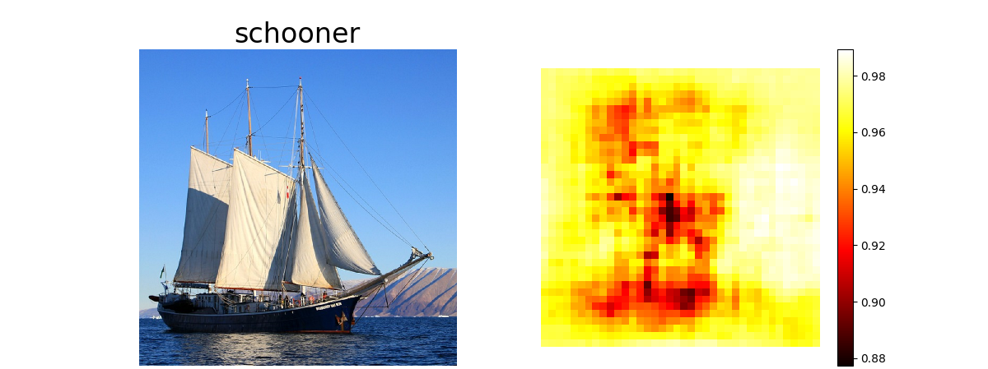
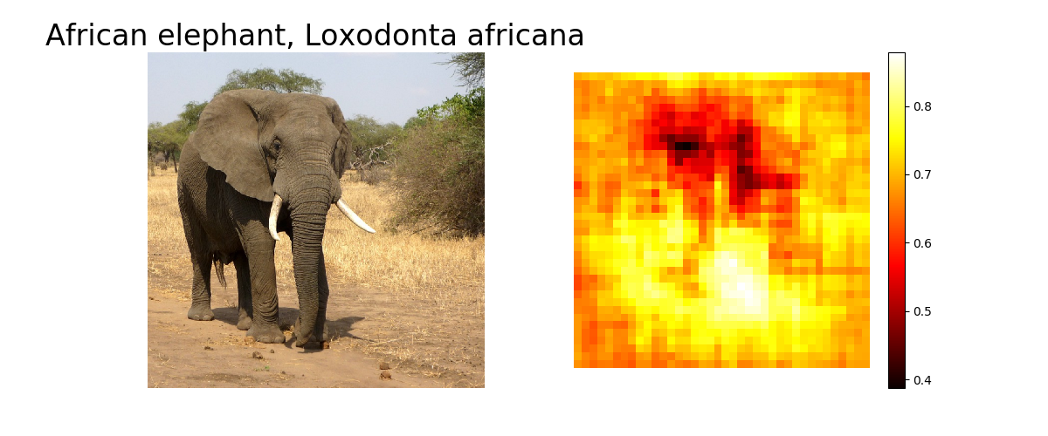
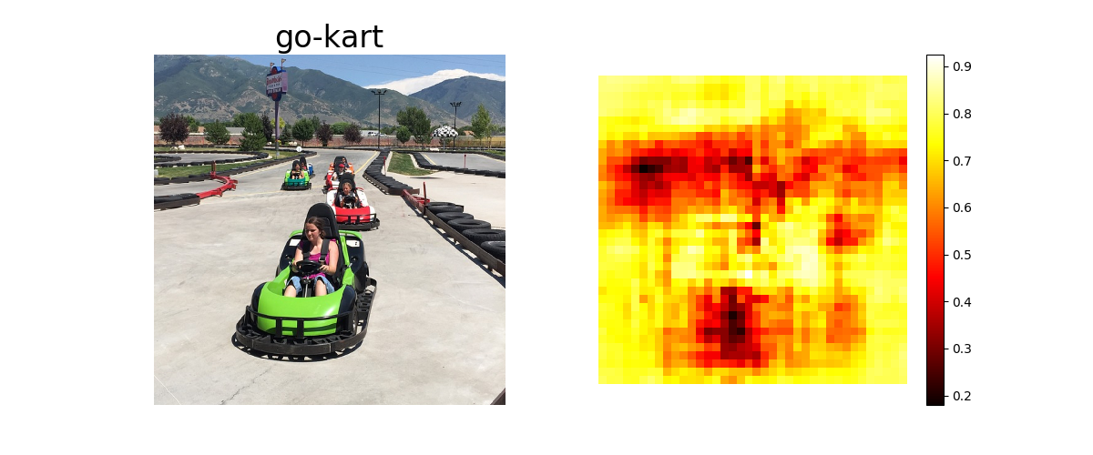
Which pixels matter: Occlusion Maps
Mask part of the image before feeding to CNN, check how much predicted probabilities change
Zeiler and Fergus, “Visualizing and Understanding Convolutional Networks”, ECCV 2014
Boat image is CC0 public domain
Elephant image is CC0 public domain
Go-Karts image is CC0 public domain
Slide Credit: Fei-Fei Li, Justin Johnson, Serena Yeung, CS 231n

Slide 31
What if our model was linear?

Slide 32
What if our model was linear?
100
0.1
-0.1
510
-200
1
0.9
-0.2
0.5
-0.9

Slide 33
But it’s not ☹

Slide 34
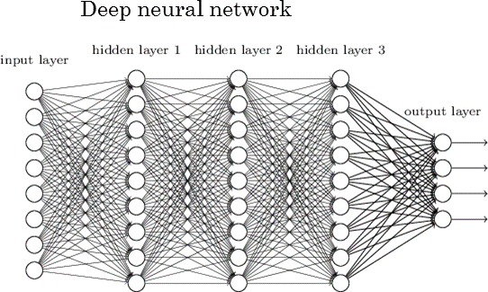
Can we make it linear?

Slide 35
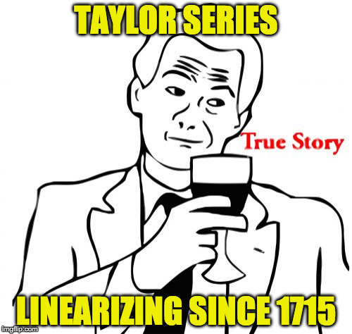
Taylor Series

Slide 36
Feature Importance in Deep Models
Backprop!

Slide 37
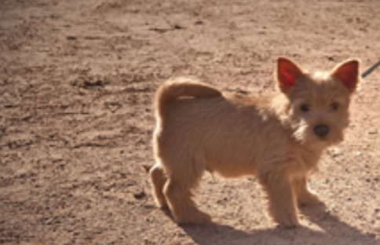
Which pixels matter: Saliency via Backprop
Forward pass: Compute probabilities
Dog
Simonyan, Vedaldi, and Zisserman, “Deep Inside Convolutional Networks: Visualising Image Classification Models and Saliency Maps”, ICLR Workshop 2014.
Figures copyright Karen Simonyan, Andrea Vedaldi, and Andrew Zisserman, 2014; reproduced with permission.
Slide Credit: Fei-Fei Li, Justin Johnson, Serena Yeung, CS 231n

Slide 38
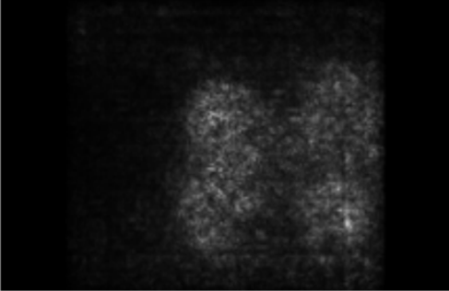
Which pixels matter: Saliency via Backprop
Forward pass: Compute probabilities
Dog
Compute gradient of (unnormalized) class score with respect to image pixels, take absolute value and max over RGB channels
Simonyan, Vedaldi, and Zisserman, “Deep Inside Convolutional Networks: Visualising Image Classification Models and Saliency Maps”, ICLR Workshop 2014.
Figures copyright Karen Simonyan, Andrea Vedaldi, and Andrew Zisserman, 2014; reproduced with permission.
Slide Credit: Fei-Fei Li, Justin Johnson, Serena Yeung, CS 231n

Slide 39
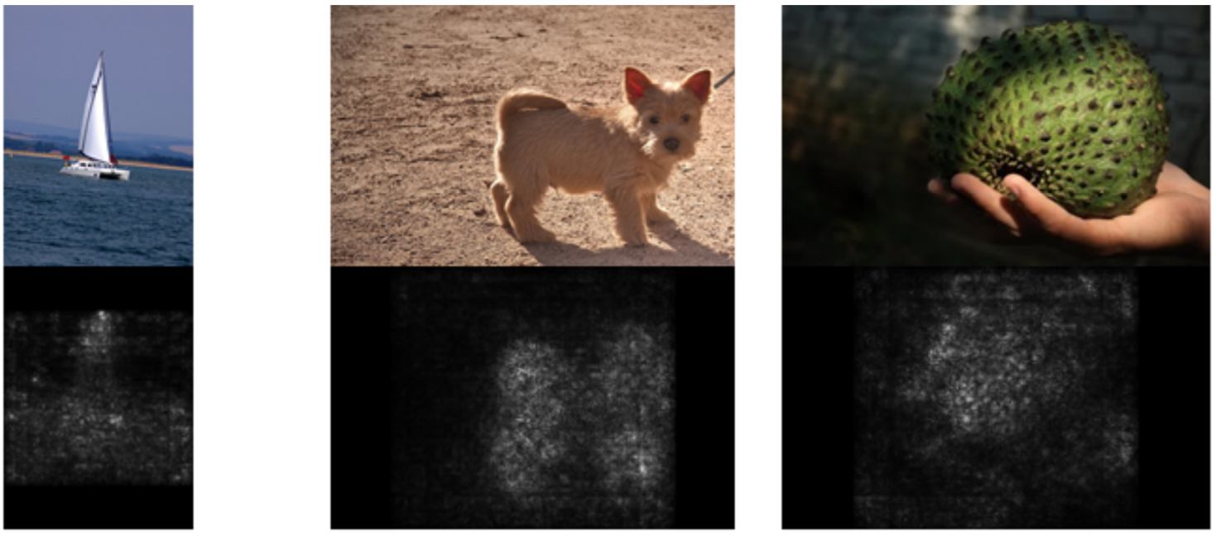
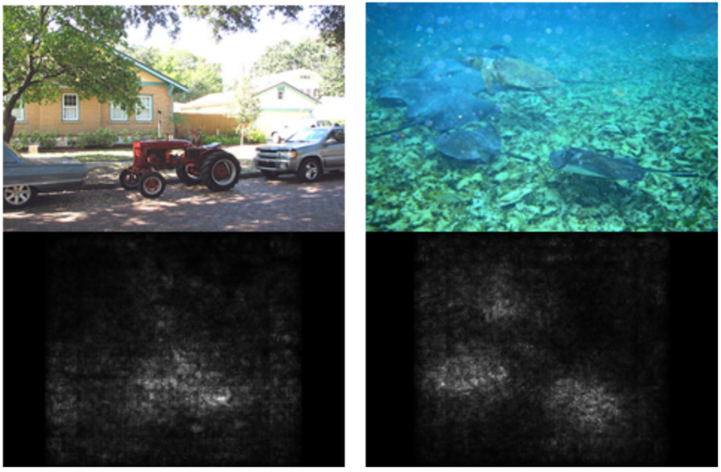
Saliency Maps
Simonyan, Vedaldi, and Zisserman, “Deep Inside Convolutional Networks: Visualising Image Classification Models and Saliency Maps”, ICLR Workshop 2014.
Figures copyright Karen Simonyan, Andrea Vedaldi, and Andrew Zisserman, 2014; reproduced with permission.
Slide Credit: Fei-Fei Li, Justin Johnson, Serena Yeung, CS 231n

Slide 40
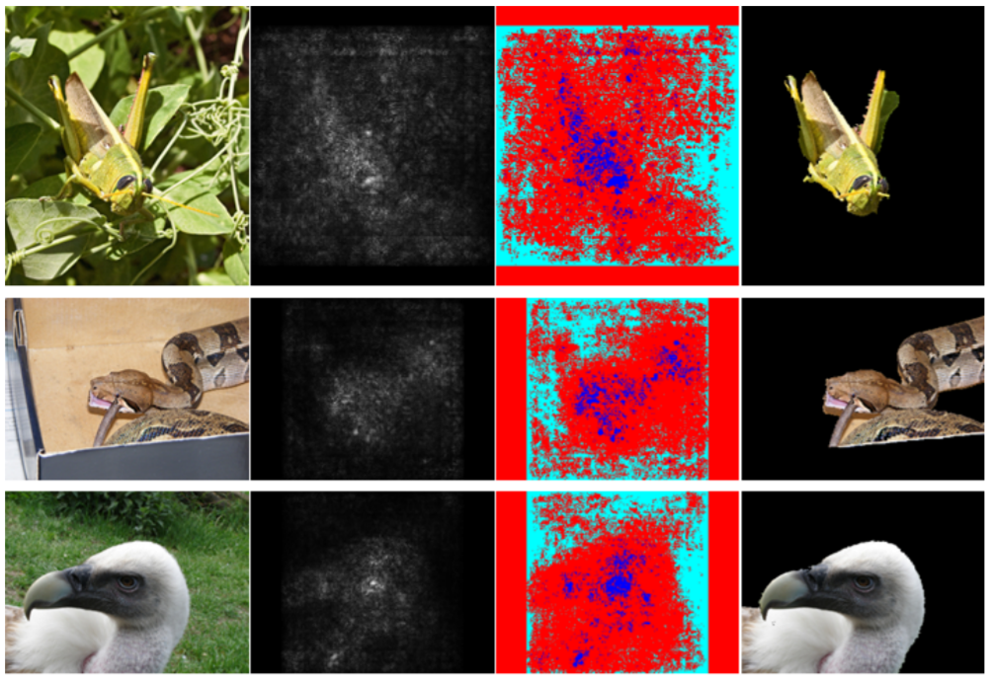
Saliency Maps: Segmentation without supervision
Use GrabCut on saliency map
Simonyan, Vedaldi, and Zisserman, “Deep Inside Convolutional Networks: Visualising Image Classification Models and Saliency Maps”, ICLR Workshop 2014.
Figures copyright Karen Simonyan, Andrea Vedaldi, and Andrew Zisserman, 2014; reproduced with permission.
Rother et al, “Grabcut: Interactive foreground extraction using iterated graph cuts”, ACM TOG 2004
Slide Credit: Fei-Fei Li, Justin Johnson, Serena Yeung, CS 231n

Slide 41
Gradient-based Visualizations
Identical for all layers except ReLU
Raw Gradients
  [Simoyan et al. ICLRw ‘14]
‘Deconvolution’
  [Zeiler & Fergus, ECCV ‘14]
Guided Backprop
  [Springenber et al. ICLR ‘15]

Slide 42
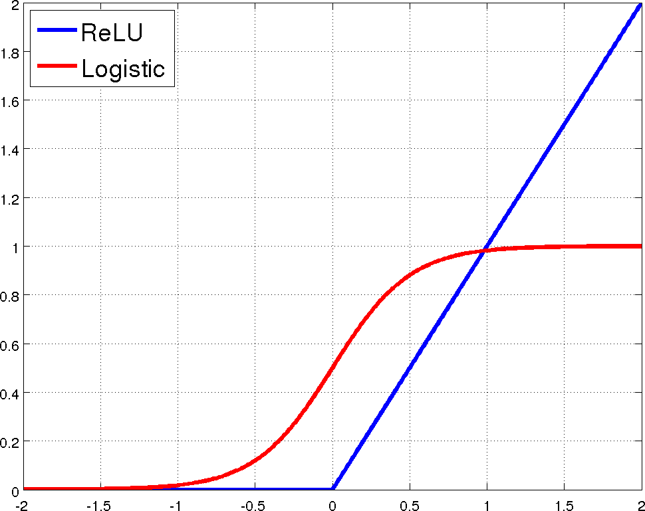
Remember ReLUs?

Slide 43
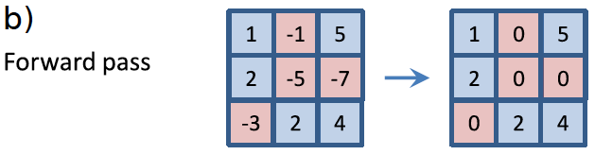
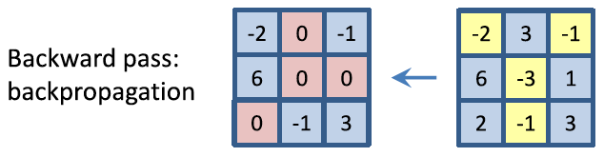
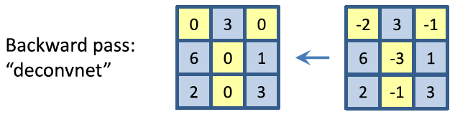
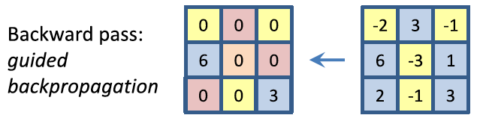

Slide 44
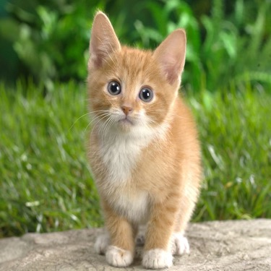
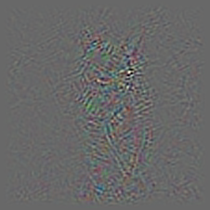
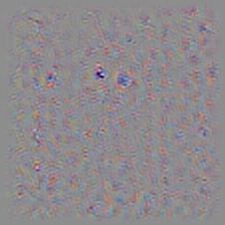
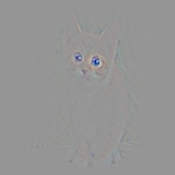
Backprop vs Deconv vs Guided BP
Guided Backprop tends to be “cleanest”
Backprop
Deconv
Guided Backprop

Slide 45
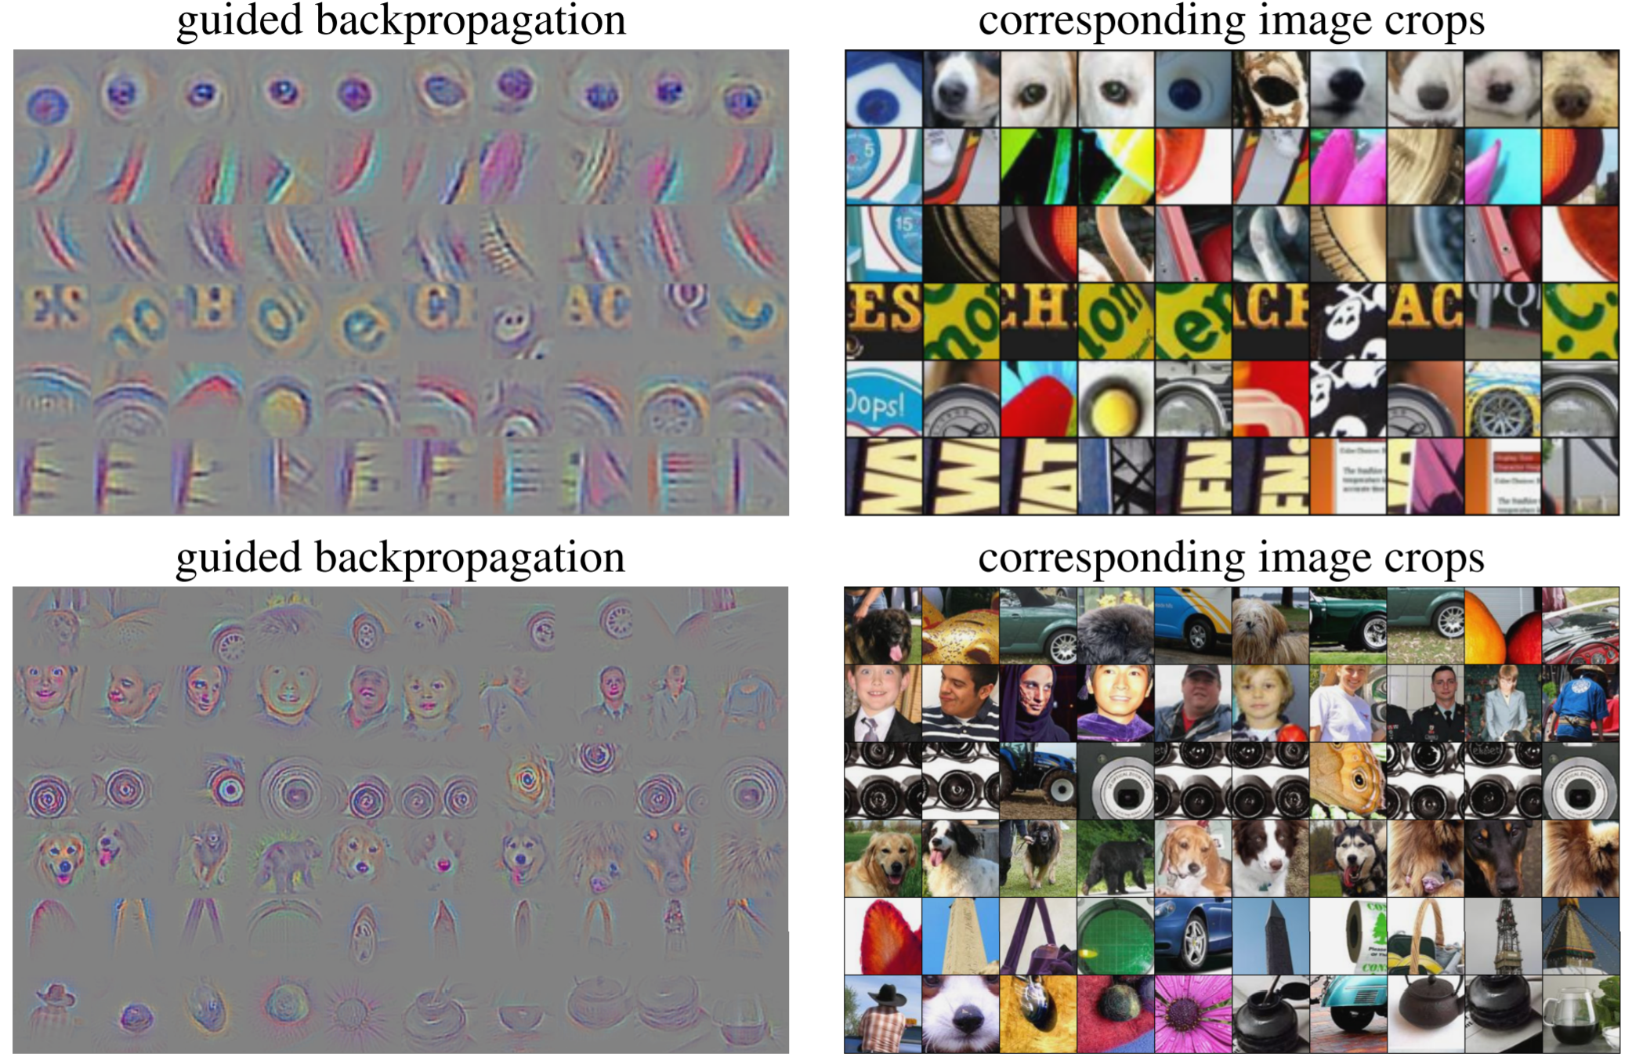
Intermediate features via (guided) backprop
Maximally activating patches
(Each row is a different neuron)
Guided Backprop
Zeiler and Fergus, “Visualizing and Understanding Convolutional Networks”, ECCV 2014
Springenberg et al, “Striving for Simplicity: The All Convolutional Net”, ICLR Workshop 2015
Figure copyright Jost Tobias Springenberg, Alexey Dosovitskiy, Thomas Brox, Martin Riedmiller, 2015; reproduced with permission.
Slide Credit: Fei-Fei Li, Justin Johnson, Serena Yeung, CS 231n

Slide 46
Intermediate features via (guided) backprop
Maximally activating patches
(Each row is a different neuron)
Guided Backprop
Zeiler and Fergus, “Visualizing and Understanding Convolutional Networks”, ECCV 2014
Springenberg et al, “Striving for Simplicity: The All Convolutional Net”, ICLR Workshop 2015
Figure copyright Jost Tobias Springenberg, Alexey Dosovitskiy, Thomas Brox, Martin Riedmiller, 2015; reproduced with permission.
Slide Credit: Fei-Fei Li, Justin Johnson, Serena Yeung, CS 231n

Slide 47
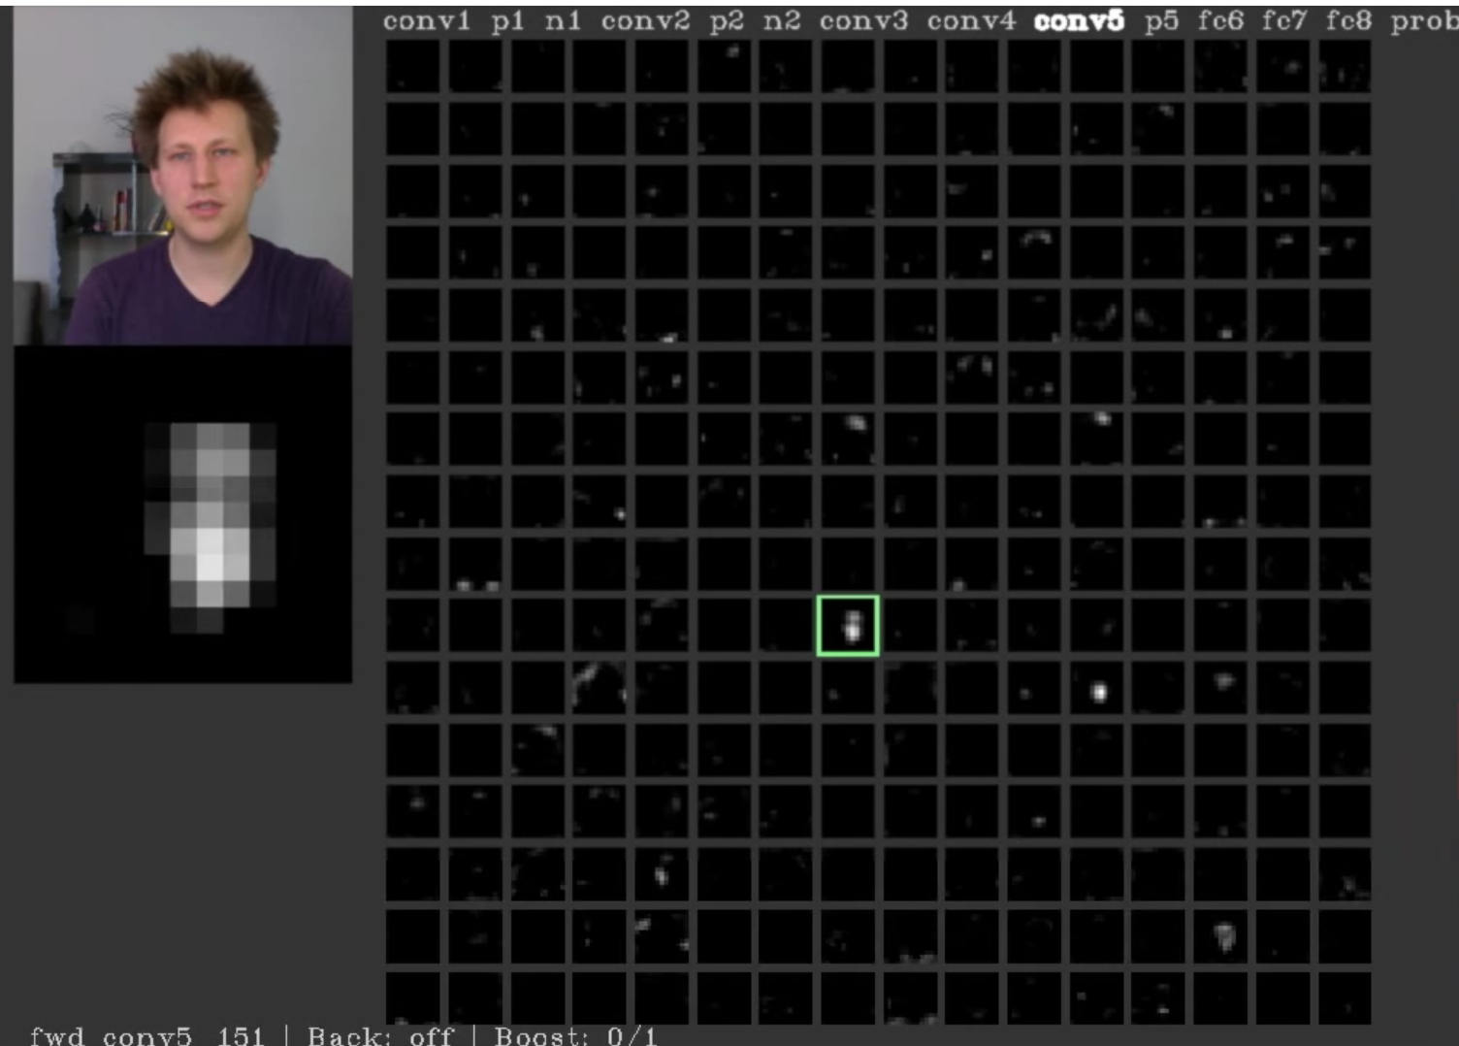
Visualizing Activations
conv5 feature map is 128x13x13; visualize as 128 13x13 grayscale images
https://youtu.be/AgkfIQ4IGaM?t=92
Yosinski et al, “Understanding Neural Networks Through Deep Visualization”, ICML DL Workshop 2014.
Figure copyright Jason Yosinski, 2014. Reproduced with permission.
Slide Credit: Fei-Fei Li, Justin Johnson, Serena Yeung, CS 231n

Slide 48
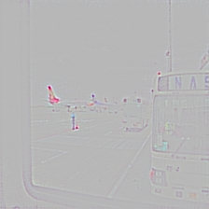


Problem with Guided Backup
Not very “class-discriminative”
GB for “airliner”
GB for “bus”
Slide Credit: Ram Selvaraju

Slide 49










Grad-CAM
Visual Explanations from Deep Networks via Gradient-based Localization
[ICCV ‘17]
  Ramprasaath Selvaraju Michael Cogswell Abhishek Das Ramakrishna Vedantam
  Devi Parikh Dhruv Batra

Slide 50







Grad-CAM
Rectified Conv
Feature Maps
+
Backprop till conv
Grad-CAM
Slide Credit: Ram Selvaraju
Notes:
Given an image like this, we feed it through the convolutional layers of a CNN, the outputs of which can be used for any task. For illustration we can consider an image classification task which uses a couple of Fully connected layers followed by the final softmax over several classes. Let’s say the network predicted Tiger Cat, and we would like to visualize where in the image the model was looking at.
To do this we first determine the neurons that are most important for predicting Tiger Cat which can be obtained by the gradients flowing to the last convolutional layer. Performing a global pooling of these gradients gives an importance weight for each of the convolutional layer neuron.
For providing an explanation for that particular input image, we take into account the forward activations and do a weighted sum with the importance weights and clamp the negative values to obtain Grad-CAM.
This can be done for any differentiable network that follows a CNN. For example, you can follow it with an RNN that can be used for Image captioning, or have an additional input channel, and perform any kind of complex interactions like in the case of Visual Question Answering.
Combining Grad-CAM with existing visualizations which are high resolution but not class-discriminative, we obtain Guided Grad-CAM, which just highlights the most important pixels that are responsible for the decision tiger cat.

Slide 51

Guided Grad-CAM
Guided Backpropagation
Rectified Conv
Feature Maps
Guided Grad-CAM
+
Backprop till conv
Grad-CAM
Slide Credit: Ram Selvaraju
Notes:
Given an image like this, we feed it through the convolutional layers of a CNN, the outputs of which can be used for any task. For illustration we can consider an image classification task which uses a couple of Fully connected layers followed by the final softmax over several classes. Let’s say the network predicted Tiger Cat, and we would like to visualize where in the image the model was looking at.
To do this we first determine the neurons that are most important for predicting Tiger Cat which can be obtained by the gradients flowing to the last convolutional layer. Performing a global pooling of these gradients gives an importance weight for each of the convolutional layer neuron.
For providing an explanation for that particular input image, we take into account the forward activations and do a weighted sum with the importance weights and clamp the negative values to obtain Grad-CAM.
This can be done for any differentiable network that follows a CNN. For example, you can follow it with an RNN that can be used for Image captioning, or have an additional input channel, and perform any kind of complex interactions like in the case of Visual Question Answering.
Combining Grad-CAM with existing visualizations which are high resolution but not class-discriminative, we obtain Guided Grad-CAM, which just highlights the most important pixels that are responsible for the decision tiger cat.

Slide 52
Analyzing Failure Modes with Grad-CAM
Reasonable predictions are made in many failure cases.
Predicted: Car mirror
Predicted: Vine snake
Ground-truth: Volcano
Ground-truth: coil
Slide Credit: Ram Selvaraju
Notes:
Given this image of the volcano, the model incorrectly predicted Car mirror. The Guided Grad-CAM explanation for this decision looks like a close-up of a car-mirror, which is very intuitive. The Grad-CAM can also localize the Ground truth category. Here is another example where the model predicted Vine Snake, and the visualization also looks like a vine snake. Again, Grad-CAM can localize the Ground-Truth category, coil.
This shows that reasonable predictions are made in many failure cases.

Slide 53







Slide 54

Grad-CAM Visual Explanations for Captioning
Slide Credit: Ram Selvaraju

Slide 55

Grad-CAM Visual Explanations for Captioning
Slide Credit: Ram Selvaraju

Slide 56


Grad-CAM Visual Explanations for VQA
What animal is in this picture? Dog
Slide Credit: Abhishek Das

Slide 57

Grad-CAM Visual Explanations for VQA
What animal is in this picture? Cat
Slide Credit: Abhishek Das

Slide 58


Grad-CAM Visual Explanations for VQA
What color is the hydrant? Yellow
Slide Credit: Abhishek Das

Slide 59

Grad-CAM Visual Explanations for VQA
What color is the hydrant? Green
Even simple non-attention based CNN+LSTM models attend to appropriate regions
Slide Credit: Abhishek Das

Slide 60


Slide 61
Plan for Today
Visualizing CNNs
  Visualizing filters
  Last layer embeddings
  Visualizing activations
  Maximally activating patches
  Occlusion maps
  Salient or “important” pixels
    Gradient-based visualizations
  How to evaluate visualization?
  Creating “prototypical” images for a class
  Creating adversarial images
  Deep dream
  Feature inversion

Slide 62
How we evaluate explanations?
Class-discriminative?
  Show what they say they found?
Building Trust with a User?
  Help users?
Human-like?
  Do machines look where humans look?

Slide 63

Is Grad-CAM more class discriminative?
Can people tell which class is being visualized?
    Images from Pascal VOC’07 with exactly 2 categories.
Intuition: A good explanation produces discriminative visualizations for the class of interest.
Slide Credit: Ram Selvaraju

Slide 64

Is Grad-CAM more class discriminative?
Human accuracy for 2-class classification
+17%
Grad-CAM makes existing visualizations class discriminative.
Slide Credit: Ram Selvaraju

Slide 65
Help establish trust with a user?
Given explanations from 2 models,
  VGG16 and AlexNet
which one is more trustworthy?
Pick images where both models = correct prediction
Show these to AMT workers and evaluate
Slide Credit: Ram Selvaraju

Slide 66




Help establish trust in a user?
Users place higher trust in a model that generalizes better.
Slide Credit: Ram Selvaraju

Slide 67
Where do humans choose to look to answer visual questions?

Slide 68


VQA-HAT (Human ATtention)

Slide 69

VQA-HAT (Human ATtention)
What food is on the table? Cake
Slide Credit: Abhishek Das

Slide 70

VQA-HAT (Human ATtention)
What animal is she riding? Horse
Slide Credit: Abhishek Das

Slide 71

VQA-HAT (Human ATtention)
What number of cats are laying on the bed? 2
Slide Credit: Abhishek Das

Slide 72



Are Grad-CAM explanations human-like?
Correlation with human attention maps
[Das & Agarwal et al. EMNLP’16]
What are they doing?
Grad-CAM for ‘eating’
Human ATtention map (HAT) for ‘eating’
Current models look at regions more similar to humans than baselines
HAT
Guided Backpropagation
0.122
Guided Grad-CAM
0.136
Slide Credit: Ram Selvaraju
Notes:
Das and Agrawal et al collected attention maps which indicate where the humans would have to look in-order to answer the question. Here are some quantitative and qualitative results showing how Grad-CAM maps from a simple non-attention based VQA model compares to human attention maps.
We see that current models look at regions more similar to humans than baselines.
(Compared to other approaches, Grad-CAM explanations indicate that current models somewhat look at the same regions as humans)

Slide 73
Plan for Today
Visualizing CNNs
  Visualizing filters
  Last layer embeddings
  Visualizing activations
  Maximally activating patches
  Occlusion maps
  Salient or “important” pixels
    Gradient-based visualizations
  How to evaluate visualizations?
  Creating “prototypical” images for a class
  Creating adversarial images
  Deep dream
  Feature inversion

Slide 74
Visualizing CNN features: Gradient Ascent on Pixels
(Guided) backprop:
Find the part of an image that a neuron responds to
Gradient ascent on pixels:
Generate a synthetic image that maximally activates a neuron
I* = arg max_{I} f(I) + R(I)
Neuron value
Natural image regularizer
Slide Credit: Fei-Fei Li, Justin Johnson, Serena Yeung, CS 231n

Slide 75

Visualizing CNN features: Gradient Ascent on Pixels
Initialize image to zeros
score for class c (before Softmax)
zero image
Repeat:
2. Forward image to compute current scores
3. Backprop to get gradient of neuron value with respect to image pixels
4. Make a small update to the image
Slide Credit: Fei-Fei Li, Justin Johnson, Serena Yeung, CS 231n

Slide 76
Visualizing CNN features: Gradient Ascent on Pixels
Simple regularizer: Penalize L2 norm of generated image
Simonyan, Vedaldi, and Zisserman, “Deep Inside Convolutional Networks: Visualising Image Classification Models and Saliency Maps”, ICLR Workshop 2014.
Figures copyright Karen Simonyan, Andrea Vedaldi, and Andrew Zisserman, 2014; reproduced with permission.
Slide Credit: Fei-Fei Li, Justin Johnson, Serena Yeung, CS 231n

Slide 77

Visualizing CNN features: Gradient Ascent on Pixels
Simple regularizer: Penalize L2 norm of generated image
Simonyan, Vedaldi, and Zisserman, “Deep Inside Convolutional Networks: Visualising Image Classification Models and Saliency Maps”, ICLR Workshop 2014.
Figures copyright Karen Simonyan, Andrea Vedaldi, and Andrew Zisserman, 2014; reproduced with permission.
Slide Credit: Fei-Fei Li, Justin Johnson, Serena Yeung, CS 231n

Slide 78

Visualizing CNN features: Gradient Ascent on Pixels
Simple regularizer: Penalize L2 norm of generated image
Yosinski et al, “Understanding Neural Networks Through Deep Visualization”, ICML DL Workshop 2014.
Figure copyright Jason Yosinski, Jeff Clune, Anh Nguyen, Thomas Fuchs, and Hod Lipson, 2014. Reproduced with permission.
Slide Credit: Fei-Fei Li, Justin Johnson, Serena Yeung, CS 231n

Slide 79
Fooling Images / Adversarial Examples
Start from an arbitrary image
Pick an arbitrary class
Modify the image to maximize the class
Repeat until network is fooled
Slide Credit: Fei-Fei Li, Justin Johnson, Serena Yeung, CS 231n

Slide 80


Fooling Images / Adversarial Examples
Boat image is CC0 public domain
Elephant image is CC0 public domain
Slide Credit: Fei-Fei Li, Justin Johnson, Serena Yeung, CS 231n

Slide 81
Plan for Today
Visualizing CNNs
  Visualizing filters
  Last layer embeddings
  Visualizing activations
  Maximally activating patches
  Occlusion maps
  Salient or “important” pixels
    Gradient-based visualizations
  How to evaluate visualizations?
  Creating “prototypical” images for a class
  Creating adversarial images
  Deep dream
  Feature inversion

Slide 82

DeepDream: Amplify existing features
Rather than synthesizing an image to maximize a specific neuron, instead try to amplify the neuron activations at some layer in the network
Choose an image and a layer in a CNN; repeat:
Forward: compute activations at chosen layer
Set gradient of chosen layer equal to its activation
Backward: Compute gradient on image
Update image
Mordvintsev, Olah, and Tyka, “Inceptionism: Going Deeper into Neural Networks”, Google Research Blog. Images are licensed under CC-BY 4.0
Slide Credit: Fei-Fei Li, Justin Johnson, Serena Yeung, CS 231n

Slide 83
DeepDream: Amplify existing features
Rather than synthesizing an image to maximize a specific neuron, instead try to amplify the neuron activations at some layer in the network
Choose an image and a layer in a CNN; repeat:
Forward: compute activations at chosen layer
Set gradient of chosen layer equal to its activation
Backward: Compute gradient on image
Update image
Equivalent to:
I* = arg max_{I} ∑_{i} f_{i}(I)²
Mordvintsev, Olah, and Tyka, “Inceptionism: Going Deeper into Neural Networks”, Google Research Blog. Images are licensed under CC-BY 4.0
Slide Credit: Fei-Fei Li, Justin Johnson, Serena Yeung, CS 231n

Slide 84

Sky image is licensed under CC-BY SA 3.0
Slide Credit: Fei-Fei Li, Justin Johnson, Serena Yeung, CS 231n

Slide 85

Image is licensed under CC-BY 4.0
Slide Credit: Fei-Fei Li, Justin Johnson, Serena Yeung, CS 231n

Slide 86

Image is licensed under CC-BY 4.0
Slide Credit: Fei-Fei Li, Justin Johnson, Serena Yeung, CS 231n

Slide 87



Feature Inversion
Given a CNN feature vector for an image, find a new image that:
Matches the given feature vector
“looks natural” (image prior regularization)
Given feature vector
Features of new image
Total Variation regularizer (encourages spatial smoothness)
Mahendran and Vedaldi, “Understanding Deep Image Representations by Inverting Them”, CVPR 2015
Slide Credit: Fei-Fei Li, Justin Johnson, Serena Yeung, CS 231n

Slide 88

Feature Inversion
Reconstructing from different layers of VGG-16
Mahendran and Vedaldi, “Understanding Deep Image Representations by Inverting Them”, CVPR 2015
Figure from Johnson, Alahi, and Fei-Fei, “Perceptual Losses for Real-Time Style Transfer and Super-Resolution”, ECCV 2016. Copyright Springer, 2016. Reproduced for educational purposes.
Slide Credit: Fei-Fei Li, Justin Johnson, Serena Yeung, CS 231n

