Slide 1
CS 4803 / 7643: Deep Learning
Topics:
  Variational Auto-Encoders (VAEs)
  Key Ideas
    AEs, Variational Inference, ELBO, Reparameterization
Dhruv Batra
Georgia Tech

Slide 2
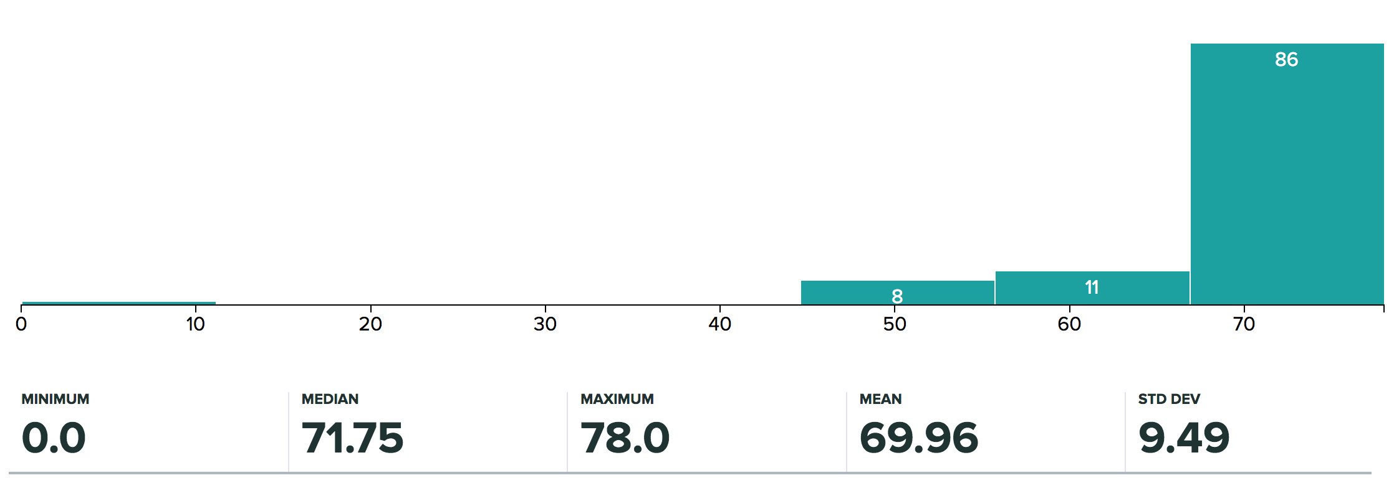
Administrativia
HW2 Grades Released
  Max regular points: 54 (4803), 78 (7643)
  Regrade requests close: 11/20, 11:55pm

Slide 3
Recap from last time

Slide 4
Overview
Unsupervised Learning
Generative Models
  PixelRNN and PixelCNN
  Variational Autoencoders (VAE)
  Generative Adversarial Networks (GAN)
Slide Credit: Fei-Fei Li, Justin Johnson, Serena Yeung, CS 231n
Notes:
Unsupervised learning problem
Generative models, type of unsupervised learning
3 types of generative models
PixelRNN and PixelCNN, type of fully visible belief networks

Slide 5
Variational Autoencoders (VAE)

Slide 6
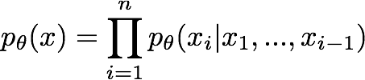

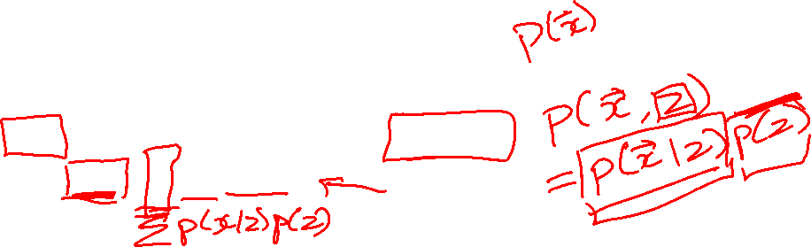
So far...
PixelCNNs define tractable density function, optimize likelihood of training data:
VAEs define intractable density function with latent z:
Cannot optimize directly, derive and optimize lower bound on likelihood instead
Slide Credit: Fei-Fei Li, Justin Johnson, Serena Yeung, CS 231n

Slide 7
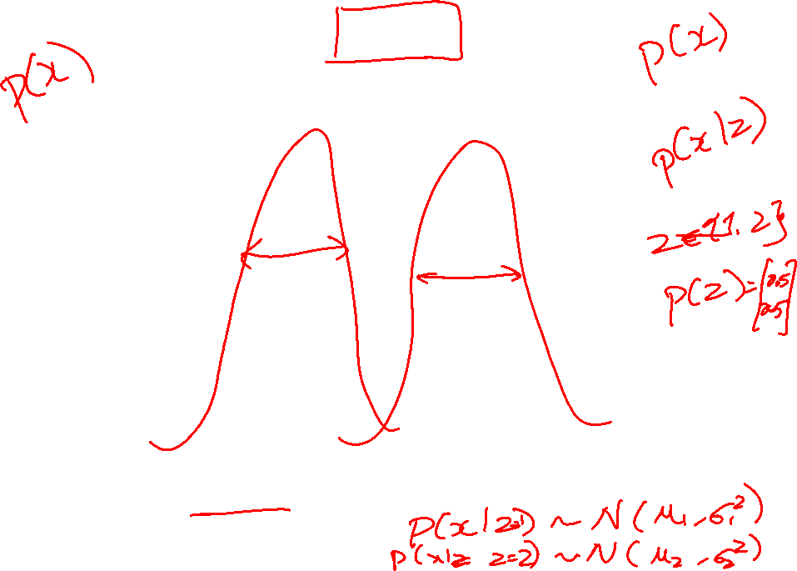
GMM
Figure Credit: Kevin Murphy

Slide 8
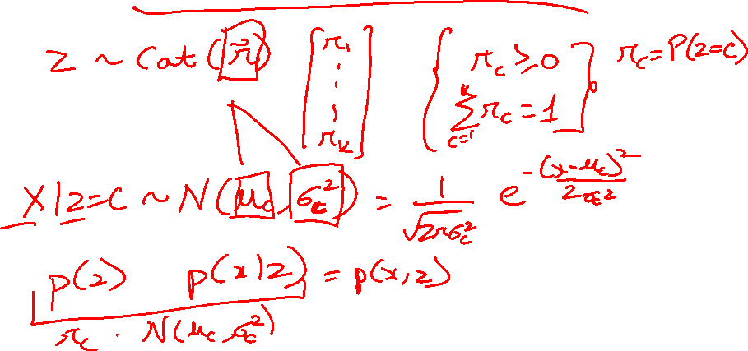
Gaussian Mixture Model

Slide 9
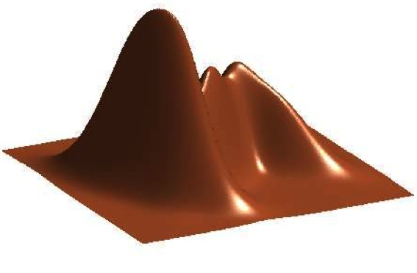
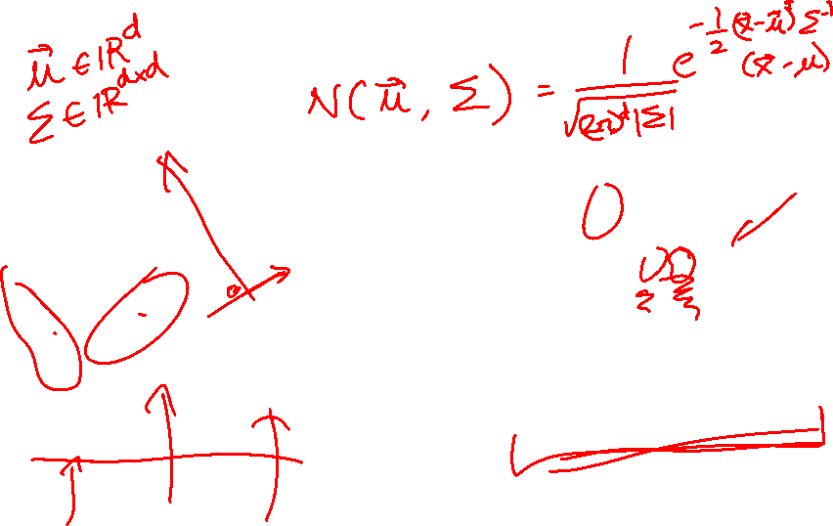
GMM
Figure Credit: Kevin Murphy

Slide 10
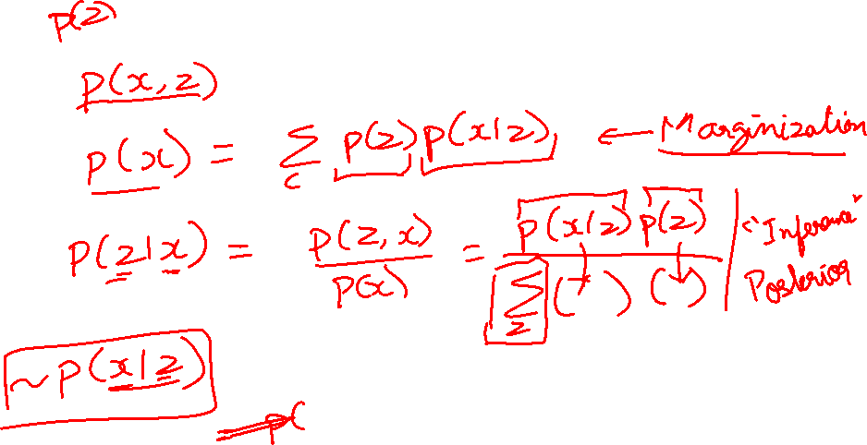
Gaussian Mixture Model

Slide 11
Variational Auto Encoders
VAEs are a combination of the following ideas:
Auto Encoders
Variational Approximation
  Variational Lower Bound / ELBO
Amortized Inference Neural Networks
“Reparameterization” Trick

Slide 12
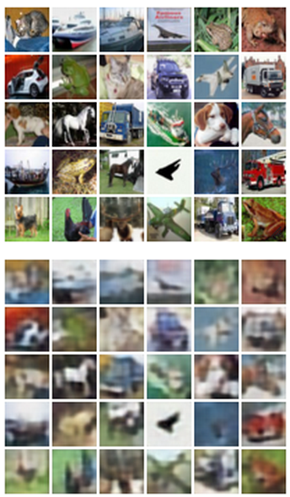

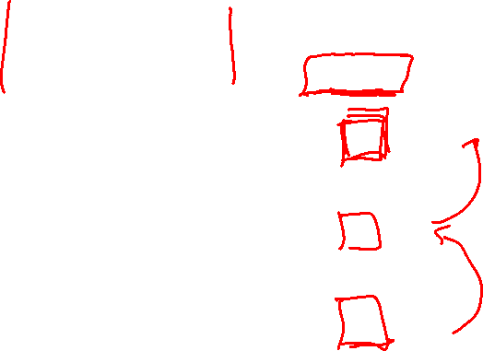
Autoencoders
Reconstructed data
Train such that features can be used to reconstruct original data
L2 Loss function:
Reconstructed input data
Encoder: 4-layer conv
Decoder: 4-layer upconv
Decoder
Input data
Features
Encoder
Input data
Slide Credit: Fei-Fei Li, Justin Johnson, Serena Yeung, CS 231n

Slide 13
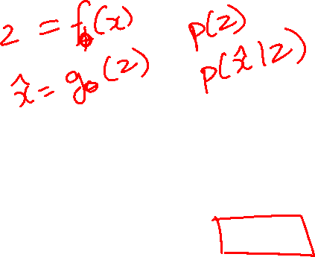
Autoencoders
Autoencoders can reconstruct data, and can learn features to initialize a supervised model
Features capture factors of variation in training data. Can we generate new images from an autoencoder?
Reconstructed input data
Decoder
Features
Encoder
Input data
Slide Credit: Fei-Fei Li, Justin Johnson, Serena Yeung, CS 231n

Slide 14
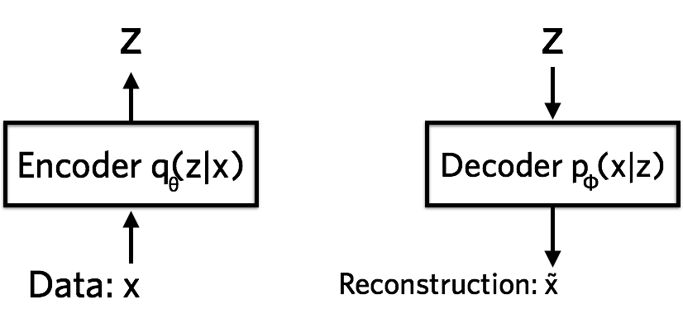


Variational Autoencoders
Probabilistic spin on autoencoders - will let us sample from the model to generate data!
$$qφ\left(z | x\right)$$
$$pθ\left(x | z\right)$$
Image Credit: https://jaan.io/what-is-variational-autoencoder-vae-tutorial/

Slide 15
Variational Auto Encoders
VAEs are a combination of the following ideas:
Auto Encoders
Variational Approximation
  Variational Lower Bound / ELBO
Amortized Inference Neural Networks
“Reparameterization” Trick

Slide 16
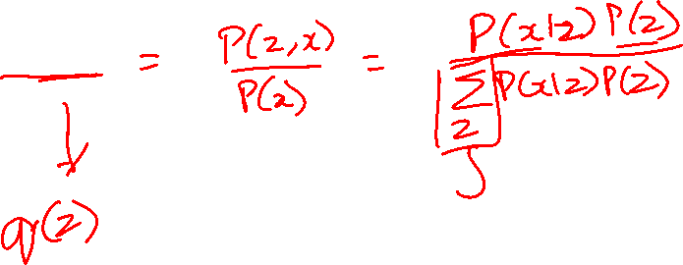
Key problem
P(z|x)

Slide 17
What is Variational Inference?
Key idea
  Reality is complex
  Can we approximate it with something “simple”?
  Just need to make sure the simple thing is “close” to the complex thing.

Slide 18
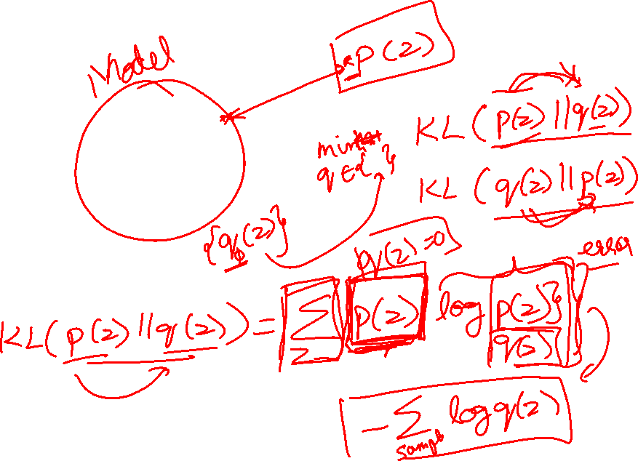
Intuition

Slide 19
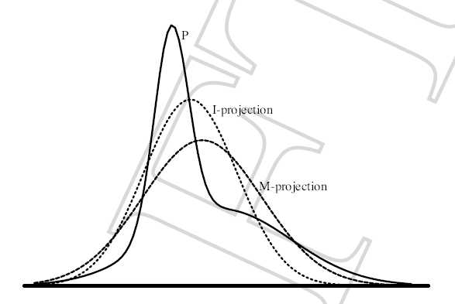
Find simple approximate distribution
Suppose p is intractable posterior
Want to find simple q that approximates p
KL divergence not symmetric
D(p||q)
  true distribution p defines support of diff.
  the “correct” direction
  will be intractable to compute
D(q||p)
  approximate distribution defines support
  tends to give overconfident results
  will be tractable
Slide Credit: Carlos Guestrin

Slide 20
Example 1
p = 2D Gaussian with arbitrary co-variance
q = 2D Gaussian with diagonal co-variance
argmin_q KL (p || q)
argmin_q KL (q || p)
p = Green; q = Red

Slide 21
Example 2
p = Mixture of Two Gaussians
q = Single Gaussian
argmin_q KL (p || q)
argmin_q KL (q || p)
p = Blue; q = Red

Slide 22
Plan for Today
VAEs
  Variational Inference → Evidence Based Lower Bound
  Reparameterization trick
  Putting it all together
Generative Adversarial Networks

Slide 23
The general learning problem with missing data
Marginal likelihood – x is observed, z is missing:

Slide 24
Applying Jensen’s inequality
Use: log ∑_{z} P(z) g(z) ≥ ∑_{z} P(z) log g(z)

Slide 25
Applying Jensen’s inequality
Use: log ∑_{z} P(z) g(z) ≥ ∑_{z} P(z) log g(z)

Slide 26
Applying Jensen’s inequality
Use: log ∑_{z} P(z) g(z) ≥ ∑_{z} P(z) log g(z)

Slide 27
Evidence Lower Bound
Define potential function F(θ,Q):

Slide 28
ELBO: Factorization #1

Slide 29
ELBO: Factorization #1

Slide 30
Evidence Lower Bound
Define potential function F(θ,Q):
EM corresponds to coordinate ascent on F
  Thus, maximizes lower bound on marginal log likelihood

Slide 31
EM is coordinate ascent
E-step: Fix θ^{(t)}, maximize F over Q:
  “Realigns” F with likelihood:

Slide 32
EM is coordinate ascent
M-step: Fix Q^{(t)}, maximize F over θ
Corresponds to weighted dataset:
  <x₁,z=1> with weight Q^{(t+1)}(z=1|x₁)
  <x₁,z=2> with weight Q^{(t+1)}(z=2|x₁)
  <x₁,z=3> with weight Q^{(t+1)}(z=3|x₁)
  <x₂,z=1> with weight Q^{(t+1)}(z=1|x₂)
  <x₂,z=2> with weight Q^{(t+1)}(z=2|x₂)
  <x₂,z=3> with weight Q^{(t+1)}(z=3|x₂)
  …

Slide 33
EM Intuition

Slide 34
GMM
Figure Credit: Kevin Murphy

Slide 35
EM for Learning GMMs
Simple Update Rules
  E-Step: estimate Q_{i}(z) = Pr(z = j | x_{i})
  M-Step: maximize expected likelihood under Q_{i}(z)

Slide 36
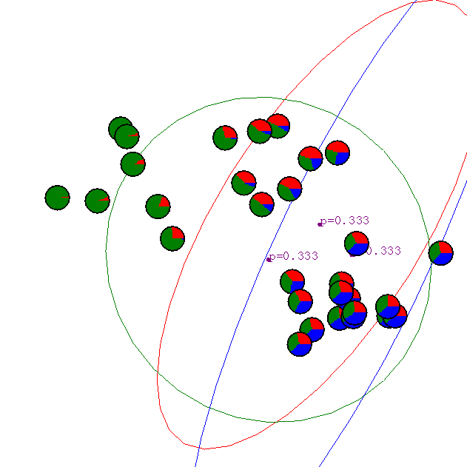
Gaussian Mixture Example: Start
Slide Credit: Carlos Guestrin

Slide 37
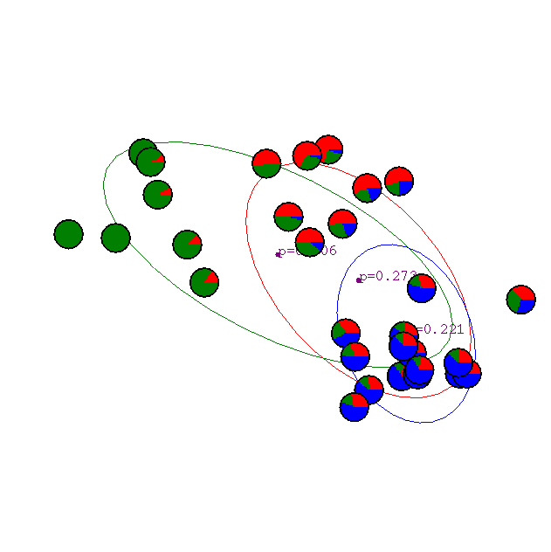
After 1st iteration
Slide Credit: Carlos Guestrin

Slide 38

After 2nd iteration
Slide Credit: Carlos Guestrin

Slide 39

After 3rd iteration
Slide Credit: Carlos Guestrin

Slide 40

After 4th iteration
Slide Credit: Carlos Guestrin

Slide 41

After 5th iteration
Slide Credit: Carlos Guestrin

Slide 42

After 6th iteration
Slide Credit: Carlos Guestrin

Slide 43

After 20th iteration
Slide Credit: Carlos Guestrin

Slide 44
Variational Autoencoders
Probabilistic spin on autoencoders - will let us sample from the model to generate data!
$$qφ\left(z | x\right)$$
$$pθ\left(x | z\right)$$
Image Credit: https://jaan.io/what-is-variational-autoencoder-vae-tutorial/

Slide 45
Evidence Lower Bound
Define potential function F(θ,Q):

Slide 46
Variational Auto Encoders
VAEs are a combination of the following ideas:
Auto Encoders
Variational Approximation
  Variational Lower Bound / ELBO
Amortized Inference Neural Networks
“Reparameterization” Trick

Slide 47
Amortized Inference Neural Networks

Slide 48
Amortized Inference Neural Networks

Slide 49
Variational Autoencoders
Probabilistic spin on autoencoders - will let us sample from the model to generate data!
$$qφ\left(z | x\right)$$
$$pθ\left(x | z\right)$$
Image Credit: https://jaan.io/what-is-variational-autoencoder-vae-tutorial/

Slide 50
Variational Auto Encoders
VAEs are a combination of the following ideas:
Auto Encoders
Variational Approximation
  Variational Lower Bound / ELBO
Amortized Inference Neural Networks
“Reparameterization” Trick

Slide 51
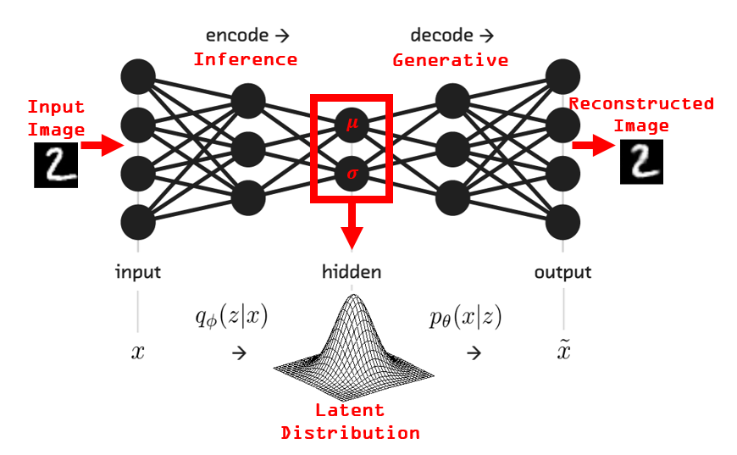
VAEs
Image Credit: https://www.kaggle.com/rvislaywade/visualizing-mnist-using-a-variational-autoencoder

Slide 52
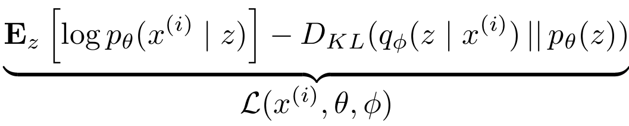
Variational Auto Encoders
Putting it all together: maximizing the likelihood lower bound
Slide Credit: Fei-Fei Li, Justin Johnson, Serena Yeung, CS 231n

Slide 53
Variational Auto Encoders
Putting it all together: maximizing the likelihood lower bound
Let’s look at computing the bound (forward pass) for a given minibatch of input data
Input Data
Slide Credit: Fei-Fei Li, Justin Johnson, Serena Yeung, CS 231n

Slide 54


Variational Auto Encoders
Putting it all together: maximizing the likelihood lower bound
Encoder network
Input Data
Slide Credit: Fei-Fei Li, Justin Johnson, Serena Yeung, CS 231n

Slide 55
Variational Auto Encoders
Putting it all together: maximizing the likelihood lower bound
Make approximate posterior distribution close to prior
Encoder network
Input Data
Slide Credit: Fei-Fei Li, Justin Johnson, Serena Yeung, CS 231n

Slide 56

Variational Auto Encoders
Putting it all together: maximizing the likelihood lower bound
Sample z from
Make approximate posterior distribution close to prior
Encoder network
Input Data
Slide Credit: Fei-Fei Li, Justin Johnson, Serena Yeung, CS 231n

Slide 57


Variational Auto Encoders
Putting it all together: maximizing the likelihood lower bound
Decoder network
Sample z from
Make approximate posterior distribution close to prior
Encoder network
Input Data
Slide Credit: Fei-Fei Li, Justin Johnson, Serena Yeung, CS 231n

Slide 58

Variational Auto Encoders
Putting it all together: maximizing the likelihood lower bound
Maximize likelihood of original input being reconstructed
Sample x|z from
Decoder network
Sample z from
Make approximate posterior distribution close to prior
Encoder network
Input Data
Slide Credit: Fei-Fei Li, Justin Johnson, Serena Yeung, CS 231n

Slide 59
Variational Auto Encoders
Putting it all together: maximizing the likelihood lower bound
Maximize likelihood of original input being reconstructed
Sample x|z from
Decoder network
Sample z from
Make approximate posterior distribution close to prior
Encoder network
For every minibatch of input data: compute this forward pass, and then backprop!
Input Data
Slide Credit: Fei-Fei Li, Justin Johnson, Serena Yeung, CS 231n

Slide 60

Variational Auto Encoders: Generating Data
Use decoder network. Now sample z from prior!
Sample x|z from
Decoder network
Sample z from
Kingma and Welling, “Auto-Encoding Variational Bayes”, ICLR 2014
Slide Credit: Fei-Fei Li, Justin Johnson, Serena Yeung, CS 231n

Slide 61
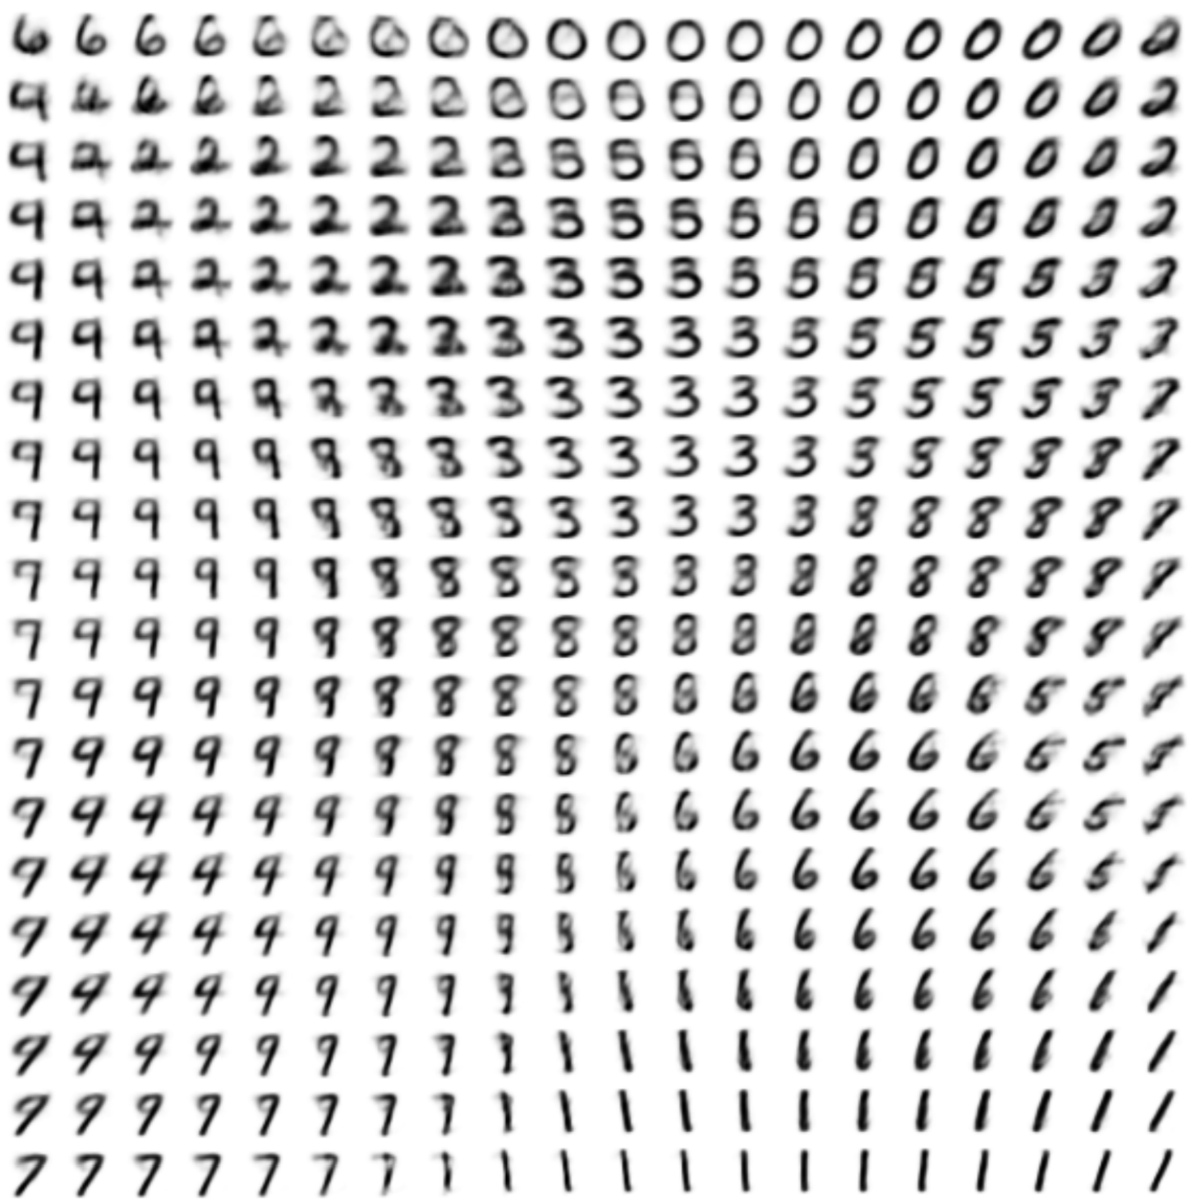
Variational Auto Encoders: Generating Data
Use decoder network. Now sample z from prior!
Sample x|z from
Decoder network
Sample z from
Kingma and Welling, “Auto-Encoding Variational Bayes”, ICLR 2014
Slide Credit: Fei-Fei Li, Justin Johnson, Serena Yeung, CS 231n

Slide 62
Variational Auto Encoders: Generating Data
Use decoder network. Now sample z from prior!
Data manifold for 2-d z
Sample x|z from
Vary z₁
Decoder network
Sample z from
Kingma and Welling, “Auto-Encoding Variational Bayes”, ICLR 2014
Vary z₂
Slide Credit: Fei-Fei Li, Justin Johnson, Serena Yeung, CS 231n

Slide 63
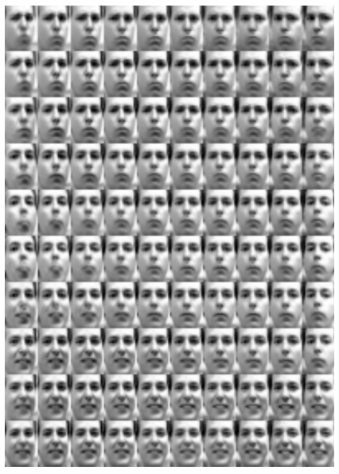
Variational Auto Encoders: Generating Data
Diagonal prior on z => independent latent variables
Different dimensions of z encode interpretable factors of variation
Degree of smile
Vary z₁
Vary z₂
Head pose
Kingma and Welling, “Auto-Encoding Variational Bayes”, ICLR 2014
Slide Credit: Fei-Fei Li, Justin Johnson, Serena Yeung, CS 231n

Slide 64
Variational Auto Encoders: Generating Data
Diagonal prior on z => independent latent variables
Different dimensions of z encode interpretable factors of variation
Degree of smile
Vary z₁
Also good feature representation that can be computed using q_{ɸ}(z|x)!
Vary z₂
Head pose
Kingma and Welling, “Auto-Encoding Variational Bayes”, ICLR 2014
Slide Credit: Fei-Fei Li, Justin Johnson, Serena Yeung, CS 231n

Slide 65
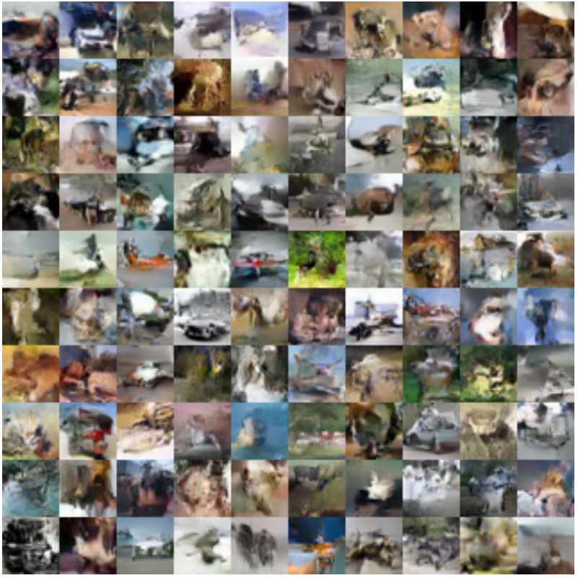
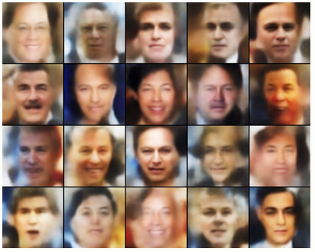
Variational Auto Encoders: Generating Data
Labeled Faces in the Wild
32x32 CIFAR-10
Figures copyright (L) Dirk Kingma et al. 2016; (R) Anders Larsen et al. 2017. Reproduced with permission.
Slide Credit: Fei-Fei Li, Justin Johnson, Serena Yeung, CS 231n

Slide 66
Variational Autoencoders
Probabilistic spin to traditional autoencoders => allows generating data
Defines an intractable density => derive and optimize a (variational) lower bound
Pros:
Principled approach to generative models
Allows inference of q(z|x), can be useful feature representation for other tasks
Cons:
Maximizes lower bound of likelihood: okay, but not as good evaluation as PixelRNN/PixelCNN
Samples blurrier and lower quality compared to state-of-the-art (GANs)
Active areas of research:
More flexible approximations, e.g. richer approximate posterior instead of diagonal Gaussian
Incorporating structure in latent variables
Slide Credit: Fei-Fei Li, Justin Johnson, Serena Yeung, CS 231n

