Slide 1
CS 4803 / 7643: Deep Learning
Topics:
  (Deep) Reinforcement Learning
  Closing time
Dhruv Batra
Georgia Tech

Slide 2
Administrativia
Last class today
Project submission
  Due: 12/04, 11:55pm
  Last deliverable in the class
  Can’t use late days
  https://piazza.com/class/jkujs03pgu75cd?cid=225

Slide 3
Recap from last time

Slide 4

Types of Learning
Supervised learning
  Learning from a “teacher”
  Training data includes desired outputs
Unsupervised learning
  Discover structure in data
  Training data does not include desired outputs
Reinforcement learning
  Learning to act under evaluative feedback (rewards)

Slide 5
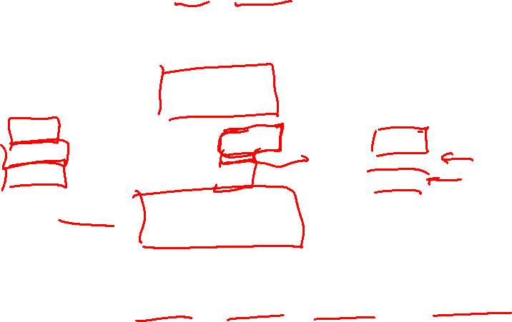
RL API
Agent
State,
Stimulus,
Situation
Reward,
Gain, Payoff,
Cost
Action,
Response,
Control
Environment
(world)
Environment may be unknown, nonlinear, stochastic and complex
Agent learns a policy mapping states to actions
  Seeking to maximize its cumulative reward in the long run
Slide Credit: Rich Sutton
Notes:
Agent and environment interact in real-time, continually learning and improving

Slide 6
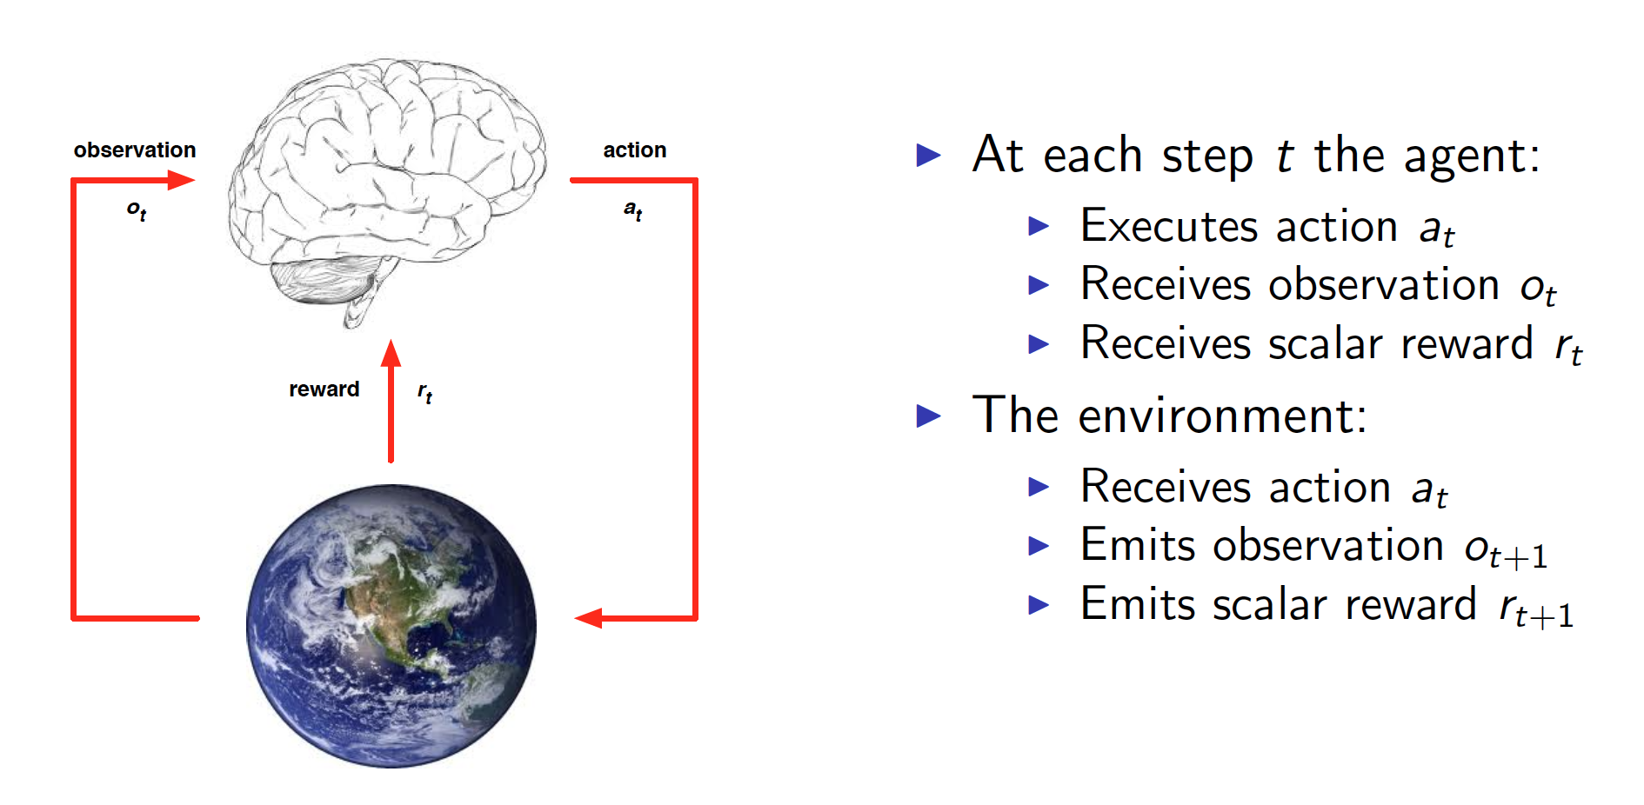
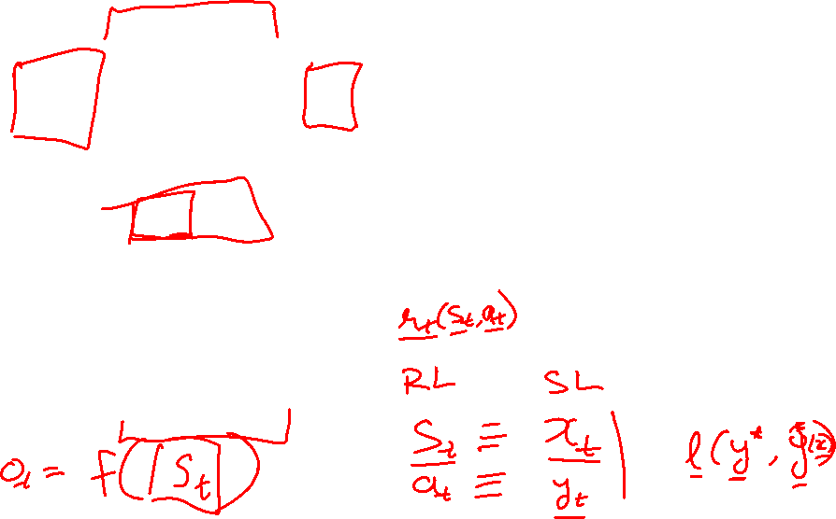
RL API
Slide Credit: David Silver

Slide 7

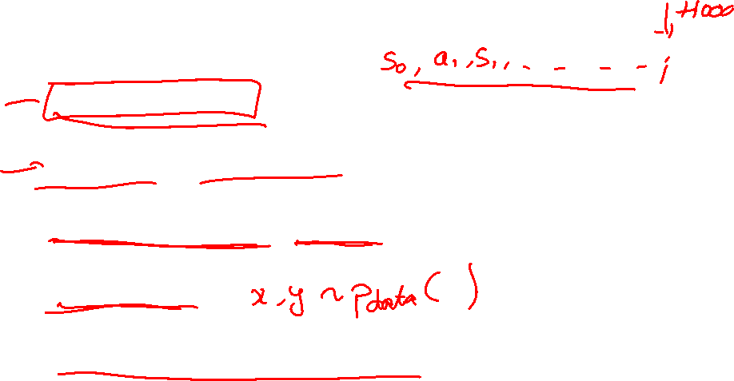
Signature challenges of RL
Evaluative feedback (reward)
Sequentiality, delayed consequences
Need for trial and error, to explore as well as exploit
Non-stationarity
The fleeting nature of time and online data
Slide Credit: Rich Sutton

Slide 8
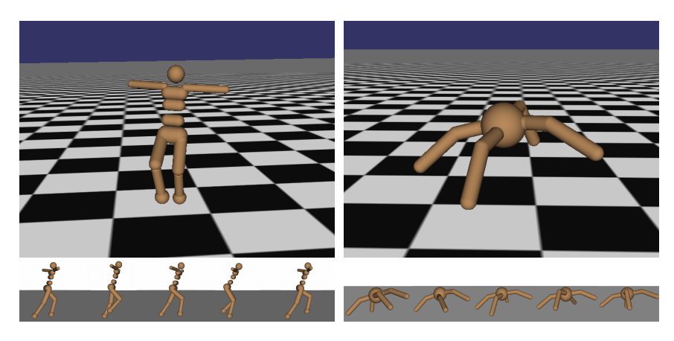
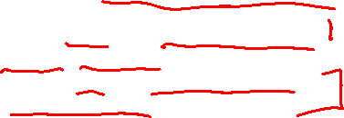
Robot Locomotion
Objective: Make the robot move forward
State: Angle and position of the joints
Action: Torques applied on joints
Reward: 1 at each time step upright + forward movement
Figures copyright John Schulman et al., 2016. Reproduced with permission.
Slide Credit: Fei-Fei Li, Justin Johnson, Serena Yeung, CS 231n

Slide 9
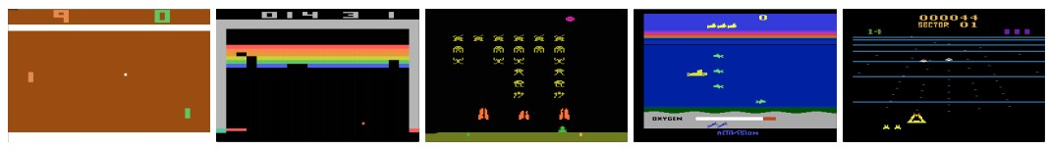
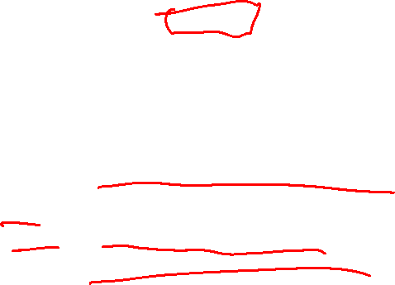
Atari Games
Objective: Complete the game with the highest score
State: Raw pixel inputs of the game state
Action: Game controls e.g. Left, Right, Up, Down
Reward: Score increase/decrease at each time step
Figures copyright Volodymyr Mnih et al., 2013. Reproduced with permission.
Slide Credit: Fei-Fei Li, Justin Johnson, Serena Yeung, CS 231n
Notes:
Games are also a big class of problems that can be formulated with RL
For example here we have atari games, which are a class success of deep RL

Slide 10
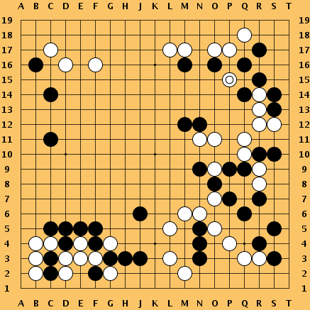
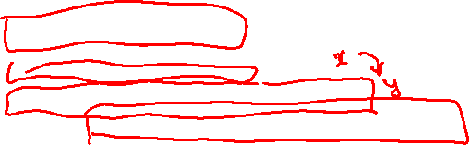
Go
Objective: Win the game!
State: Position of all pieces
Action: Where to put the next piece down
Reward: 1 if win at the end of the game, 0 otherwise
This image is CC0 public domain
Slide Credit: Fei-Fei Li, Justin Johnson, Serena Yeung, CS 231n
Notes:
Something that was a huge achievement last year when DeepMind’s AlphaGo beat Lee Sedol, the best Go player of the last few years, and just last night, competing again

Slide 11

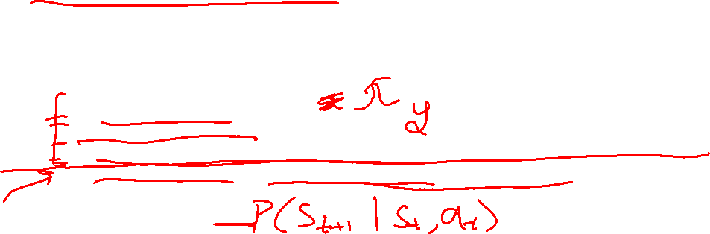
Markov Decision Process
Mathematical formulation of the RL problem
Defined by:
: set of possible states
: set of possible actions
: distribution of reward given (state, action) pair
: transition probability i.e. distribution over next state given (state, action) pair
: discount factor
Slide Credit: Fei-Fei Li, Justin Johnson, Serena Yeung, CS 231n
Notes:
MDP satisfies Markov property
Define by tuple of objects

Slide 12
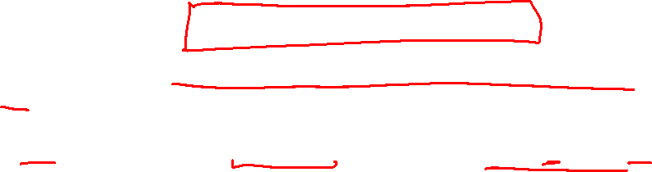
Markov Decision Process
Mathematical formulation of the RL problem
Life is trajectory:
Markov property: Current state completely characterizes the state of the world
Defined by:
: set of possible states
: set of possible actions
: distribution of reward given (state, action) pair
: transition probability i.e. distribution over next state given (state, action) pair
: discount factor
Slide Credit: Fei-Fei Li, Justin Johnson, Serena Yeung, CS 231n
Notes:
MDP satisfies Markov property
Define by tuple of objects

Slide 13
Components of an RL Agent
Policy
  How does an agent behave?
Value function
  How good is each state and/or state-action pair?
Model
  Agent’s representation of the environment

Slide 14
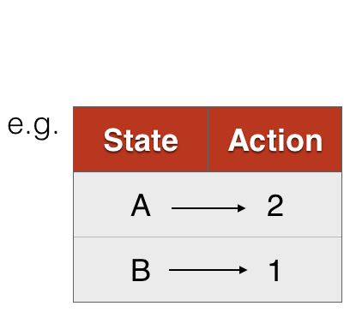
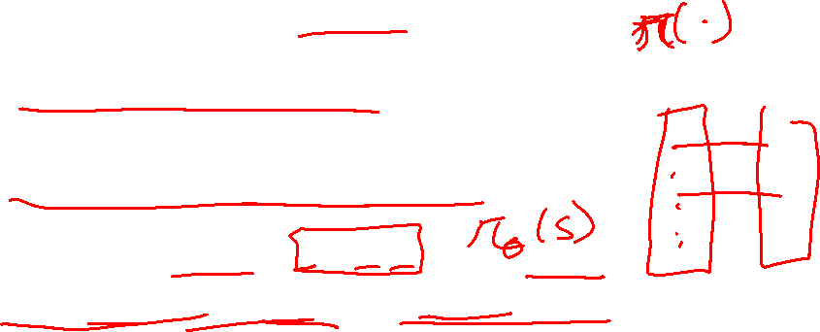
Policy
A policy is how the agent acts
Formally, map from states to actions

Slide 15
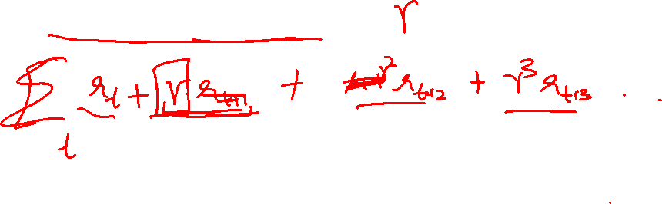
The optimal policy 𝝿*
What’s a good policy?
Maximizes current reward? Sum of all future reward?
Discounted future rewards!
Notes:
Can work with maximizing the expected sum of rewards

Slide 16

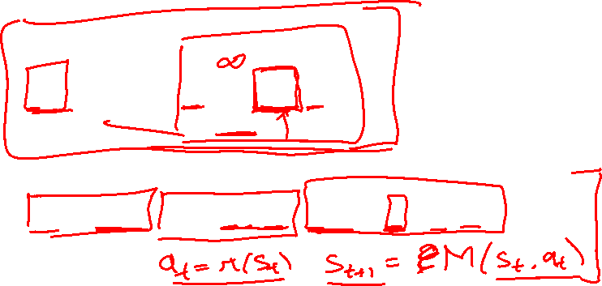
The optimal policy 𝝿*
What’s a good policy?
Maximizes current reward? Sum of all future reward?
Discounted future rewards!
Formally:
with
Notes:
Can work with maximizing the expected sum of rewards

Slide 17
Components of an RL Agent
Policy
  How does an agent behave?
Value function
  How good is each state and/or state-action pair?
Model
  Agent’s representation of the environment

Slide 18
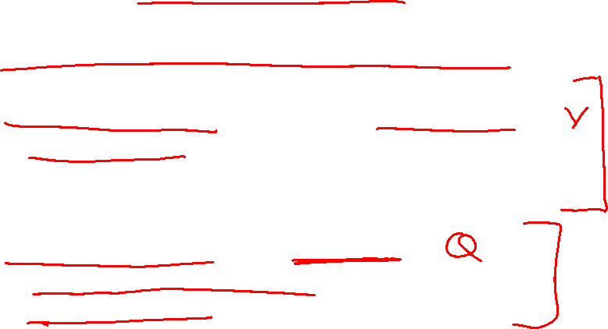
Value Function
A value function is a prediction of future reward
“State Value Function” or simply “Value Function”
  How good is a state?
  Am I screwed? Am I winning this game?
“Action Value Function” or Q-function
  How good is a state action-pair?
  Should I do this now?

Slide 19

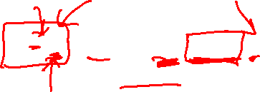
Definitions: Value function and Q-value function
Following a policy produces sample trajectories (or paths) s₀, a₀, r₀, s₁, a₁, r₁, …
How good is a state?
The value function at state s, is the expected cumulative reward from state s
(and following the policy thereafter):
Slide Credit: Fei-Fei Li, Justin Johnson, Serena Yeung, CS 231n

Slide 20

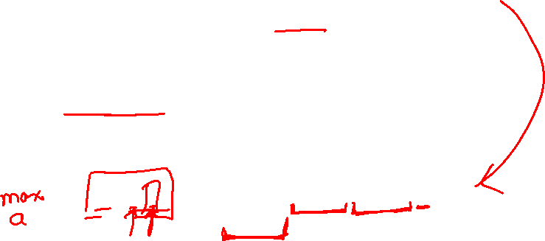
Definitions: Value function and Q-value function
Following a policy produces sample trajectories (or paths) s₀, a₀, r₀, s₁, a₁, r₁, …
How good is a state?
The value function at state s, is the expected cumulative reward from state s
(and following the policy thereafter):
How good is a state-action pair?
The Q-value function at state s and action a, is the expected cumulative reward from taking action a in state s (and following the policy thereafter):
Slide Credit: Fei-Fei Li, Justin Johnson, Serena Yeung, CS 231n

Slide 21
Components of an RL Agent
Policy
  How does an agent behave?
Value function
  How good is each state and/or state-action pair?
Model
  Agent’s representation of the environment

Slide 22
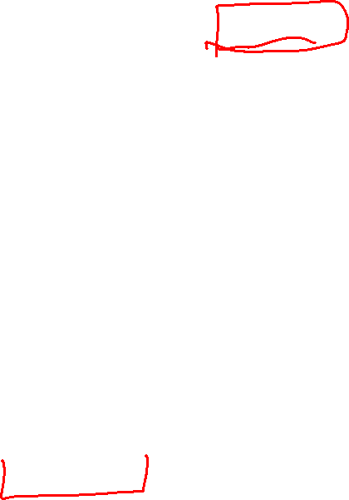
Model
Slide Credit: David Silver

Slide 23
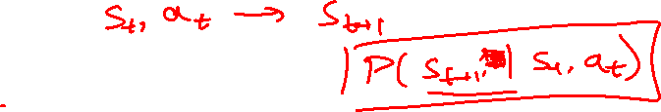
Model
Model predicts what the world will do next
Slide Credit: David Silver

Slide 24
Plan for Today
(Deep) Reinforcement Learning
  Policy gradients
Closing the loop

Slide 25
Components of an RL Agent
Policy
  How does an agent behave?
Value function
  How good is each state and/or state-action pair?
Model
  Agent’s representation of the environment

Slide 26
Maze Example
Slide Credit: David Silver

Slide 27
Maze Example: Policy
Slide Credit: David Silver

Slide 28
Maze Example: Value
Slide Credit: David Silver

Slide 29
Maze Example: Model
Slide Credit: David Silver

Slide 30
Components of an RL Agent
Value function
  How good is each state and/or state-action pair?
Policy
  How does an agent behave?
Model
  Agent’s representation of the environment

Slide 31
Approaches to RL
Value-based RL
  Estimate the optimal action-value function
Policy-based RL
  Search directly for the optimal policy
Model
  Build a model of the world
    State transition, reward probabilities
  Plan (e.g. by look-ahead) using model

Slide 32
Deep RL
Value-based RL
  Use neural nets to represent Q function
Policy-based RL
  Use neural nets to represent policy
Model
  Use neural nets to represent and learn the model

Slide 33
Deep RL
Value-based RL
  Use neural nets to represent Q function
Policy-based RL
  Use neural nets to represent policy
Model
  Use neural nets to represent and learn the model

Slide 34

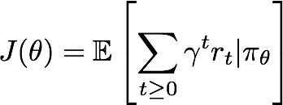
Policy Gradients
Formally, let’s define a class of parameterized policies:
For each policy, define its value:
Slide Credit: Fei-Fei Li, Justin Johnson, Serena Yeung, CS 231n

Slide 35

Policy Gradients
Formally, let’s define a class of parameterized policies:
For each policy, define its value:
We want to find the optimal policy
How can we do this?
Slide Credit: Fei-Fei Li, Justin Johnson, Serena Yeung, CS 231n

Slide 36
Policy Gradients
Formally, let’s define a class of parameterized policies:
For each policy, define its value:
We want to find the optimal policy
How can we do this?
Gradient ascent on policy parameters!
Slide Credit: Fei-Fei Li, Justin Johnson, Serena Yeung, CS 231n

Slide 37
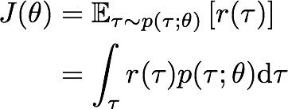

REINFORCE algorithm
Mathematically, we can write:
Where r(𝜏) is the reward of a trajectory
Slide Credit: Fei-Fei Li, Justin Johnson, Serena Yeung, CS 231n
Notes:
Let’s talk about how we’re going to do this, which we’re going to call the reinforce algorithm
We’re going to sample trajectories of experience s0,a0,r0, s1, and so on, with our policy pi_theta
For each trajectory, we can compute a reward for that trajectory
and the value of a policy pi_theta will just be the expected reward of these trajectories that come from following pi_theta

Slide 38


REINFORCE algorithm
Mathematically, we can write:
Where r(𝜏) is the reward of a trajectory
Slide Credit: Fei-Fei Li, Justin Johnson, Serena Yeung, CS 231n
Notes:
Let’s talk about how we’re going to do this, which we’re going to call the reinforce algorithm
We’re going to sample trajectories of experience s0,a0,r0, s1, and so on, with our policy pi_theta
For each trajectory, we can compute a reward for that trajectory
and the value of a policy pi_theta will just be the expected reward of these trajectories that come from following pi_theta

Slide 39
REINFORCE algorithm
Expected reward:
Slide Credit: Fei-Fei Li, Justin Johnson, Serena Yeung, CS 231n

Slide 40

REINFORCE algorithm
Expected reward:
Now let’s differentiate this:
Slide Credit: Fei-Fei Li, Justin Johnson, Serena Yeung, CS 231n
Notes:
Want to do gradient ascent, so let’s differentiate this

Slide 41
REINFORCE algorithm
Expected reward:
Now let’s differentiate this:
Intractable! Expectation of gradient is problematic when p depends on θ
Slide Credit: Fei-Fei Li, Justin Johnson, Serena Yeung, CS 231n

Slide 42

REINFORCE algorithm
Expected reward:
Now let’s differentiate this:
However, we can use a nice trick:
Intractable! Expectation of gradient is problematic when p depends on θ
Slide Credit: Fei-Fei Li, Justin Johnson, Serena Yeung, CS 231n

Slide 43
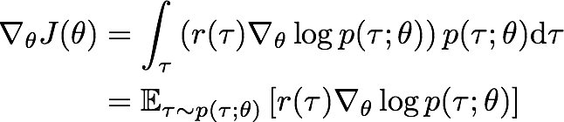
REINFORCE algorithm
Expected reward:
Now let’s differentiate this:
However, we can use a nice trick:
If we inject this back:
Intractable! Expectation of gradient is problematic when p depends on θ
Can estimate with Monte Carlo sampling
Slide Credit: Fei-Fei Li, Justin Johnson, Serena Yeung, CS 231n
Notes:
Core idea of reinforce
Transform a gradient of an expectation into an expectation of gradients
Can now estimate our gradient using sample trajectories

Slide 44
REINFORCE algorithm
Can we compute those quantities without knowing the transition probabilities?
We have:
Slide Credit: Fei-Fei Li, Justin Johnson, Serena Yeung, CS 231n

Slide 45
REINFORCE algorithm
Can we compute those quantities without knowing the transition probabilities?
We have:
Thus:
Slide Credit: Fei-Fei Li, Justin Johnson, Serena Yeung, CS 231n

Slide 46

REINFORCE algorithm
Can we compute those quantities without knowing the transition probabilities?
We have:
Thus:
And when differentiating:
Doesn’t depend on transition probabilities!
Slide Credit: Fei-Fei Li, Justin Johnson, Serena Yeung, CS 231n

Slide 47

REINFORCE algorithm
Can we compute those quantities without knowing the transition probabilities?
We have:
Thus:
And when differentiating:
Therefore when sampling a trajectory 𝜏, we can estimate J(𝜃) with
Doesn’t depend on transition probabilities!
Slide Credit: Fei-Fei Li, Justin Johnson, Serena Yeung, CS 231n

Slide 48
Intuition
Gradient estimator:
Interpretation:
If r(𝜏) is high, push up the probabilities of the actions seen
If r(𝜏) is low, push down the probabilities of the actions seen
Slide Credit: Fei-Fei Li, Justin Johnson, Serena Yeung, CS 231n

Slide 49
Intuition
Gradient estimator:
Interpretation:
If r(𝜏) is high, push up the probabilities of the actions seen
If r(𝜏) is low, push down the probabilities of the actions seen
Might seem simplistic to say that if a trajectory is good then all its actions were good. But in expectation, it averages out!
Slide Credit: Fei-Fei Li, Justin Johnson, Serena Yeung, CS 231n

Slide 50
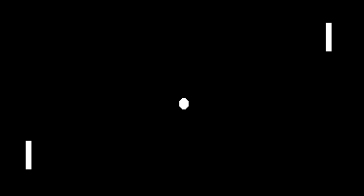
Pong from pixels
Image Credit: http://karpathy.github.io/2016/05/31/rl/

Slide 51
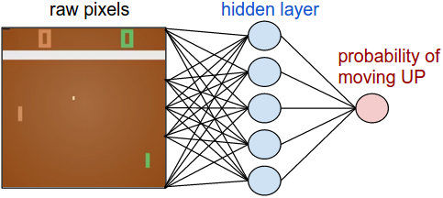
Pong from pixels
Image Credit: http://karpathy.github.io/2016/05/31/rl/

Slide 52
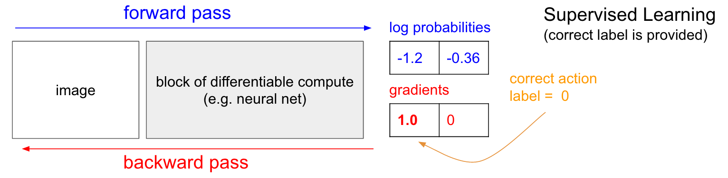
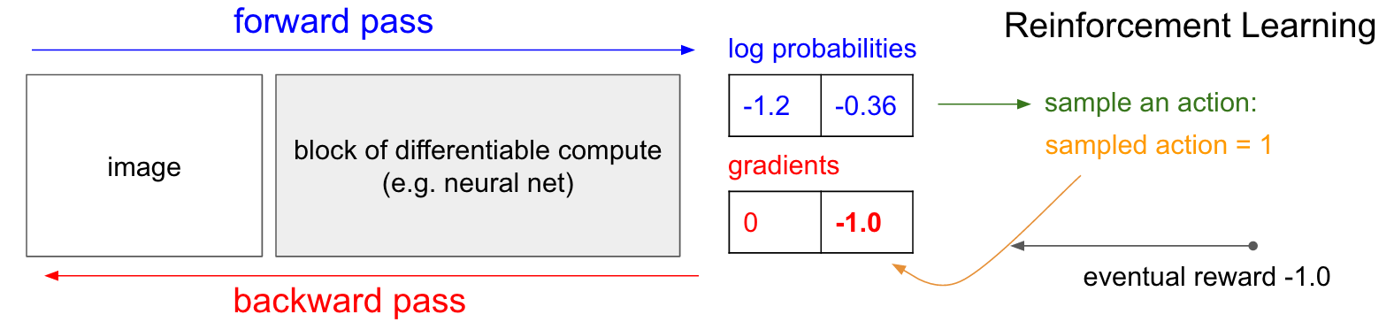
Pong from pixels
Image Credit: http://karpathy.github.io/2016/05/31/rl/

Slide 53
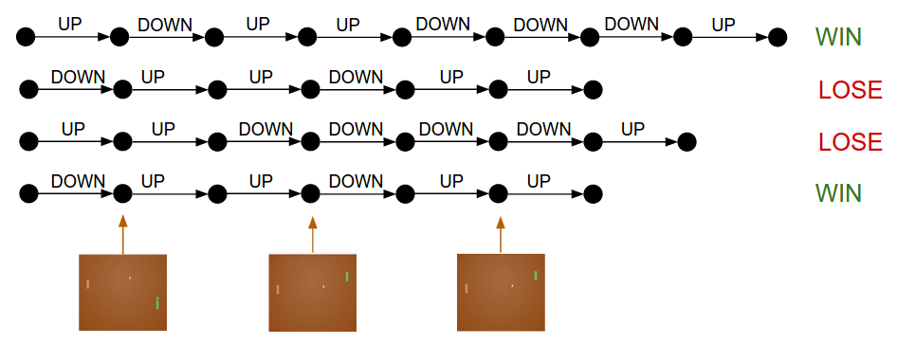
Intuition

Slide 54
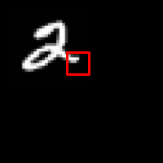
REINFORCE in action: Recurrent Attention Model (RAM)
Objective: Image Classification
Take a sequence of “glimpses” selectively focusing on regions of the image, to predict class
Inspiration from human perception and eye movements
Saves computational resources => scalability
Able to ignore clutter / irrelevant parts of image
State: Glimpses seen so far
Action: (x,y) coordinates (center of glimpse) of where to look next in image
Reward: 1 at the final timestep if image correctly classified, 0 otherwise
glimpse
[Mnih et al. 2014]
Slide Credit: Fei-Fei Li, Justin Johnson, Serena Yeung, CS 231n
Notes:
Selectively focus on parts of the image, build up information as you look around

Slide 55
REINFORCE in action: Recurrent Attention Model (RAM)
Objective: Image Classification
Take a sequence of “glimpses” selectively focusing on regions of the image, to predict class
Inspiration from human perception and eye movements
Saves computational resources => scalability
Able to ignore clutter / irrelevant parts of image
State: Glimpses seen so far
Action: (x,y) coordinates (center of glimpse) of where to look next in image
Reward: 1 at the final timestep if image correctly classified, 0 otherwise
glimpse
Glimpsing is a non-differentiable operation => learn policy for how to take glimpse actions using REINFORCE
Given state of glimpses seen so far, use RNN to model the state and output next action
[Mnih et al. 2014]
Slide Credit: Fei-Fei Li, Justin Johnson, Serena Yeung, CS 231n
Notes:
Selectively focus on parts of the image, build up information as you look around

Slide 56


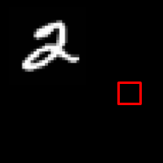
REINFORCE in action: Recurrent Attention Model (RAM)
(x₁, y₁)
Input image
NN
[Mnih et al. 2014]
Slide Credit: Fei-Fei Li, Justin Johnson, Serena Yeung, CS 231n

Slide 57
REINFORCE in action: Recurrent Attention Model (RAM)
(x₁, y₁)
(x₂, y₂)
Input image
NN
NN
[Mnih et al. 2014]
Slide Credit: Fei-Fei Li, Justin Johnson, Serena Yeung, CS 231n

Slide 58
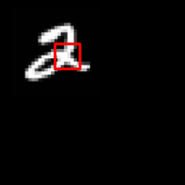
REINFORCE in action: Recurrent Attention Model (RAM)
(x₁, y₁)
(x₂, y₂)
(x₃, y₃)
Input image
NN
NN
NN
[Mnih et al. 2014]
Slide Credit: Fei-Fei Li, Justin Johnson, Serena Yeung, CS 231n

Slide 59
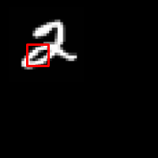
REINFORCE in action: Recurrent Attention Model (RAM)
(x₁, y₁)
(x₂, y₂)
(x₃, y₃)
(x₄, y₄)
Input image
NN
NN
NN
NN
[Mnih et al. 2014]
Slide Credit: Fei-Fei Li, Justin Johnson, Serena Yeung, CS 231n

Slide 60
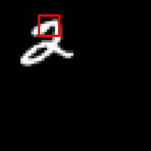
REINFORCE in action: Recurrent Attention Model (RAM)
(x₁, y₁)
(x₂, y₂)
(x₃, y₃)
(x₄, y₄)
(x₅, y₅)
Softmax
Input image
NN
y=2
NN
NN
NN
NN
[Mnih et al. 2014]
Slide Credit: Fei-Fei Li, Justin Johnson, Serena Yeung, CS 231n

Slide 61

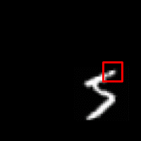
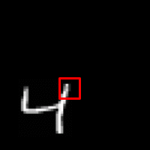
REINFORCE in action: Recurrent Attention Model (RAM)
Has also been used in many other tasks including fine-grained image recognition, image captioning, and visual question-answering!
Figures copyright Daniel Levy, 2017. Reproduced with permission.
[Mnih et al. 2014]
Slide Credit: Fei-Fei Li, Justin Johnson, Serena Yeung, CS 231n

Slide 62
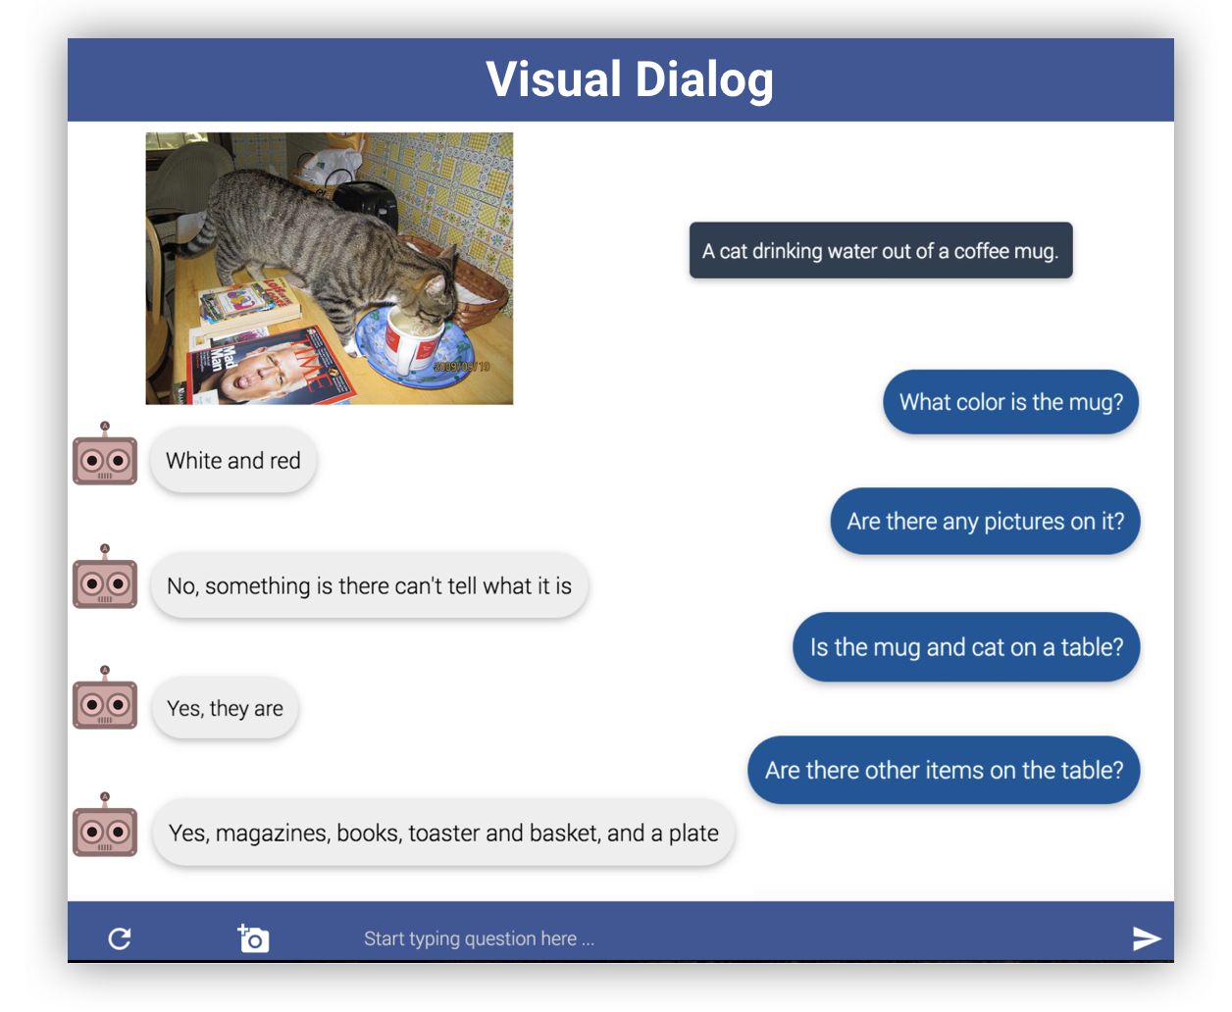

Visual Dialog

Slide 63


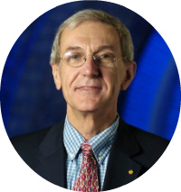


Learning Cooperative Visual Dialog Agents with Deep Reinforcement Learning
[ICCV ‘17]
Abhishek Das*
(Georgia Tech)
Satwik Kottur*
(CMU)
José Moura
(CMU)
Stefan Lee
(Virginia Tech)
Dhruv Batra
(Georgia Tech)

Slide 64


Image Guessing Game
Slide Credit: Abhishek Das

Slide 65


Image Guessing Game
Slide Credit: Abhishek Das

Slide 66
Image Guessing Game
Q-Bot
asks questions
is blindfolded
Slide Credit: Abhishek Das

Slide 67

Image Guessing Game
asks questions
Q-Bot
is blindfolded
Slide Credit: Abhishek Das

Slide 68
Image Guessing Game
asks questions
A-Bot
answers questions
sees an image
Slide Credit: Abhishek Das

Slide 69
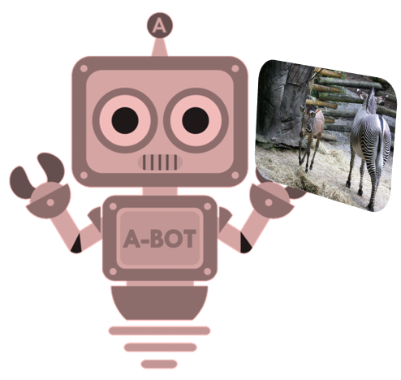
Image Guessing Game
asks questions
answers questions
A-Bot
sees an image
Slide Credit: Abhishek Das

Slide 70
Image Guessing Game
asks questions
Slide Credit: Abhishek Das

Slide 71






Image Guessing Game
asks questions
Slide Credit: Abhishek Das

Slide 72

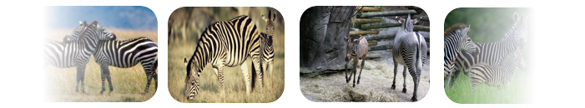
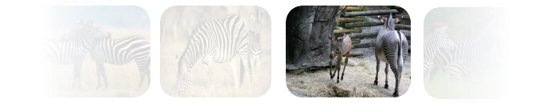
Image Guessing Game
asks questions
Slide Credit: Abhishek Das

Slide 73


RL for Cooperative Dialog Agents
Agents: (Q-bot, A-bot)
Environment: Image
Action:
  Q-bot: question (symbol sequence)
  A-bot: answer (symbol sequence)
  Q-bot: image regression
State
  Q-bot:
  A-bot:
q_{t}
Any people in the shot?
a_{t}
No, there aren’t any.

Slide 74
RL for Cooperative Dialog Agents
Action:
  Q-bot: question (symbol sequence)
  A-bot: answer (symbol sequence)
  Q-bot: image regression
State
  Q-bot:
  A-bot:
q_{t}
Any people in the shot?
a_{t}
No, there aren’t any.

Slide 75
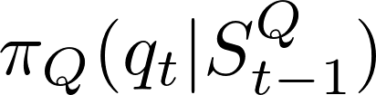

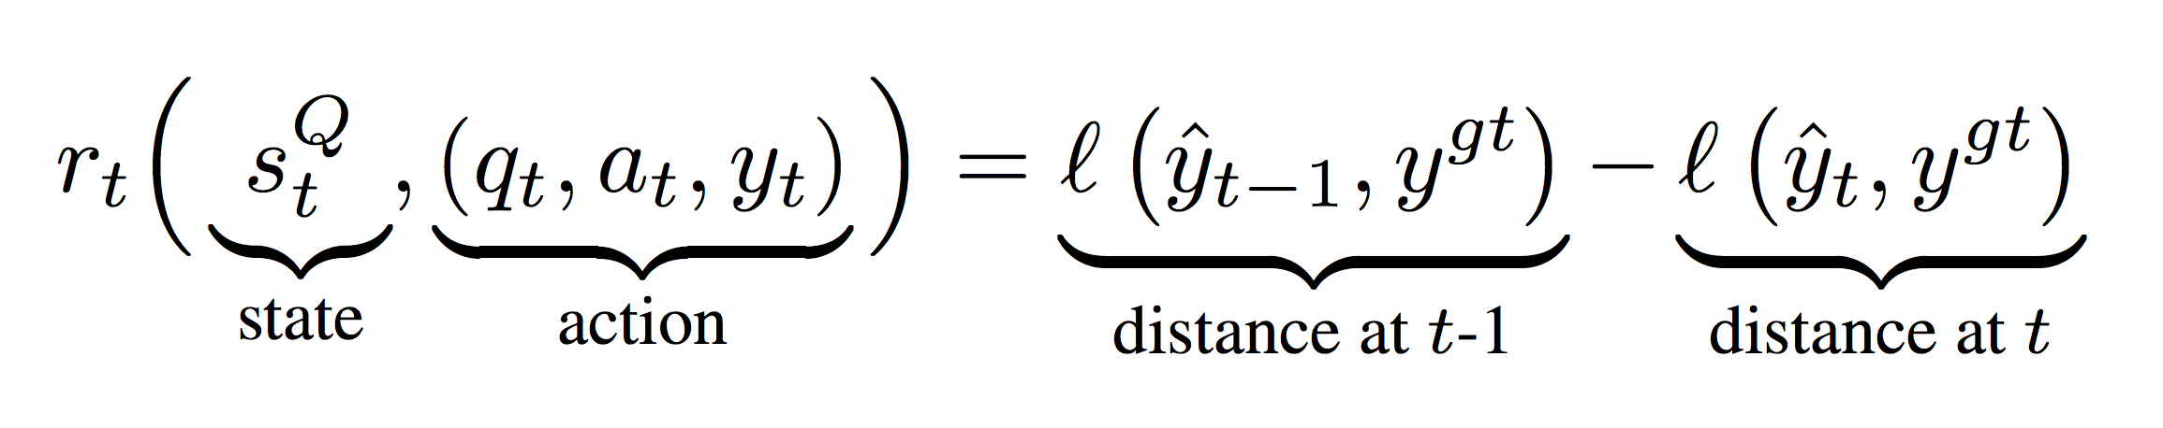
RL for Cooperative Dialog Agents
Action:
  Q-bot: question (symbol sequence)
  A-bot: answer (symbol sequence)
  Q-bot: image regression
State
  Q-bot:
  A-bot:
Policy
Reward
q_{t}
Any people in the shot?
a_{t}
No, there aren’t any.
Q-bot
A-bot

Slide 76
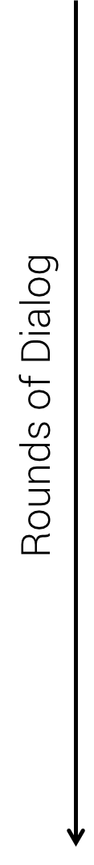
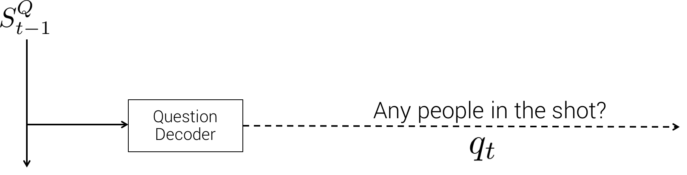
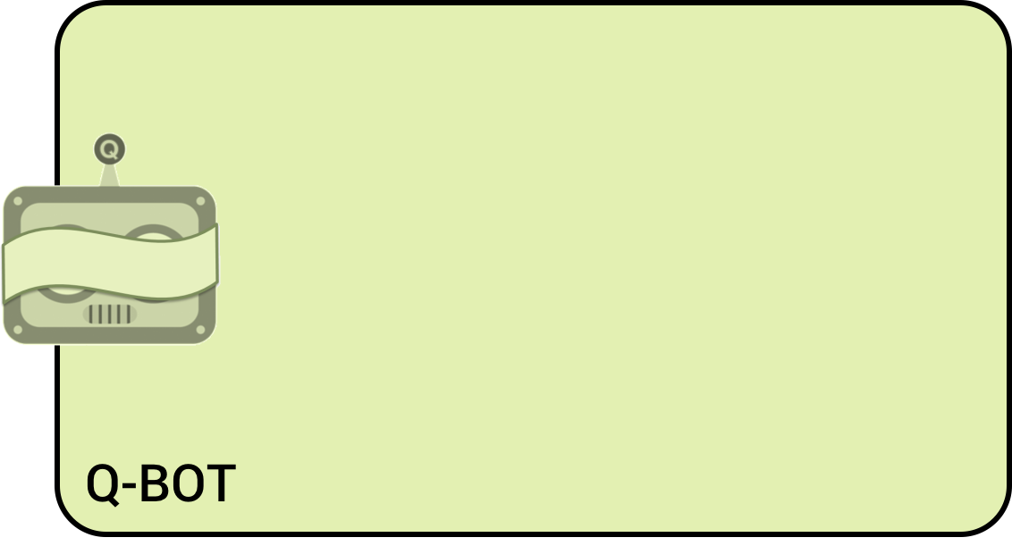
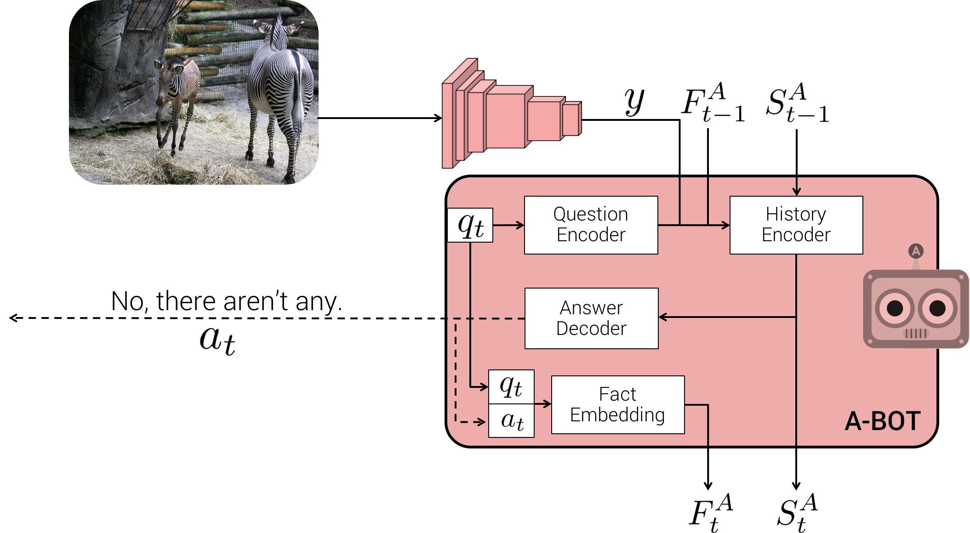
Policy Networks
Q-Bot
A-Bot
A-BOT
Slide Credit: Abhishek Das

Slide 77
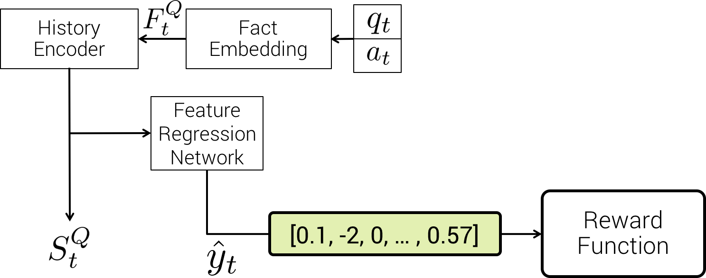
Policy Networks
Q-Bot
A-Bot
Slide Credit: Abhishek Das

Slide 78
Policy Networks
Q-Bot
A-Bot
Slide Credit: Abhishek Das

Slide 79
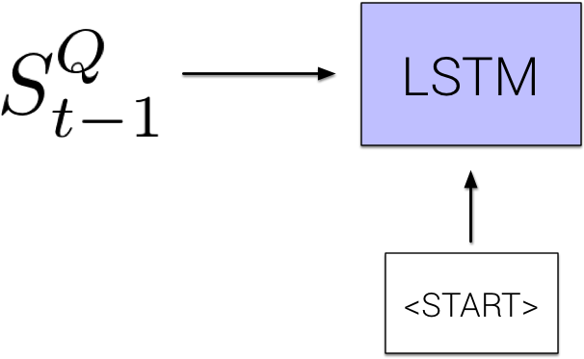
Policy Networks
Q-Bot
A-Bot
Slide Credit: Abhishek Das

Slide 80

Policy Networks
Q-Bot
A-Bot
Slide Credit: Abhishek Das

Slide 81

Policy Networks
Q-Bot
A-Bot
Slide Credit: Abhishek Das

Slide 82

Policy Networks
Q-Bot
A-Bot
Slide Credit: Abhishek Das

Slide 83

Policy Networks
Q-Bot
A-Bot
Slide Credit: Abhishek Das

Slide 84
Policy Networks
Q-Bot
A-Bot
Slide Credit: Abhishek Das

Slide 85
Policy Networks
Q-Bot
A-Bot
Slide Credit: Abhishek Das

Slide 86
Policy Networks
Q-Bot
A-Bot
VGG-16
Slide Credit: Abhishek Das

Slide 87



Policy Networks
Q-Bot
A-Bot
Slide Credit: Abhishek Das

Slide 88

Policy Networks
Q-Bot
A-Bot
Slide Credit: Abhishek Das

Slide 89


Policy Networks
Q-Bot
Fact
Embedding
A-Bot
Two zebra are walking around their pen at the zoo.
Slide Credit: Abhishek Das

Slide 90

Policy Networks
Q-Bot
Fact
Embedding
A-Bot
Is this zoo?
Yes
Two zebra are walking around their pen at the zoo.
Slide Credit: Abhishek Das

Slide 91

Policy Networks
Q-Bot
Fact
Embedding
A-Bot
How many zebra?
Two
Is this zoo?
Yes
Two zebra are walking around their pen at the zoo.
Slide Credit: Abhishek Das

Slide 92





Policy Networks
Q-Bot
History
Encoder
Fact
Embedding
A-Bot
How many zebra?
Two
Is this zoo?
Yes
Two zebra are walking around their pen at the zoo.
Slide Credit: Abhishek Das

Slide 93


Policy Networks
Q-Bot
History
Encoder
Fact
Embedding
A-Bot
How many zebra?
Two
Is this zoo?
Yes
Two zebra are walking around their pen at the zoo.
Slide Credit: Abhishek Das

Slide 94


Policy Networks
Q-Bot
History
Encoder
Fact
Embedding
A-Bot
How many zebra?
Two
Is this zoo?
Yes
Two zebra are walking around their pen at the zoo.
Slide Credit: Abhishek Das

Slide 95
Policy Networks
Q-Bot
A-Bot
Slide Credit: Abhishek Das

Slide 96
Policy Networks
Q-Bot
A-Bot
Slide Credit: Abhishek Das

Slide 97



Policy Networks
Q-Bot
A-Bot
Slide Credit: Abhishek Das

Slide 98
Policy Networks
Q-Bot
A-Bot
Slide Credit: Abhishek Das

Slide 99
Policy Gradients
REINFORCE Gradients
Slide Credit: Abhishek Das

Slide 100
Turing Test

Slide 101


SL vs RL
SL Agents
RL Agents

Slide 102
Plan for Today
(Deep) Reinforcement Learning
  Policy gradients
Closing the loop

Slide 103
So what is Deep (Machine) Learning?
A few different ideas:
(Hierarchical) Compositionality
  Cascade of non-linear transformations
  Multiple layers of representations
End-to-End Learning
  Learning (goal-driven) representations
  Learning to feature extraction
Distributed Representations
  No single neuron “encodes” everything
  Groups of neurons work together

Slide 104


Building A Complicated Function
Given a library of simple functions
Idea 2: Compositions
Deep Learning
Grammar models
Scattering transforms…
Compose into a
complicate function
Slide Credit: Marc'Aurelio Ranzato, Yann LeCun

Slide 105
Differentiable Computation Graph
Any DAG of differentialble modules is allowed!
Slide Credit: Marc'Aurelio Ranzato

Slide 106
So what is Deep (Machine) Learning?
A few different ideas:
(Hierarchical) Compositionality
  Cascade of non-linear transformations
  Multiple layers of representations
End-to-End Learning
  Learning (goal-driven) representations
  Learning to feature extraction
Distributed Representations
  No single neuron “encodes” everything
  Groups of neurons work together

Slide 107

“Shallow” vs Deep Learning
“Shallow” models
Deep models
hand-crafted
Feature Extractor
“Simple” Trainable
Classifier
fixed
learned
Trainable
Feature-Transform /
Classifier
Trainable
Feature-Transform /
Classifier
Trainable
Feature-Transform /
Classifier
Learned Internal Representations
Slide Credit: Marc'Aurelio Ranzato, Yann LeCun

Slide 108

Key Computation: Forward-Prop
Slide Credit: Marc'Aurelio Ranzato, Yann LeCun

Slide 109

Key Computation: Back-Prop
Slide Credit: Marc'Aurelio Ranzato, Yann LeCun

Slide 110
So what is Deep (Machine) Learning?
A few different ideas:
(Hierarchical) Compositionality
  Cascade of non-linear transformations
  Multiple layers of representations
End-to-End Learning
  Learning (goal-driven) representations
  Learning to feature extraction
Distributed Representations
  No single neuron “encodes” everything
  Groups of neurons work together

Slide 111

Distributed Representations Toy Example
Can we interpret each dimension?
Slide Credit: Moontae Lee

Slide 112

Power of distributed representations!
Local
Distributed
Slide Credit: Moontae Lee

Slide 113
What is this class about?

Slide 114
What is this class about?
Introduction to Deep Learning
Goal:
  After finishing this class, you should be ready to get started on your first DL research project.
    CNNs
    RNNs
    Deep Reinforcement Learning
    Generative Models (VAEs, GANs)
Target Audience:
  Senior undergrads, MS-ML, and new PhD students

Slide 115
What did we learn?
Background & Basics
    Neural Networks, Backprop, Optimization (SGD)
Module 1: Convolutional Neural Networks (CNNs)
    Architectures, Pre-training, Fine-tuning
    Visualizations, Fooling CNSS, Adversarial examples
    Different tasks: detection CNNs, segmentation CNNs
Module 2: Recurrent Neural Networks (RNNs)
    Difficulty of learning; “Vanilla” RNNs, LSTMs, GRU
    RNNs for Sequence-to-Sequence (machine translation & image captioning, VQA, Visual Dialog)
Module 3: Deep Reinforcement Learning
    Overview, policy gradients
    Optimizing Neural Sequence Models for goal-driven rewards
Module 4: Deep Structured Prediction
    Crash course on Bayes Nets, Variational Inference
    Variational Auto Encoders (VAEs)
Module 5: Advanced Topics
    GANs, Adversarial Learning

Slide 116


Arxiv Fire Hose
PhD Student
Deep Learning papers

Slide 117

Feedback

Slide 118
Thanks!

