Slide 1
CS 4803 / 7643: Deep Learning
Topics:
  (Finish) Computing Gradients
    Backprop in FC+ReLU NNs
  Convolutional Neural Networks
Dhruv Batra
Georgia Tech

Slide 2
Administrativia
HW1 Reminder
  Due: 10/02, 11:55pm
HW0 grades
  Out week of 10/01

Slide 3
Project
Goal
  Chance to try Deep Learning
  Combine with other classes / research / credits / anything
    You have our blanket permission
    Extra credit for shooting for a publication
    Get permission from other instructors; delineate different parts
  Encouraged to apply to your research (computer vision, NLP, robotics,…)
  Must be done this semester.
  Groups of 3-4
Main categories
  Application/Survey
    Compare a bunch of existing algorithms on a new application domain of your interest
  Formulation/Development
    Formulate a new model or algorithm for a new or old problem
  Theory
    Theoretically analyze an existing algorithm

Slide 4
Computing
Major bottleneck
  GPUs
Options
  Your own / group / advisor’s resources
  Google Cloud Credits
    $50 credits to every registered student courtesy Google
  https://colab.research.google.com
  Minsky cluster in IC

Slide 5
Administrativia
Project Teams Google Doc
  https://docs.google.com/spreadsheets/d/1BipWLvvWb7Fu6OSDd-uOCF1Lr_4drKOCRVdhxm_eSHc/edit#gid=0
  Project Title
  1-3 sentence project summary TL;DR
  Team member names

Slide 6
Recap from last time

Slide 7
How do we compute gradients?
Analytic or “Manual” Differentiation
Symbolic Differentiation
Numerical Differentiation
Automatic Differentiation
  Forward mode AD
  Reverse mode AD
    aka “backprop”

Slide 8
Computational Graph
Any DAG of differentiable modules is allowed!
Slide Credit: Marc'Aurelio Ranzato

Slide 9
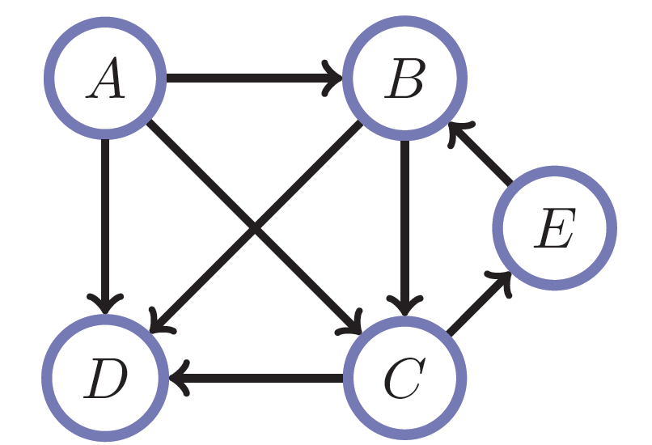
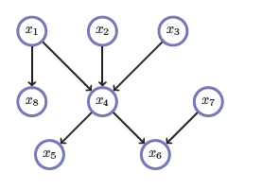
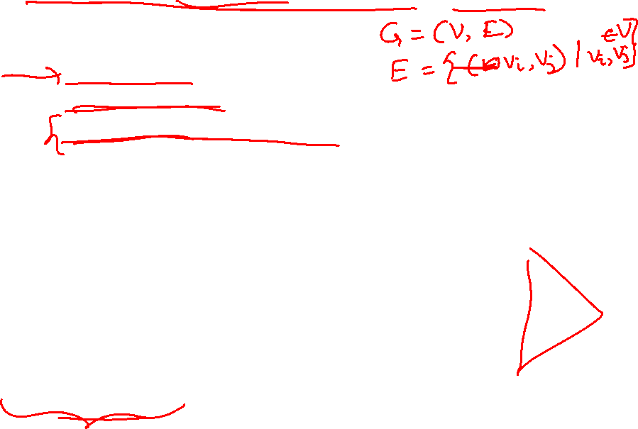
Directed Acyclic Graphs (DAGs)
Exactly what the name suggests
  Directed edges
  No (directed) cycles
  Underlying undirected cycles okay

Slide 10
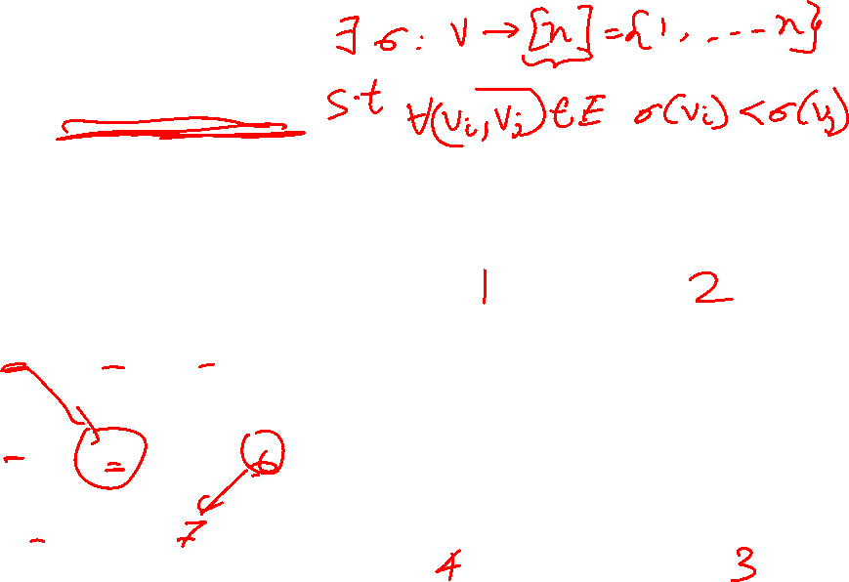
Directed Acyclic Graphs (DAGs)
Concept
  Topological Ordering

Slide 11
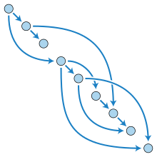
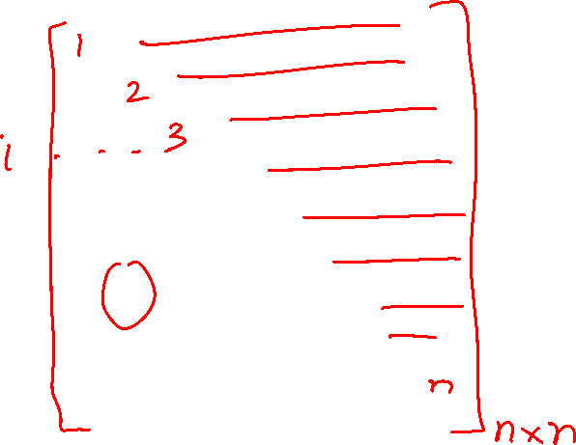
Directed Acyclic Graphs (DAGs)

Slide 12
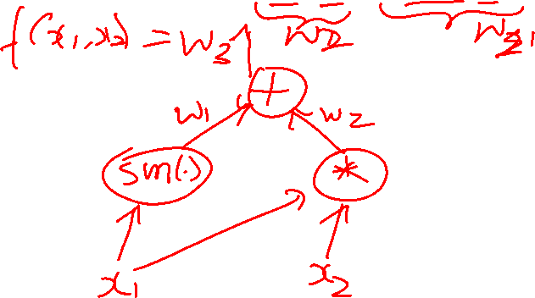
Computational Graphs
Notation

Slide 13
How do we compute gradients?
Analytic or “Manual” Differentiation
Symbolic Differentiation
Numerical Differentiation
Automatic Differentiation
  Forward mode AD
  Reverse mode AD
    aka “backprop”

Slide 14
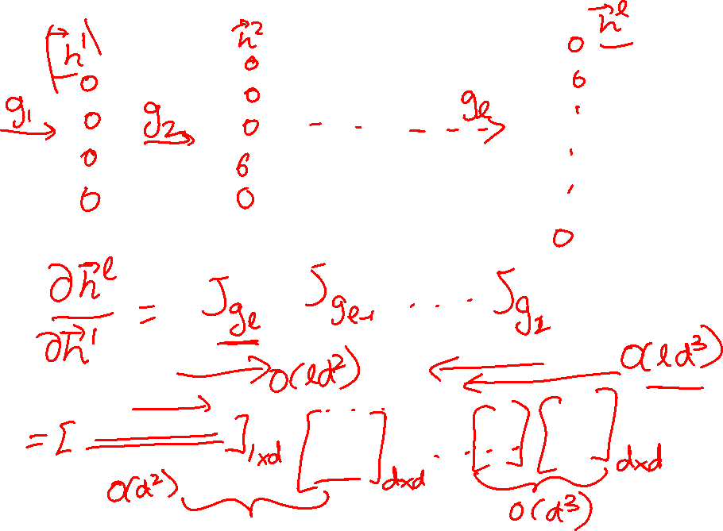
Chain Rule: Cascaded

Slide 15
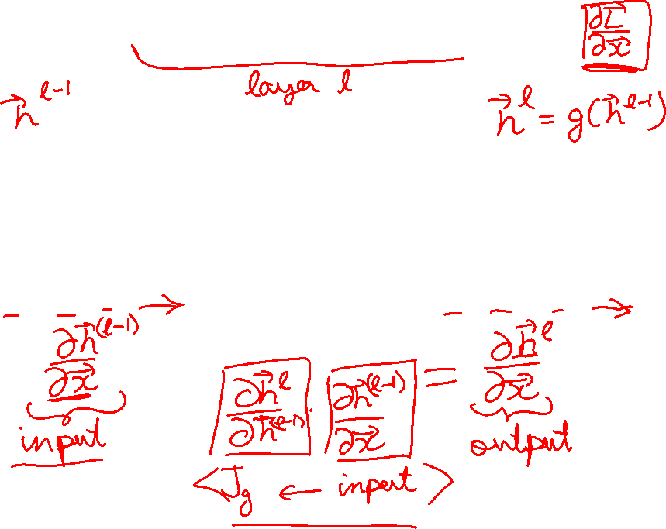
Forward mode AD
g
Notes:
What we’re doing in backprop is we have all these nodes in our computational graph, each node only aware of immediate surroundings
at each node have ...

Slide 16
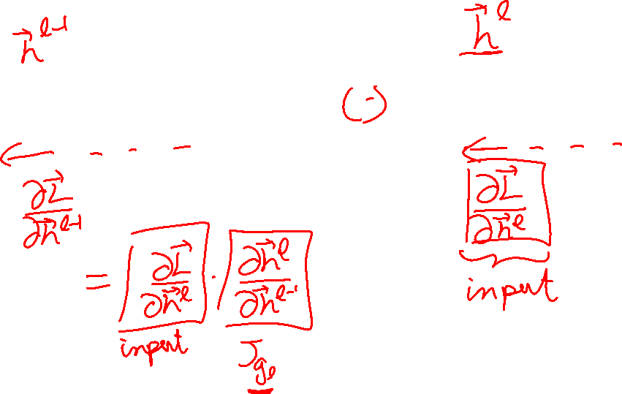
Reverse mode AD
g
Notes:
What we’re doing in backprop is we have all these nodes in our computational graph, each node only aware of immediate surroundings
at each node have ...

Slide 17
Forward mode vs Reverse Mode
Key Computations

Slide 18
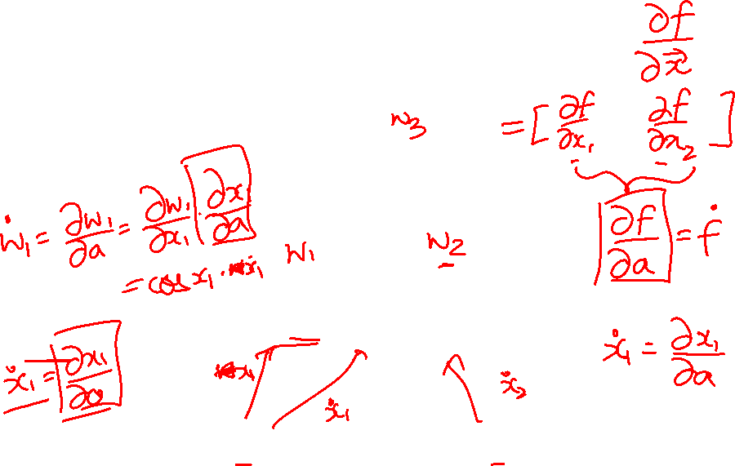
Example: Forward mode AD
+
sin( )
*
x₁
x₂

Slide 19
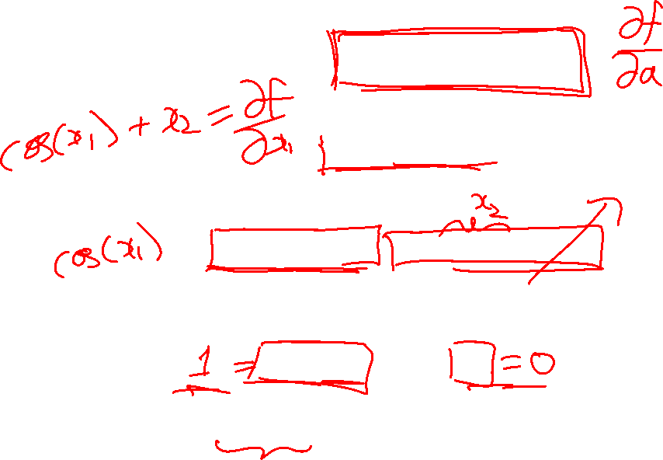
Example: Forward mode AD
+
sin( )
*
x₁
x₂

Slide 20
Example: Forward mode AD
+
sin( )
*
x₁
x₂

Slide 21
Example: Reverse mode AD
+
sin( )
*
x₁
x₂

Slide 22
Example: Reverse mode AD
+
sin( )
*
x₁
x₂

Slide 23
Forward Pass vs
Forward mode AD vs Reverse Mode AD
+
sin( )
*
x₁
x₂
+
+
sin( )
*
sin( )
*
x₁
x₂
x₁
x₂

Slide 24
Forward mode vs Reverse Mode
What are the differences?
Which one is faster to compute?
  Forward or backward?

Slide 25
Forward mode vs Reverse Mode
What are the differences?
Which one is faster to compute?
  Forward or backward?
Which one is more memory efficient (less storage)?
  Forward or backward?

Slide 26
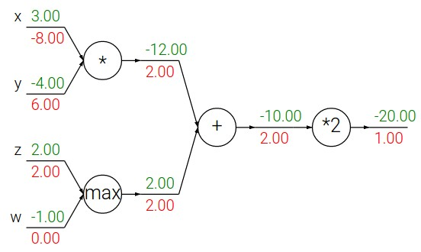
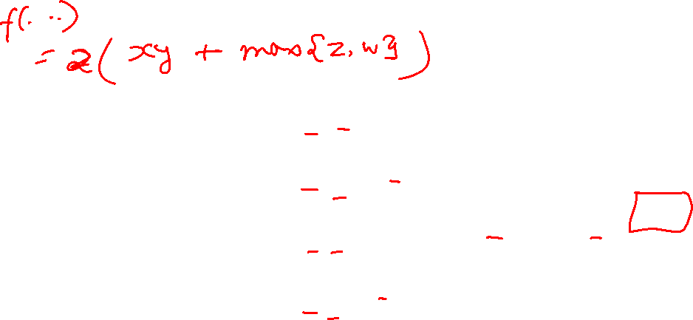
Patterns in backward flow
Slide Credit: Fei-Fei Li, Justin Johnson, Serena Yeung, CS 231n

Slide 27
Patterns in backward flow
Slide Credit: Fei-Fei Li, Justin Johnson, Serena Yeung, CS 231n

Slide 28
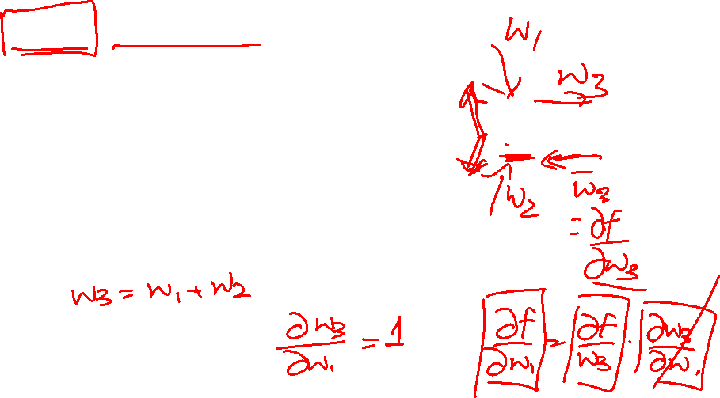
Patterns in backward flow
add gate: gradient distributor
Slide Credit: Fei-Fei Li, Justin Johnson, Serena Yeung, CS 231n

Slide 29
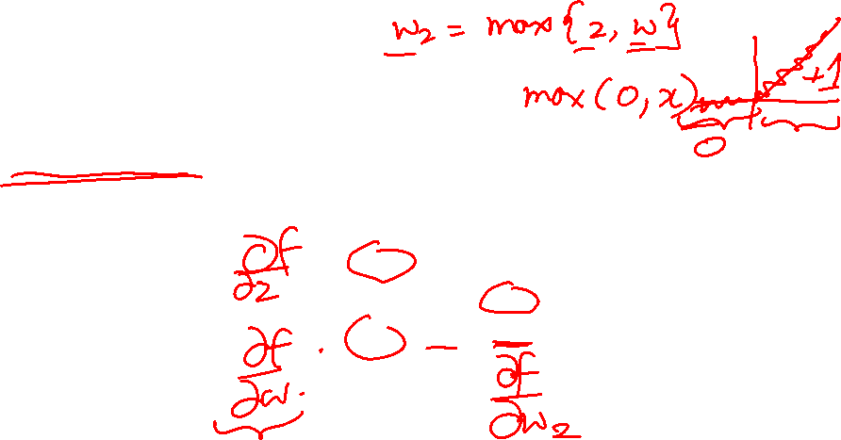
Patterns in backward flow
add gate: gradient distributor
Q: What is a max gate?
Slide Credit: Fei-Fei Li, Justin Johnson, Serena Yeung, CS 231n

Slide 30
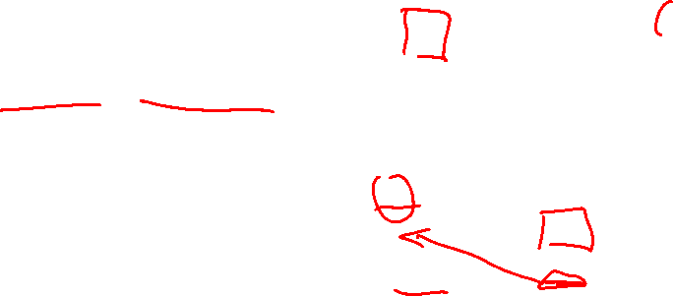
Patterns in backward flow
add gate: gradient distributor
max gate: gradient router
Slide Credit: Fei-Fei Li, Justin Johnson, Serena Yeung, CS 231n

Slide 31
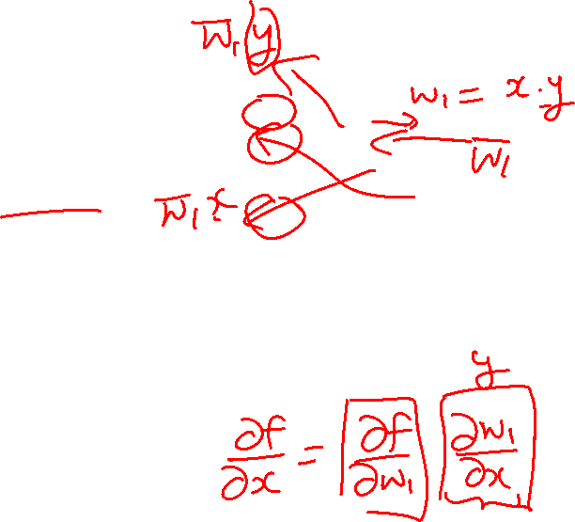
Patterns in backward flow
add gate: gradient distributor
max gate: gradient router
Q: What is a mul gate?
Slide Credit: Fei-Fei Li, Justin Johnson, Serena Yeung, CS 231n

Slide 32

Patterns in backward flow
add gate: gradient distributor
max gate: gradient router
mul gate: gradient switcher
Slide Credit: Fei-Fei Li, Justin Johnson, Serena Yeung, CS 231n
Notes:
Gradient switcher and scaler
Mul: scale upstream gradient by value of other branch

Slide 33
Duality in Fprop and Bprop
FPROP
BPROP
SUM
+
COPY
+

Slide 34
Plan for Today
(Finish) Computing Gradients
  Backprop in FC+ReLU NNs
Convolutional Neural Networks

Slide 35
Jacobian of ReLU
g(x) = max(0,x)
(elementwise)
4096-d
input vector
4096-d
output vector
Slide Credit: Fei-Fei Li, Justin Johnson, Serena Yeung, CS 231n

Slide 36
Jacobian of ReLU
g(x) = max(0,x)
(elementwise)
4096-d
input vector
4096-d
output vector
Q: what is the size of the Jacobian matrix?
Slide Credit: Fei-Fei Li, Justin Johnson, Serena Yeung, CS 231n
Notes:
Partial deriv. Of each dimension of output with respect to each dimension of input

Slide 37
Jacobian of ReLU
g(x) = max(0,x)
(elementwise)
4096-d
input vector
4096-d
output vector
Q: what is the size of the Jacobian matrix?
[4096 x 4096!]
Slide Credit: Fei-Fei Li, Justin Johnson, Serena Yeung, CS 231n

Slide 38
Jacobian of ReLU
g(x) = max(0,x)
(elementwise)
4096-d
input vector
4096-d
output vector
Q: what is the size of the Jacobian matrix?
[4096 x 4096!]
in practice we process an entire minibatch (e.g. 100) of examples at one time:
i.e. Jacobian would technically be a
[409,600 x 409,600] matrix :\
Slide Credit: Fei-Fei Li, Justin Johnson, Serena Yeung, CS 231n

Slide 39
Jacobian of ReLU
g(x) = max(0,x)
(elementwise)
4096-d
input vector
4096-d
output vector
Q: what is the size of the Jacobian matrix?
[4096 x 4096!]
Q2: what does it look like?
Slide Credit: Fei-Fei Li, Justin Johnson, Serena Yeung, CS 231n
Notes:
For each elem in input, for each elem in output

Slide 40
Jacobian of ReLU
g(x) = max(0,x)
(elementwise)
4096-d
input vector
4096-d
output vector
Slide Credit: Fei-Fei Li, Justin Johnson, Serena Yeung, CS 231n
Notes:
For each elem in input, for each elem in output

Slide 41
Jacobians of FC-Layer

Slide 42
Jacobians of FC-Layer

Slide 43
Jacobians of FC-Layer

Slide 44
Jacobians of FC-Layer

Slide 45
Convolutional Neural Networks
(without the brain stuff)
Slide Credit: Fei-Fei Li, Justin Johnson, Serena Yeung, CS 231n

Slide 46
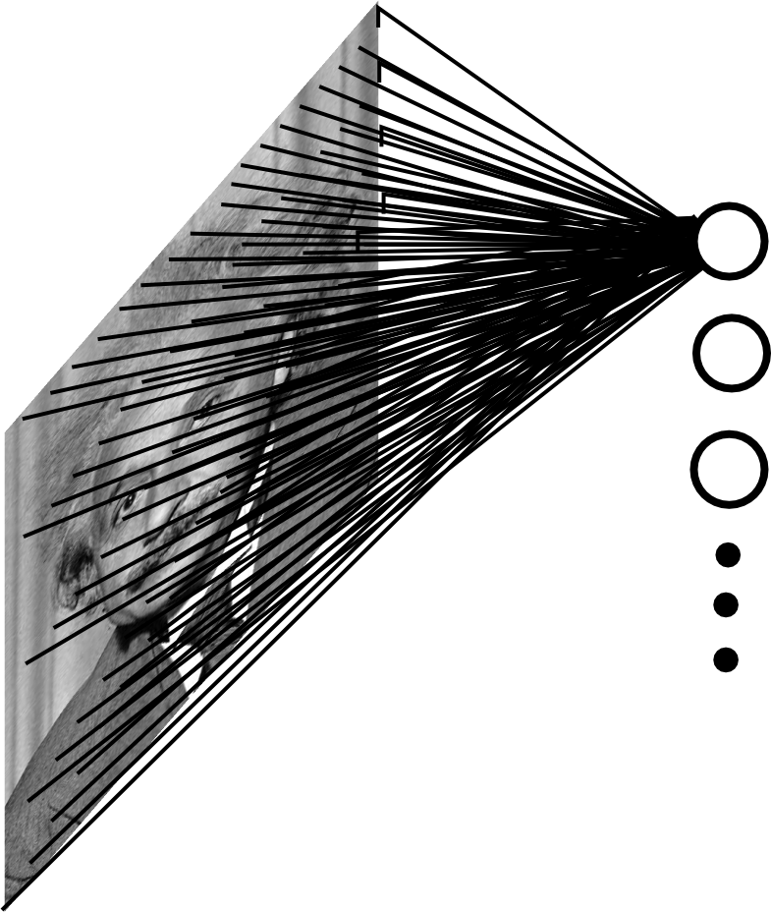
Fully Connected Layer
Example: 200x200 image
40K hidden units
~2B parameters!!!
- Spatial correlation is local
- Waste of resources + we have not enough training samples anyway..
Slide Credit: Marc'Aurelio Ranzato

Slide 47
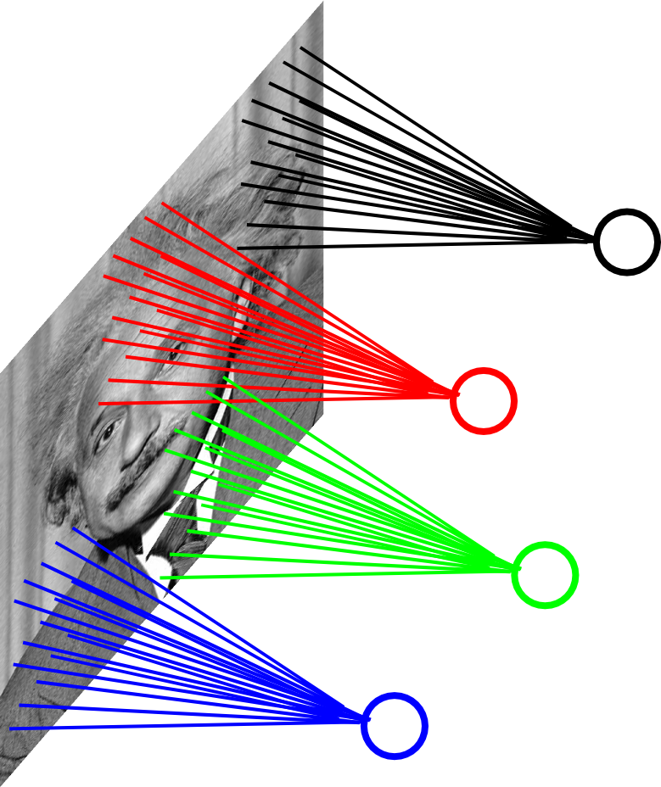
Locally Connected Layer
Example: 200x200 image
40K hidden units
Filter size: 10x10
4M parameters
Note: This parameterization is good when input image is registered (e.g., face recognition).
Slide Credit: Marc'Aurelio Ranzato

Slide 48
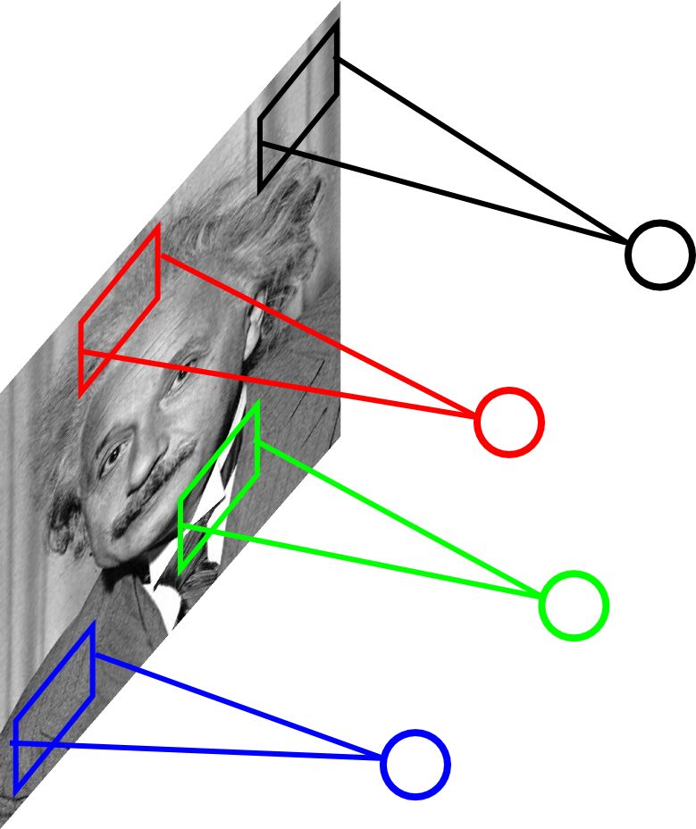
Locally Connected Layer
STATIONARITY? Statistics is similar at different locations
Slide Credit: Marc'Aurelio Ranzato

Slide 49
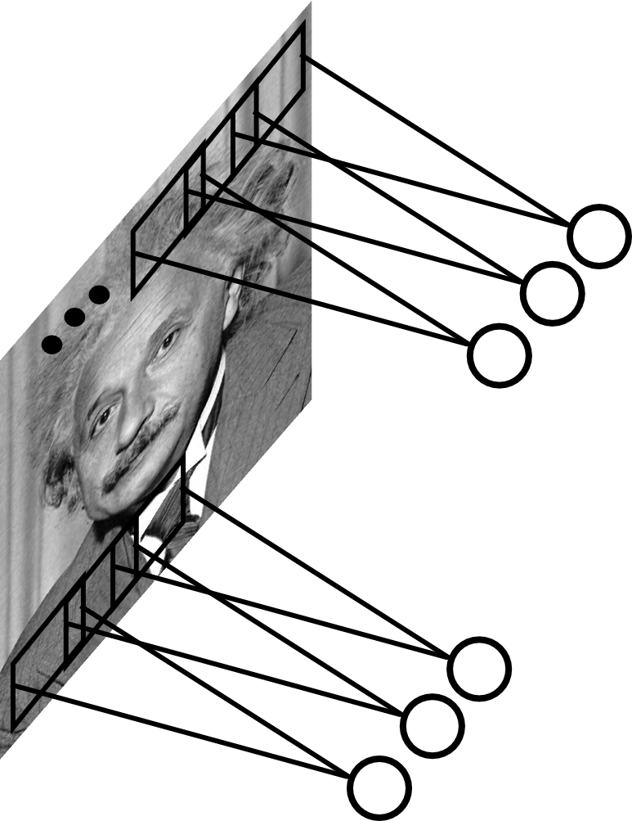
Convolutional Layer
Share the same parameters across different locations (assuming input is stationary):
Convolutions with learned kernels
Slide Credit: Marc'Aurelio Ranzato

Slide 50
Convolutions!

Slide 51
Convolutions for mathematicians

Slide 52
Convolutions for mathematicians

Slide 53
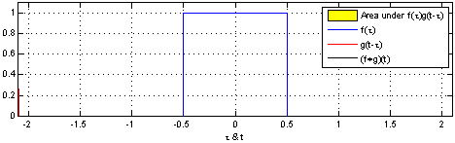
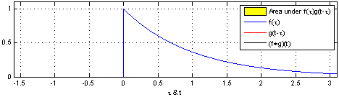
"Convolution of box signal with itself2" by Convolution_of_box_signal_with_itself.gif: Brian Ambergderivative work: Tinos (talk) - Convolution_of_box_signal_with_itself.gif. Licensed under CC BY-SA 3.0 via Commons - https://commons.wikimedia.org/wiki/File:Convolution_of_box_signal_with_itself2.gif#/media/File:Convolution_of_box_signal_with_itself2.gif

Slide 54
Convolutions for computer scientists

Slide 55
Convolutions for computer scientists

Slide 56
Convolutions for programmers

Slide 57
Convolutions for programmers

Slide 58
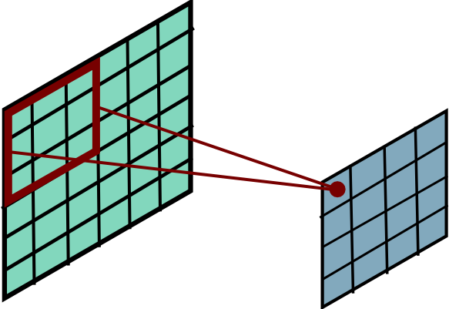
Convolutional Layer
Slide Credit: Marc'Aurelio Ranzato

Slide 59
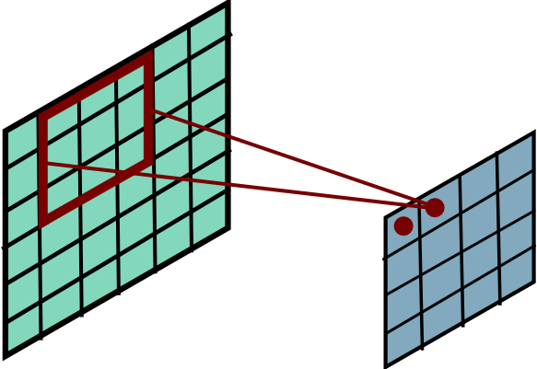
Convolutional Layer
Slide Credit: Marc'Aurelio Ranzato

Slide 60
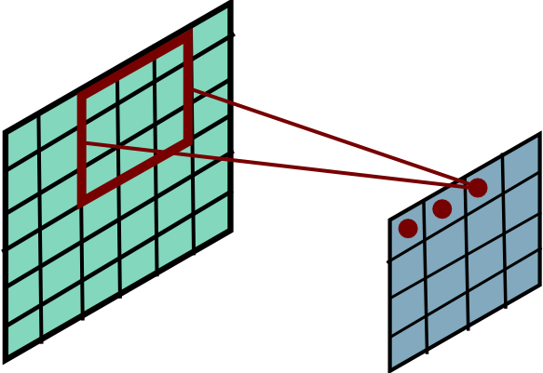
Convolutional Layer
Slide Credit: Marc'Aurelio Ranzato

Slide 61
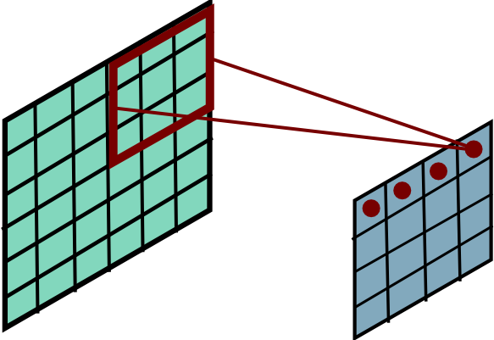
Convolutional Layer
Slide Credit: Marc'Aurelio Ranzato

Slide 62
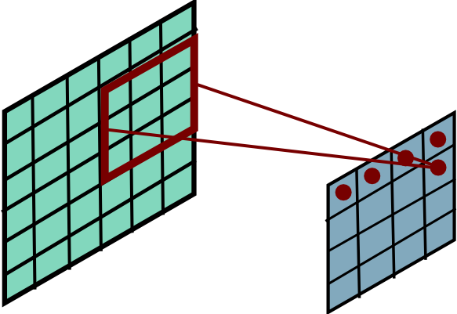
Convolutional Layer
Slide Credit: Marc'Aurelio Ranzato

Slide 63
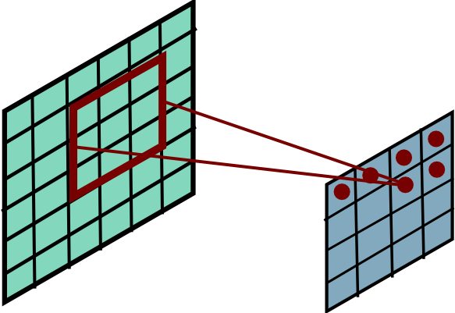
Convolutional Layer
Slide Credit: Marc'Aurelio Ranzato

Slide 64
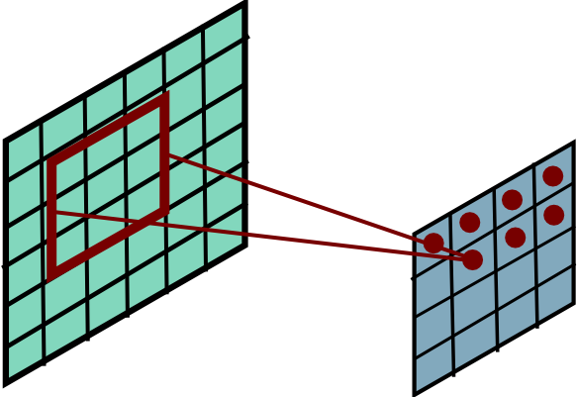
Convolutional Layer
Slide Credit: Marc'Aurelio Ranzato

Slide 65
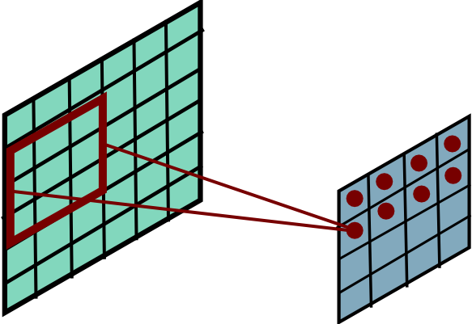
Convolutional Layer
Slide Credit: Marc'Aurelio Ranzato

Slide 66
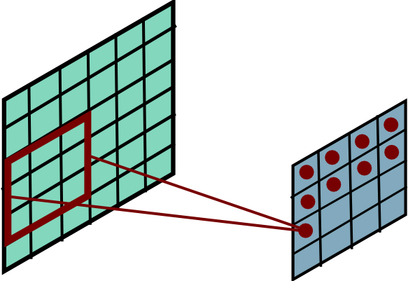
Convolutional Layer
Slide Credit: Marc'Aurelio Ranzato

Slide 67
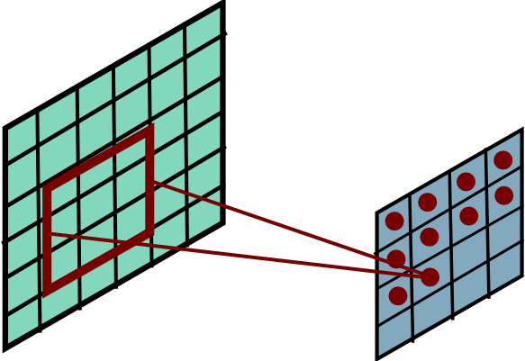
Convolutional Layer
Slide Credit: Marc'Aurelio Ranzato

Slide 68
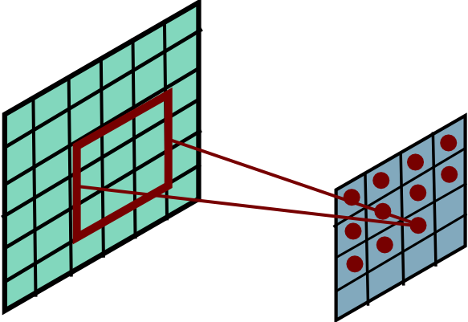
Convolutional Layer
Slide Credit: Marc'Aurelio Ranzato

Slide 69
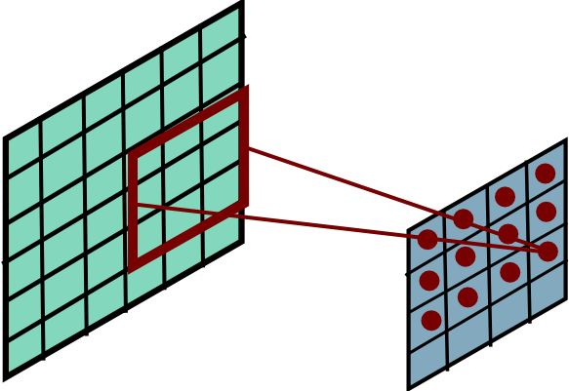
Convolutional Layer
Slide Credit: Marc'Aurelio Ranzato

Slide 70
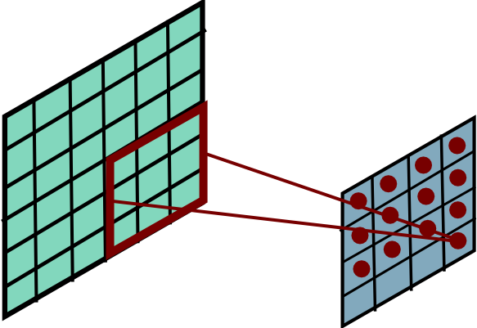
Convolutional Layer
Slide Credit: Marc'Aurelio Ranzato

Slide 71
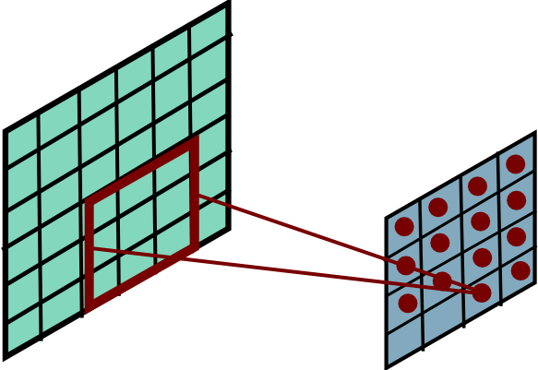
Convolutional Layer
Slide Credit: Marc'Aurelio Ranzato

Slide 72
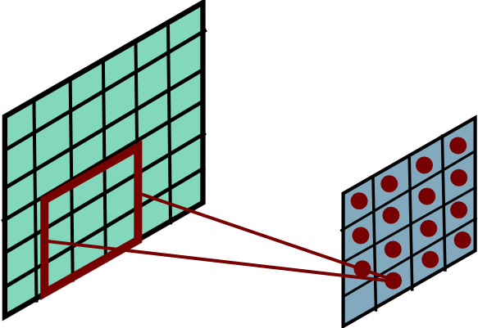
Convolutional Layer
Slide Credit: Marc'Aurelio Ranzato

Slide 73
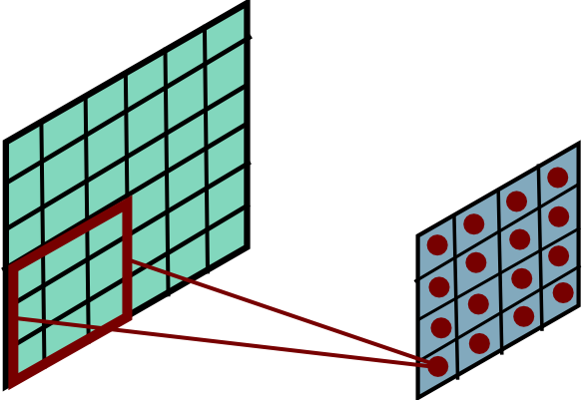
Convolutional Layer
Mathieu et al. “Fast training of CNNs through FFTs” ICLR 2014
Slide Credit: Marc'Aurelio Ranzato

Slide 74
Convolution Explained
http://setosa.io/ev/image-kernels/
https://github.com/bruckner/deepViz

Slide 75
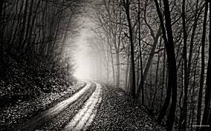
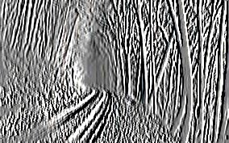
Convolutional Layer
-1 0 1
-1 0 1
-1 0 1
=
*
Slide Credit: Marc'Aurelio Ranzato

Slide 76
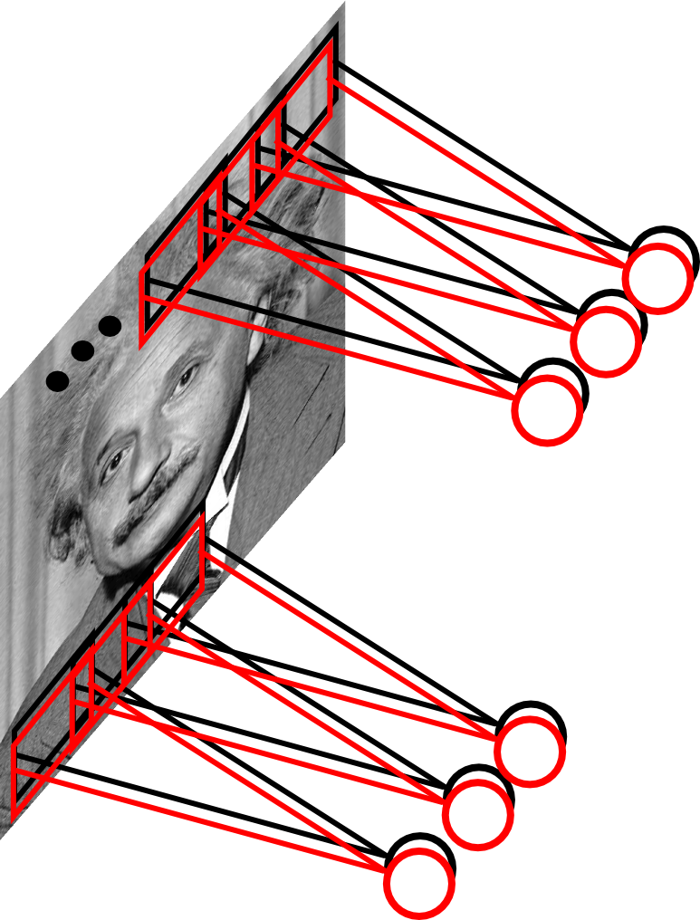
Convolutional Layer
Learn multiple filters.
E.g.: 200x200 image
100 Filters
Filter size: 10x10
10K parameters
Slide Credit: Marc'Aurelio Ranzato

Slide 77
Fully Connected Layer
32x32x3 image -> stretch to 3072 x 1
input
activation
1
1
3072
10 x 3072
weights
10
Slide Credit: Fei-Fei Li, Justin Johnson, Serena Yeung, CS 231n
Notes:
Preserve spatial structure of input

Slide 78
Fully Connected Layer
32x32x3 image -> stretch to 3072 x 1
input
activation
1
1
3072
10 x 3072
weights
10
1 number:
the result of taking a dot product between a row of W and the input (a 3072-dimensional dot product)
Slide Credit: Fei-Fei Li, Justin Johnson, Serena Yeung, CS 231n
Notes:
Preserve spatial structure of input

Slide 79
Convolutional Layer

Slide 80
Convolutional Layer

Slide 81
Convolution Layer
32x32x3 image -> preserve spatial structure
32
height
32
width
3
depth
Slide Credit: Fei-Fei Li, Justin Johnson, Serena Yeung, CS 231n
Notes:
Preserve spatial structure of input

Slide 82
Convolution Layer
32x32x3 image
5x5x3 filter
32
Convolve the filter with the image
i.e. “slide over the image spatially, computing dot products”
32
3
Slide Credit: Fei-Fei Li, Justin Johnson, Serena Yeung, CS 231n

Slide 83
Convolution Layer
Filters always extend the full depth of the input volume
32x32x3 image
5x5x3 filter
32
Convolve the filter with the image
i.e. “slide over the image spatially, computing dot products”
32
3
Slide Credit: Fei-Fei Li, Justin Johnson, Serena Yeung, CS 231n

Slide 84


Convolution Layer
32x32x3 image
5x5x3 filter
32
1 number:
the result of taking a dot product between the filter and a small 5x5x3 chunk of the image
(i.e. 5*5*3 = 75-dimensional dot product + bias)
32
3
Slide Credit: Fei-Fei Li, Justin Johnson, Serena Yeung, CS 231n

Slide 85
Convolution Layer
activation map
32x32x3 image
5x5x3 filter
32
28
convolve (slide) over all spatial locations
32
28
3
1
Slide Credit: Fei-Fei Li, Justin Johnson, Serena Yeung, CS 231n

Slide 86
consider a second, green filter
Convolution Layer
32x32x3 image
5x5x3 filter
activation maps
32
28
convolve (slide) over all spatial locations
32
28
3
1
Slide Credit: Fei-Fei Li, Justin Johnson, Serena Yeung, CS 231n

Slide 87
For example, if we had 6 5x5 filters, we’ll get 6 separate activation maps:
activation maps
32
28
Convolution Layer
32
28
3
6
We stack these up to get a “new image” of size 28x28x6!
Slide Credit: Fei-Fei Li, Justin Johnson, Serena Yeung, CS 231n

