Slide 1
CS 4803 / 7643: Deep Learning
Topics:
  Convolutional Neural Networks
    Stride, padding
    Pooling layers
    Fully-connected layers as convolutions
Dhruv Batra
Georgia Tech

Slide 2
Administrativia
HW1 Reminder
  Due: 10/02, 11:55pm

Slide 3
Recap from last time

Slide 4
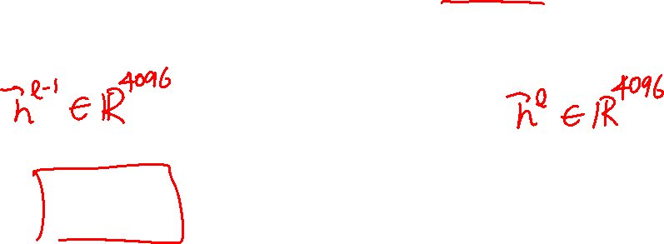
Jacobian of ReLU
g(x) = max(0,x)
(elementwise)
4096-d
input vector
4096-d
output vector
Slide Credit: Fei-Fei Li, Justin Johnson, Serena Yeung, CS 231n

Slide 5
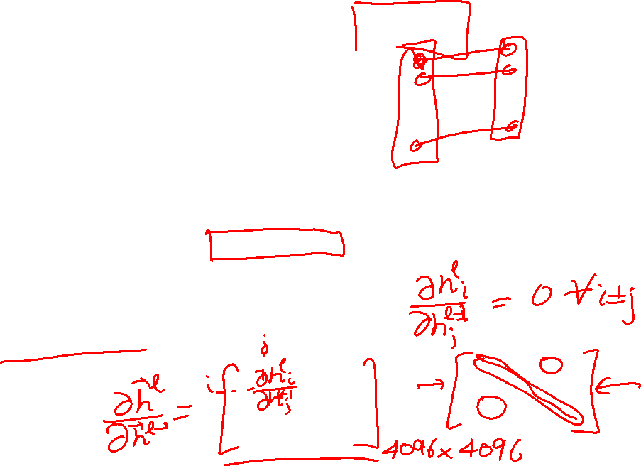
Jacobian of ReLU
g(x) = max(0,x)
(elementwise)
4096-d
input vector
4096-d
output vector
Q: what is the size of the Jacobian matrix?
Slide Credit: Fei-Fei Li, Justin Johnson, Serena Yeung, CS 231n
Notes:
Partial deriv. Of each dimension of output with respect to each dimension of input

Slide 6
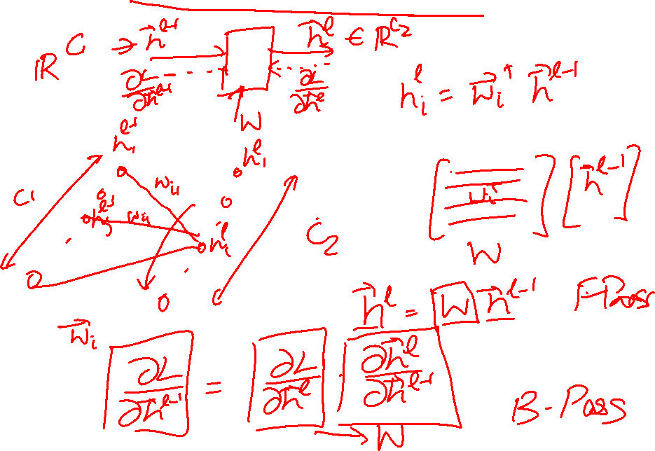
Jacobians of FC-Layer

Slide 7
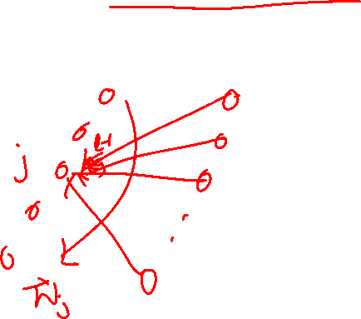
Jacobians of FC-Layer

Slide 8
Jacobians of FC-Layer

Slide 9
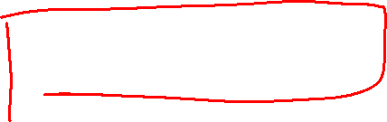
Convolutional Neural Networks
(without the brain stuff)
Slide Credit: Fei-Fei Li, Justin Johnson, Serena Yeung, CS 231n

Slide 10
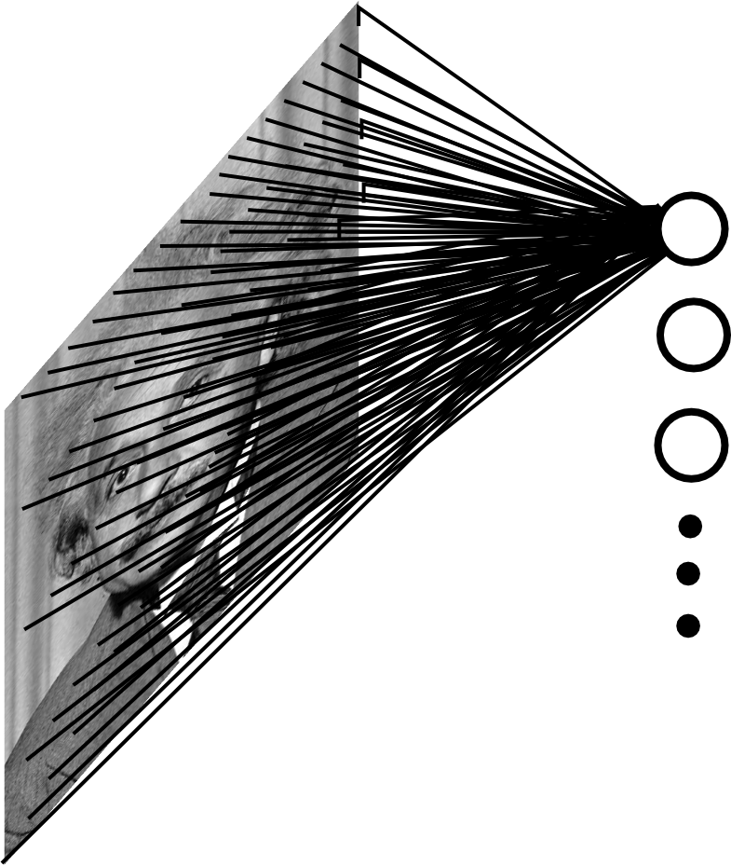
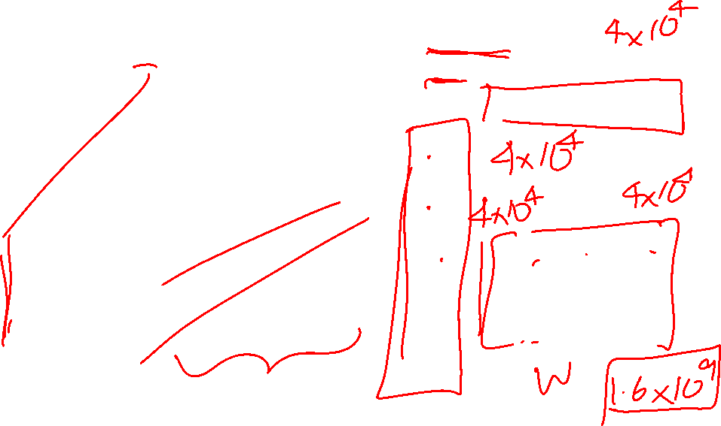
Fully Connected Layer
Example: 200x200 image
40K hidden units
~2B parameters!!!
- Spatial correlation is local
- Waste of resources + we have not enough training samples anyway..
Slide Credit: Marc'Aurelio Ranzato

Slide 11
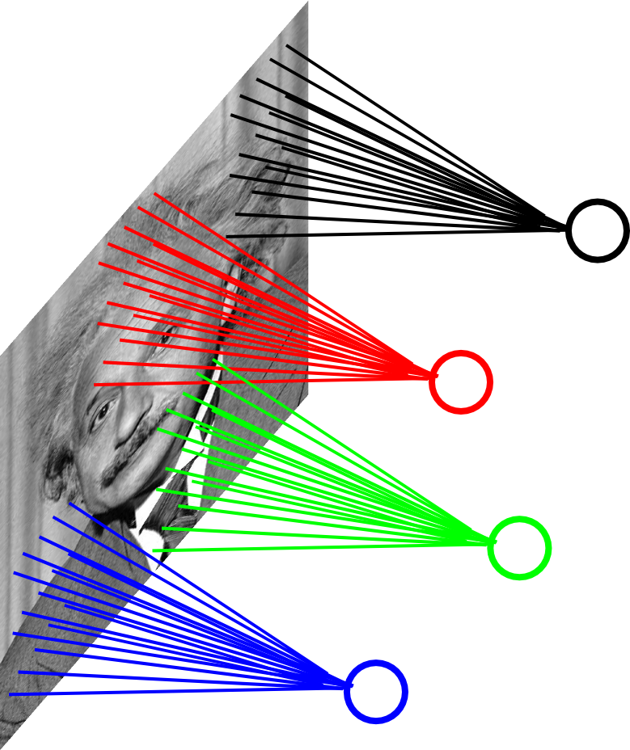
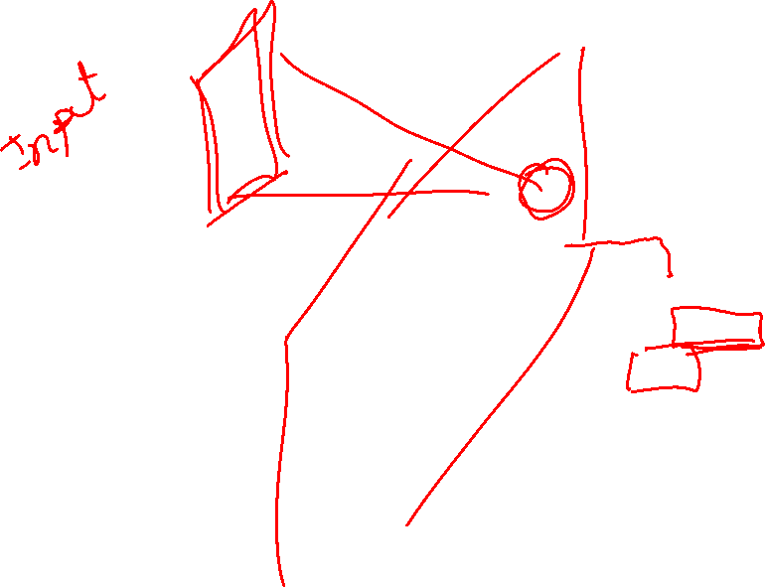
Locally Connected Layer
Example: 200x200 image
40K hidden units
Filter size: 10x10
4M parameters
Note: This parameterization is good when input image is registered (e.g., face recognition).
Slide Credit: Marc'Aurelio Ranzato

Slide 12
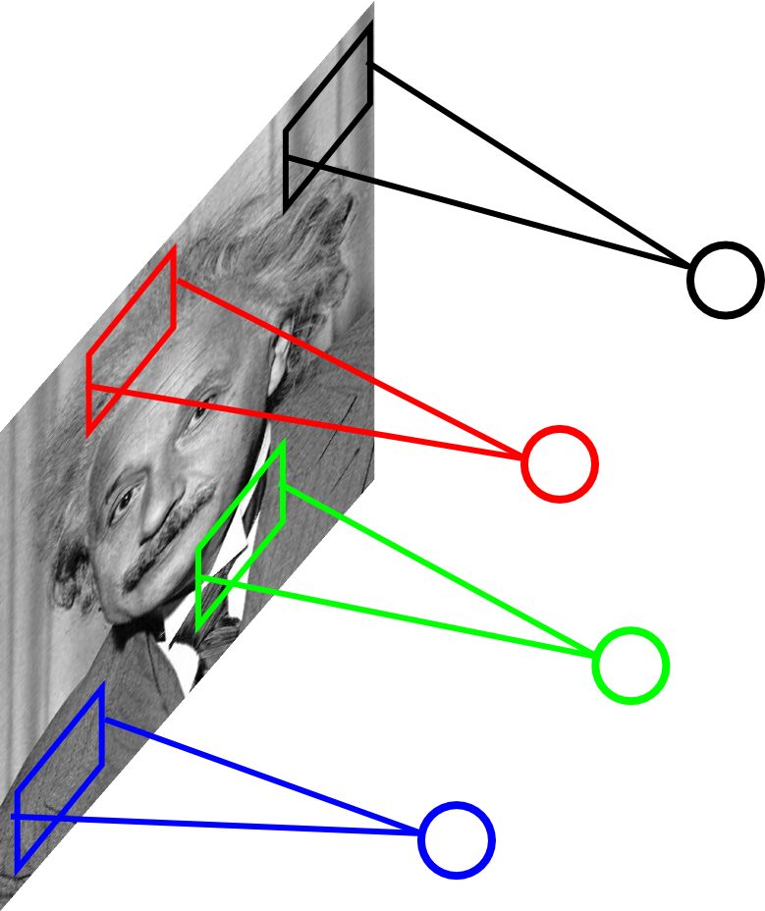
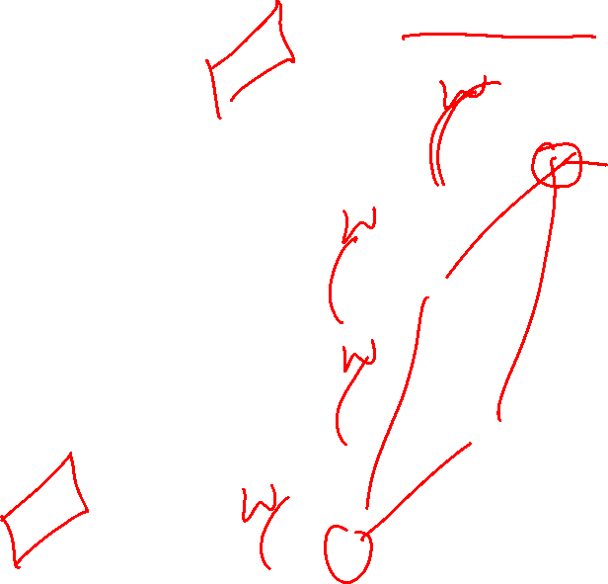
Locally Connected Layer
STATIONARITY? Statistics is similar at different locations
Slide Credit: Marc'Aurelio Ranzato

Slide 13
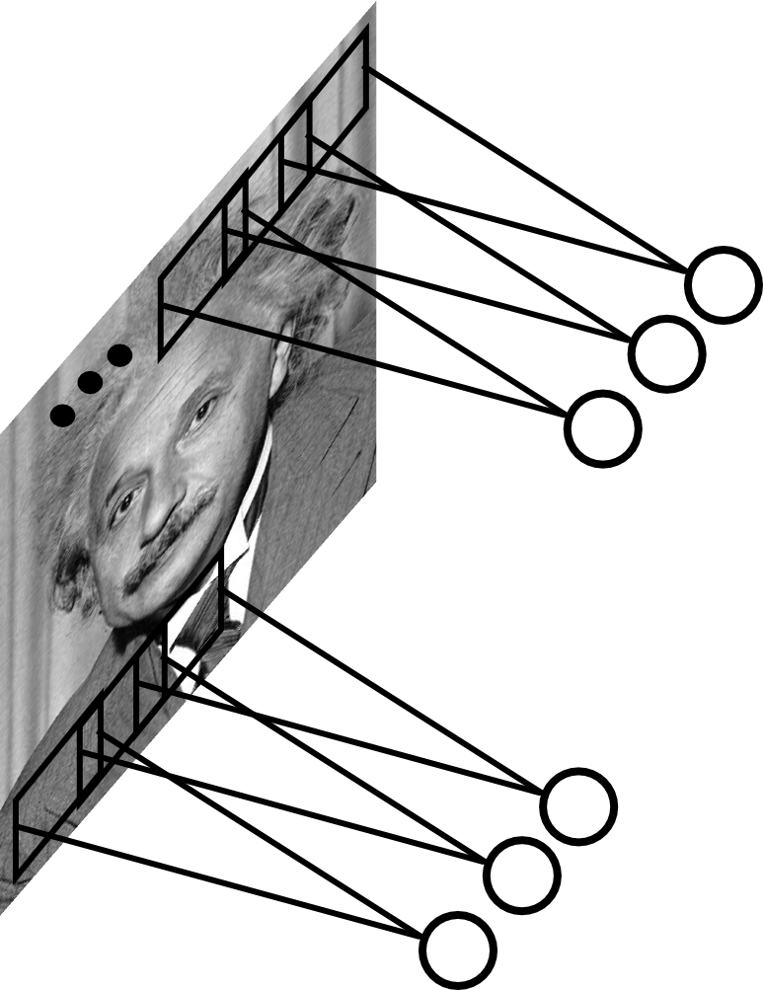
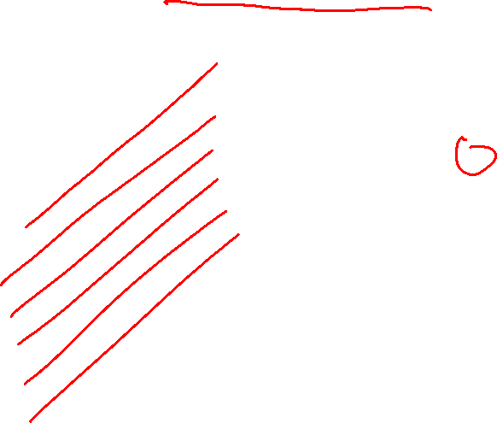
Convolutional Layer
Share the same parameters across different locations (assuming input is stationary):
Convolutions with learned kernels
Slide Credit: Marc'Aurelio Ranzato

Slide 14

Convolutions!

Slide 15
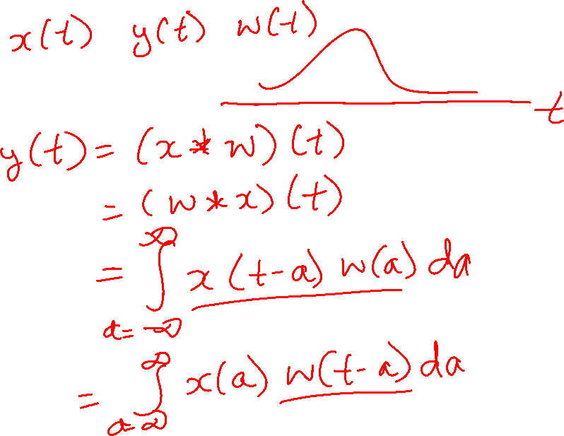
Convolutions for mathematicians

Slide 16
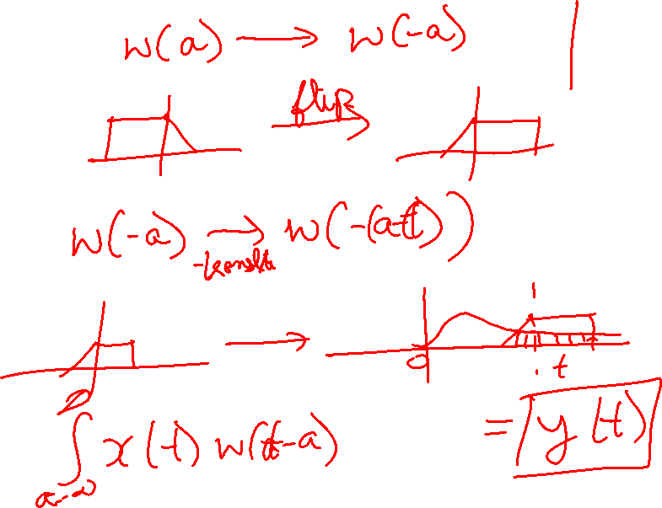
Convolutions for mathematicians

Slide 17
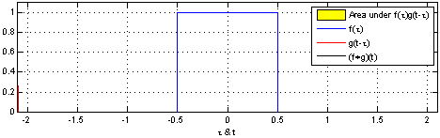
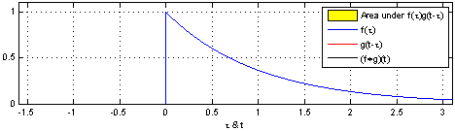
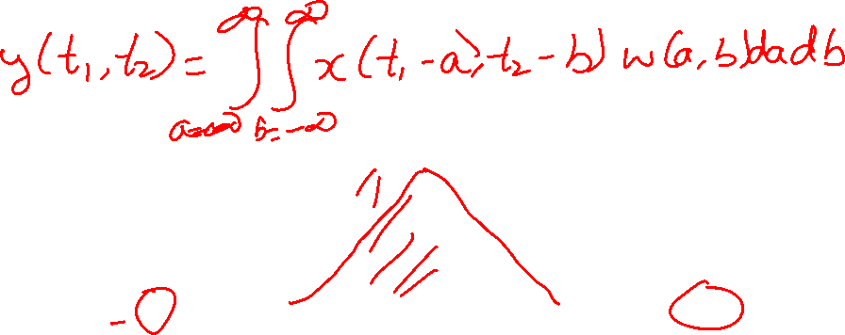
"Convolution of box signal with itself2" by Convolution_of_box_signal_with_itself.gif: Brian Ambergderivative work: Tinos (talk) - Convolution_of_box_signal_with_itself.gif. Licensed under CC BY-SA 3.0 via Commons - https://commons.wikimedia.org/wiki/File:Convolution_of_box_signal_with_itself2.gif#/media/File:Convolution_of_box_signal_with_itself2.gif

Slide 18
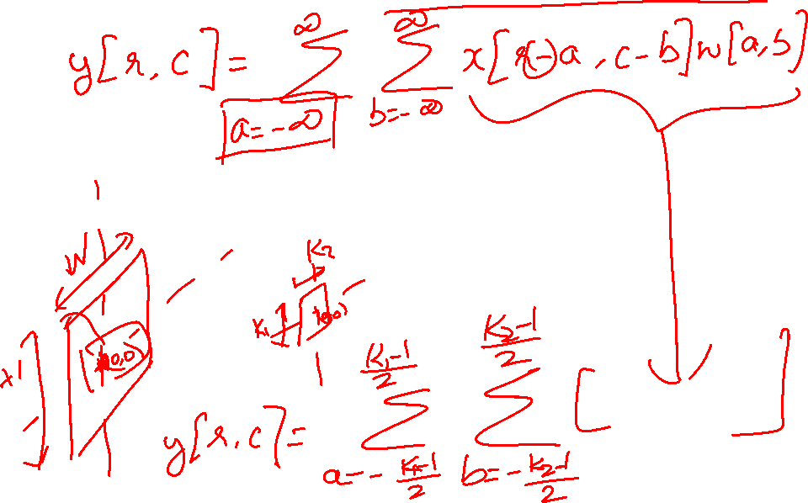
Convolutions for computer scientists

Slide 19
Convolutions for computer scientists

Slide 20
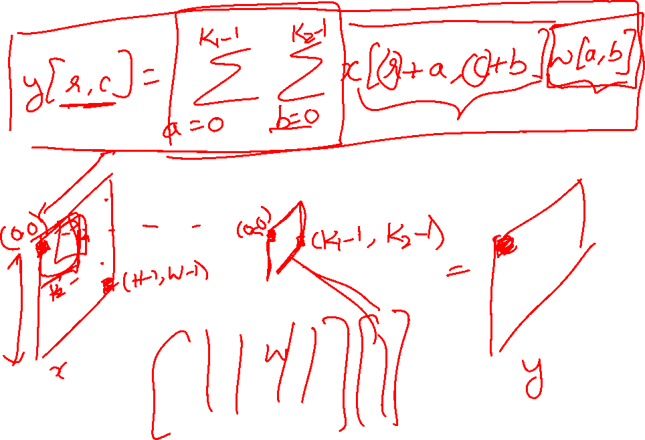
Convolutions for programmers

Slide 21
Convolutions for programmers

Slide 22
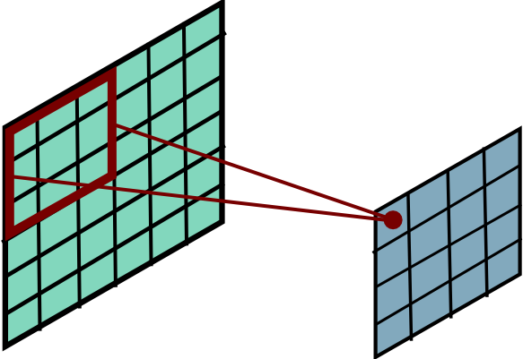
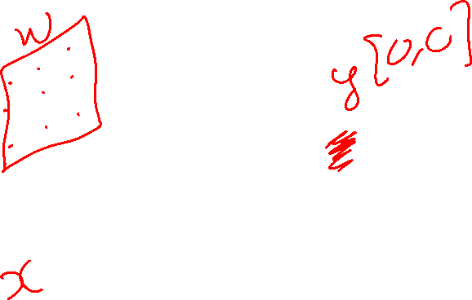
Convolutional Layer
Slide Credit: Marc'Aurelio Ranzato

Slide 23
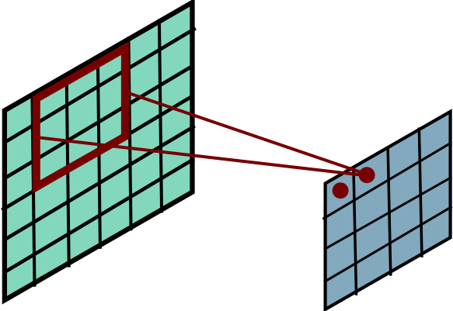
Convolutional Layer
Slide Credit: Marc'Aurelio Ranzato

Slide 24
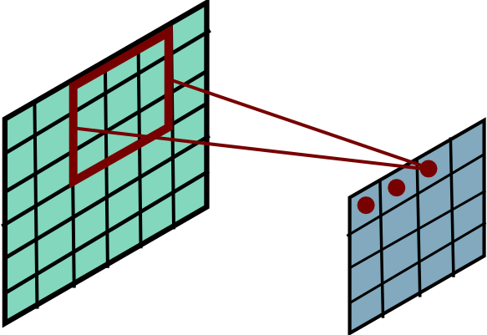
Convolutional Layer
Slide Credit: Marc'Aurelio Ranzato

Slide 25
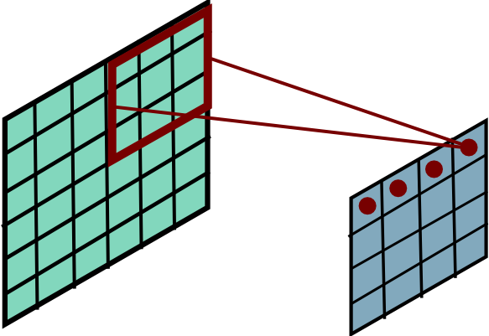
Convolutional Layer
Slide Credit: Marc'Aurelio Ranzato

Slide 26
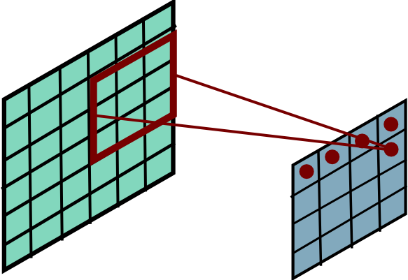

Convolutional Layer
Slide Credit: Marc'Aurelio Ranzato

Slide 27
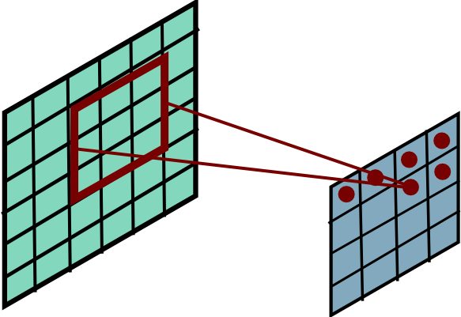
Convolutional Layer
Slide Credit: Marc'Aurelio Ranzato

Slide 28
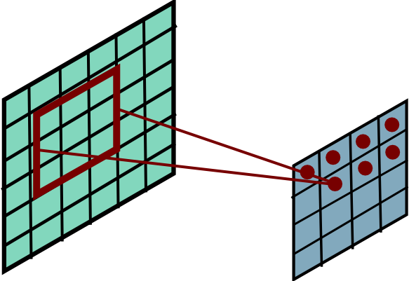
Convolutional Layer
Slide Credit: Marc'Aurelio Ranzato

Slide 29
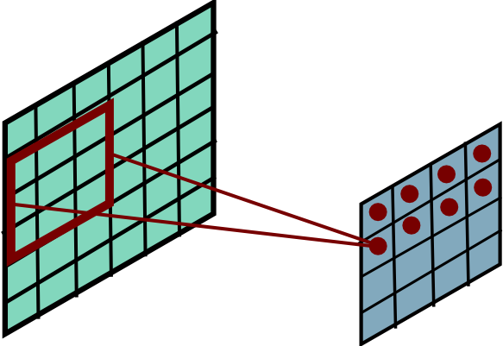
Convolutional Layer
Slide Credit: Marc'Aurelio Ranzato

Slide 30
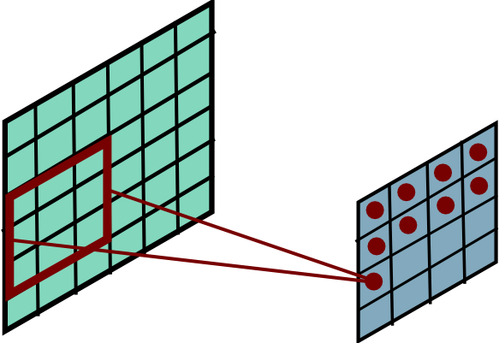
Convolutional Layer
Slide Credit: Marc'Aurelio Ranzato

Slide 31
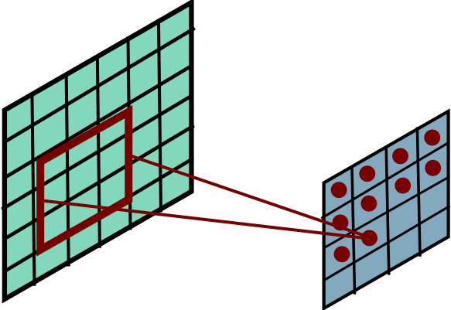
Convolutional Layer
Slide Credit: Marc'Aurelio Ranzato

Slide 32
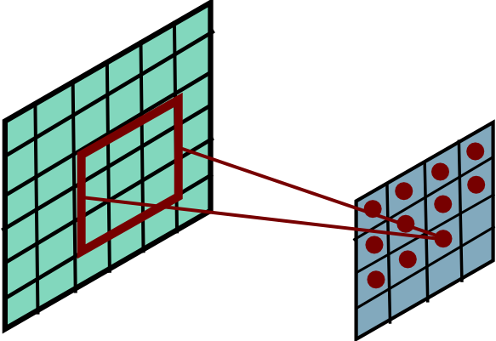
Convolutional Layer
Slide Credit: Marc'Aurelio Ranzato

Slide 33
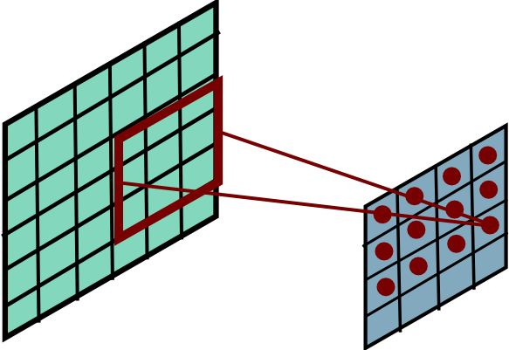
Convolutional Layer
Slide Credit: Marc'Aurelio Ranzato

Slide 34
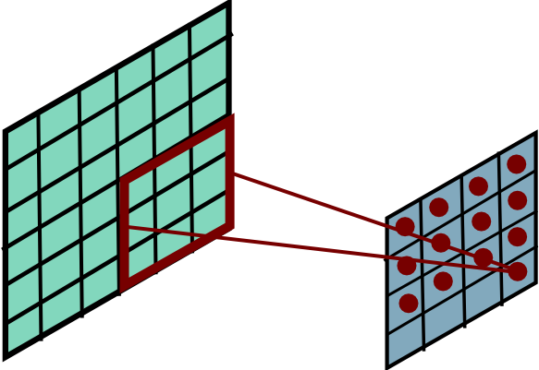
Convolutional Layer
Slide Credit: Marc'Aurelio Ranzato

Slide 35
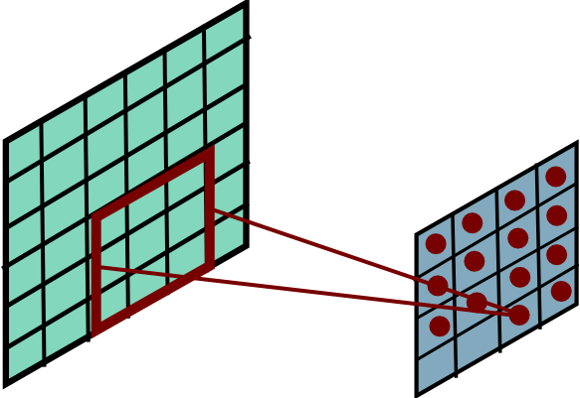
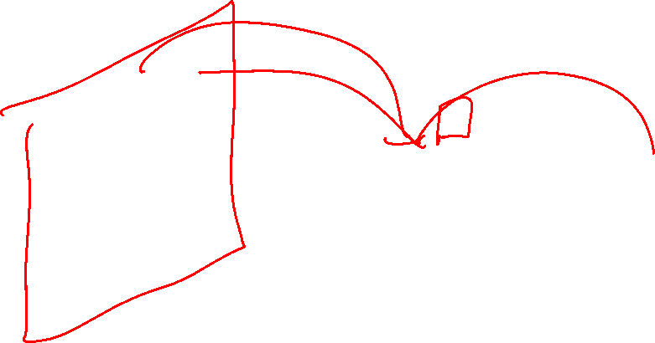
Convolutional Layer
Slide Credit: Marc'Aurelio Ranzato

Slide 36
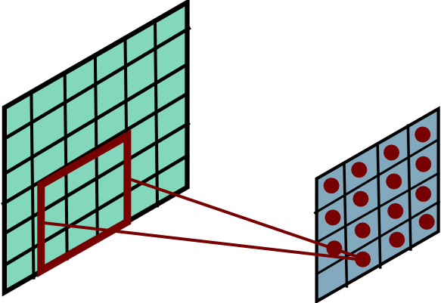
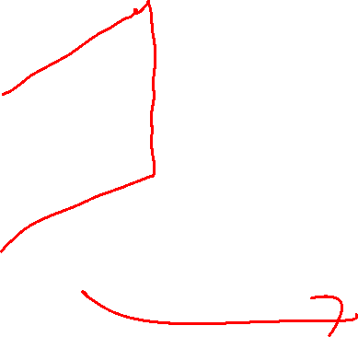
Convolutional Layer
Slide Credit: Marc'Aurelio Ranzato

Slide 37
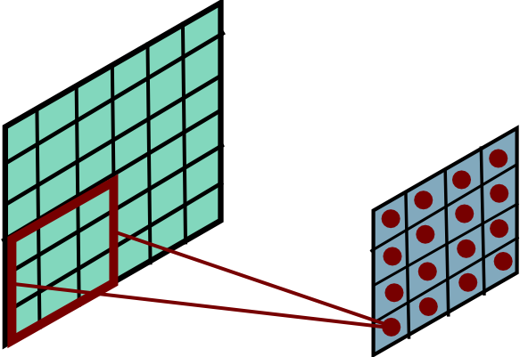
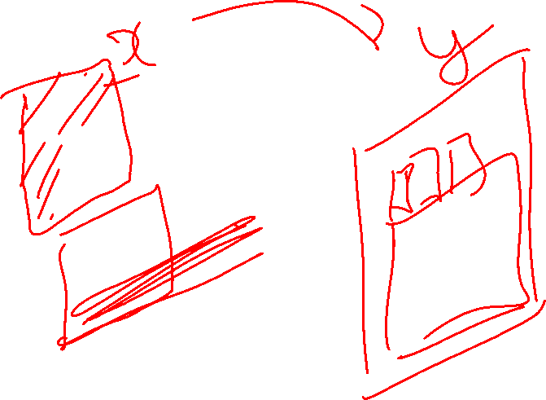
Convolutional Layer
Mathieu et al. “Fast training of CNNs through FFTs” ICLR 2014
Slide Credit: Marc'Aurelio Ranzato

Slide 38
Plan for Today
Convolutional Neural Networks
  Stride, padding
  Pooling layers
  Fully-connected layers as convolutions

Slide 39
Convolution Explained
http://setosa.io/ev/image-kernels/
https://github.com/bruckner/deepViz

Slide 40
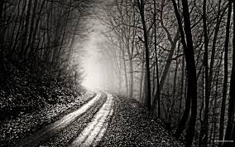
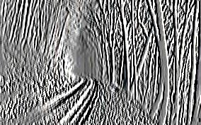
Convolutional Layer
-1 0 1
-1 0 1
-1 0 1
=
*
Slide Credit: Marc'Aurelio Ranzato

Slide 41
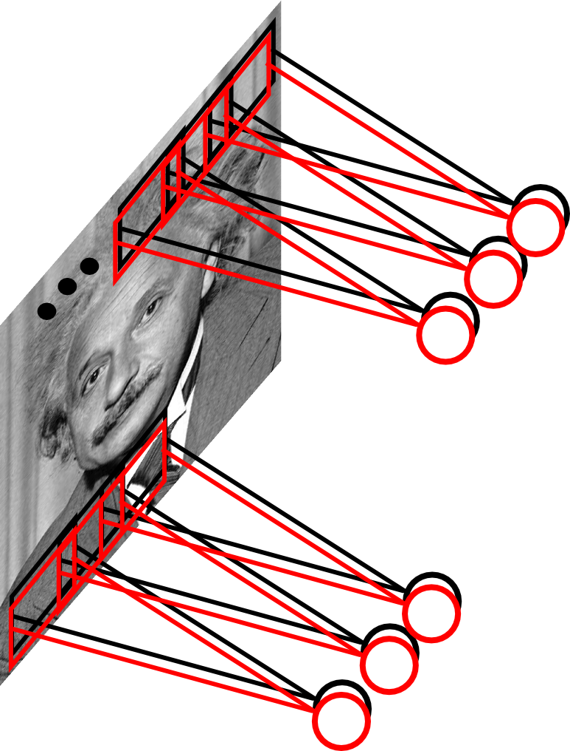
Convolutional Layer
Learn multiple filters.
E.g.: 200x200 image
100 Filters
Filter size: 10x10
10K parameters
Slide Credit: Marc'Aurelio Ranzato

Slide 42
FC vs Conv Layer

Slide 43
FC vs Conv Layer

Slide 44
Fully Connected Layer
32x32x3 image -> stretch to 3072 x 1
input
activation
1
1
3072
10 x 3072
weights
10
Slide Credit: Fei-Fei Li, Justin Johnson, Serena Yeung, CS 231n
Notes:
Preserve spatial structure of input

Slide 45
Fully Connected Layer
32x32x3 image -> stretch to 3072 x 1
input
activation
1
1
3072
10 x 3072
weights
10
1 number:
the result of taking a dot product between a row of W and the input (a 3072-dimensional dot product)
Slide Credit: Fei-Fei Li, Justin Johnson, Serena Yeung, CS 231n
Notes:
Preserve spatial structure of input

Slide 46
Convolution Layer
32x32x3 image -> preserve spatial structure
32
height
32
width
3
depth
Slide Credit: Fei-Fei Li, Justin Johnson, Serena Yeung, CS 231n
Notes:
Preserve spatial structure of input

Slide 47
Convolution Layer
32x32x3 image
5x5x3 filter
32
Convolve the filter with the image
i.e. “slide over the image spatially, computing dot products”
32
3
Slide Credit: Fei-Fei Li, Justin Johnson, Serena Yeung, CS 231n

Slide 48
Convolution Layer
Filters always extend the full depth of the input volume
32x32x3 image
5x5x3 filter
32
Convolve the filter with the image
i.e. “slide over the image spatially, computing dot products”
32
3
Slide Credit: Fei-Fei Li, Justin Johnson, Serena Yeung, CS 231n

Slide 49


Convolution Layer
32x32x3 image
5x5x3 filter
32
1 number:
the result of taking a dot product between the filter and a small 5x5x3 chunk of the image
(i.e. 5*5*3 = 75-dimensional dot product + bias)
32
3
Slide Credit: Fei-Fei Li, Justin Johnson, Serena Yeung, CS 231n

Slide 50
Convolution Layer
activation map
32x32x3 image
5x5x3 filter
32
28
convolve (slide) over all spatial locations
32
28
3
1
Slide Credit: Fei-Fei Li, Justin Johnson, Serena Yeung, CS 231n

Slide 51
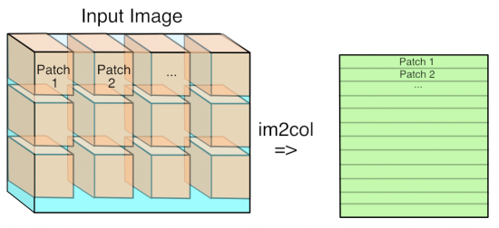
Im2Col
Figure Credit: https://petewarden.com/2015/04/20/why-gemm-is-at-the-heart-of-deep-learning/

Slide 52
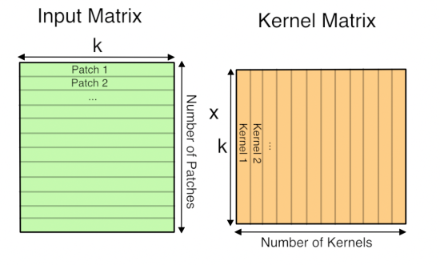
GEMM
Figure Credit: https://petewarden.com/2015/04/20/why-gemm-is-at-the-heart-of-deep-learning/

Slide 53
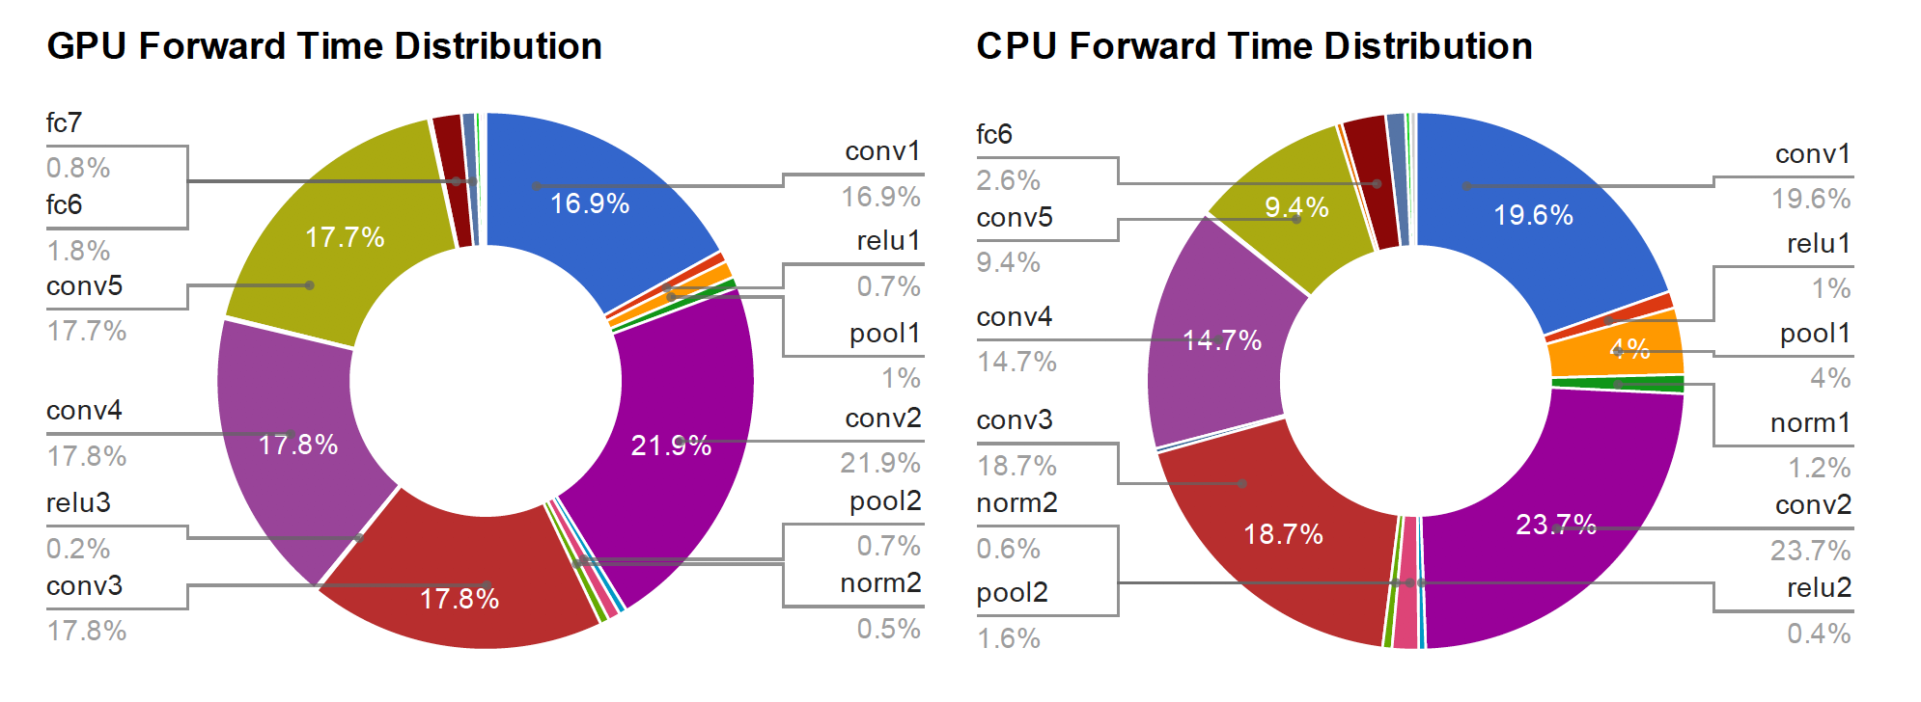
Time Distribution of AlexNet
Figure Credit: Yangqing Jia, PhD Thesis

Slide 54
consider a second, green filter
Convolution Layer
32x32x3 image
5x5x3 filter
activation maps
32
28
convolve (slide) over all spatial locations
32
28
3
1
Slide Credit: Fei-Fei Li, Justin Johnson, Serena Yeung, CS 231n

Slide 55
For example, if we had 6 5x5 filters, we’ll get 6 separate activation maps:
activation maps
32
28
Convolution Layer
32
28
3
6
We stack these up to get a “new image” of size 28x28x6!
Slide Credit: Fei-Fei Li, Justin Johnson, Serena Yeung, CS 231n

Slide 56
Preview: ConvNet is a sequence of Convolution Layers, interspersed with activation functions
32
28
CONV,
ReLU
e.g. 6 5x5x3 filters
32
28
3
6
Slide Credit: Fei-Fei Li, Justin Johnson, Serena Yeung, CS 231n

Slide 57
Preview: ConvNet is a sequence of Convolutional Layers, interspersed with activation functions
32
28
24
….
CONV,
ReLU
e.g. 6 5x5x3 filters
CONV,
ReLU
e.g. 10 5x5x6 filters
CONV,
ReLU
32
28
24
3
6
10
Slide Credit: Fei-Fei Li, Justin Johnson, Serena Yeung, CS 231n

Slide 58

Convolutional Neural Networks
  a
Image Credit: Yann LeCun, Kevin Murphy

Slide 59
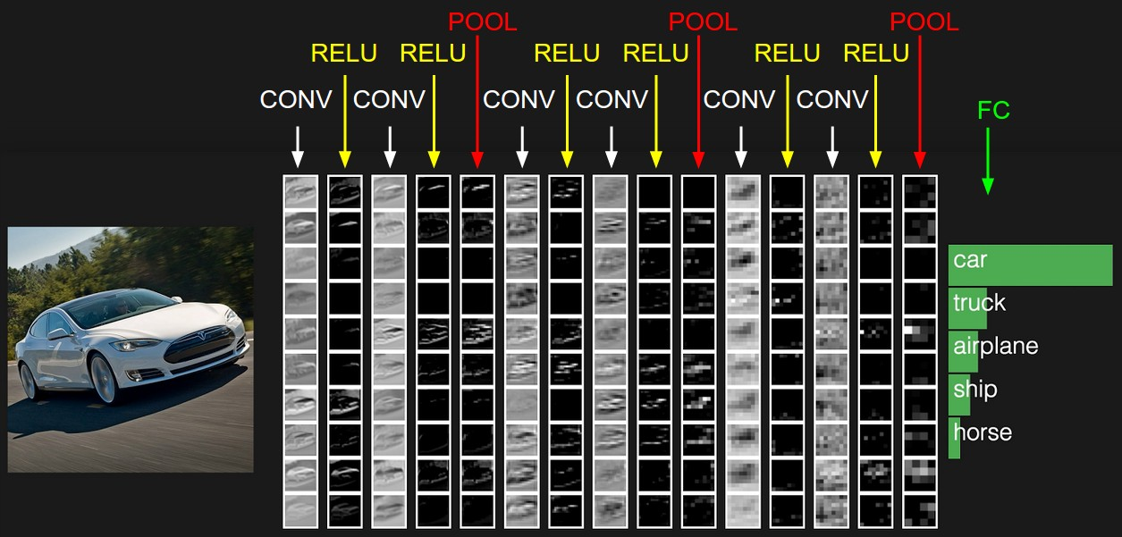
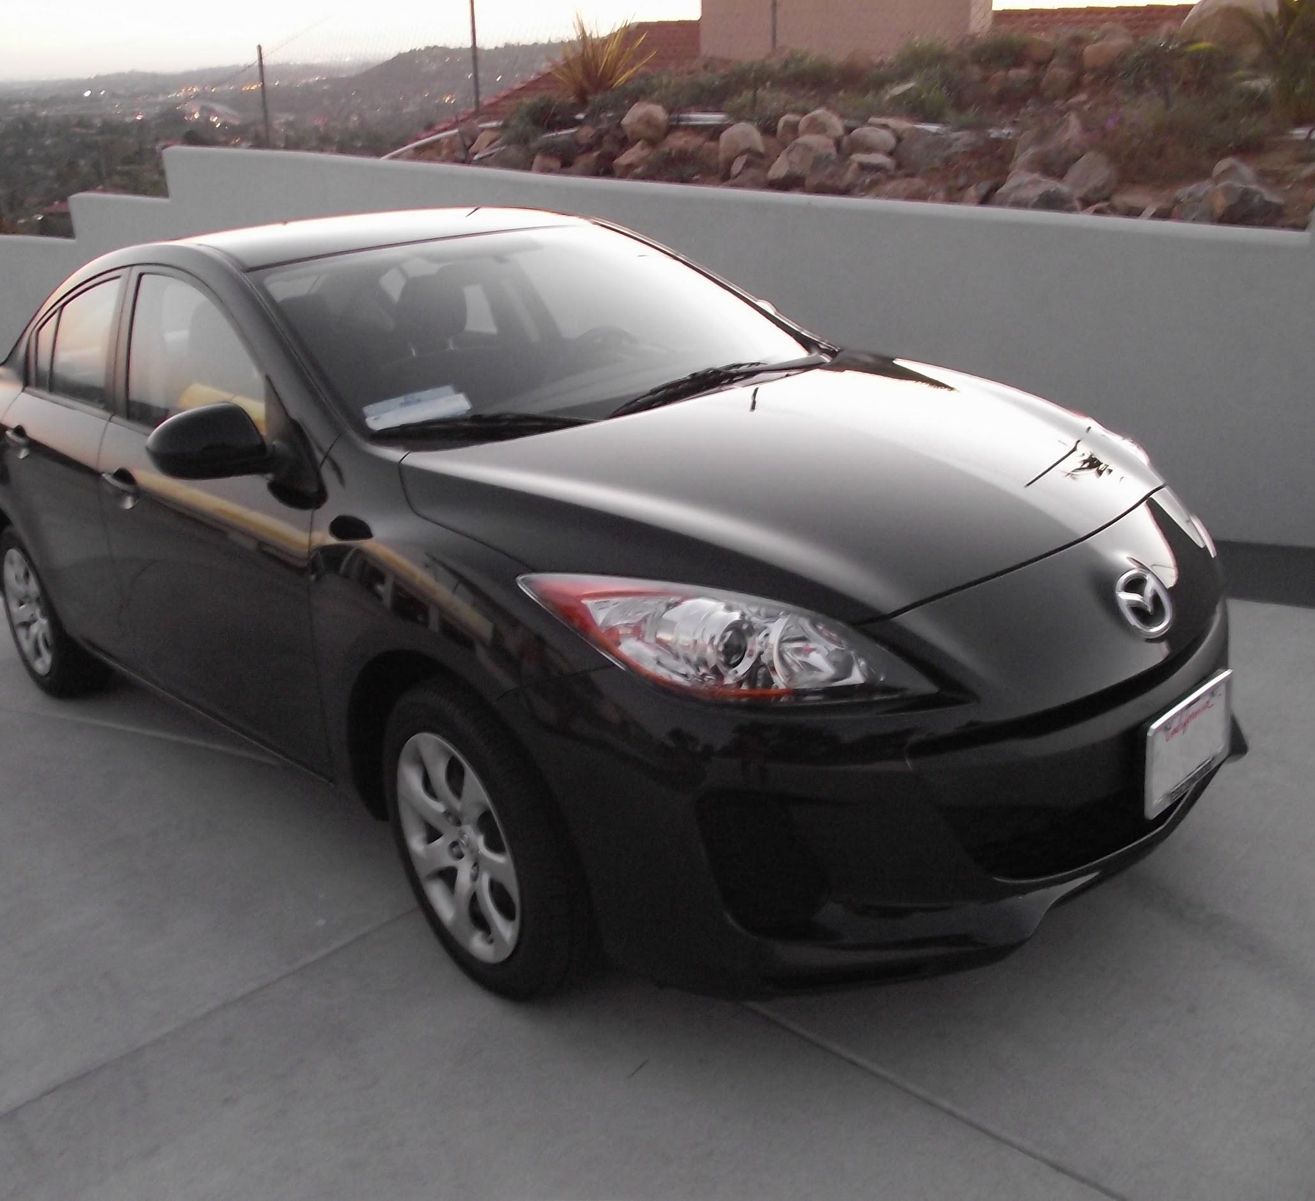
preview:
Slide Credit: Fei-Fei Li, Justin Johnson, Serena Yeung, CS 231n
Notes:
Convnet is stack of layers
Look at how an image progresses through the network, and sizes of output after each layer
Car image is photo taken by Lane McIntosh, permission to use.

Slide 60
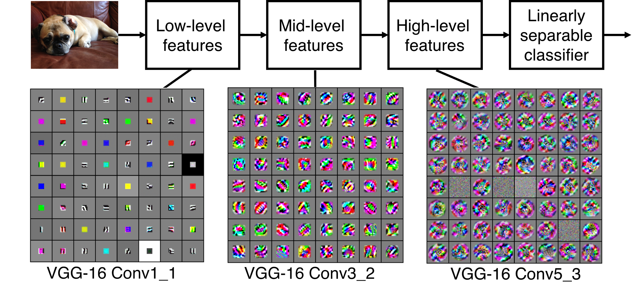
Preview
[Zeiler and Fergus 2013]
Visualization of VGG-16 by Lane McIntosh. VGG-16 architecture from [Simonyan and Zisserman 2014].
Slide Credit: Fei-Fei Li, Justin Johnson, Serena Yeung, CS 231n
Notes:
Each layer has many filters each producing an activation map
what ends up learning is hierarchy of filters, talk more in depth later
In this visualization [Lane] maximized the activity of a central cluster of units from the same filter type in various VGG-16 layers by taking image gradients. So not exactly what Zeiler and Fergus did, but somewhat similar.

Slide 61
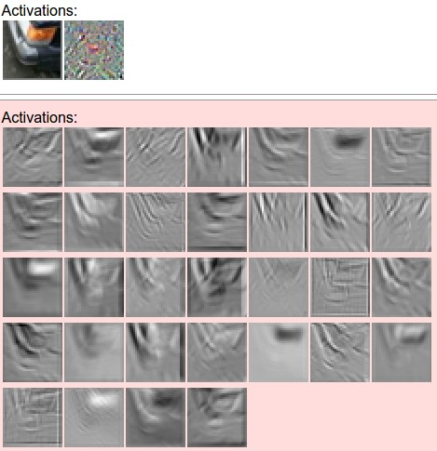
one filter =>
one activation map
example 5x5 filters
(32 total)
Figure copyright Andrej Karpathy.
Slide Credit: Fei-Fei Li, Justin Johnson, Serena Yeung, CS 231n
Notes:
Here have examples of activation maps produced by each filter
Each filter is slid over input to layer to produce an activation map
Because of sliding, call convolutional
Conv with neg. of filter (cross correlation)

Slide 62

Visualizing Learned Filters
Figure Credit: [Zeiler & Fergus ECCV14]

Slide 63

Visualizing Learned Filters
Figure Credit: [Zeiler & Fergus ECCV14]

Slide 64

Visualizing Learned Filters
Figure Credit: [Zeiler & Fergus ECCV14]

Slide 65
A closer look at spatial dimensions:
activation map
32x32x3 image
5x5x3 filter
32
28
convolve (slide) over all spatial locations
32
28
3
1
Slide Credit: Fei-Fei Li, Justin Johnson, Serena Yeung, CS 231n

Slide 66
A closer look at spatial dimensions:
7
7x7 input (spatially)
assume 3x3 filter
7
Slide Credit: Fei-Fei Li, Justin Johnson, Serena Yeung, CS 231n

Slide 67
A closer look at spatial dimensions:
7
7x7 input (spatially)
assume 3x3 filter
7
Slide Credit: Fei-Fei Li, Justin Johnson, Serena Yeung, CS 231n

Slide 68
A closer look at spatial dimensions:
7
7x7 input (spatially)
assume 3x3 filter
7
Slide Credit: Fei-Fei Li, Justin Johnson, Serena Yeung, CS 231n

Slide 69
A closer look at spatial dimensions:
7
7x7 input (spatially)
assume 3x3 filter
7
Slide Credit: Fei-Fei Li, Justin Johnson, Serena Yeung, CS 231n

Slide 70
A closer look at spatial dimensions:
7
7x7 input (spatially)
assume 3x3 filter
=> 5x5 output
7
Slide Credit: Fei-Fei Li, Justin Johnson, Serena Yeung, CS 231n

Slide 71
A closer look at spatial dimensions:
7
7x7 input (spatially)
assume 3x3 filter
applied with stride 2
7
Slide Credit: Fei-Fei Li, Justin Johnson, Serena Yeung, CS 231n

Slide 72
A closer look at spatial dimensions:
7
7x7 input (spatially)
assume 3x3 filter
applied with stride 2
7
Slide Credit: Fei-Fei Li, Justin Johnson, Serena Yeung, CS 231n

Slide 73
A closer look at spatial dimensions:
7
7x7 input (spatially)
assume 3x3 filter
applied with stride 2
=> 3x3 output!
7
Slide Credit: Fei-Fei Li, Justin Johnson, Serena Yeung, CS 231n

Slide 74
A closer look at spatial dimensions:
7
7x7 input (spatially)
assume 3x3 filter
applied with stride 3?
7
Slide Credit: Fei-Fei Li, Justin Johnson, Serena Yeung, CS 231n

Slide 75
A closer look at spatial dimensions:
7
7x7 input (spatially)
assume 3x3 filter
applied with stride 3?
7
doesn’t fit!
cannot apply 3x3 filter on 7x7 input with stride 3.
Slide Credit: Fei-Fei Li, Justin Johnson, Serena Yeung, CS 231n

Slide 76
N
Output size:
(N - F) / stride + 1
e.g. N = 7, F = 3:
stride 1 => (7 - 3)/1 + 1 = 5
stride 2 => (7 - 3)/2 + 1 = 3
stride 3 => (7 - 3)/3 + 1 = 2.33 :\
F
F
N
Slide Credit: Fei-Fei Li, Justin Johnson, Serena Yeung, CS 231n

Slide 77
In practice: Common to zero pad the border
0 | 0 | 0 | 0 | 0 | 0
0
0
0
0
e.g. input 7x7
3x3 filter, applied with stride 1
pad with 1 pixel border => what is the output?
(recall:)
(N - F) / stride + 1
Slide Credit: Fei-Fei Li, Justin Johnson, Serena Yeung, CS 231n

Slide 78
In practice: Common to zero pad the border
0 | 0 | 0 | 0 | 0 | 0
0
0
0
0
e.g. input 7x7
3x3 filter, applied with stride 1
pad with 1 pixel border => what is the output?
7x7 output!
Slide Credit: Fei-Fei Li, Justin Johnson, Serena Yeung, CS 231n

Slide 79
In practice: Common to zero pad the border
0 | 0 | 0 | 0 | 0 | 0
0
0
0
0
e.g. input 7x7
3x3 filter, applied with stride 1
pad with 1 pixel border => what is the output?
7x7 output!
in general, common to see CONV layers with stride 1, filters of size FxF, and zero-padding with (F-1)/2. (will preserve size spatially)
e.g. F = 3 => zero pad with 1
F = 5 => zero pad with 2
F = 7 => zero pad with 3
Slide Credit: Fei-Fei Li, Justin Johnson, Serena Yeung, CS 231n

Slide 80
Remember back to…
E.g. 32x32 input convolved repeatedly with 5x5 filters shrinks volumes spatially!
(32 -> 28 -> 24 ...). Shrinking too fast is not good, doesn’t work well.
32
28
24
….
CONV,
ReLU
e.g. 6 5x5x3 filters
CONV,
ReLU
e.g. 10 5x5x6 filters
CONV,
ReLU
32
28
24
3
6
10
Slide Credit: Fei-Fei Li, Justin Johnson, Serena Yeung, CS 231n

Slide 81
Examples time:
Input volume: 32x32x3
10 5x5 filters with stride 1, pad 2
Output volume size: ?
Slide Credit: Fei-Fei Li, Justin Johnson, Serena Yeung, CS 231n
Notes:
(32+2*2-5)/1+1 = 32 spatially
(Input size + 2*padding - stride) / 1 + 1 for new spatial size
10 filters

Slide 82
Examples time:
Input volume: 32x32x3
10 5x5 filters with stride 1, pad 2
Output volume size:
(32+2*2-5)/1+1 = 32 spatially, so
32x32x10
Slide Credit: Fei-Fei Li, Justin Johnson, Serena Yeung, CS 231n

Slide 83
Examples time:
Input volume: 32x32x3
10 5x5 filters with stride 1, pad 2
Number of parameters in this layer?
Slide Credit: Fei-Fei Li, Justin Johnson, Serena Yeung, CS 231n
Notes:
each filter has 5*5*3 + 1 = 76 params
1 for bias

Slide 84
Examples time:
Input volume: 32x32x3
10 5x5 filters with stride 1, pad 2
Number of parameters in this layer?
each filter has 5*5*3 + 1 = 76 params (+1 for bias)
=> 76*10 = 760
Slide Credit: Fei-Fei Li, Justin Johnson, Serena Yeung, CS 231n

Slide 85

Slide Credit: Fei-Fei Li, Justin Johnson, Serena Yeung, CS 231n

Slide 86
Common settings:
K = (powers of 2, e.g. 32, 64, 128, 512)
F = 3, S = 1, P = 1
F = 5, S = 1, P = 2
F = 5, S = 2, P = ? (whatever fits)
F = 1, S = 1, P = 0
Slide Credit: Fei-Fei Li, Justin Johnson, Serena Yeung, CS 231n

Slide 87
(btw, 1x1 convolution layers make perfect sense)
1x1 CONV
with 32 filters
56
56
(each filter has size 1x1x64, and performs a 64-dimensional dot product)
56
56
64
32
Slide Credit: Fei-Fei Li, Justin Johnson, Serena Yeung, CS 231n

Slide 88

Example: CONV layer in Torch
Torch is licensed under BSD 3-clause.
Slide Credit: Fei-Fei Li, Justin Johnson, Serena Yeung, CS 231n

Slide 89

Example: CONV layer in Caffe
Caffe is licensed under BSD 2-Clause.
Slide Credit: Fei-Fei Li, Justin Johnson, Serena Yeung, CS 231n

Slide 90

The brain/neuron view of CONV Layer
32
28
An activation map is a 28x28 sheet of neuron outputs:
Each is connected to a small region in the input
All of them share parameters
“5x5 filter” -> “5x5 receptive field for each neuron”
32
28
3
Slide Credit: Fei-Fei Li, Justin Johnson, Serena Yeung, CS 231n

Slide 91
Reminder: Fully Connected Layer
Each neuron looks at the full input volume
32x32x3 image -> stretch to 3072 x 1
input
activation
1
1
3072
10 x 3072
weights
10
1 number:
the result of taking a dot product between a row of W and the input (a 3072-dimensional dot product)
Slide Credit: Fei-Fei Li, Justin Johnson, Serena Yeung, CS 231n
Notes:
Preserve spatial structure of input

Slide 92
two more layers to go: POOL/FC
Slide Credit: Fei-Fei Li, Justin Johnson, Serena Yeung, CS 231n
Notes:
Car image is photo taken by Lane McIntosh, permission to use.

Slide 93

Pooling Layer
Let us assume filter is an “eye” detector.
Q.: how can we make the detection robust to the exact location of the eye?
Slide Credit: Marc'Aurelio Ranzato

Slide 94

Pooling Layer
By “pooling” (e.g., taking max) filter
responses at different locations we gain robustness to the exact spatial location of features.
Slide Credit: Marc'Aurelio Ranzato

Slide 95

Pooling layer
makes the representations smaller and more manageable
operates over each activation map independently:
Slide Credit: Fei-Fei Li, Justin Johnson, Serena Yeung, CS 231n

Slide 96
MAX POOLING
Single depth slice
1 | 1 | 2 | 4
5 | 6 | 7 | 8
3 | 2 | 1 | 0
1 | 2 | 3 | 4
dim 1
max pool with 2x2 filters and stride 2
6 | 8
3 | 4
dim 2
Slide Credit: Fei-Fei Li, Justin Johnson, Serena Yeung, CS 231n

Slide 97
Pooling Layer: Examples
Max-pooling:
Average-pooling:
L2-pooling:
L2-pooling over features:
Slide Credit: Marc'Aurelio Ranzato

Slide 98

Slide Credit: Fei-Fei Li, Justin Johnson, Serena Yeung, CS 231n

Slide 99
Common settings:
F = 2, S = 2
F = 3, S = 2
Slide Credit: Fei-Fei Li, Justin Johnson, Serena Yeung, CS 231n

Slide 100
Pooling Layer: Receptive Field Size
Conv.
layer
Pool.
layer
If convolutional filters have size KxK and stride 1, and pooling layer has pools of size PxP, then each unit in the pooling layer depends upon a patch (at the input of the preceding conv. layer) of size: (P+K-1)x(P+K-1)
Slide Credit: Marc'Aurelio Ranzato

Slide 101

Pooling Layer: Receptive Field Size
Conv.
layer
Pool.
layer
If convolutional filters have size KxK and stride 1, and pooling layer has pools of size PxP, then each unit in the pooling layer depends upon a patch (at the input of the preceding conv. layer) of size: (P+K-1)x(P+K-1)
Slide Credit: Marc'Aurelio Ranzato

Slide 102
Fully Connected Layer (FC layer)
Contains neurons that connect to the entire input volume, as in ordinary Neural Networks
Slide Credit: Fei-Fei Li, Justin Johnson, Serena Yeung, CS 231n
Notes:
Car image is photo taken by Lane McIntosh, permission to use.

Slide 103
Convolutional Nets
Example:
  http://yann.lecun.com/exdb/lenet/index.html
Image Credit: Yann LeCun, Kevin Murphy

Slide 104

Note: After several stages of convolution-pooling, the spatial resolution is greatly reduced (usually to about 5x5) and the number of feature maps is large (several hundreds depending on the application).
It would not make sense to convolve again (there is no translation invariance and support is too small). Everything is vectorized and fed into several fully connected layers.
If the input of the fully connected layers is of size 5x5xN, the first fully connected layer can be seen as a conv. layer with 5x5 kernels.
The next fully connected layer can be seen as a conv. layer with 1x1 kernels.
Slide Credit: Marc'Aurelio Ranzato

Slide 105

Classical View
Figure Credit: [Long, Shelhamer, Darrell CVPR15]

Slide 106
H hidden units
NxNxC, N small
Fully conn. layer
Slide Credit: Marc'Aurelio Ranzato

Slide 107

Classical View = Inefficient

Slide 108
Classical View
Figure Credit: [Long, Shelhamer, Darrell CVPR15]

Slide 109

Re-interpretation
Just squint a little!
Figure Credit: [Long, Shelhamer, Darrell CVPR15]

Slide 110

“Fully Convolutional” Networks
Can run on an image of any size!
Figure Credit: [Long, Shelhamer, Darrell CVPR15]

Slide 111
H hidden units /
1x1xH feature maps
NxNxC, N small
Fully conn. layer /
Conv. layer (H kernels of size NxNxC)
Slide Credit: Marc'Aurelio Ranzato

Slide 112
K hidden units /
1x1xK feature maps
H hidden units /
1x1xH feature maps
MxMxN, M small
Fully conn. layer /
Conv. layer (H kernels of size MxMxN)
Fully conn. layer /
Conv. layer (K kernels of size 1x1xH)
Slide Credit: Marc'Aurelio Ranzato

Slide 113
Viewing fully connected layers as convolutional layers enables efficient use of convnets on bigger images (no need to slide windows but unroll network over space as needed to re-use computation).
TRAINING TIME
Input
Image
CNN
TEST TIME
Input
Image
Input
Image
CNN
y
x
Slide Credit: Marc'Aurelio Ranzato

Slide 114
Viewing fully connected layers as convolutional layers enables efficient use of convnets on bigger images (no need to slide windows but unroll network over space as needed to re-use computation).
TRAINING TIME
Input
Image
CNN
TEST TIME
CNNs work on any image size!
Input
Image
CNN
y
x
Unrolling is order of magnitudes more eficient than sliding windows!
Slide Credit: Marc'Aurelio Ranzato

Slide 115
Re-interpretation
Just squint a little!
Figure Credit: [Long, Shelhamer, Darrell CVPR15]

Slide 116
“Fully Convolutional” Networks
Can run on an image of any size!
Figure Credit: [Long, Shelhamer, Darrell CVPR15]

Slide 117

“Fully Convolutional” Networks
Up-sample to get segmentation maps
Figure Credit: [Long, Shelhamer, Darrell CVPR15]

Slide 118
Benefit of this thinking
Mathematically elegant
Efficiency
  Can run network on arbitrary image
  Without multiple crops

Slide 119
Summary
- ConvNets stack CONV,POOL,FC layers
- Trend towards smaller filters and deeper architectures
- Trend towards getting rid of POOL/FC layers (just CONV)
- Typical architectures look like
[(CONV-RELU)*N-POOL?]*M-(FC-RELU)*K,SOFTMAX
where N is usually up to ~5, M is large, 0 <= K <= 2.
but recent advances such as ResNet/GoogLeNet challenge this paradigm
Slide Credit: Fei-Fei Li, Justin Johnson, Serena Yeung, CS 231n

