Slide 1
CS 4803 / 7643: Deep Learning
Topics:
  Convolutional Neural Networks
    Stride, padding
    Pooling layers
    Fully-connected layers as convolutions
Dhruv Batra
Georgia Tech

Slide 2
Administrativia
HW1 Reminder
  Due: 09/26, 11:55pm
  https://evalai.cloudcv.org/web/challenges/challenge-page/431/leaderboard/1200
Project Teams Google Doc
  https://docs.google.com/spreadsheets/d/1ouD6ctaemV_3nb2MQHs7rUOAaW9DFLu8I5Zd3yOFs7E/edit?usp=sharing
  Project Title
  1-3 sentence project summary TL;DR
  Team member names

Slide 3
Recap from last time

Slide 4
Convolutional Neural Networks
(without the brain stuff)
Slide Credit: Fei-Fei Li, Justin Johnson, Serena Yeung, CS 231n

Slide 5
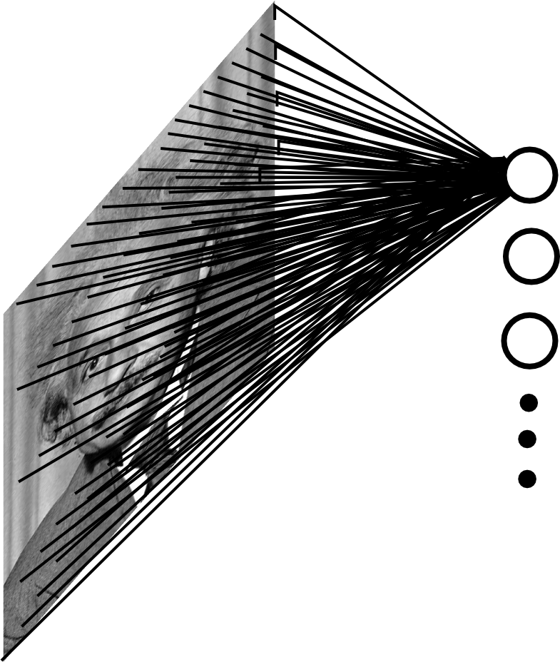
Fully Connected Layer
Example: 200x200 image
40K hidden units
~2B parameters!!!
- Spatial correlation is local
- Waste of resources + we have not enough training samples anyway..
Slide Credit: Marc'Aurelio Ranzato

Slide 6
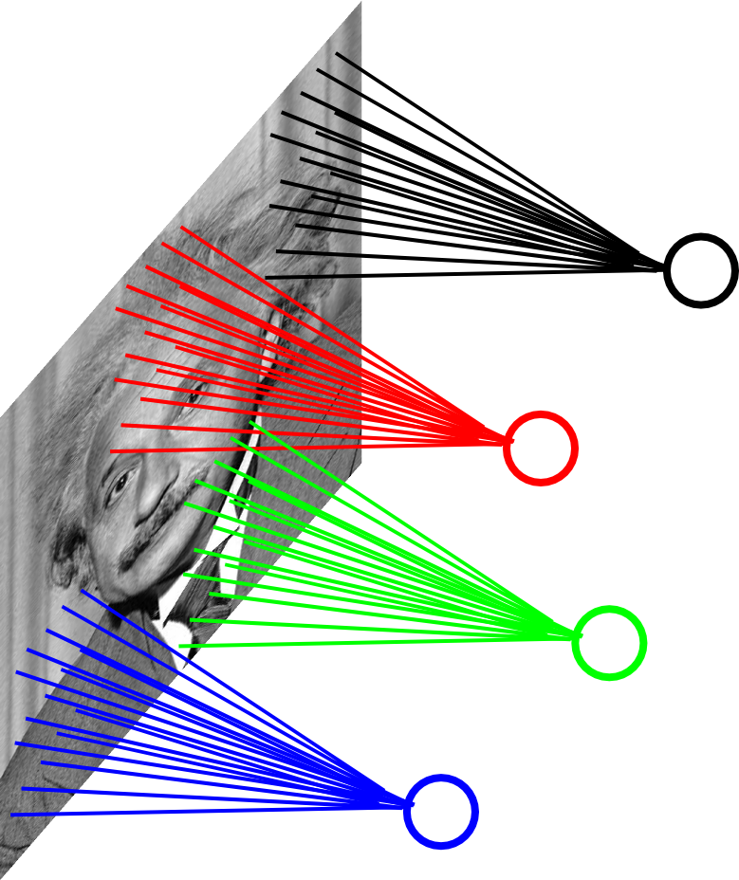
Locally Connected Layer
Example: 200x200 image
40K hidden units
“Filter” size: 10x10
4M parameters
Note:
This parameterization is good when input image is registered (e.g., face recognition).
Slide Credit: Marc'Aurelio Ranzato

Slide 7
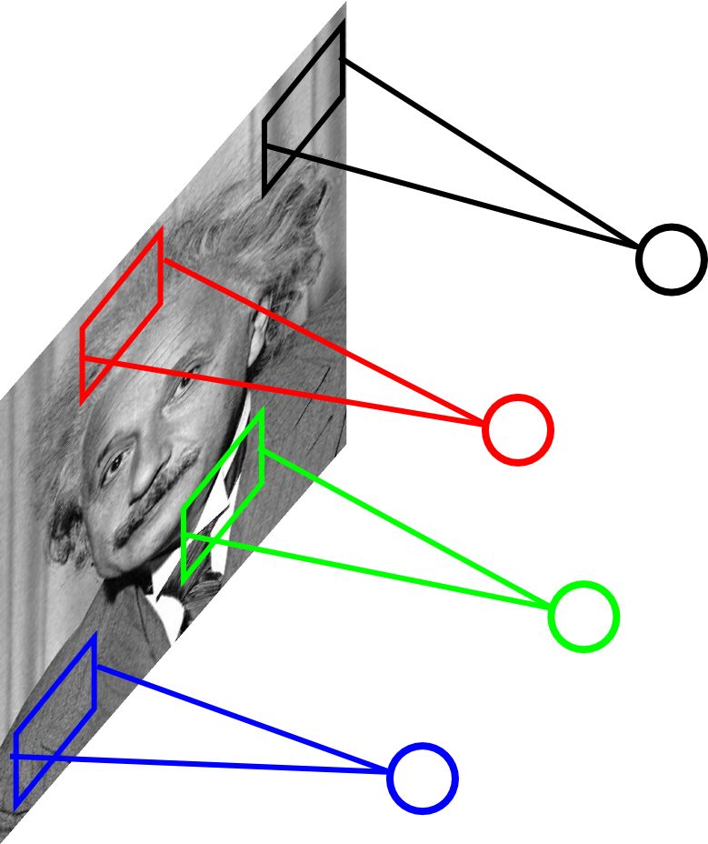
Locally Connected Layer
STATIONARITY?
Statistics similar at all locations
Slide Credit: Marc'Aurelio Ranzato

Slide 8
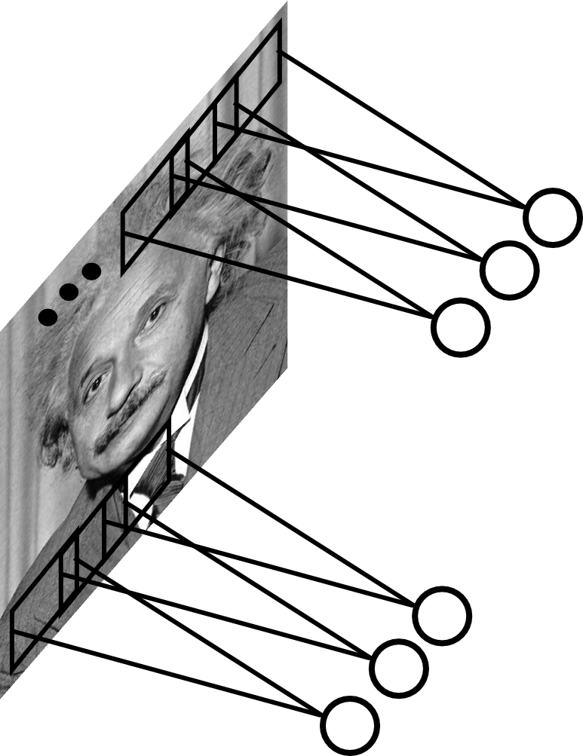
Convolutional Layer
Share the same parameters across different locations (assuming input is stationary):
Convolutions with learned kernels
Slide Credit: Marc'Aurelio Ranzato

Slide 9
Convolutions!

Slide 10
Convolutions for programmers

Slide 11
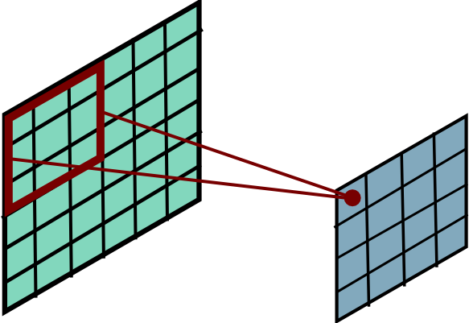
Convolution
Slide Credit: Marc'Aurelio Ranzato

Slide 12
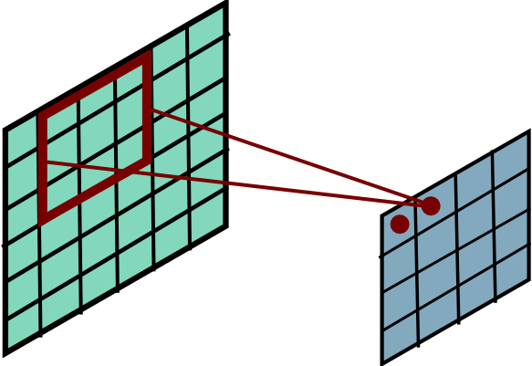
Convolution
Slide Credit: Marc'Aurelio Ranzato

Slide 13
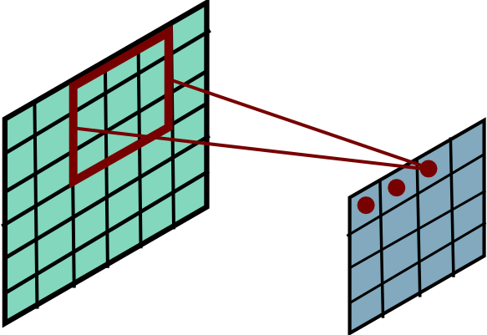
Convolution
Slide Credit: Marc'Aurelio Ranzato

Slide 14
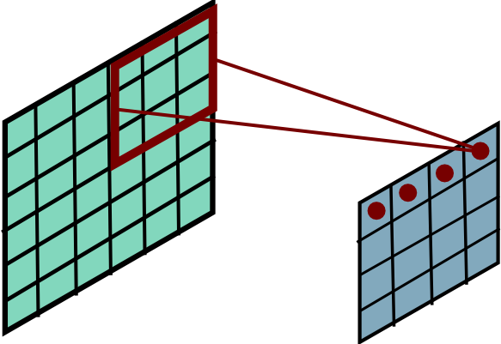
Convolution
Slide Credit: Marc'Aurelio Ranzato

Slide 15
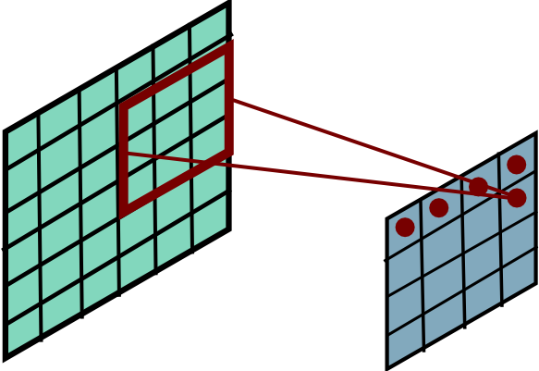
Convolution
Slide Credit: Marc'Aurelio Ranzato

Slide 16
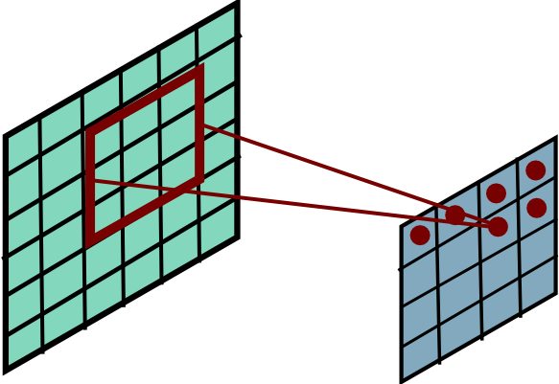
Convolution
Slide Credit: Marc'Aurelio Ranzato

Slide 17
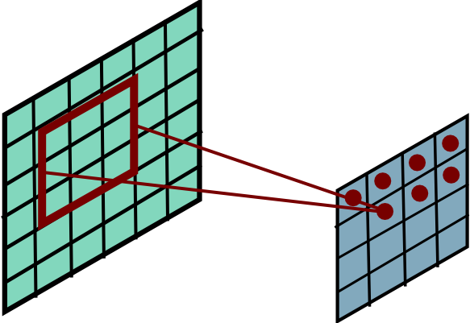
Convolution
Slide Credit: Marc'Aurelio Ranzato

Slide 18
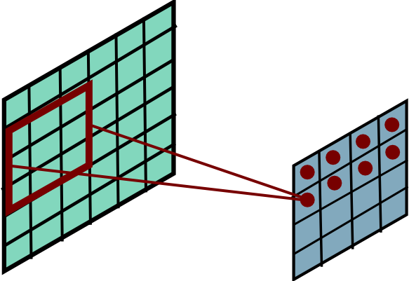
Convolution
Slide Credit: Marc'Aurelio Ranzato

Slide 19
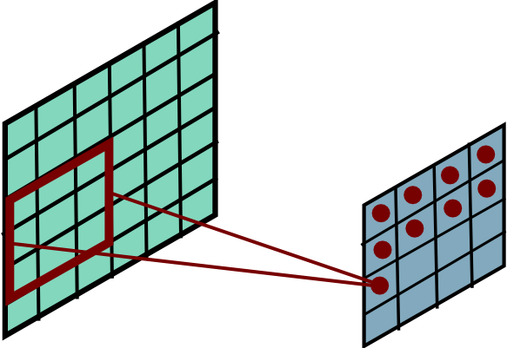
Convolution
Slide Credit: Marc'Aurelio Ranzato

Slide 20
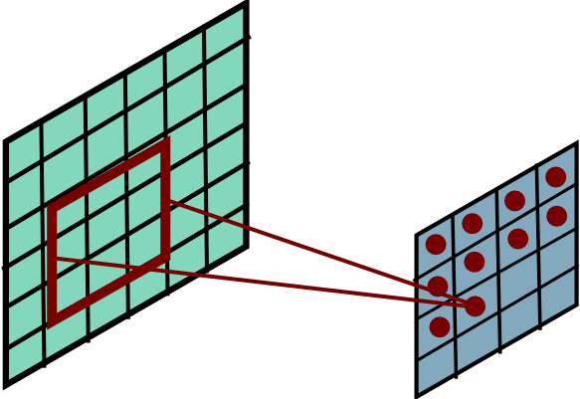
Convolution
Slide Credit: Marc'Aurelio Ranzato

Slide 21
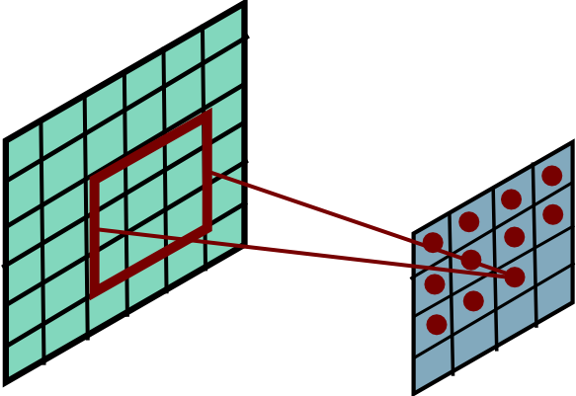
Convolution
Slide Credit: Marc'Aurelio Ranzato

Slide 22
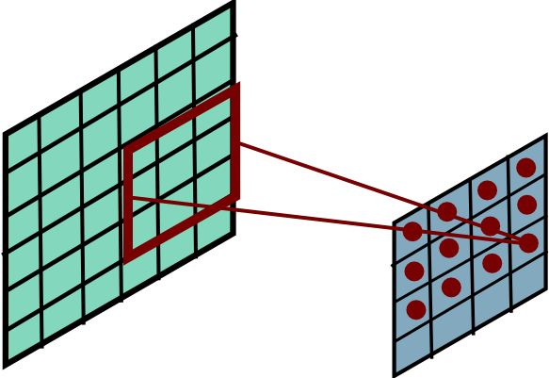
Convolution
Slide Credit: Marc'Aurelio Ranzato

Slide 23
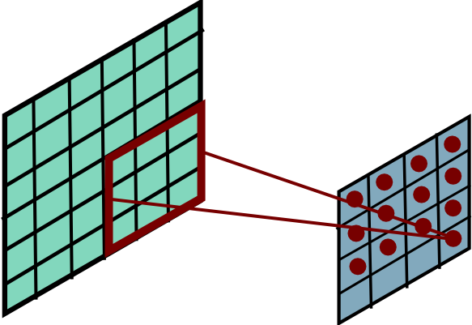
Convolution
Slide Credit: Marc'Aurelio Ranzato

Slide 24
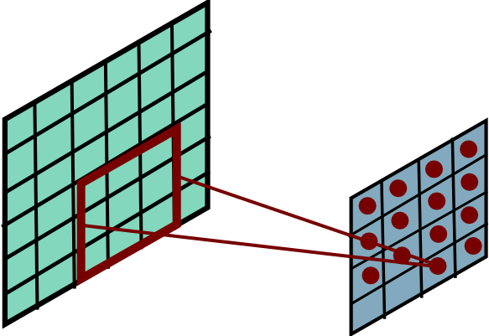
Convolution
Slide Credit: Marc'Aurelio Ranzato

Slide 25
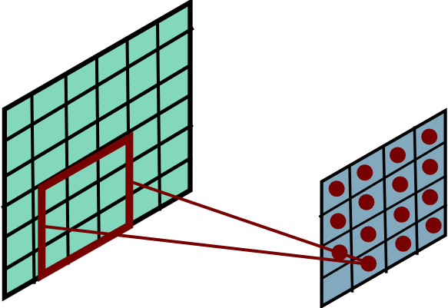
Convolution
Slide Credit: Marc'Aurelio Ranzato

Slide 26
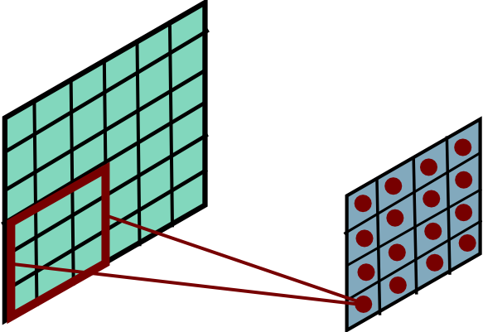
Convolution
Slide Credit: Marc'Aurelio Ranzato

Slide 27
Convolution Layer
32x32x3 image -> preserve spatial structure
32
height
32
width
3
depth
Slide Credit: Fei-Fei Li, Justin Johnson, Serena Yeung, CS 231n
Notes:
Preserve spatial structure of input

Slide 28
Convolution Layer
32x32x3 image
5x5x3 filter
32
32
3
Slide Credit: Fei-Fei Li, Justin Johnson, Serena Yeung, CS 231n

Slide 29
Convolution Layer
Filters always extend the full depth of the input volume
32x32x3 image
5x5x3 filter
32
32
3
Slide Credit: Fei-Fei Li, Justin Johnson, Serena Yeung, CS 231n

Slide 30


Convolution Layer
32x32x3 image
5x5x3 filter
32
1 number:
the result of taking a dot product between the filter and a small 5x5x3 chunk of the image
(i.e. 5*5*3 = 75-dimensional dot product + bias)
32
3
Slide Credit: Fei-Fei Li, Justin Johnson, Serena Yeung, CS 231n

Slide 31
Convolution Layer
activation map
32x32x3 image
5x5x3 filter
32
28
convolve (slide) over all spatial locations,
computing all dot products
32
28
3
1
Slide Credit: Fei-Fei Li, Justin Johnson, Serena Yeung, CS 231n

Slide 32
consider a second, green filter
Convolution Layer
32x32x3 image
5x5x3 filter
activation maps
32
28
convolve (slide) over all spatial locations
32
28
3
1
Slide Credit: Fei-Fei Li, Justin Johnson, Serena Yeung, CS 231n

Slide 33
For example, if we had 6 5x5 filters, we’ll get 6 separate activation maps:
activation maps
32
28
Convolution Layer
32
28
3
6
We stack these up to get a “new image” of size 28x28x6!
Slide Credit: Fei-Fei Li, Justin Johnson, Serena Yeung, CS 231n

Slide 34
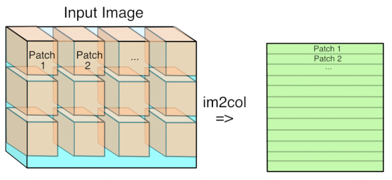
Im2Col
Figure Credit: https://petewarden.com/2015/04/20/why-gemm-is-at-the-heart-of-deep-learning/

Slide 35
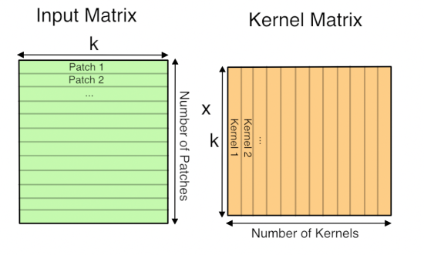
GEMM
Figure Credit: https://petewarden.com/2015/04/20/why-gemm-is-at-the-heart-of-deep-learning/

Slide 36
Preview: ConvNet is a sequence of Convolution Layers, interspersed with activation functions
32
28
CONV,
ReLU
e.g. 6 5x5x3 filters
32
28
3
6
Slide Credit: Fei-Fei Li, Justin Johnson, Serena Yeung, CS 231n

Slide 37
Preview: ConvNet is a sequence of Convolutional Layers, interspersed with activation functions
32
28
24
….
CONV,
ReLU
e.g. 6 5x5x3 filters
CONV,
ReLU
e.g. 10 5x5x6 filters
CONV,
ReLU
32
28
24
3
6
10
Slide Credit: Fei-Fei Li, Justin Johnson, Serena Yeung, CS 231n

Slide 38
Plan for Today
Convolutional Neural Networks
  Features learned by CNN layers
  Stride, padding
  1x1 convolutions
  Pooling layers
  Fully-connected layers as convolutions

Slide 39

Convolutional Neural Networks
Image Credit: Yann LeCun, Kevin Murphy

Slide 40
Convolutional Neural Networks
  a
Image Credit: Yann LeCun, Kevin Murphy

Slide 41
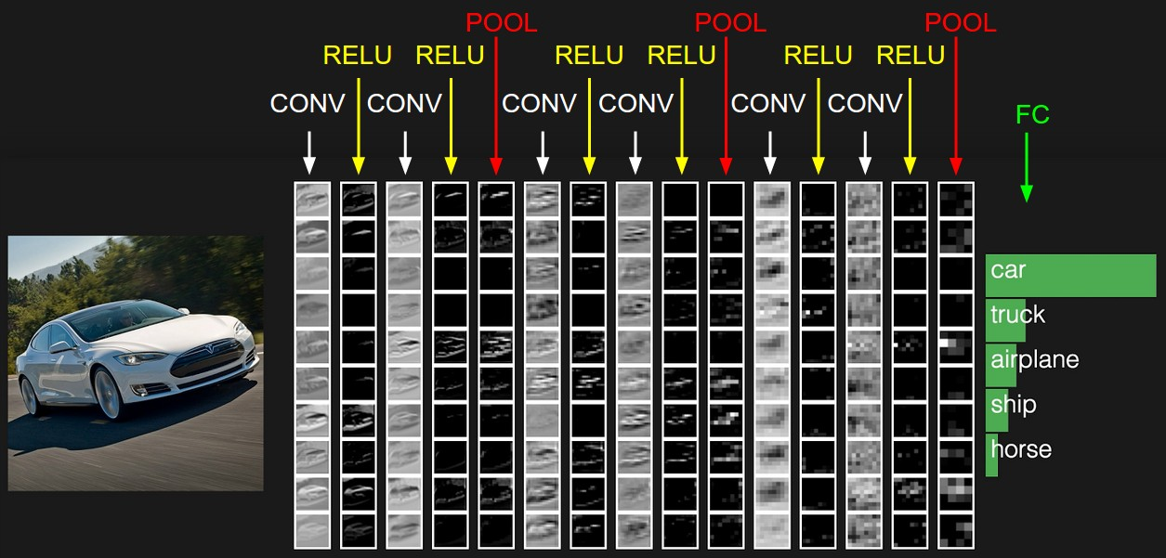
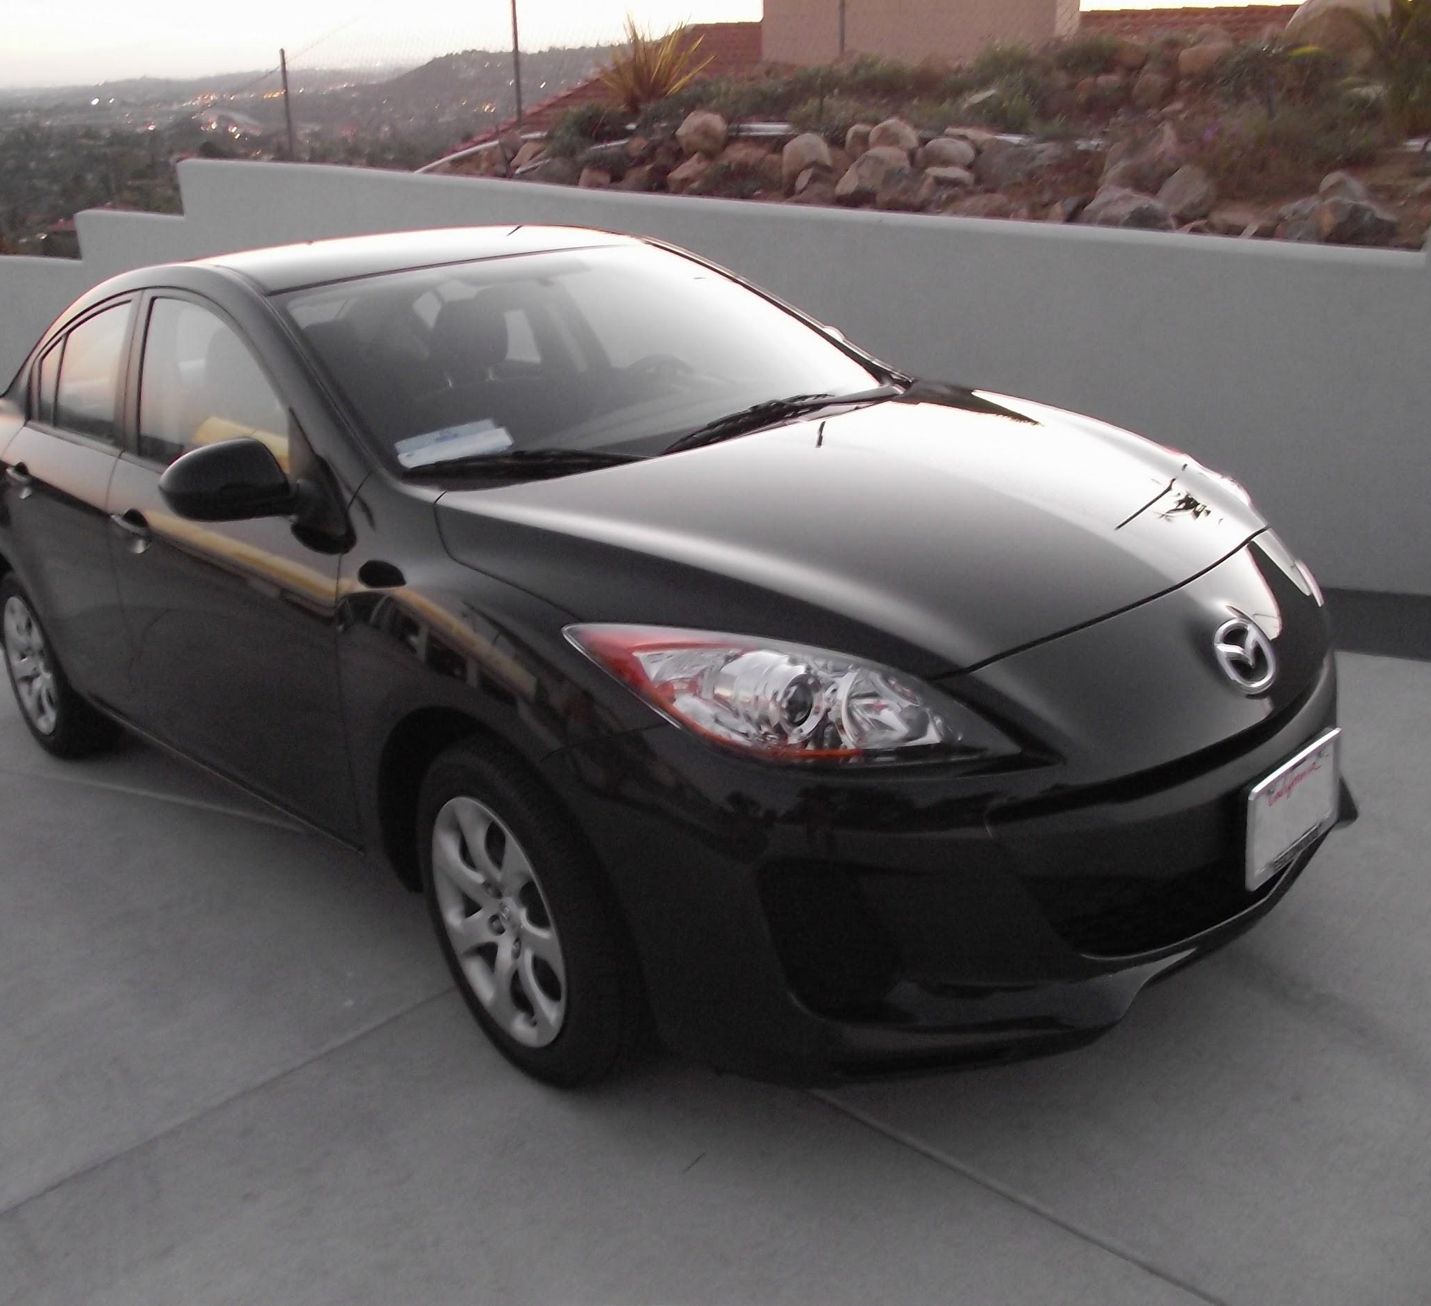
preview:
Slide Credit: Fei-Fei Li, Justin Johnson, Serena Yeung, CS 231n
Notes:
Convnet is stack of layers
Look at how an image progresses through the network, and sizes of output after each layer
Car image is photo taken by Lane McIntosh, permission to use.

Slide 42
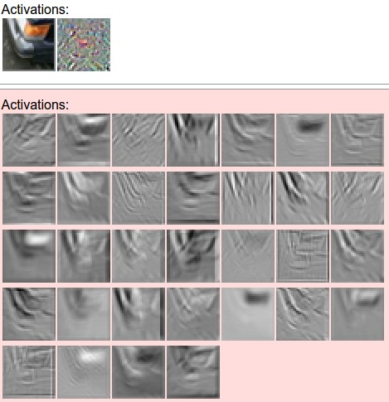
one filter =>
one activation map
example 5x5 filters
(32 total)
Figure copyright Andrej Karpathy.
Slide Credit: Fei-Fei Li, Justin Johnson, Serena Yeung, CS 231n
Notes:
Here have examples of activation maps produced by each filter
Each filter is slid over input to layer to produce an activation map
Because of sliding, call convolutional
Conv with neg. of filter (cross correlation)

Slide 43
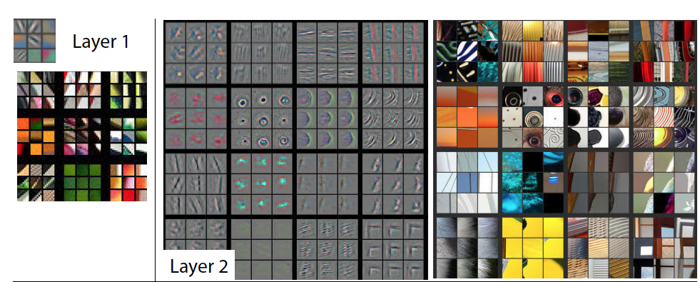
Visualizing Learned Filters
Figure Credit: [Zeiler & Fergus ECCV14]

Slide 44
Visualizing Learned Filters
Figure Credit: [Zeiler & Fergus ECCV14]

Slide 45
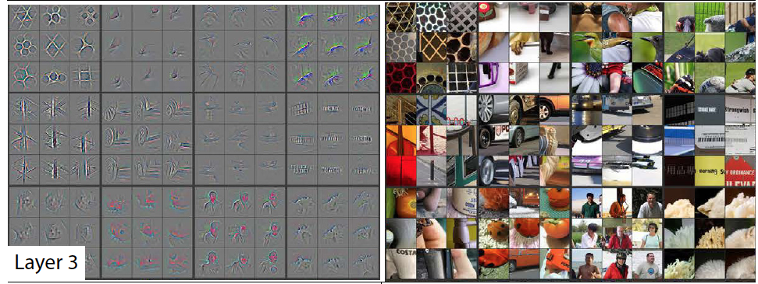
Visualizing Learned Filters
Figure Credit: [Zeiler & Fergus ECCV14]

Slide 46
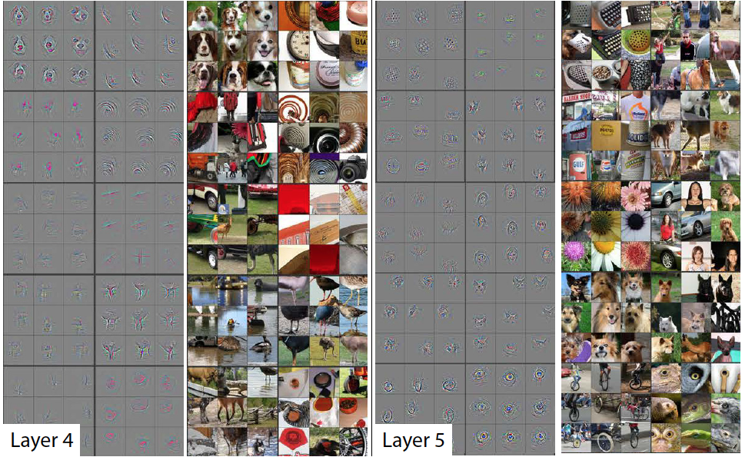
Visualizing Learned Filters
Figure Credit: [Zeiler & Fergus ECCV14]

Slide 47
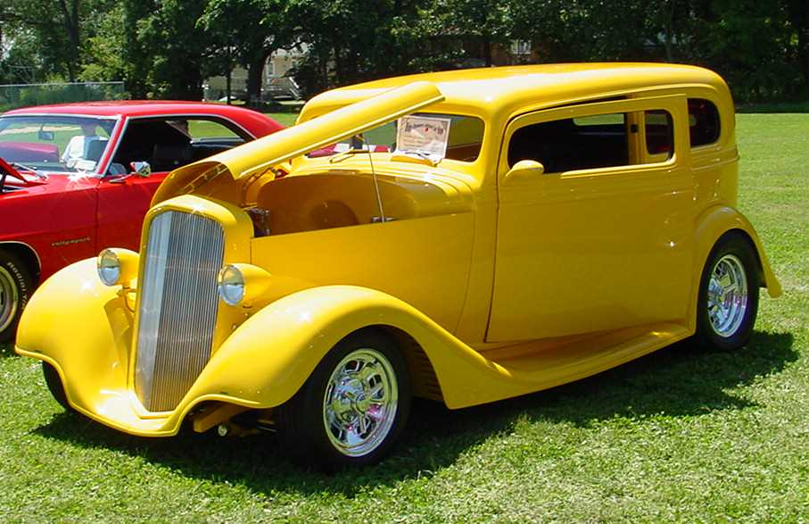
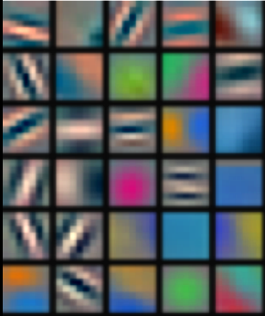
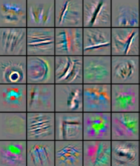
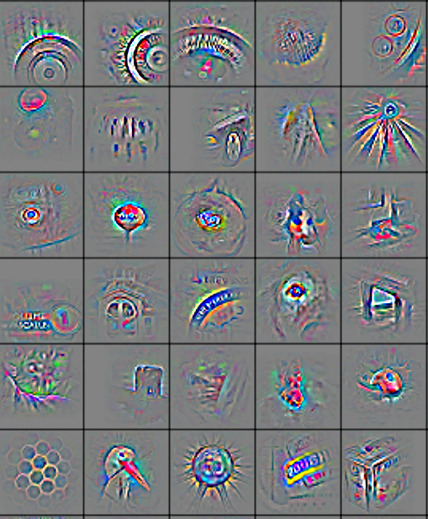
We can learn image features now!
Low-Level
Feature
Mid-Level
Feature
High-Level
Feature
Linear
Classifier
“car”
Feature visualization of convolutional net trained on ImageNet from [Zeiler & Fergus 2013]
Slide Credit: Marc'Aurelio Ranzato, Yann LeCun

Slide 48
Plan for Today
Convolutional Neural Networks
  Features learned by CNN layers
  Stride, padding
  1x1 convolutions
  Pooling layers
  Fully-connected layers as convolutions

Slide 49
A closer look at spatial dimensions:
activation map
32x32x3 image
5x5x3 filter
32
28
convolve (slide) over all spatial locations
32
28
3
1
Slide Credit: Fei-Fei Li, Justin Johnson, Serena Yeung, CS 231n

Slide 50
A closer look at spatial dimensions:
7
7x7 input (spatially)
assume 3x3 filter
7
Slide Credit: Fei-Fei Li, Justin Johnson, Serena Yeung, CS 231n

Slide 51
A closer look at spatial dimensions:
7
7x7 input (spatially)
assume 3x3 filter
7
Slide Credit: Fei-Fei Li, Justin Johnson, Serena Yeung, CS 231n

Slide 52
A closer look at spatial dimensions:
7
7x7 input (spatially)
assume 3x3 filter
7
Slide Credit: Fei-Fei Li, Justin Johnson, Serena Yeung, CS 231n

Slide 53
A closer look at spatial dimensions:
7
7x7 input (spatially)
assume 3x3 filter
7
Slide Credit: Fei-Fei Li, Justin Johnson, Serena Yeung, CS 231n

Slide 54
A closer look at spatial dimensions:
7
7x7 input (spatially)
assume 3x3 filter
=> 5x5 output
7
Slide Credit: Fei-Fei Li, Justin Johnson, Serena Yeung, CS 231n

Slide 55
A closer look at spatial dimensions:
7
7x7 input (spatially)
assume 3x3 filter
applied with stride 2
7
Slide Credit: Fei-Fei Li, Justin Johnson, Serena Yeung, CS 231n

Slide 56
A closer look at spatial dimensions:
7
7x7 input (spatially)
assume 3x3 filter
applied with stride 2
7
Slide Credit: Fei-Fei Li, Justin Johnson, Serena Yeung, CS 231n

Slide 57
A closer look at spatial dimensions:
7
7x7 input (spatially)
assume 3x3 filter
applied with stride 2
=> 3x3 output!
7
Slide Credit: Fei-Fei Li, Justin Johnson, Serena Yeung, CS 231n

Slide 58
A closer look at spatial dimensions:
7
7x7 input (spatially)
assume 3x3 filter
applied with stride 3?
7
Slide Credit: Fei-Fei Li, Justin Johnson, Serena Yeung, CS 231n

Slide 59
A closer look at spatial dimensions:
7
7x7 input (spatially)
assume 3x3 filter
applied with stride 3?
7
doesn’t fit!
cannot apply 3x3 filter on 7x7 input with stride 3.
Slide Credit: Fei-Fei Li, Justin Johnson, Serena Yeung, CS 231n

Slide 60
N
Output size:
(N - F) / stride + 1
e.g. N = 7, F = 3:
stride 1 => (7 - 3)/1 + 1 = 5
stride 2 => (7 - 3)/2 + 1 = 3
stride 3 => (7 - 3)/3 + 1 = 2.33 :\
F
F
N
Slide Credit: Fei-Fei Li, Justin Johnson, Serena Yeung, CS 231n

Slide 61
Remember back to…
E.g. 32x32 input convolved repeatedly with 5x5 filters shrinks volumes spatially!
(32 -> 28 -> 24 ...). Shrinking too fast is not good, doesn’t work well.
32
28
24
….
CONV,
ReLU
e.g. 6 5x5x3 filters
CONV,
ReLU
e.g. 10 5x5x6 filters
CONV,
ReLU
32
28
24
3
6
10
Slide Credit: Fei-Fei Li, Justin Johnson, Serena Yeung, CS 231n

Slide 62
In practice: Common to zero pad the border
0 | 0 | 0 | 0 | 0 | 0
0
0
0
0
e.g. input 7x7
3x3 filter, applied with stride 1
pad with 1 pixel border => what is the output?
(recall:)
(N - F) / stride + 1
Slide Credit: Fei-Fei Li, Justin Johnson, Serena Yeung, CS 231n

Slide 63
In practice: Common to zero pad the border
0 | 0 | 0 | 0 | 0 | 0
0
0
0
0
e.g. input 7x7
3x3 filter, applied with stride 1
pad with 1 pixel border => what is the output?
7x7 output!
Slide Credit: Fei-Fei Li, Justin Johnson, Serena Yeung, CS 231n

Slide 64
In practice: Common to zero pad the border
0 | 0 | 0 | 0 | 0 | 0
0
0
0
0
e.g. input 7x7
3x3 filter, applied with stride 1
pad with 1 pixel border => what is the output?
7x7 output!
in general, common to see CONV layers with stride 1, filters of size FxF, and zero-padding with (F-1)/2. (will preserve size spatially)
e.g. F = 3 => zero pad with 1
F = 5 => zero pad with 2
F = 7 => zero pad with 3
Slide Credit: Fei-Fei Li, Justin Johnson, Serena Yeung, CS 231n

Slide 65
Examples time:
Input volume: 32x32x3
10 5x5 filters with stride 1, pad 2
Output volume size: ?
Slide Credit: Fei-Fei Li, Justin Johnson, Serena Yeung, CS 231n
Notes:
(32+2*2-5)/1+1 = 32 spatially
(Input size + 2*padding - stride) / 1 + 1 for new spatial size
10 filters

Slide 66
Examples time:
Input volume: 32x32x3
10 5x5 filters with stride 1, pad 2
Output volume size:
(32+2*2-5)/1+1 = 32 spatially, so
32x32x10
Slide Credit: Fei-Fei Li, Justin Johnson, Serena Yeung, CS 231n

Slide 67
Examples time:
Input volume: 32x32x3
10 5x5 filters with stride 1, pad 2
Number of parameters in this layer?
Slide Credit: Fei-Fei Li, Justin Johnson, Serena Yeung, CS 231n
Notes:
each filter has 5*5*3 + 1 = 76 params
1 for bias

Slide 68
Examples time:
Input volume: 32x32x3
10 5x5 filters with stride 1, pad 2
Number of parameters in this layer?
each filter has 5*5*3 + 1 = 76 params (+1 for bias)
=> 76*10 = 760
Slide Credit: Fei-Fei Li, Justin Johnson, Serena Yeung, CS 231n

Slide 69
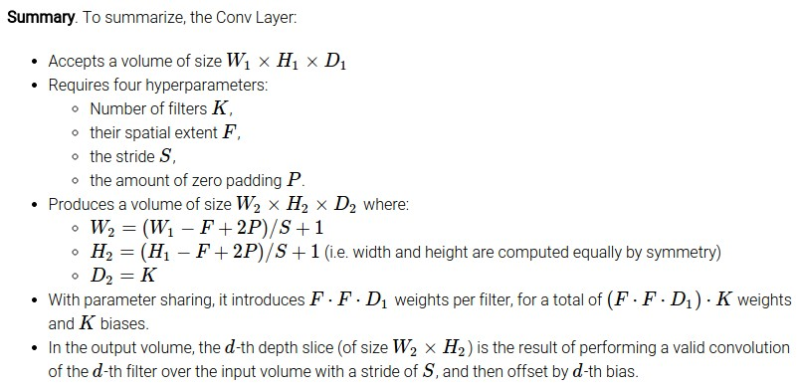
Slide Credit: Fei-Fei Li, Justin Johnson, Serena Yeung, CS 231n

Slide 70
Common settings:
K = (powers of 2, e.g. 32, 64, 128, 512)
F = 3, S = 1, P = 1
F = 5, S = 1, P = 2
F = 5, S = 2, P = ? (whatever fits)
F = 1, S = 1, P = 0
Slide Credit: Fei-Fei Li, Justin Johnson, Serena Yeung, CS 231n

Slide 71
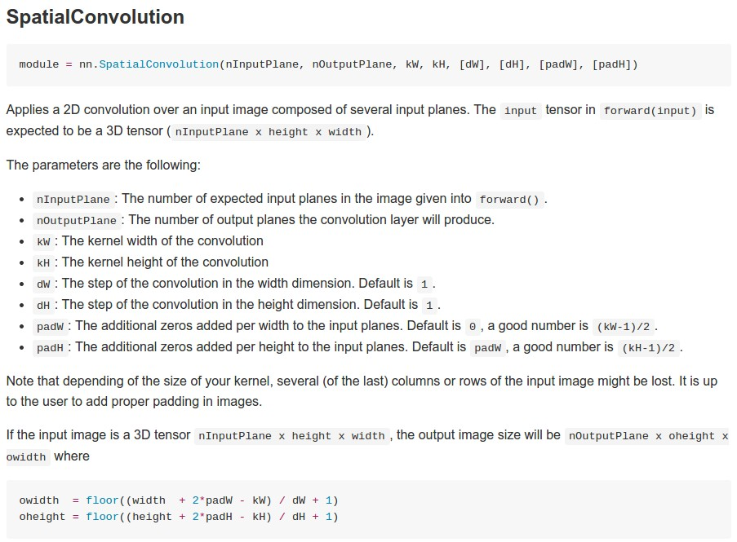
Example: CONV layer in Torch
Torch is licensed under BSD 3-clause.
Slide Credit: Fei-Fei Li, Justin Johnson, Serena Yeung, CS 231n

Slide 72
Plan for Today
Convolutional Neural Networks
  Features learned by CNN layers
  Stride, padding
  1x1 convolutions
  Pooling layers
  Fully-connected layers as convolutions
  Backprop in conv layers

Slide 73
Can we have 1x1 filters?

Slide 74
1x1 convolution layers make perfect sense
1x1 CONV
with 32 filters
56
56
(each filter has size 1x1x64, and performs a 64-dimensional dot product)
56
56
64
32
Slide Credit: Fei-Fei Li, Justin Johnson, Serena Yeung, CS 231n

Slide 75
Fully Connected Layer as 1x1 Conv
32x32x3 image -> stretch to 3072 x 1
input
activation
1
1
3072
10 x 3072
weights
10
1 number:
the result of taking a dot product between a row of W and the input (a 3072-dimensional dot product)
Slide Credit: Fei-Fei Li, Justin Johnson, Serena Yeung, CS 231n
Notes:
Preserve spatial structure of input

