Slide 1
CS 4803 / 7643: Deep Learning
Topics:
  Optimization
  Computing Gradients
Dhruv Batra
Georgia Tech

Slide 2
Administrativia
HW1 Reminder
  Due: 09/26, 11:55pm
  https://www.cc.gatech.edu/classes/AY2020/cs7643_fall/Z3o9P26CwTPZZMDXyWYDj3/hw1.pdf
  https://www.cc.gatech.edu/classes/AY2020/cs7643_fall/Z3o9P26CwTPZZMDXyWYDj3/hw1-q8/
  https://evalai.cloudcv.org/web/challenges/challenge-page/431/leaderboard/1200

Slide 3
Recap from last time

Slide 4

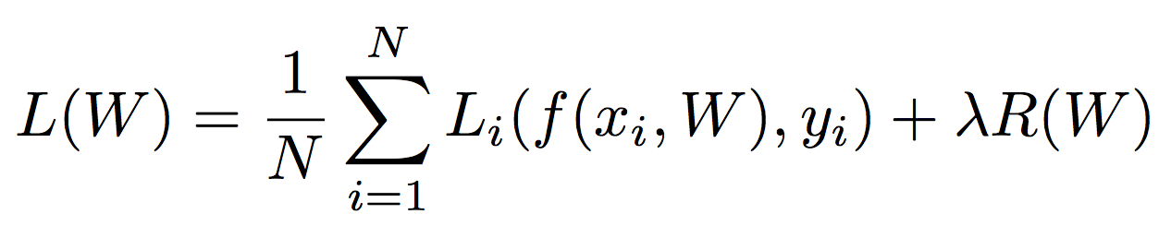
Regularization
= regularization strength
(hyperparameter)
Data loss: Model predictions should match training data
Regularization: Prevent the model from doing too well on training data
Occam’s Razor:
“Among competing hypotheses, the simplest is the best”
William of Ockham, 1285 - 1347
Slide Credit: Fei-Fei Li, Justin Johnson, Serena Yeung, CS 231n

Slide 5



Regularization
= regularization strength
(hyperparameter)
Data loss: Model predictions should match training data
Regularization: Prevent the model from doing too well on training data
Simple examples
L2 regularization:
L1 regularization:
Elastic net (L1 + L2):
More complex:
Dropout
Batch normalization
Stochastic depth, fractional pooling, etc
Slide Credit: Fei-Fei Li, Justin Johnson, Serena Yeung, CS 231n

Slide 6
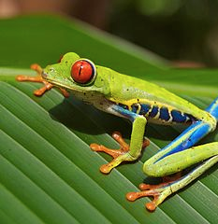

So far: Linear Classifiers
Class scores
f(x) = Wx

Slide 7
Hard cases for a linear classifier
Class 1:
First and third quadrants
Class 2:
Second and fourth quadrants
Class 1:
1 <= L2 norm <= 2
Class 2:
Everything else
Class 1:
Three modes
Class 2:
Everything else
Slide Credit: Fei-Fei Li, Justin Johnson, Serena Yeung, CS 231n

Slide 8
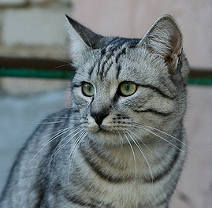
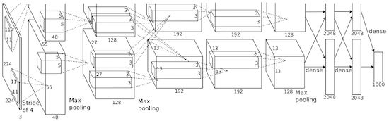
Image features vs Neural Nets
f
Feature Extraction
10 numbers giving scores for classes
training
Krizhevsky, Sutskever, and Hinton, “Imagenet classification with deep convolutional neural networks”, NIPS 2012.
Figure copyright Krizhevsky, Sutskever, and Hinton, 2012. Reproduced with permission.
10 numbers giving scores for classes
training

Slide 9

Neural networks: without the brain stuff
(Before) Linear score function:
Slide Credit: Fei-Fei Li, Justin Johnson, Serena Yeung, CS 231n
Notes:
Have been using linear score function as running example of function to optimize

Slide 10

Neural networks: without the brain stuff
(Before) Linear score function:
(Now) 2-layer Neural Network
Slide Credit: Fei-Fei Li, Justin Johnson, Serena Yeung, CS 231n
Notes:
Instead of using single linear transformation, stack 2 together, get 2-layer network

Slide 11
Neural networks: without the brain stuff
(Before) Linear score function:
(Now) 2-layer Neural Network
x
h
W1
W2
s
3072
100
10
Slide Credit: Fei-Fei Li, Justin Johnson, Serena Yeung, CS 231n
Notes:
First have W1*x, then nonlinear function, then second linear layer
More broadly speaking, NN are class of functions where simpler functions are stacked on top of each other in a hierarchical way to make up a more complex, nonlinear function. Have multiple stages of hierarchical computation.

Slide 12
Neural networks: without the brain stuff
(Before) Linear score function:
(Now) 2-layer Neural Network
x
h
W1
W2
s
3072
100
10
Slide Credit: Fei-Fei Li, Justin Johnson, Serena Yeung, CS 231n
Notes:
Biological inspirations to neurons in brain that we’ll discuss later
Looking at it mathematically first, one thing this can help solve, is if we look back to our linear score function, each row of W corresponded to a template
Problem that there can be only one template per class, can’t look for multiple modes
Now intermediate layers can represent anonymous templates that later get recombined
Intermediate layers anonymous templates that get recombined. solves mode problems

Slide 13
Neural networks: without the brain stuff
(Before) Linear score function:
(Now) 2-layer Neural Network
or 3-layer Neural Network
Slide Credit: Fei-Fei Li, Justin Johnson, Serena Yeung, CS 231n
Notes:
Can stack more of these layers to get deeper networks, where the term deep NN comes from

Slide 14
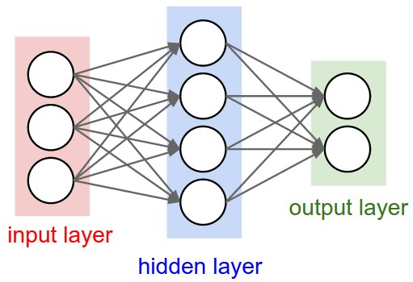
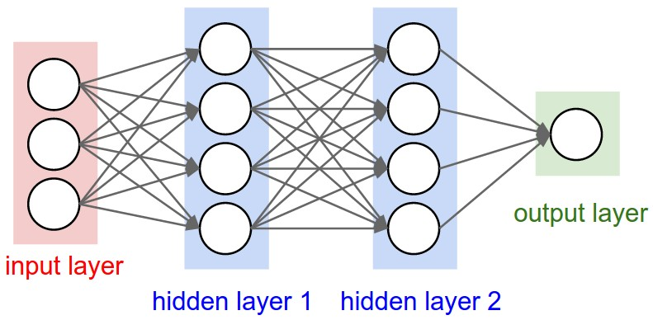
Multilayer Networks
Cascaded “neurons”
The output from one layer is the input to the next
Each layer has its own sets of weights
Image Credit: Andrej Karpathy, CS231n

Slide 15
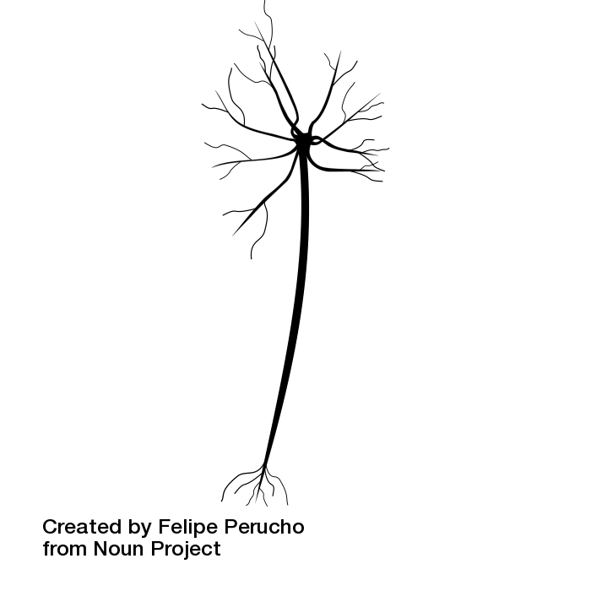
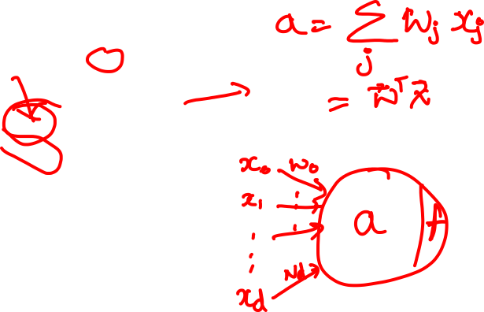
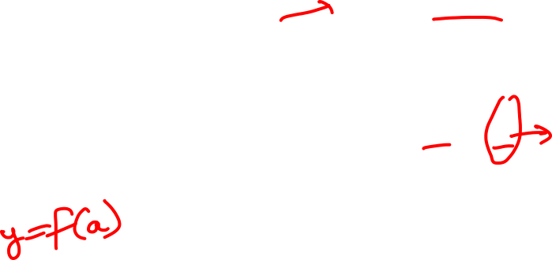
Impulses carried toward cell body
dendrite
presynaptic
terminal
axon
cell body
Impulses carried away from cell body
This image by Felipe Perucho
is licensed under CC-BY 3.0
Slide Credit: Fei-Fei Li, Justin Johnson, Serena Yeung, CS 231n

Slide 16
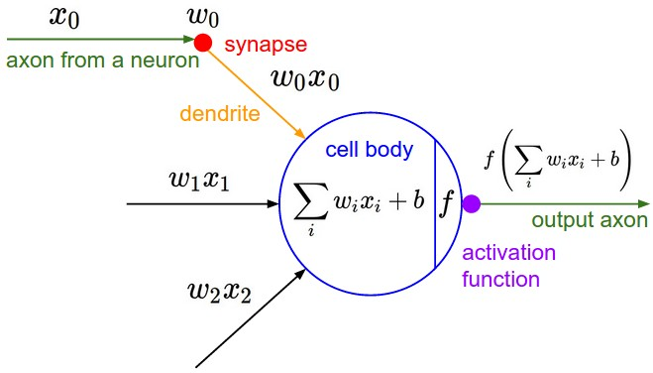
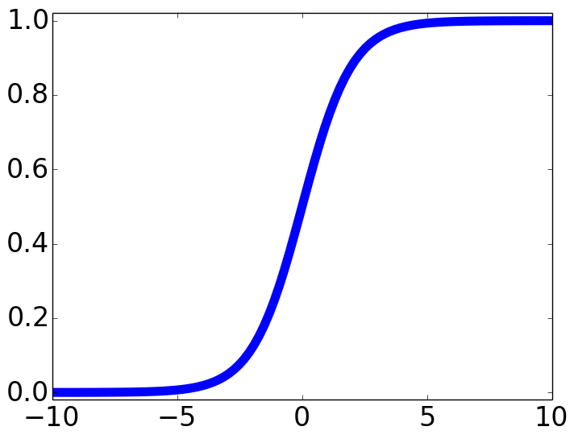

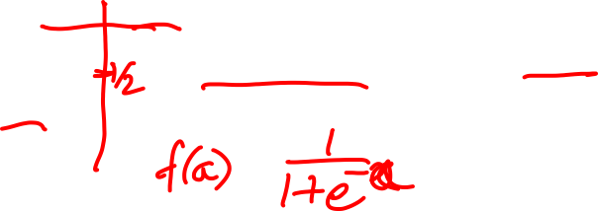
Impulses carried toward cell body
dendrite
presynaptic
terminal
axon
cell body
Impulses carried away from cell body
This image by Felipe Perucho
is licensed under CC-BY 3.0
sigmoid activation function
Slide Credit: Fei-Fei Li, Justin Johnson, Serena Yeung, CS 231n

Slide 17
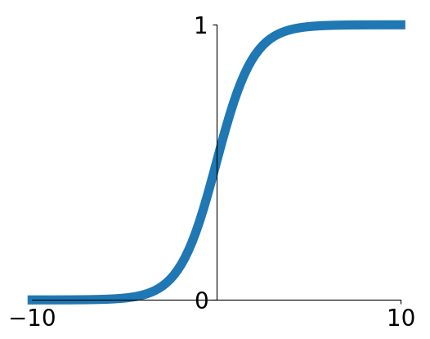
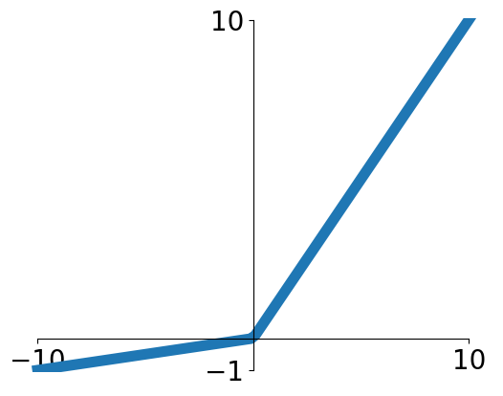


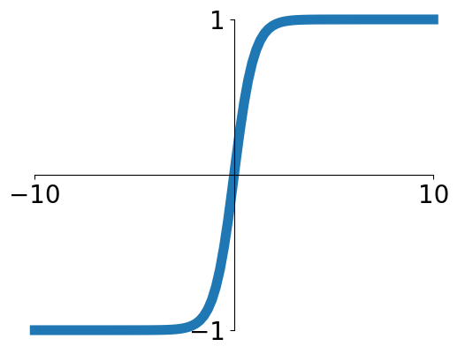


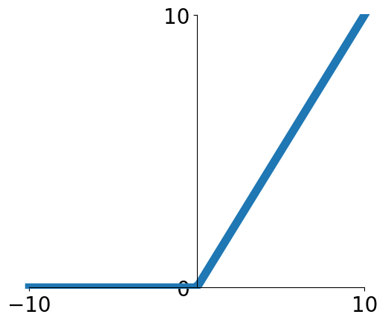
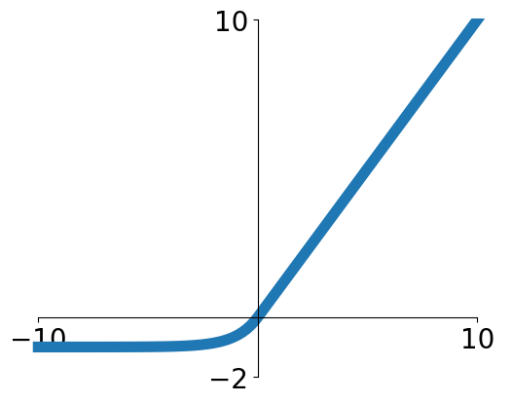

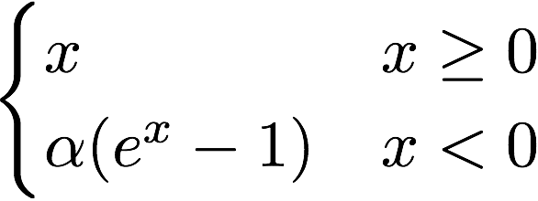
Activation functions
Sigmoid
Leaky ReLU
tanh
Maxout
ReLU
ELU
Slide Credit: Fei-Fei Li, Justin Johnson, Serena Yeung, CS 231n

Slide 18
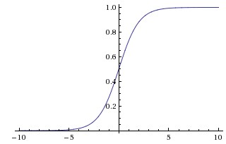
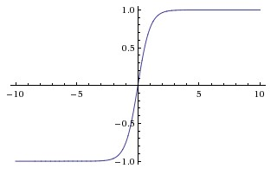
Activation Functions
sigmoid vs tanh

Slide 19
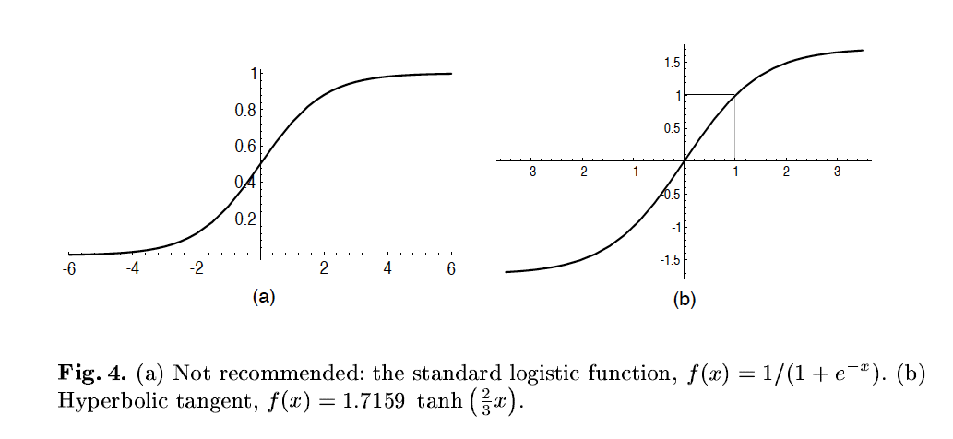
A quick note
Image Credit: LeCun et al. ‘98

Slide 20
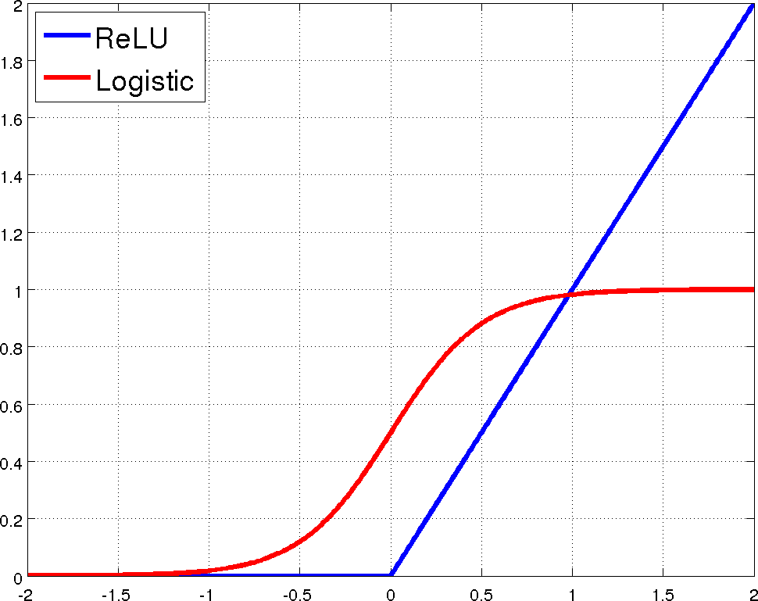
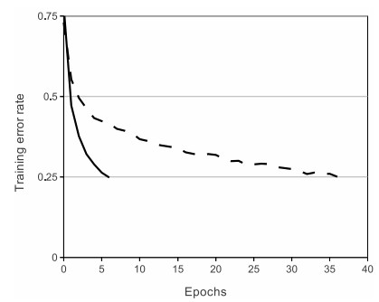
Rectified Linear Units (ReLU)
[Krizhevsky et al., NIPS12]

Slide 21
Plan for Today
Optimization
Computing Gradients

Slide 22
Optimization

Slide 23
Supervised Learning
Input: x (images, text, emails…)
Output: y (spam or non-spam…)
(Unknown) Target Function
  f: X → Y (the “true” mapping / reality)
Data
  (x₁,y₁), (x₂,y₂), …, (x_{N},y_{N})
Model / Hypothesis Class
  {h: X → Y}
  e.g. y = h(x) = sign(w^{T}x)
Loss Function
  How good is a model wrt my data D?
Learning = Search in hypothesis space
  Find best h in model class.

Slide 24
Demo Time
https://playground.tensorflow.org

Slide 25

This image is CC0 1.0 public domain
Slide Credit: Fei-Fei Li, Justin Johnson, Serena Yeung, CS 231n

Slide 26

Strategy: Follow the slope
Slide Credit: Fei-Fei Li, Justin Johnson, Serena Yeung, CS 231n

Slide 27

Strategy: Follow the slope
In 1-dimension, the derivative of a function:
Slide Credit: Fei-Fei Li, Justin Johnson, Serena Yeung, CS 231n

Slide 28
Strategy: Follow the slope
In 1-dimension, the derivative of a function:
In multiple dimensions, the gradient is the vector of (partial derivatives) along each dimension
The slope in any direction is the dot product of the direction with the gradient
The direction of steepest descent is the negative gradient
Slide Credit: Fei-Fei Li, Justin Johnson, Serena Yeung, CS 231n

Slide 29

http://demonstrations.wolfram.com/VisualizingTheGradientVector/
W_2
original W
W_1
negative gradient direction
Slide Credit: Fei-Fei Li, Justin Johnson, Serena Yeung, CS 231n

Slide 30
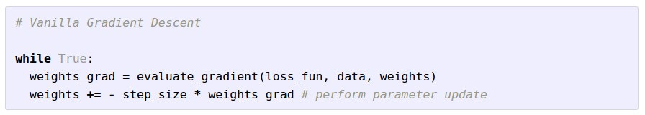
Gradient Descent
Slide Credit: Fei-Fei Li, Justin Johnson, Serena Yeung, CS 231n

Slide 31
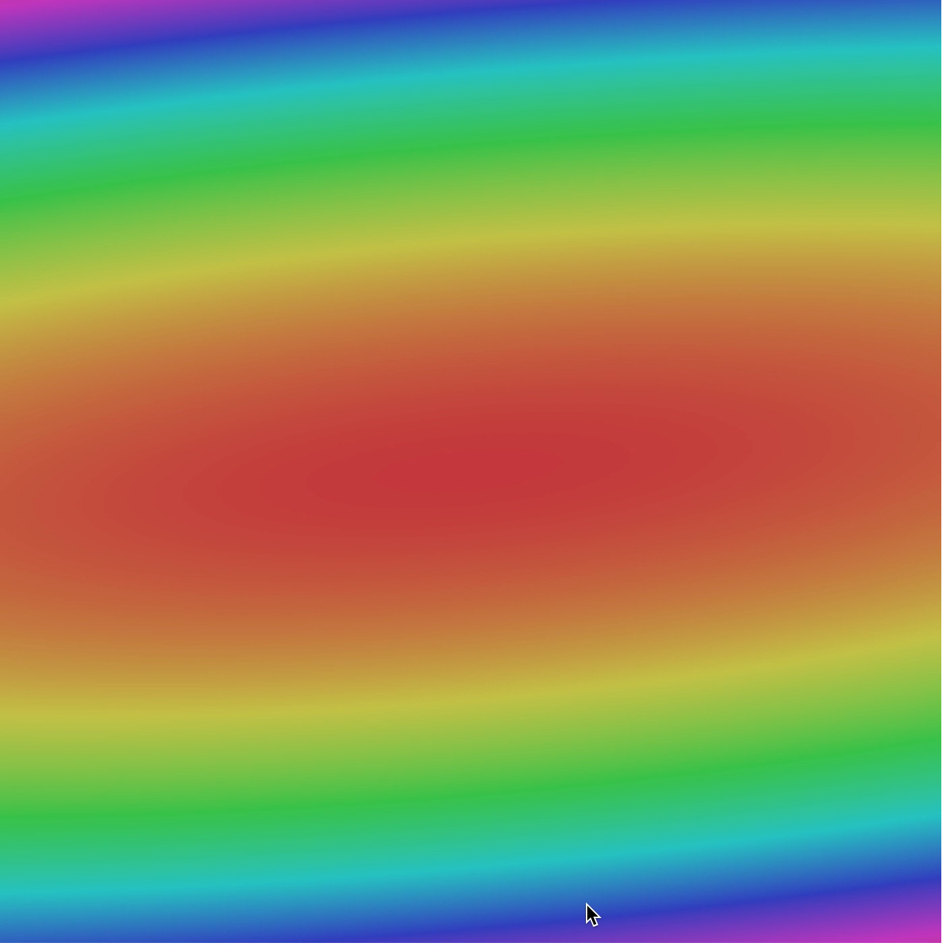
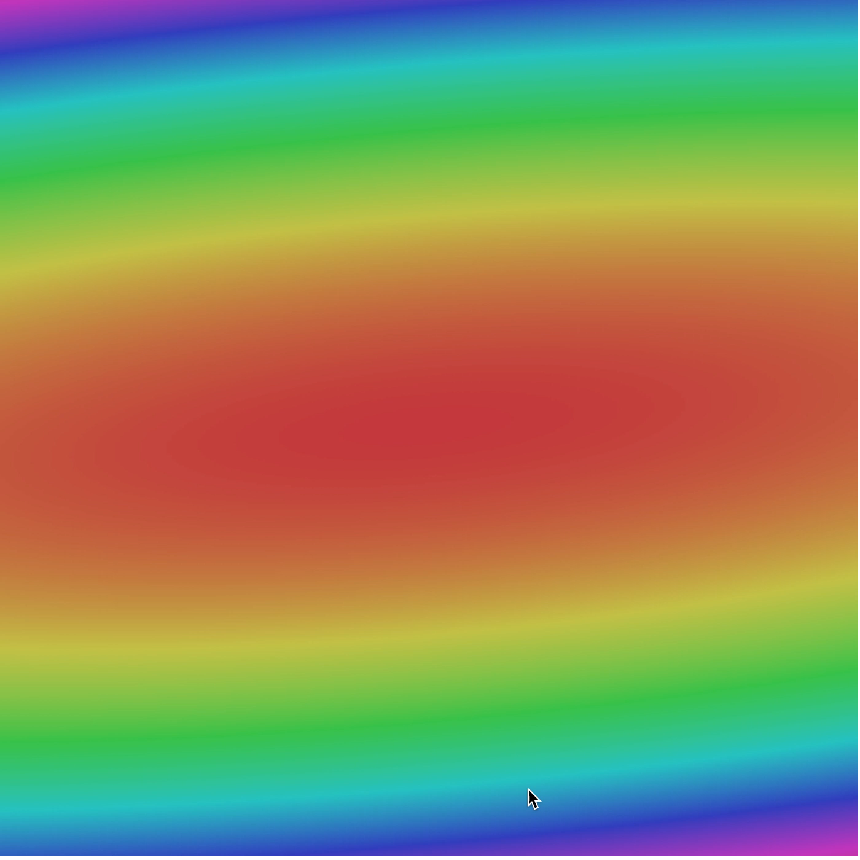
Slide Credit: Fei-Fei Li, Justin Johnson, Serena Yeung, CS 231n

Slide 32
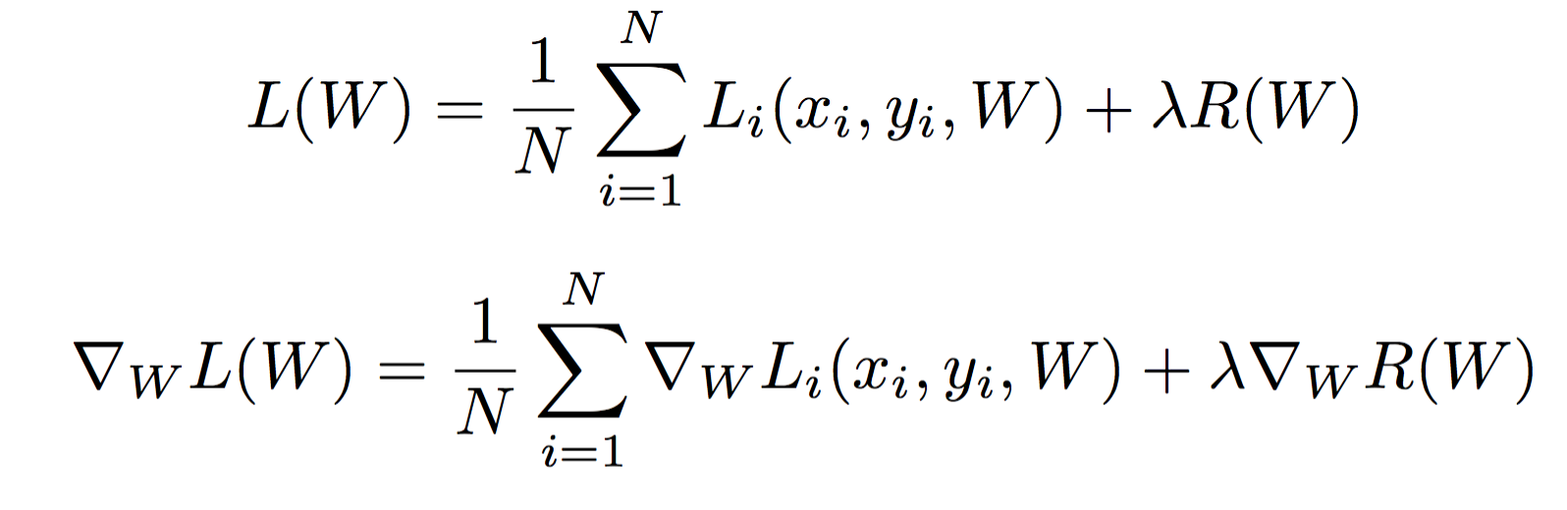
Gradient Descent has a problem
Full sum expensive when N is large!
Slide Credit: Fei-Fei Li, Justin Johnson, Serena Yeung, CS 231n

Slide 33
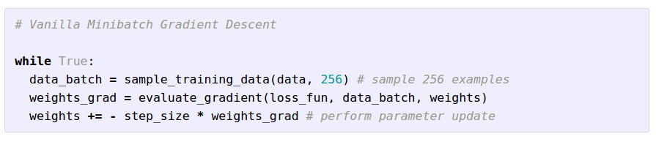
Stochastic Gradient Descent (SGD)
Full sum expensive when N is large!
Approximate sum using a minibatch of examples
32 / 64 / 128 common
Slide Credit: Fei-Fei Li, Justin Johnson, Serena Yeung, CS 231n

Slide 34
Stochastic Gradient Descent (SGD)
Slide Credit: Fei-Fei Li, Justin Johnson, Serena Yeung, CS 231n

Slide 35
Stochastic Gradient Descent (SGD)
Slide Credit: Fei-Fei Li, Justin Johnson, Serena Yeung, CS 231n

Slide 36
Stochastic Gradient Descent (SGD)
Full sum expensive when N is large!
Approximate sum using a minibatch of examples
32 / 64 / 128 common
Slide Credit: Fei-Fei Li, Justin Johnson, Serena Yeung, CS 231n

Slide 37
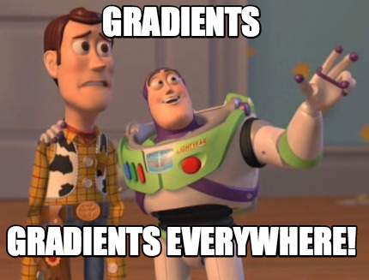

Slide 38
How do we compute gradients?
Analytic or “Manual” Differentiation
Symbolic Differentiation
Numerical Differentiation
Automatic Differentiation
  Forward mode AD
  Reverse mode AD
    aka “backprop”

Slide 39
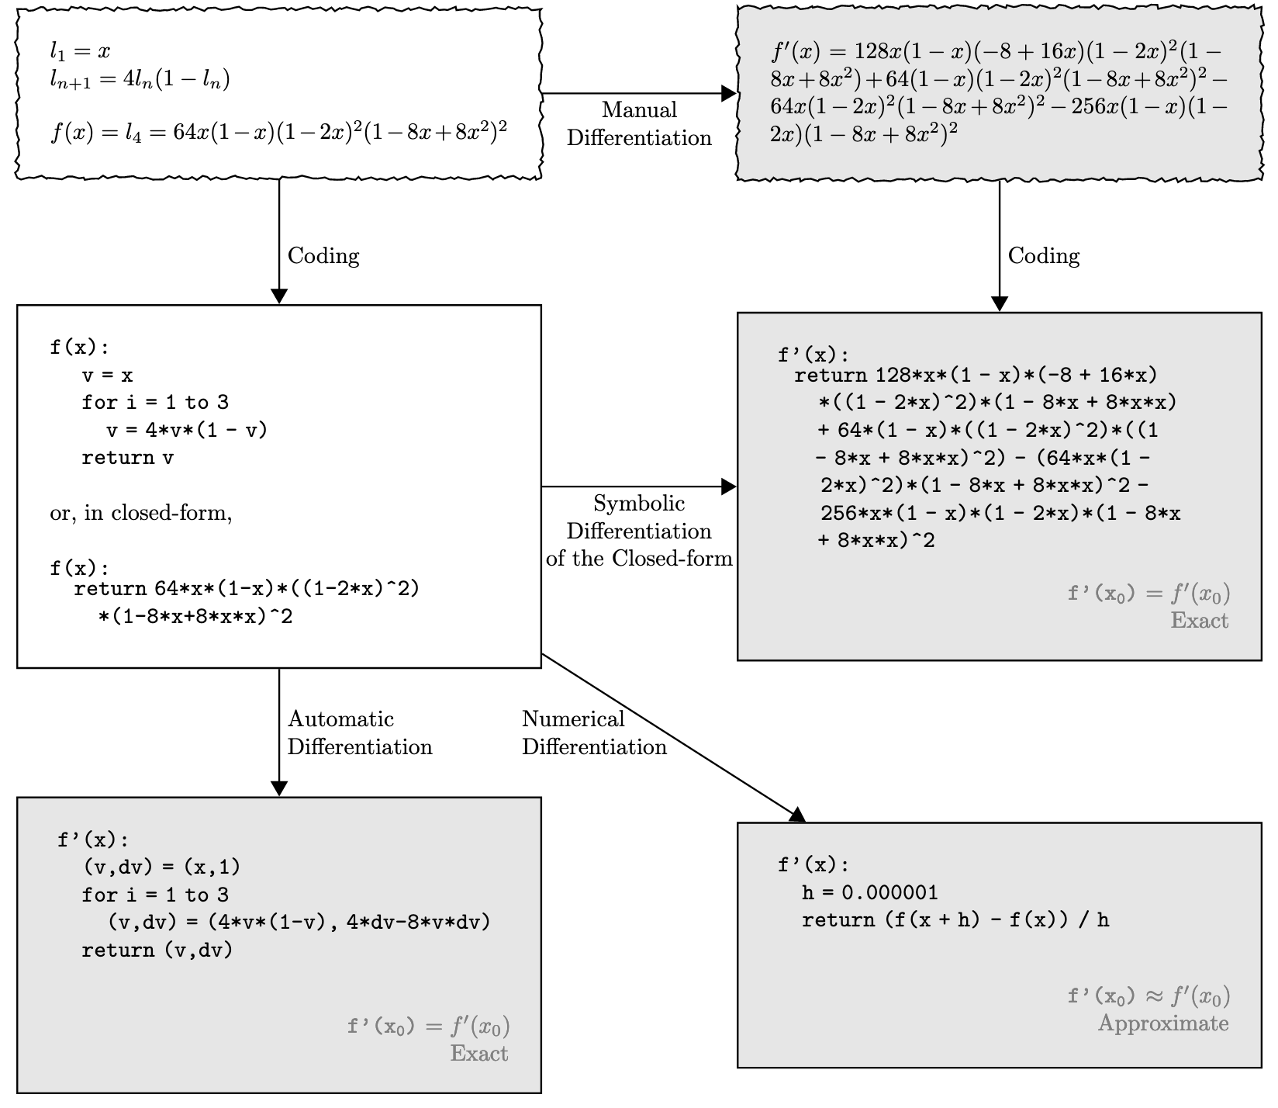
Figure Credit: Baydin et al. https://arxiv.org/abs/1502.05767

Slide 40
Figure Credit: Baydin et al. https://arxiv.org/abs/1502.05767

Slide 41
Figure Credit: Baydin et al. https://arxiv.org/abs/1502.05767

Slide 42
Figure Credit: Baydin et al. https://arxiv.org/abs/1502.05767

Slide 43
How do we compute gradients?
Analytic or “Manual” Differentiation
Symbolic Differentiation
Numerical Differentiation
Automatic Differentiation
  Forward mode AD
  Reverse mode AD
    aka “backprop”

Slide 44
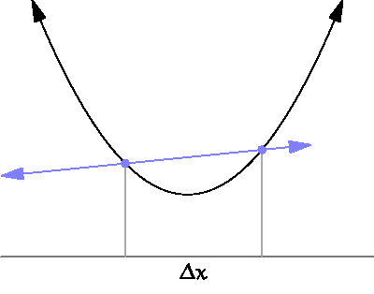
By Brnbrnz (Own work) [CC BY-SA 4.0 (http://creativecommons.org/licenses/by-sa/4.0)]

Slide 45
current W:
[0.34,
-1.11,
0.78,
0.12,
0.55,
2.81,
-3.1,
-1.5,
0.33,…]
loss 1.25347
gradient dW:
[?,
?,
?,
?,
?,
?,
?,
?,
?,…]
Slide Credit: Fei-Fei Li, Justin Johnson, Serena Yeung, CS 231n

Slide 46
current W:
[0.34,
-1.11,
0.78,
0.12,
0.55,
2.81,
-3.1,
-1.5,
0.33,…]
loss 1.25347
W + h (first dim):
[0.34 + 0.0001,
-1.11,
0.78,
0.12,
0.55,
2.81,
-3.1,
-1.5,
0.33,…]
loss 1.25322
gradient dW:
[?,
?,
?,
?,
?,
?,
?,
?,
?,…]
Slide Credit: Fei-Fei Li, Justin Johnson, Serena Yeung, CS 231n

Slide 47
current W:
[0.34,
-1.11,
0.78,
0.12,
0.55,
2.81,
-3.1,
-1.5,
0.33,…]
loss 1.25347
W + h (first dim):
[0.34 + 0.0001,
-1.11,
0.78,
0.12,
0.55,
2.81,
-3.1,
-1.5,
0.33,…]
loss 1.25322
gradient dW:
[-2.5,
?,
?,
?,
?,
?,
?,
?,
?,…]
(1.25322 - 1.25347)/0.0001
= -2.5
Slide Credit: Fei-Fei Li, Justin Johnson, Serena Yeung, CS 231n

Slide 48
current W:
[0.34,
-1.11,
0.78,
0.12,
0.55,
2.81,
-3.1,
-1.5,
0.33,…]
loss 1.25347
W + h (second dim):
[0.34,
-1.11 + 0.0001,
0.78,
0.12,
0.55,
2.81,
-3.1,
-1.5,
0.33,…]
loss 1.25353
gradient dW:
[-2.5,
?,
?,
?,
?,
?,
?,
?,
?,…]
Slide Credit: Fei-Fei Li, Justin Johnson, Serena Yeung, CS 231n

Slide 49
current W:
[0.34,
-1.11,
0.78,
0.12,
0.55,
2.81,
-3.1,
-1.5,
0.33,…]
loss 1.25347
W + h (second dim):
[0.34,
-1.11 + 0.0001,
0.78,
0.12,
0.55,
2.81,
-3.1,
-1.5,
0.33,…]
loss 1.25353
gradient dW:
[-2.5,
0.6,
?,
?,
?,
?,
?,
?,
?,…]
(1.25353 - 1.25347)/0.0001
= 0.6
Slide Credit: Fei-Fei Li, Justin Johnson, Serena Yeung, CS 231n

Slide 50
current W:
[0.34,
-1.11,
0.78,
0.12,
0.55,
2.81,
-3.1,
-1.5,
0.33,…]
loss 1.25347
W + h (third dim):
[0.34,
-1.11,
0.78 + 0.0001,
0.12,
0.55,
2.81,
-3.1,
-1.5,
0.33,…]
loss 1.25347
gradient dW:
[-2.5,
0.6,
?,
?,
?,
?,
?,
?,
?,…]
Slide Credit: Fei-Fei Li, Justin Johnson, Serena Yeung, CS 231n

Slide 51
current W:
[0.34,
-1.11,
0.78,
0.12,
0.55,
2.81,
-3.1,
-1.5,
0.33,…]
loss 1.25347
W + h (third dim):
[0.34,
-1.11,
0.78 + 0.0001,
0.12,
0.55,
2.81,
-3.1,
-1.5,
0.33,…]
loss 1.25347
gradient dW:
[-2.5,
0.6,
0,
?,
?,
?,
?,
?,
?,…]
(1.25347 - 1.25347)/0.0001
= 0
Slide Credit: Fei-Fei Li, Justin Johnson, Serena Yeung, CS 231n

Slide 52
Numerical vs Analytic Gradients
Numerical gradient: slow :(, approximate :(, easy to write :)
Analytic gradient: fast :), exact :), error-prone :(
In practice: Derive analytic gradient, check your implementation with numerical gradient.
This is called a gradient check.
Slide Credit: Fei-Fei Li, Justin Johnson, Serena Yeung, CS 231n

Slide 53
How do we compute gradients?
Analytic or “Manual” Differentiation
Symbolic Differentiation
Numerical Differentiation
Automatic Differentiation
  Forward mode AD
  Reverse mode AD
    aka “backprop”

Slide 54
Vector/Matrix Derivatives Notation

Slide 55
Vector/Matrix Derivatives Notation

Slide 56
Vector Derivative Example

Slide 57
Vector Derivative Example

Slide 58
Extension to Tensors

Slide 59
Chain Rule: Composite Functions

Slide 60
Chain Rule: Scalar Case

Slide 61
Chain Rule: Vector Case

Slide 62
Chain Rule: Jacobian view

Slide 63
Chain Rule: Graphical view

Slide 64
Chain Rule: Cascaded

Slide 65
Chain Rule: How should we multiply?

Slide 66
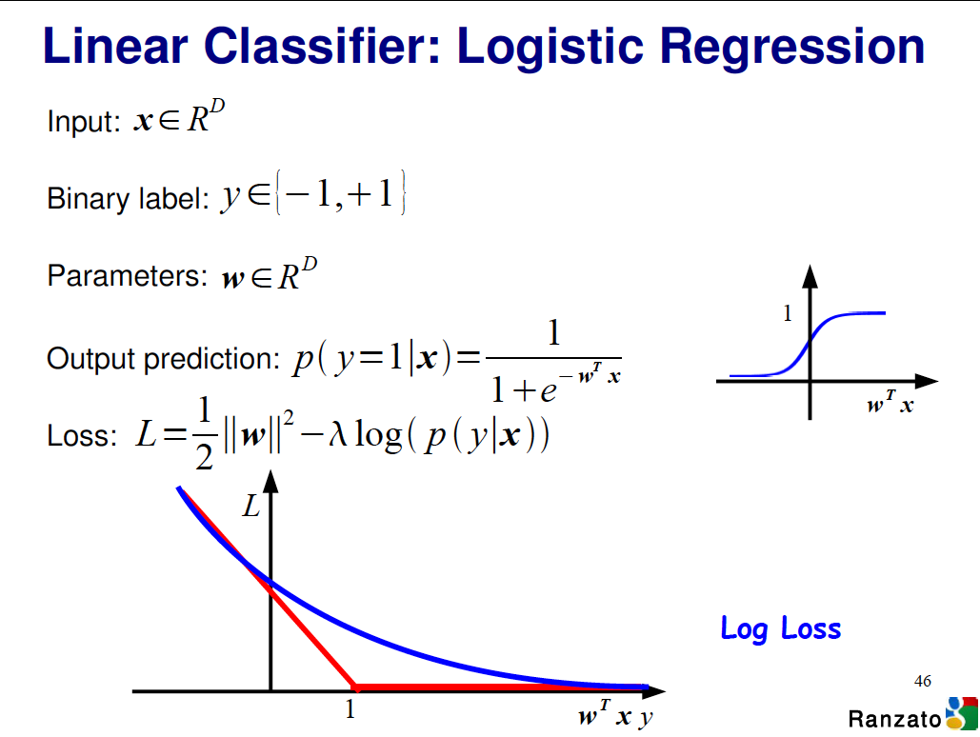

Slide 67
Logistic Regression Derivatives

Slide 68
Logistic Regression Derivatives

Slide 69

Convolutional network (AlexNet)
input image
weights
loss
Figure copyright Alex Krizhevsky, Ilya Sutskever, and Geoffrey Hinton, 2012. Reproduced with permission.
Slide Credit: Fei-Fei Li, Justin Johnson, Serena Yeung, CS 231n
Notes:
Becomes very useful when we work with complex functions

Slide 70
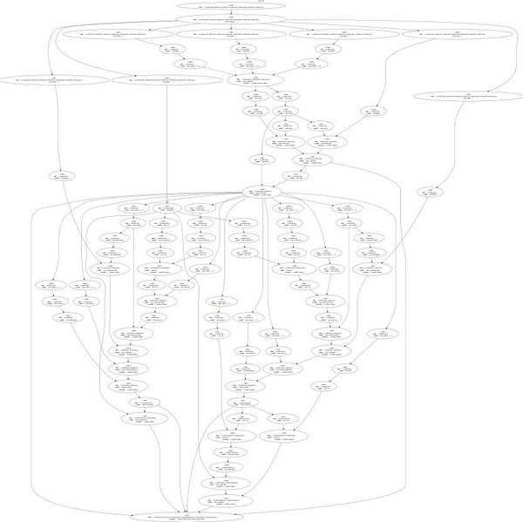
Neural Turing Machine
input image
loss
Figure reproduced with permission from a Twitter post by Andrej Karpathy.
Slide Credit: Fei-Fei Li, Justin Johnson, Serena Yeung, CS 231n
Notes:
Things get even crazier

Slide 71
How do we compute gradients?
Analytic or “Manual” Differentiation
Symbolic Differentiation
Numerical Differentiation
Automatic Differentiation
  Forward mode AD
  Reverse mode AD
    aka “backprop”

