Slide 1
CS 4803 / 7643: Deep Learning
Topics:
  Automatic Differentiation
    (Finish) Forward mode vs Reverse mode AD
    Patterns in backprop
    Jacobians in FC+ReLU NNs
Dhruv Batra
Georgia Tech

Slide 2
Administrativia
HW1 Reminder
  Due: 09/26, 11:55pm

Slide 3
Project
Goal
  Chance to take on something open-ended
  Encouraged to apply to your research
  (computer vision, NLP, robotics,…)
Main categories
  Application/Survey
    Compare a collection of existing algorithms on a new application domain of your interest
  Formulation/Development
    Formulate a new model or algorithm for a new or old problem
  Theory
    Theoretically analyze an existing algorithm

Slide 4
Project
Rules
  Combine with other classes / research / credits / anything
    You have our blanket permission
    Get permission from other instructors; delineate different parts
  Must be done this semester.
  Groups of 3-4
Expectations
  20% of final grade = individual effort equivalent to 1 HW
  Expectation scales with team size
  Most work will be done in Nov but please plan early.

Slide 5

Project Ideas
NeurIPS Reproducibility Challenge
  https://reproducibility-challenge.github.io/neurips2019/
  https://reproducibility-challenge.github.io/neurips2019/task/

Slide 6
Computing
Major bottleneck
  GPUs
Options
  Your own / group / advisor’s resources
  Google Cloud Credits
    $50 credits to every registered student courtesy Google
  Google Colab
    jupyter-notebook + free GPU instance

Slide 7
Administrativia
Project Teams Google Doc
  https://docs.google.com/spreadsheets/d/1ouD6ctaemV_3nb2MQHs7rUOAaW9DFLu8I5Zd3yOFs7E/edit?usp=sharing
  Project Title
  1-3 sentence project summary TL;DR
  Team member names

Slide 8
Recap from last time

Slide 9
How do we compute gradients?
Analytic or “Manual” Differentiation
Symbolic Differentiation
Numerical Differentiation
Automatic Differentiation
  Forward mode AD
  Reverse mode AD
    aka “backprop”

Slide 10
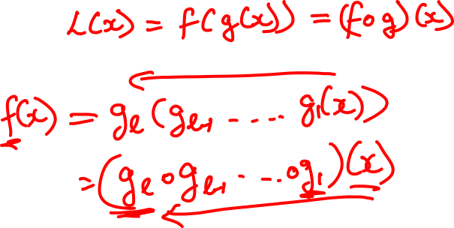
Chain Rule: Composite Functions

Slide 11
Chain Rule: Scalar Case

Slide 12
Chain Rule: Vector Case

Slide 13
Chain Rule: Jacobian view

Slide 14
Chain Rule: Graphical view

Slide 15
Chain Rule: Cascaded

Slide 16
Deep Learning = Differentiable Programming
Computation = Graph
  Input = Data + Parameters
  Output = Loss
  Scheduling = Topological ordering
Auto-Diff
  A family of algorithms for
  implementing chain-rule on computation graphs

Slide 17
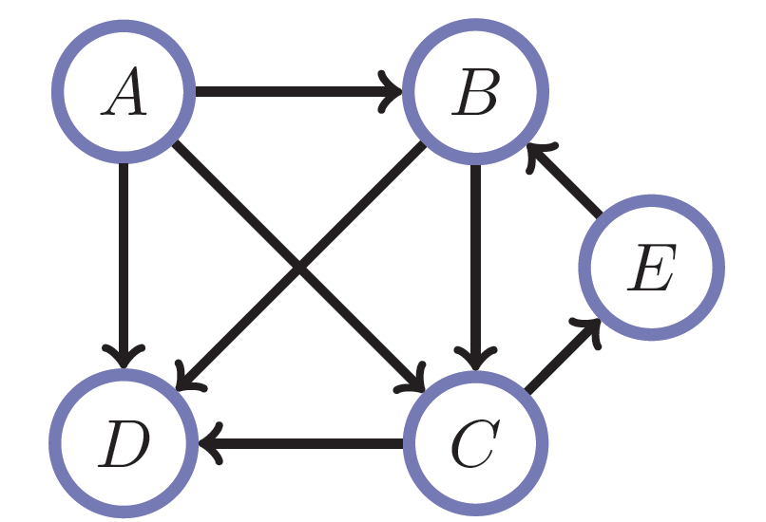
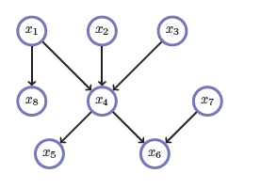
Directed Acyclic Graphs (DAGs)
Exactly what the name suggests
  Directed edges
  No (directed) cycles
  Underlying undirected cycles okay

Slide 18
Directed Acyclic Graphs (DAGs)
Concept
  Topological Ordering

Slide 19
Computational Graphs
Notation

Slide 20
Deep Learning = Differentiable Programming
Computation = Graph
  Input = Data + Parameters
  Output = Loss
  Scheduling = Topological ordering
Auto-Diff
  A family of algorithms for
  implementing chain-rule on computation graphs

Slide 21
Forward mode AD
g
Notes:
What we’re doing in backprop is we have all these nodes in our computational graph, each node only aware of immediate surroundings
at each node have ...

Slide 22
Reverse mode AD
g
Notes:
What we’re doing in backprop is we have all these nodes in our computational graph, each node only aware of immediate surroundings
at each node have ...

Slide 23
Plan for Today
Automatic Differentiation
  (Finish) Forward mode vs Reverse mode AD
  Backprop
  Patterns in backprop
  Jacobians in FC+ReLU NNs

Slide 24
Example: Forward mode AD
+
sin( )
*
x₁
x₂

Slide 25
Example: Forward mode AD
+
sin( )
*
x₁
x₂

Slide 26
Example: Forward mode AD
+
sin( )
*
x₁
x₂

Slide 27
Example: Forward mode AD
+
sin( )
*
x₁
x₂

Slide 28
Example: Forward mode AD
Q: What happens if there’s another input variable x₃?
+
sin( )
*
x₁
x₂

Slide 29
Example: Forward mode AD
Q: What happens if there’s another input variable x₃?
A: more sophisticated graph;
d “forward props” for d variables
+
sin( )
*
x₁
x₂

Slide 30
Example: Forward mode AD
Q: What happens if there’s another output variable f₂?
+
sin( )
*
x₁
x₂

Slide 31
Example: Forward mode AD
Q: What happens if there’s another output variable f₂?
A: more sophisticated graph;
single “forward prop”
+
sin( )
*
x₁
x₂

Slide 32
Example: Reverse mode AD
+
sin( )
*
x₁
x₂

Slide 33
Example: Reverse mode AD
+
sin( )
*
x₁
x₂

Slide 34
Example: Reverse mode AD
+
sin( )
*
x₁
x₂

Slide 35
Gradients add at branches
+
Slide Credit: Fei-Fei Li, Justin Johnson, Serena Yeung, CS 231n
Notes:
Gradients add at branches, from multivariate chain rule
Since wiggling this node affects both connected nodes in the forward pass, then at backprop the upstream gradient coming into this node is the sum of the gradients flowing back from both nodes

Slide 36
Example: Reverse mode AD
Q: What happens if there’s another input variable x₃?
+
sin( )
*
x₁
x₂

Slide 37
Example: Reverse mode AD
Q: What happens if there’s another input variable x₃?
A: more sophisticated graph;
single “backward prop”
+
sin( )
*
x₁
x₂

Slide 38
Example: Reverse mode AD
Q: What happens if there’s another output variable f₂?
+
sin( )
*
x₁
x₂

Slide 39
Example: Reverse mode AD
Q: What happens if there’s another output variable f₂?
A: more sophisticated graph;
c “backward props” for c vars
+
sin( )
*
x₁
x₂

Slide 40
Forward mode vs Reverse Mode
x → Graph → L
Intuition of Jacobian

Slide 41
Forward mode vs Reverse Mode
What are the differences?
Which one is faster to compute?
  Forward or backward?

Slide 42
Forward mode vs Reverse Mode
What are the differences?
Which one is faster to compute?
  Forward or backward?
Which one is more memory efficient (less storage)?
  Forward or backward?

Slide 43
Forward Pass vs
Forward mode AD vs Reverse Mode AD
+
sin( )
*
x₁
x₂
+
+
sin( )
*
sin( )
*
x₁
x₂
x₁
x₂

Slide 44
Plan for Today
Automatic Differentiation
  (Finish) Forward mode vs Reverse mode AD
  Backprop
  Patterns in backprop
  Jacobians in FC+ReLU NNs

Slide 45
Computational Graph
Any DAG of differentiable modules is allowed!
Slide Credit: Marc'Aurelio Ranzato

Slide 46
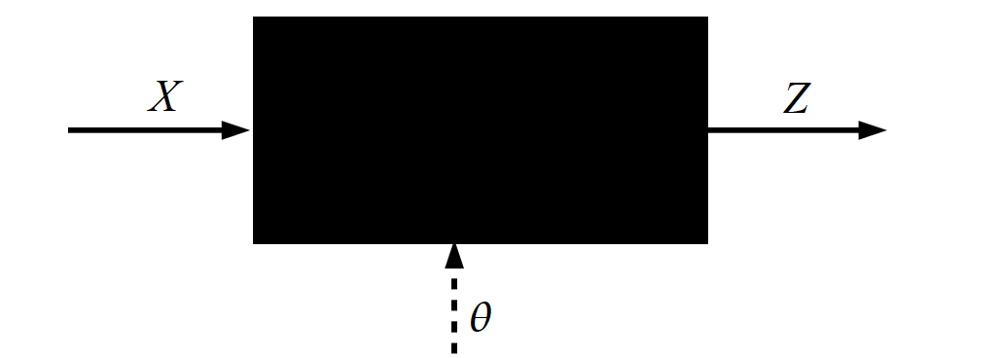
Key Computation: Forward-Prop
Slide Credit: Marc'Aurelio Ranzato, Yann LeCun

Slide 47
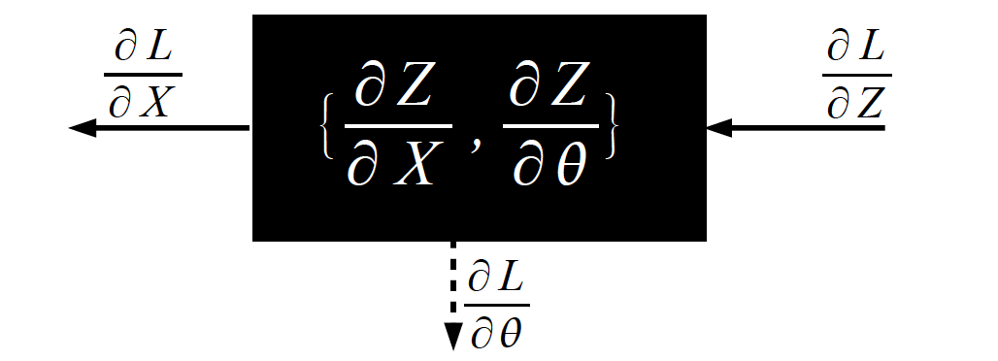
Key Computation: Back-Prop
Slide Credit: Marc'Aurelio Ranzato, Yann LeCun

Slide 48
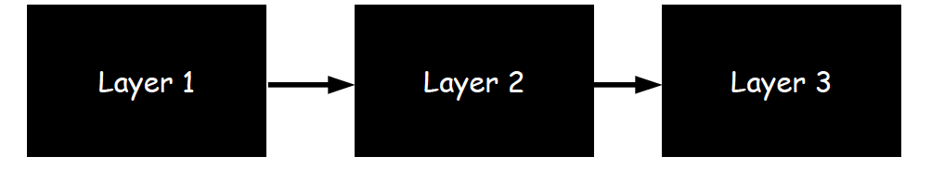
Neural Network Training
Step 1: Compute Loss on mini-batch [F-Pass]
Slide Credit: Marc'Aurelio Ranzato, Yann LeCun

Slide 49
Neural Network Training
Step 1: Compute Loss on mini-batch [F-Pass]
Slide Credit: Marc'Aurelio Ranzato, Yann LeCun

Slide 50
Neural Network Training
Step 1: Compute Loss on mini-batch [F-Pass]
Slide Credit: Marc'Aurelio Ranzato, Yann LeCun

Slide 51
Neural Network Training
Step 1: Compute Loss on mini-batch [F-Pass]
Step 2: Compute gradients wrt parameters [B-Pass]
Slide Credit: Marc'Aurelio Ranzato, Yann LeCun

Slide 52
Neural Network Training
Step 1: Compute Loss on mini-batch [F-Pass]
Step 2: Compute gradients wrt parameters [B-Pass]
Slide Credit: Marc'Aurelio Ranzato, Yann LeCun

Slide 53
Neural Network Training
Step 1: Compute Loss on mini-batch [F-Pass]
Step 2: Compute gradients wrt parameters [B-Pass]
Slide Credit: Marc'Aurelio Ranzato, Yann LeCun

Slide 54

Neural Network Training
Step 1: Compute Loss on mini-batch [F-Pass]
Step 2: Compute gradients wrt parameters [B-Pass]
Step 3: Use gradient to update parameters
Slide Credit: Marc'Aurelio Ranzato, Yann LeCun

Slide 55
Figure Credit: Andrea Vedaldi

