Slide 1
CS 4803 / 7643: Deep Learning
Topics:
  Convolutional Neural Networks
    What is a convolution?
    FC vs Conv Layers
Dhruv Batra
Georgia Tech

Slide 2
Administrativia
HW1 Reminder
  Due: 09/26, 11:55pm
  https://evalai.cloudcv.org/web/challenges/challenge-page/431/leaderboard/1200
Project Teams Google Doc
  https://docs.google.com/spreadsheets/d/1ouD6ctaemV_3nb2MQHs7rUOAaW9DFLu8I5Zd3yOFs7E/edit?usp=sharing
  Project Title
  1-3 sentence project summary TL;DR
  Team member names

Slide 3
Plan for Today
Convolutional Neural Networks
  What is a convolution?
  FC vs Conv Layers

Slide 4
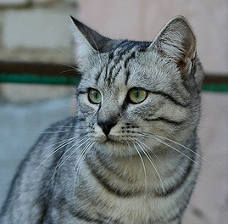
Recall: Linear Classifier
3072x1
f(x,W) = Wx + b
10x1
Image
10x1
10x3072
f(x,W)
10 numbers giving class scores
Array of 32x32x3 numbers
(3072 numbers total)
W
parameters
or weights
Slide Credit: Fei-Fei Li, Justin Johnson, Serena Yeung, CS 231n

Slide 5
Example with an image with 4 pixels, and 3 classes (cat/dog/ship)
Stretch pixels into column
56
231
24
2
0.2 | -0.5 | 0.1 | 2.0
1.5 | 1.3 | 2.1 | 0.0
0 | 0.25 | 0.2 | -0.3
1.1
3.2
-1.2
-96.8
437.9
61.95
Cat score
56 | 231
24 | 2
+
=
Dog score
Ship score
Input image
W
b
Slide Credit: Fei-Fei Li, Justin Johnson, Serena Yeung, CS 231n

Slide 6



Recall: (Fully-Connected) Neural networks
(Before) Linear score function:
(Now) 2-layer Neural Network
x
h
W1
W2
s
3072
100
10
Slide Credit: Fei-Fei Li, Justin Johnson, Serena Yeung, CS 231n
Notes:
Biological inspirations to neurons in brain that we’ll discuss later
Looking at it mathematically first, one thing this can help solve, is if we look back to our linear score function, each row of W corresponded to a template
Problem that there can be only one template per class, can’t look for multiple modes
Now intermediate layers can represent anonymous templates that later get recombined
Intermediate layers anonymous templates that get recombined. solves mode problems

Slide 7
Convolutional Neural Networks
(without the brain stuff)
Slide Credit: Fei-Fei Li, Justin Johnson, Serena Yeung, CS 231n

Slide 8
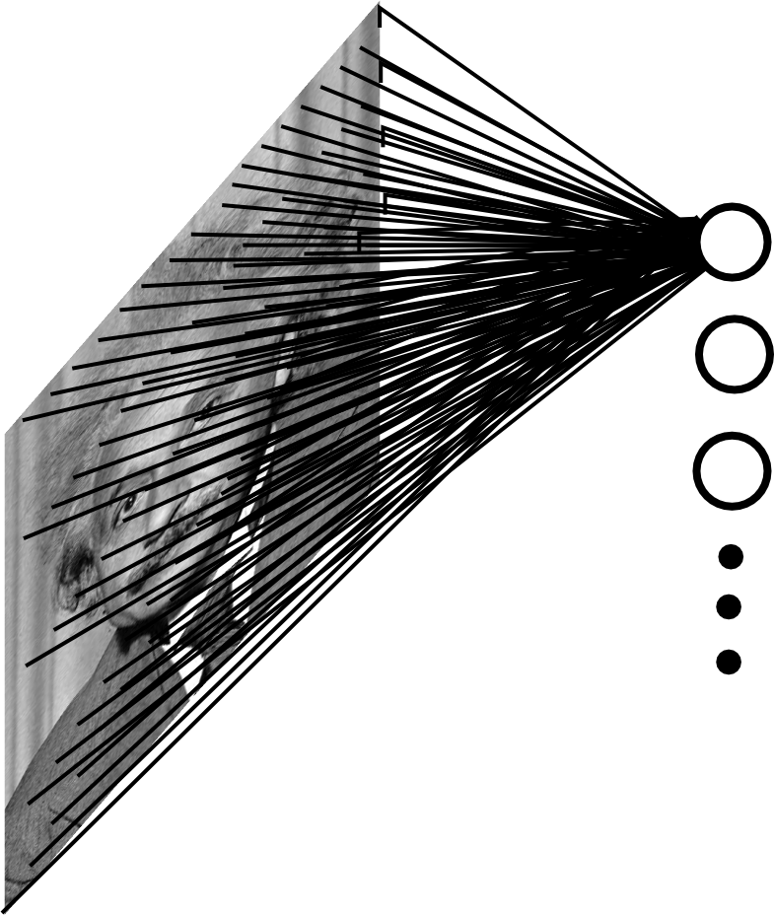
Fully Connected Layer
Example: 200x200 image
40K hidden units
~2B parameters!!!
- Spatial correlation is local
- Waste of resources + we have not enough training samples anyway..
Slide Credit: Marc'Aurelio Ranzato

Slide 9
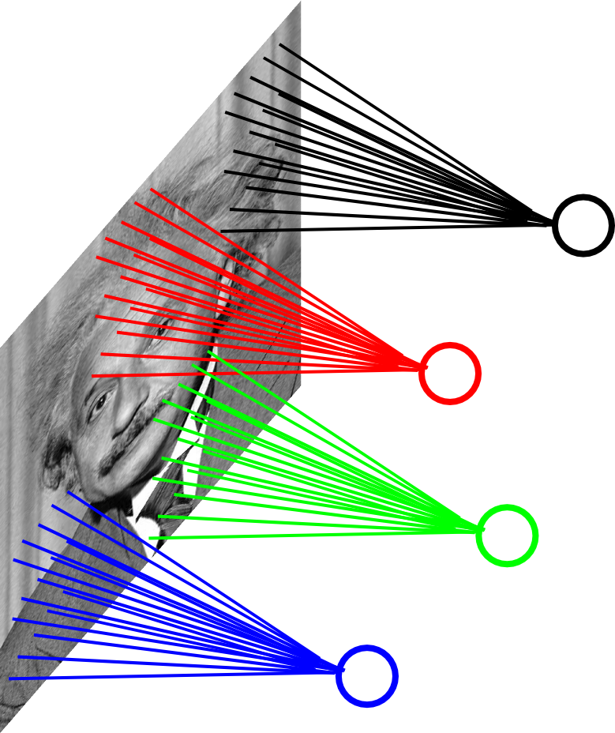
Locally Connected Layer
Example: 200x200 image
40K hidden units
“Filter” size: 10x10
4M parameters
Note:
This parameterization is good when input image is registered (e.g., face recognition).
Slide Credit: Marc'Aurelio Ranzato

Slide 10
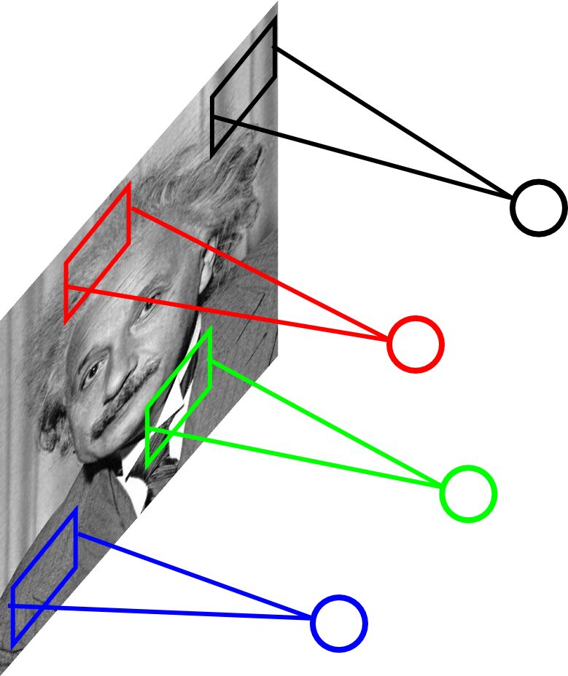
Locally Connected Layer
STATIONARITY?
Statistics similar at all locations
Slide Credit: Marc'Aurelio Ranzato

Slide 11
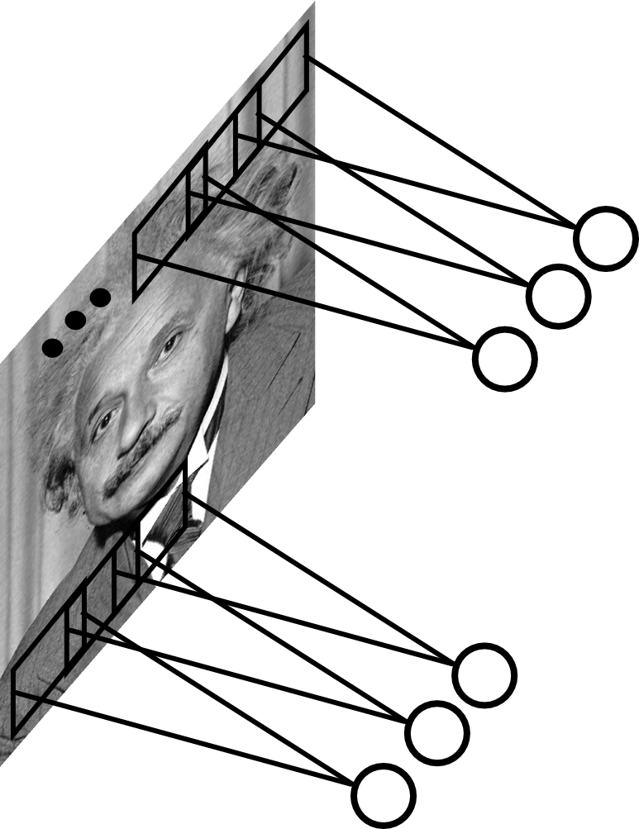
Convolutional Layer
Share the same parameters across different locations (assuming input is stationary):
Convolutions with learned kernels
Slide Credit: Marc'Aurelio Ranzato

Slide 12
Convolutions!

Slide 13
Convolutions for mathematicians

Slide 14
Convolutions for mathematicians

Slide 15
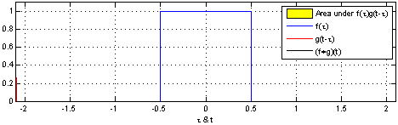
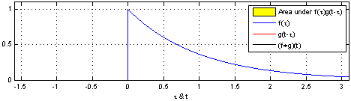
"Convolution of box signal with itself2" by Convolution_of_box_signal_with_itself.gif: Brian Ambergderivative work: Tinos (talk) - Convolution_of_box_signal_with_itself.gif. Licensed under CC BY-SA 3.0 via Commons - https://commons.wikimedia.org/wiki/File:Convolution_of_box_signal_with_itself2.gif#/media/File:Convolution_of_box_signal_with_itself2.gif

Slide 16
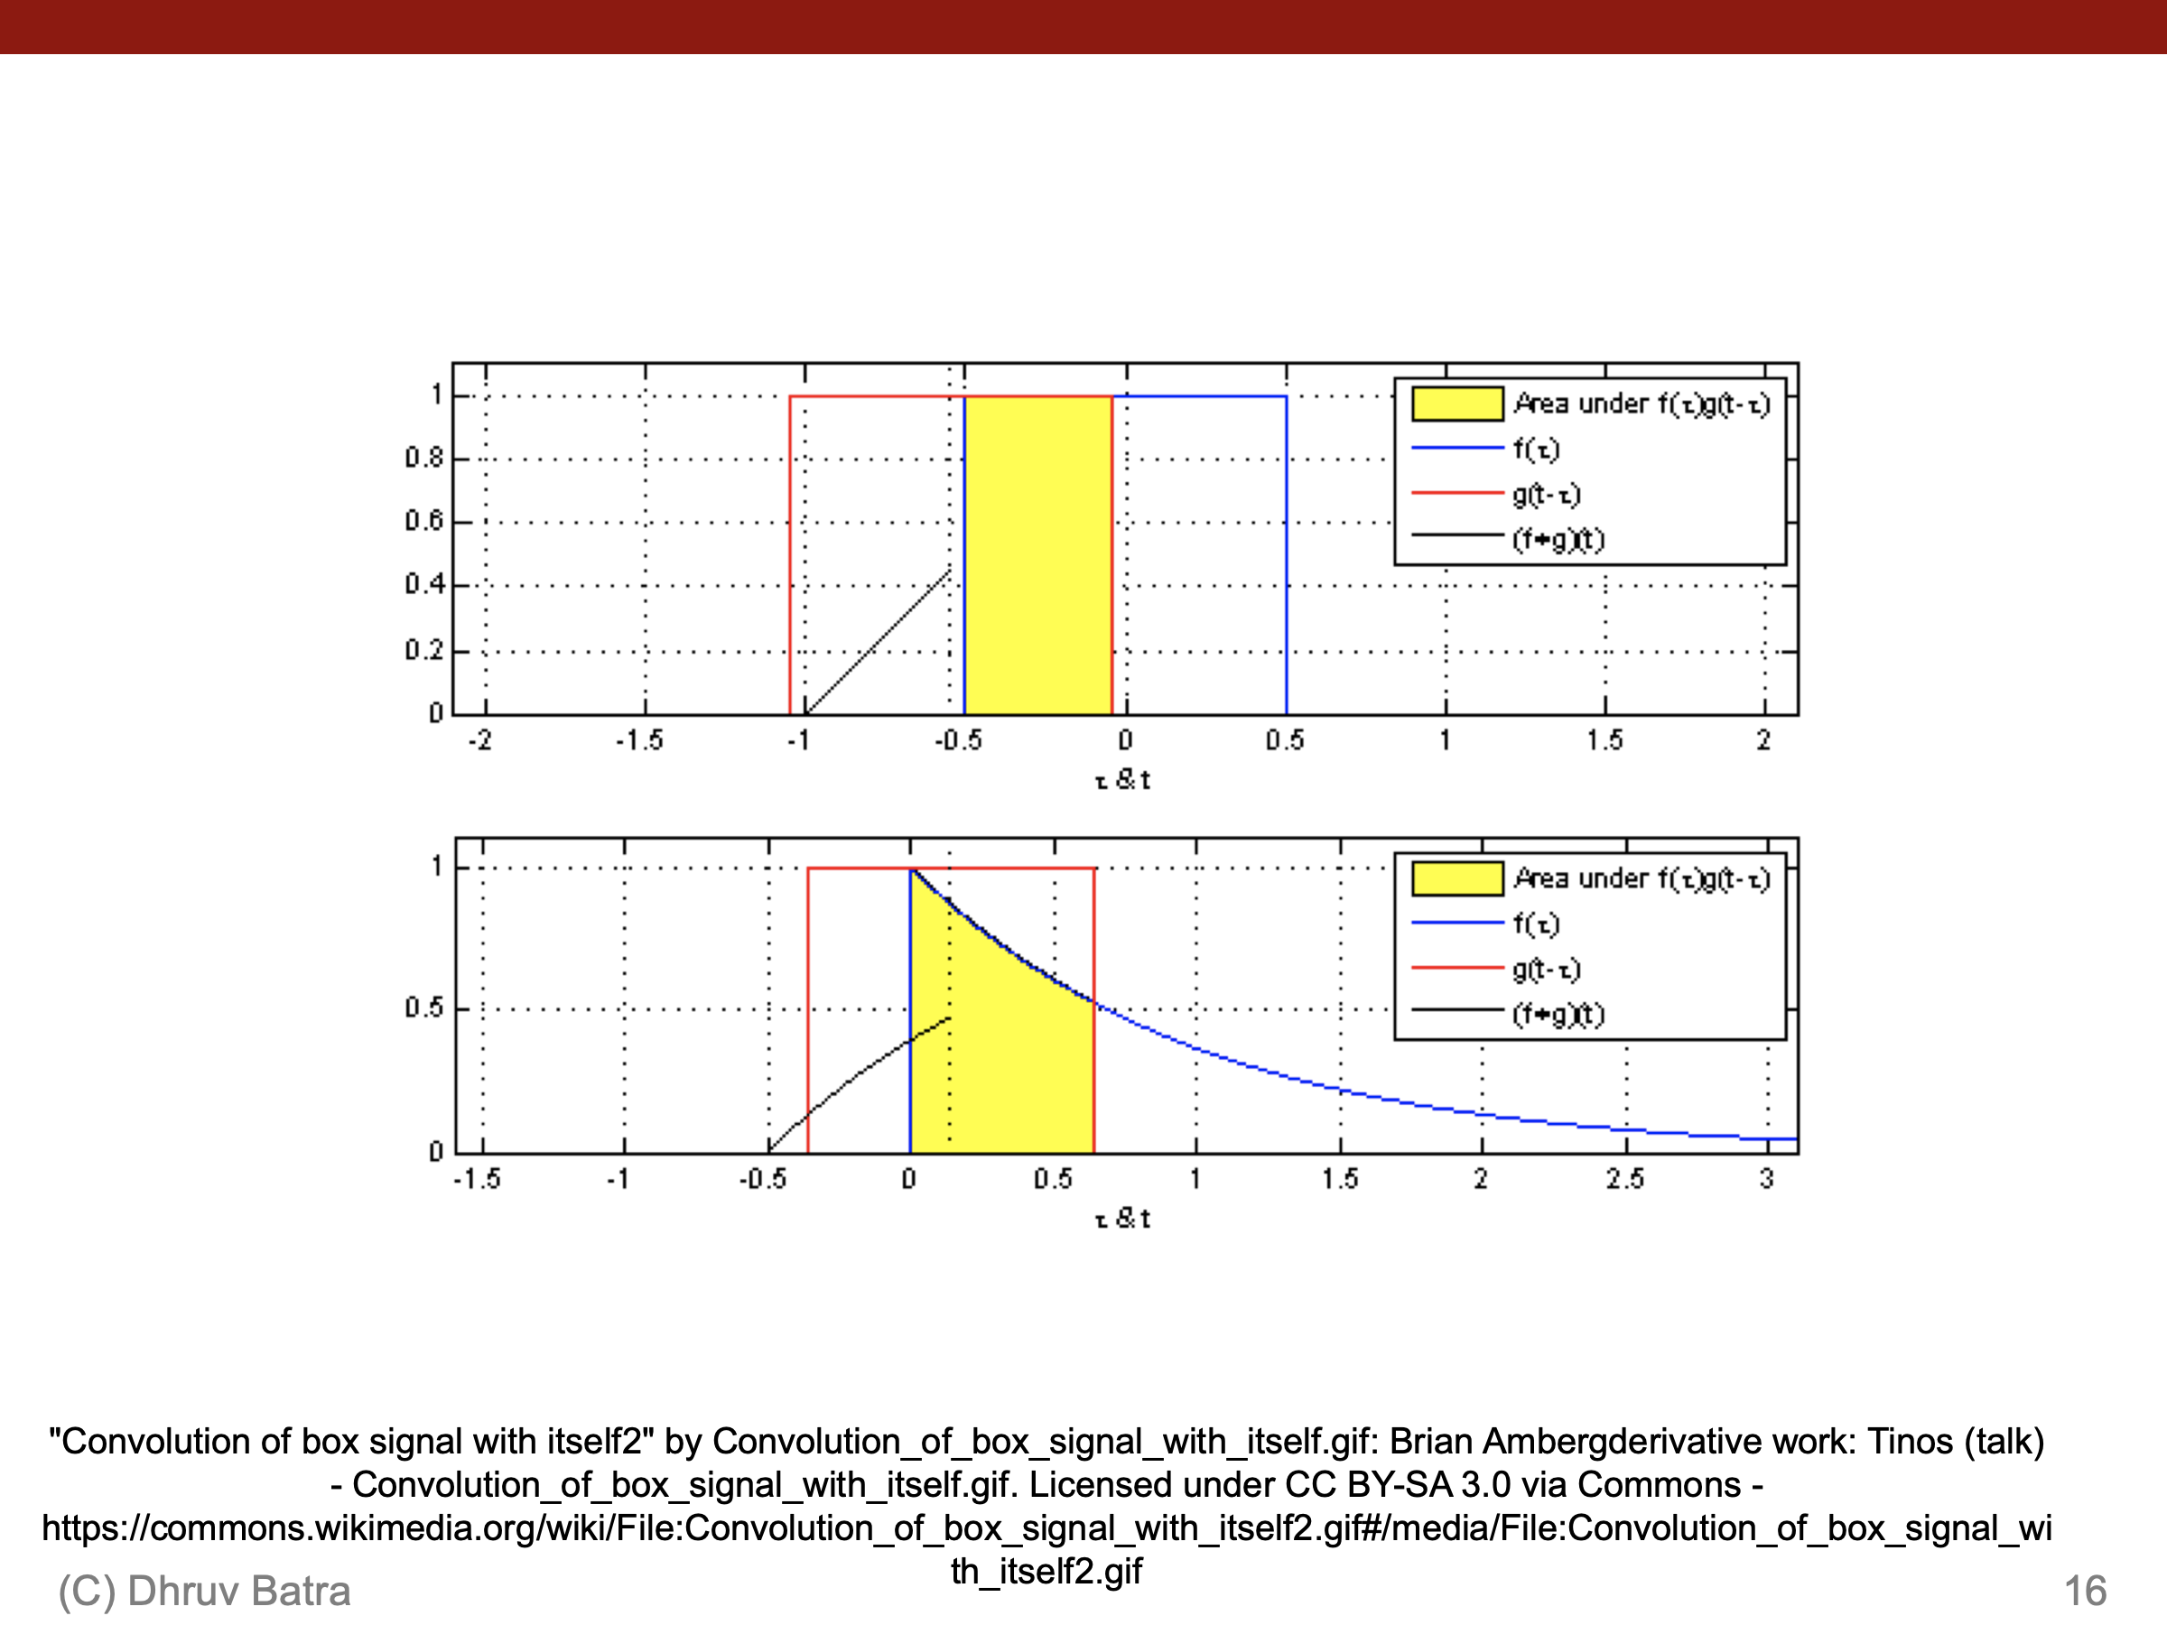
"Convolution of box signal with itself2" by Convolution_of_box_signal_with_itself.gif: Brian Ambergderivative work: Tinos (talk) - Convolution_of_box_signal_with_itself.gif. Licensed under CC BY-SA 3.0 via Commons - https://commons.wikimedia.org/wiki/File:Convolution_of_box_signal_with_itself2.gif#/media/File:Convolution_of_box_signal_with_itself2.gif

Slide 17
Convolutions for mathematicians
One dimension
Two dimensions

Slide 18
Convolutions for computer scientists

Slide 19
Convolutions for computer scientists

Slide 20
Convolutions for programmers

Slide 21
Convolutions for programmers

Slide 22
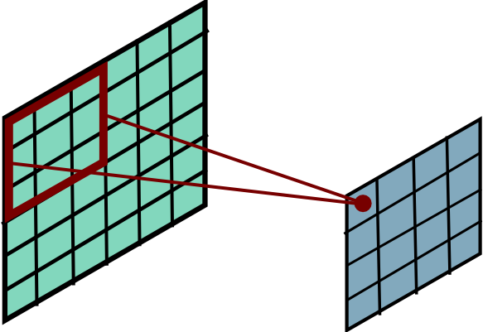
Convolutional Layer
Slide Credit: Marc'Aurelio Ranzato

Slide 23
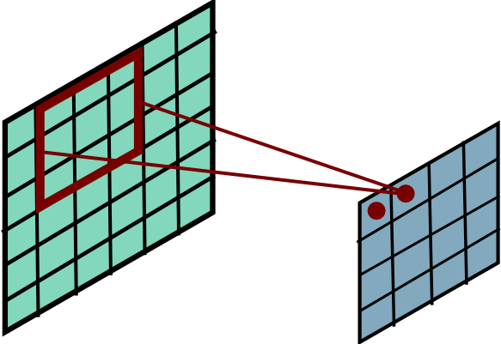
Convolutional Layer
Slide Credit: Marc'Aurelio Ranzato

Slide 24
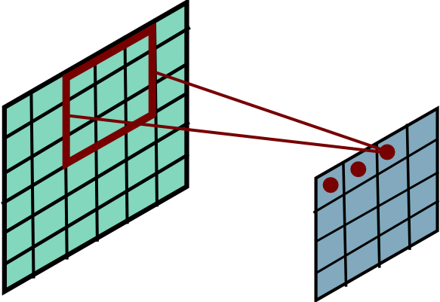
Convolutional Layer
Slide Credit: Marc'Aurelio Ranzato

Slide 25
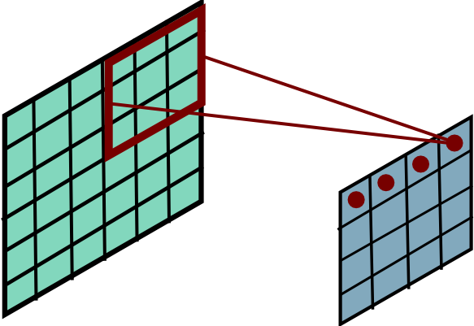
Convolutional Layer
Slide Credit: Marc'Aurelio Ranzato

Slide 26
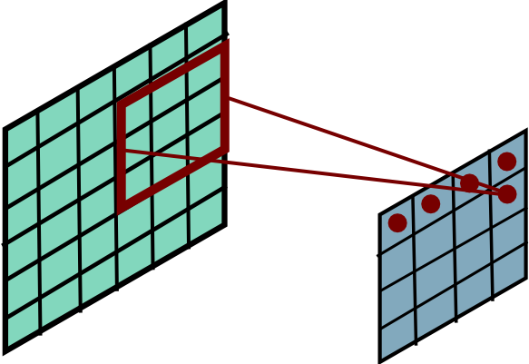
Convolutional Layer
Slide Credit: Marc'Aurelio Ranzato

Slide 27
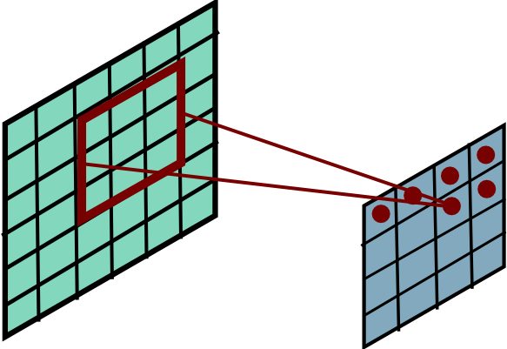
Convolutional Layer
Slide Credit: Marc'Aurelio Ranzato

Slide 28
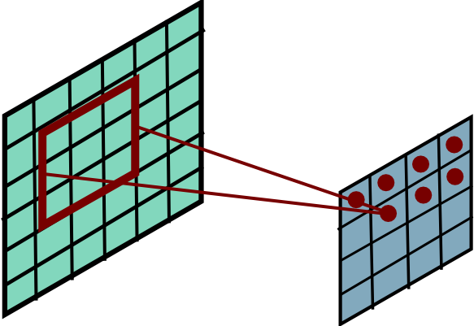
Convolutional Layer
Slide Credit: Marc'Aurelio Ranzato

Slide 29
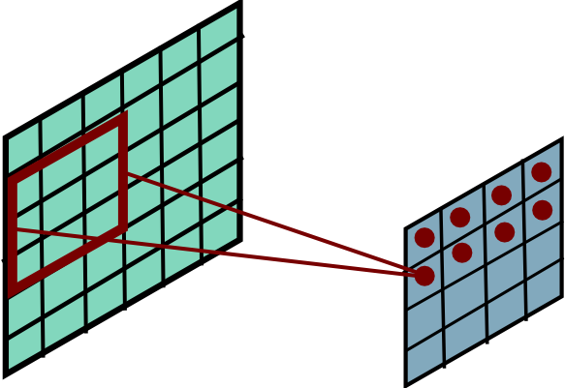
Convolutional Layer
Slide Credit: Marc'Aurelio Ranzato

Slide 30
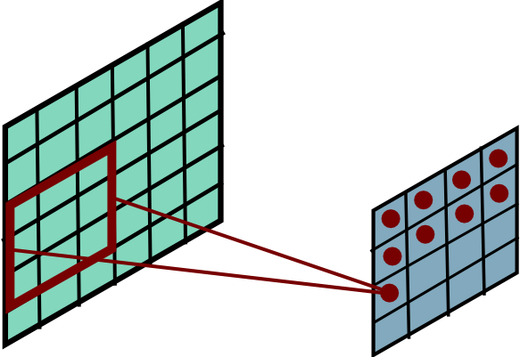
Convolutional Layer
Slide Credit: Marc'Aurelio Ranzato

Slide 31
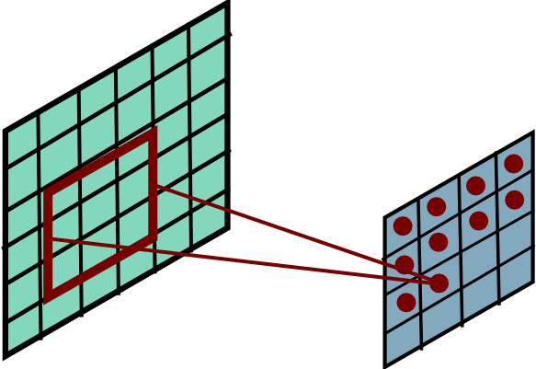
Convolutional Layer
Slide Credit: Marc'Aurelio Ranzato

Slide 32
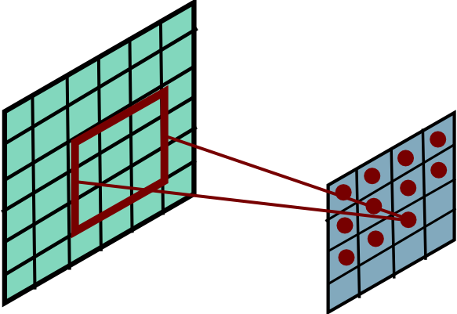
Convolutional Layer
Slide Credit: Marc'Aurelio Ranzato

Slide 33
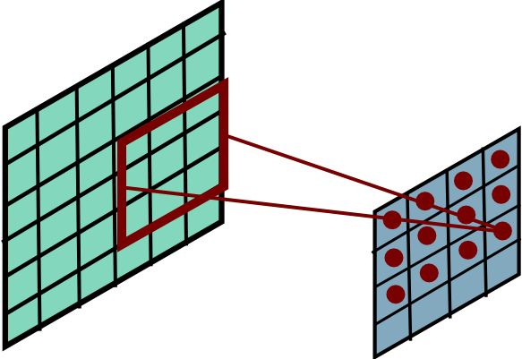
Convolutional Layer
Slide Credit: Marc'Aurelio Ranzato

Slide 34
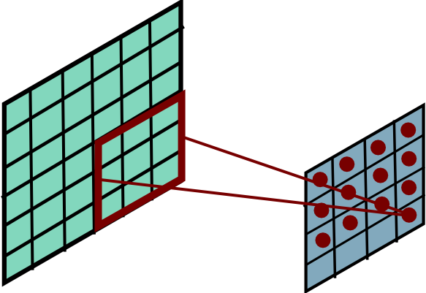
Convolutional Layer
Slide Credit: Marc'Aurelio Ranzato

Slide 35
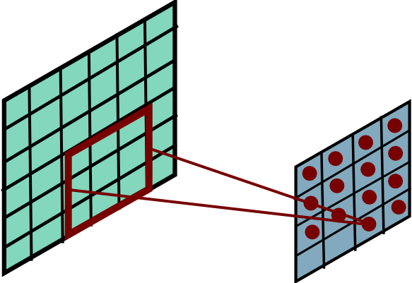
Convolutional Layer
Slide Credit: Marc'Aurelio Ranzato

Slide 36
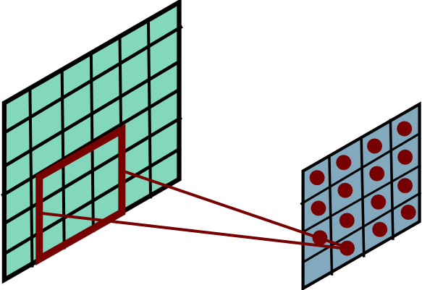
Convolutional Layer
Slide Credit: Marc'Aurelio Ranzato

Slide 37
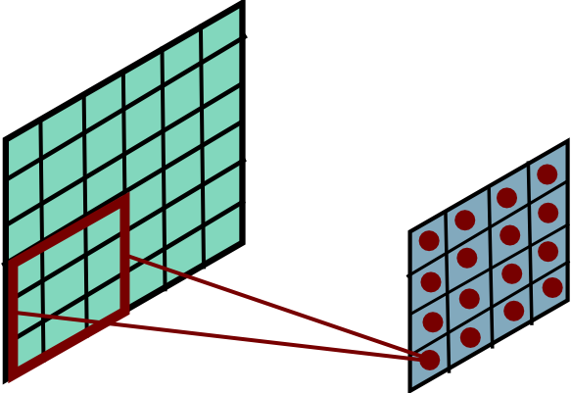
Convolutional Layer
Slide Credit: Marc'Aurelio Ranzato

Slide 38
Convolution Explained
http://setosa.io/ev/image-kernels/
https://github.com/bruckner/deepViz

Slide 39
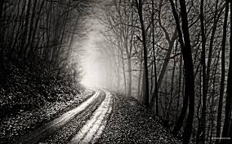
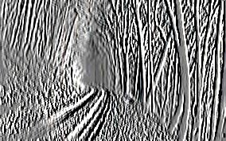
Convolutional Layer
-1 0 1
-1 0 1
-1 0 1
=
*
Slide Credit: Marc'Aurelio Ranzato

Slide 40
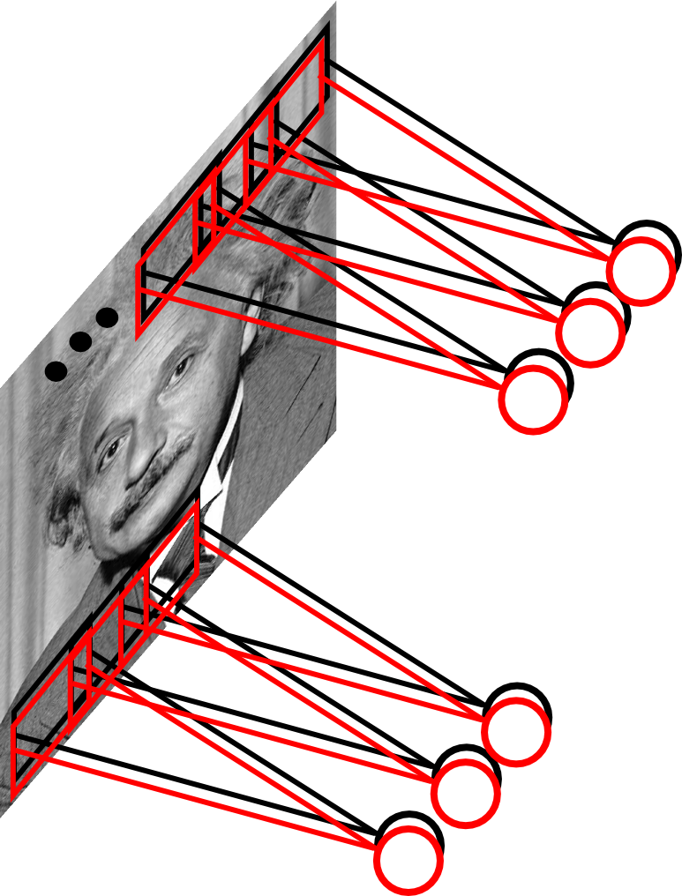
Convolutional Layer
Learn multiple filters.
E.g.: 200x200 image
100 Filters
Filter size: 10x10
10K parameters
Slide Credit: Marc'Aurelio Ranzato

Slide 41
FC vs Conv Layer

Slide 42
FC vs Conv Layer

Slide 43
Convolution Layer
32x32x3 image -> preserve spatial structure
32
height
32
width
3
depth
Slide Credit: Fei-Fei Li, Justin Johnson, Serena Yeung, CS 231n
Notes:
Preserve spatial structure of input

Slide 44
Convolution Layer
32x32x3 image
5x5x3 filter
32
Convolve the filter with the image
i.e. “slide over the image spatially, computing dot products”
32
3
Slide Credit: Fei-Fei Li, Justin Johnson, Serena Yeung, CS 231n

Slide 45
Convolution Layer
Filters always extend the full depth of the input volume
32x32x3 image
5x5x3 filter
32
Convolve the filter with the image
i.e. “slide over the image spatially, computing dot products”
32
3
Slide Credit: Fei-Fei Li, Justin Johnson, Serena Yeung, CS 231n

Slide 46


Convolution Layer
32x32x3 image
5x5x3 filter
32
1 number:
the result of taking a dot product between the filter and a small 5x5x3 chunk of the image
(i.e. 5*5*3 = 75-dimensional dot product + bias)
32
3
Slide Credit: Fei-Fei Li, Justin Johnson, Serena Yeung, CS 231n

Slide 47
Convolution Layer
activation map
32x32x3 image
5x5x3 filter
32
28
convolve (slide) over all spatial locations
32
28
3
1
Slide Credit: Fei-Fei Li, Justin Johnson, Serena Yeung, CS 231n

Slide 48
consider a second, green filter
Convolution Layer
32x32x3 image
5x5x3 filter
activation maps
32
28
convolve (slide) over all spatial locations
32
28
3
1
Slide Credit: Fei-Fei Li, Justin Johnson, Serena Yeung, CS 231n

Slide 49
For example, if we had 6 5x5 filters, we’ll get 6 separate activation maps:
activation maps
32
28
Convolution Layer
32
28
3
6
We stack these up to get a “new image” of size 28x28x6!
Slide Credit: Fei-Fei Li, Justin Johnson, Serena Yeung, CS 231n

Slide 50
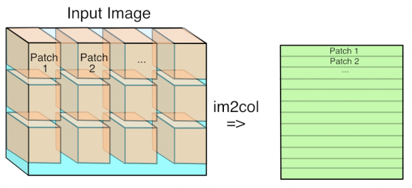
Im2Col
Figure Credit: https://petewarden.com/2015/04/20/why-gemm-is-at-the-heart-of-deep-learning/

Slide 51
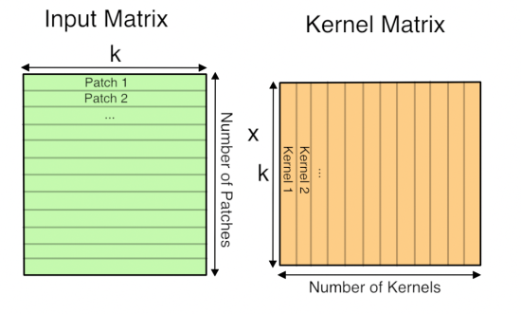
GEMM
Figure Credit: https://petewarden.com/2015/04/20/why-gemm-is-at-the-heart-of-deep-learning/

Slide 52
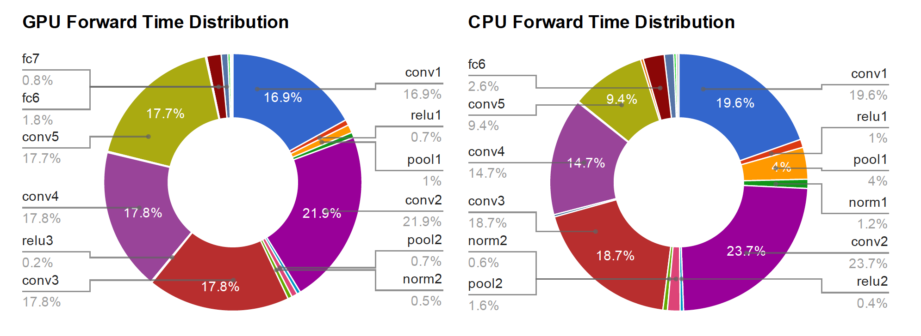
Time Distribution of AlexNet
Figure Credit: Yangqing Jia, PhD Thesis

Slide 53
Preview: ConvNet is a sequence of Convolution Layers, interspersed with activation functions
32
28
CONV,
ReLU
e.g. 6 5x5x3 filters
32
28
3
6
Slide Credit: Fei-Fei Li, Justin Johnson, Serena Yeung, CS 231n

Slide 54
Preview: ConvNet is a sequence of Convolutional Layers, interspersed with activation functions
32
28
24
….
CONV,
ReLU
e.g. 6 5x5x3 filters
CONV,
ReLU
e.g. 10 5x5x6 filters
CONV,
ReLU
32
28
24
3
6
10
Slide Credit: Fei-Fei Li, Justin Johnson, Serena Yeung, CS 231n

