Slide 1

SC Compilers & the Java Memory Model
David Devecsery

Slide 2
Administration!
  Submit your discussion preferences
    On Canvas!
  Project Proposal info coming soon!

Slide 3
Clarification
  C++11 atomic sequential consistency semantics
    Creates a global ordering w.r.t. all other SC memory accesses
    Also: acts as an acquire if on a load AND/OR a release if on a store

Slide 4
C++11 SC Accesses
  Can we see a==1, b==0, c==1, d==0 in C++11?
Initial: y = 0, x = 0
Thread 1
store(x, 1,
SC)
Thread 2
store(y, 1,
SC)
Thread 3
a = load(x,
Acquire)
b = load(y,
Acquire)
Thread 4
c = load(y,
Acquire)
d = load(x,
Acquire)
Acquire-Release Relation

Slide 5
C++11 SC Accesses
Impossible.
Must load from Store, since there is a complete HB chain from the store to the load.
  Can we see a==1, b==0, c==1, d==0 in C++11?
Initial: y = 0, x = 0
Thread 1
store(x, 1,
SC)
Thread 2
store(y, 1,
SC)
Thread 3
a = load(x,
Acquire)
b = load(y,
Acquire)
Thread 4
c = load(y,
Acquire)
d = load(x,
Acquire)
Acquire-Release Relation
Acquire-Release Relation
SC Relation

Slide 6
The Java Memory Model (POPL’05)
  Goals (according to the paper) provide balance between:
    “Sufficient ease of use”
    “Transformations and optimizations”
  Overall:
    DRF0-like memory model
    BUT, attempt to provide defined safety properties on a data-race

Slide 7
The Java Memory Model (POPL’05)
  My opinion on goals:
    Poorly stated in paper, “ease of use” is misleading
    Really providing safety from “out-of-nowhere” operations.
    These are security needs of the Java language (pointers/references can’t come out of nowhere in your type-safe language!)
    Not easy to reason about from a programmers prospective!
    Goal: get these safety properties while minimally sacrificing performance

Slide 8
Defined behavior on Data-race?
  We want to remove “out-of-nowhere” reads
  This shouldn’t happen:
Initial: x = y = 0
In DRF0, this is allowed
How can we disable this, but not impact compiler optimization?
Thread 1
r1 = x;
y = r1;
Thread 2
r2 = y;
x = r2;
Disallow: r1 == r2 == 42

Slide 9
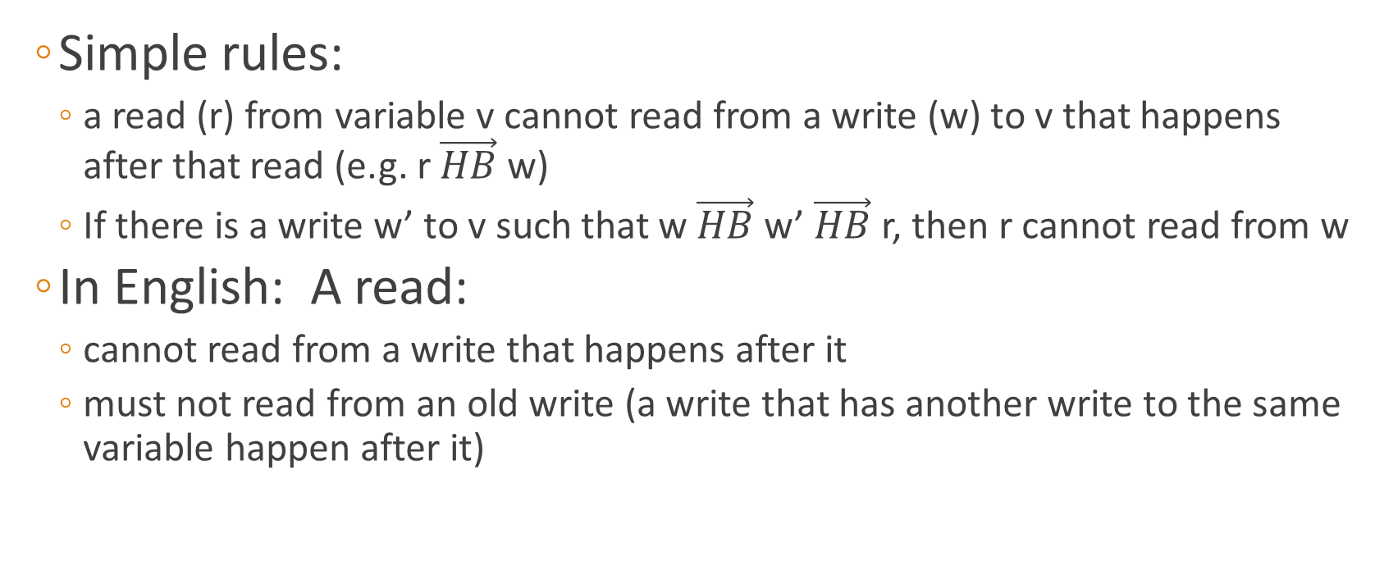
Lets try a “happens-before” memory model
  Simple rules:
    a read (r) from variable v cannot read from a write (w) to v that happens after that read (e.g. r $\vec{HB}$ w)
    If there is a write w’ to v such that w $\vec{HB}$ w’ $\vec{HB}$ r, then r cannot read from w
  In English: A read:
    cannot read from a write that happens after it
    must not read from an old write (a write that has another write to the same variable happen after it)

Slide 10
Does the “Happens-before” memory model solve our problem?
  Consider this program:
Initial: x == y == 0
Yes:
The write of 42 to y could happen before r1 = x, and the write of 42 to x could happen before r2 = y
(There is no happens-before relation in this code)
Thread 1
r1 = x;
if (r1 != 0)
y = 42;
Thread 2
r2 = y;
if (r2 != 0)
x = 42
Is: y = 42, x = 42 possible?

Slide 11
What should the JMM allow?
  Consider this program:
Should x == y == 42 be possible?
Initial: x == y == 0
Thread 1
r1 = x;
if (r1 != 0)
y = 42;
Thread 2
r2 = y;
if (r2 != 0)
x = 42
No:
This program doesn’t have a data-race, the assignment of x and y will never be run!
Is: y = 42, x = 42 possible?

Slide 12
Instead, Java uses a notion of “causality”
  Logically, there must exist a “valid execution” which can create these operations.
  But, how to construct these executions
    A well formed execution consists of a set of validly committed actions
    Paper gives a set of formal rules for committing actions

Slide 13
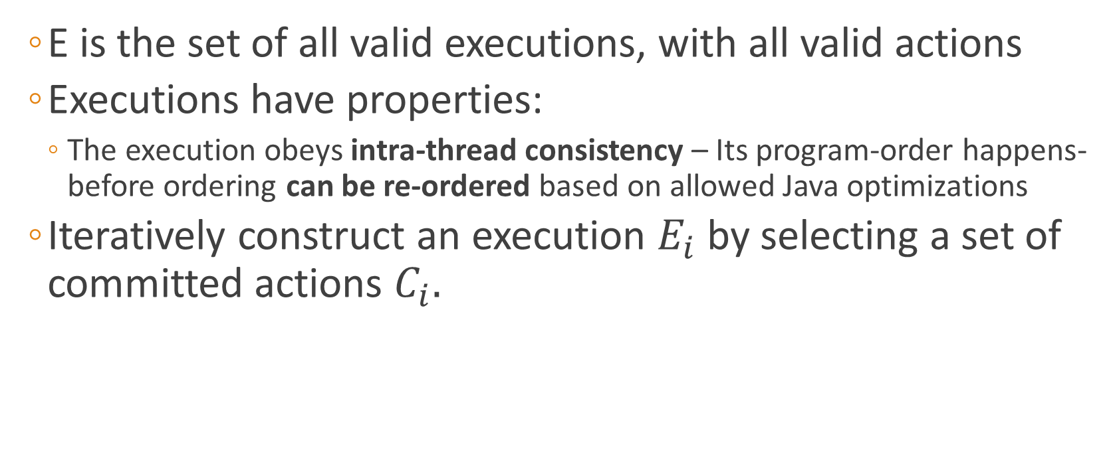
Execution rules (in English)
  E is the set of all valid executions, with all valid actions
  Executions have properties:
    The execution obeys intra-thread consistency – Its program-order happens-before ordering can be re-ordered based on allowed Java optimizations
  Iteratively construct an execution $E_{i}$ by selecting a set of committed actions $C_{i}.$

Slide 14
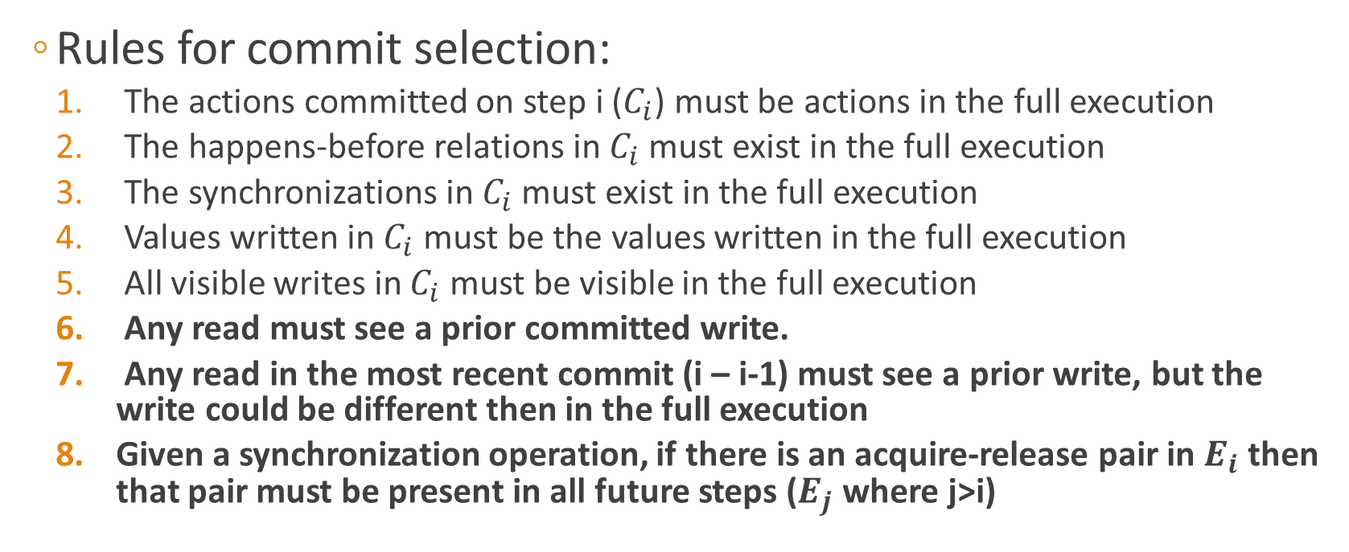
Approximate execution rules (in English)
  Rules for commit selection:
    The actions committed on step i ($C_{i}$) must be actions in the full execution
    The happens-before relations in$C_{i}$ must exist in the full execution
    The synchronizations in $C_{i}$ must exist in the full execution
    Values written in $C_{i}$ must be the values written in the full execution
    All visible writes in $C_{i}$ must be visible in the full execution
    Any read must see a prior committed write.
    Any read in the most recent commit (i – i-1) must see a prior write, but the write could be different then in the full execution
    Given a synchronization operation, if there is an acquire-release pair in $E_{i}$ then that pair must be present in all future steps ($E_{j}$ where j>i)

Slide 15
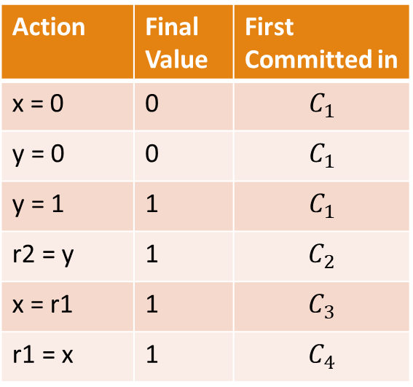
Putting it together.
  Lets walk through an example of allowed behavior
Initial: x == y == 0
Action | Final Value | First Committed in
x = 0 | 0 | $$C_{1}$$
y = 0 | 0 | $$C_{1}$$
y = 1 | 1 | $$C_{1}$$
r2 = y | 1 | $$C_{2}$$
x = r1 | 1 | $$C_{3}$$
r1 = x | 1 | $$C_{4}$$
Thread 1
r1 = x
y = 1
Thread 2
r2 = y
x = r2
Allow: r1 == r2 == 1

Slide 16
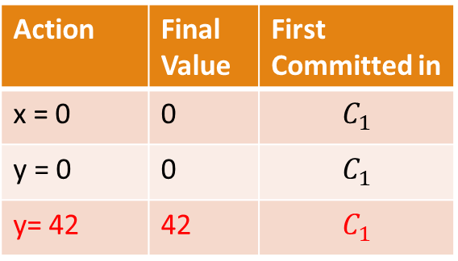
Putting it together.
  Can you show how this behavior is illegal?
Initial: x == y == 0
Action | Final Value | First Committed in
x = 0 | 0 | $$C_{1}$$
y = 0 | 0 | $$C_{1}$$
y= 42 | 42 | $$C_{1}$$
Thread 1
r1 = x
if (r1 != 0)
y = 42
Thread 2
r2 = y
if (r2 != 0)
x = 42
We can’t run this step, why?
It depends on r1 != 0, which hasn’t happened yet.
This violates the intra-thread semantics of the program, and is not a valid execution
Allow: r1 == r2 == r3 == 2
Hint: Consider possible
transformations / reorderings

Slide 17
Putting it together.
  Can you show how this behavior is legal?
Initial: a = 0, b = 1
Thread 1
r1 = a
r2 = a
if (r1 == r2)
b = 2
Thread 2
r3 = b
a = r3
Allow: r1 == r2 == r3 == 2
Hint: Consider possible
transformations

Slide 18
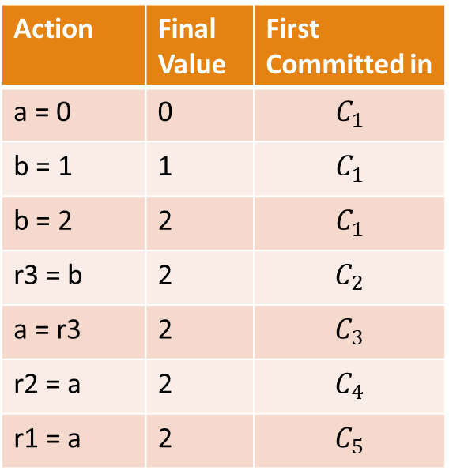
Putting it together.
The model does not disallow hoisting b=2.
  Can you show how this behavior is legal?
Initial: a = 0, b = 1
Action | Final Value | First Committed in
a = 0 | 0 | $$C_{1}$$
b = 1 | 1 | $$C_{1}$$
b = 2 | 2 | $$C_{1}$$
r3 = b | 2 | $$C_{2}$$
a = r3 | 2 | $$C_{3}$$
r2 = a | 2 | $$C_{4}$$
r1 = a | 2 | $$C_{5}$$
Thread 1
r1 = a
r2 = a
if (r1 == r2)
b = 2
Thread 2
r3 = b
a = r3
Allow: r1 == r2 == r3 == 2
Hint: Consider possible
transformations / reorderings

Slide 19
Putting it together.
  Can you show how this behavior is legal?
Initial: a = 0, b = 1
Action | Final Value | First Committed in
a = 0 | 0 | $$C_{1}$$
b = 1 | 1 | $$C_{1}$$
b = 2 | 2 | $$C_{1}$$
r3 = b | 2 | $$C_{2}$$
a = r3 | 2 | $$C_{3}$$
r2 = a | 2 | $$C_{4}$$
r1 = a | 2 | $$C_{5}$$
Thread 1
r1 = a
r2 = a
if (r1 == r2)
b = 2
Thread 2
r3 = b
a = r3
Why can this run?
r1 and r2 = a, so there exists an execution in E where b = 2 is executed
Allow: r1 == r2 == r3 == 2
Hint: Consider possible
transformations / reorderings

Slide 20
Putting it together.
This transformation obeys the intra-thread consistency of the JLS
  Can you show how this behavior is legal?
Initial: a = 0, b = 1
Action | Final Value | First Committed in
a = 0 | 0 | $$C_{1}$$
b = 1 | 1 | $$C_{1}$$
b = 2 | 2 | $$C_{1}$$
r3 = b | 2 | $$C_{2}$$
a = r3 | 2 | $$C_{3}$$
r2 = a | 2 | $$C_{4}$$
r1 = a | 2 | $$C_{5}$$
Thread 1
b = 2
r1 = a
r2 = a
if (true) ;
Thread 2
r3 = b
a = r3
Why can this run?
r1 and r2 = a, so there exists an execution in E where b = 2 is executed
Allow: r1 == r2 == r3 == 2
Hint: Consider possible
transformations / reorderings

Slide 21
What are your opinions of this model?
  Is it easy to reason about or understand?
  Do you think it accomplishes its goal well?
    Is it really reasonable?
    Does it allow optimizations?
  What does this gain over a purely SC implementation?
    What does an SC compiler give up?

Slide 22
Preview (next class)
  The JMM has problems.
    Its not simple to reason about
    It does disable important optimizations
      (and C++ does too)

Slide 23
What types of optimizations break SC?
  What breaks SC in an optimizing compiler?
Reordering of dependent shared memory operations.

Slide 24
What optimizations break SC?
  Does this break SC?
Initial: ready = false, a = null
Thread 1
ready = true;
a = new int[10];
Thread 2
if (ready)
a[5] = 5;
Thread 1
a = new int[10];
ready = true;
Thread 2
if (ready)
a[5] = 5;

Slide 25
What optimizations break SC?
  Is this valid in a DRF0 compiler?
Reordering within the lock is still invalid, these another thread could access ready, then a without a lock!
Initial: ready = false, a = null
Thread 1
lock(m1)
ready = true;
a = new int[10];
unlock(m1);
Thread 2
lock(m1)
if (ready)
a[5] = 5;
unlock(m1)
Thread 1
lock(m1);
a = new int[10];
ready = true;
unlock(m1)
Thread 2
lock(m1);
if (ready)
a[5] = 5;
unlock(m1)

Slide 26
What optimizations break SC?
  Does this transformation break SC? Why or why not?
Initial: ready = false, a = null
Thread 1
b = a
z = b [10]
c = a
w = c[1]
Thread 2
a = new int[10]
Thread 1
b = a
z = b[10]
w = b[1]
Thread 2
a = new int[10]

Slide 27

What optimizations break SC?
  Does this transformation break SC? Why or why not?
Initial: ready = false, a = null
Thread 1
b = a
z = b + 10
c = a
w = c[1]
Thread 2
a = new int[10]
Thread 1
b = a
z = b + 10
w = b[1]
Thread 2
a = new int[10]

Slide 28
What compiler transformations are SC?
  What rules guard safe reorderings?
    “Every behavior of the transformed program is a behavior of the original program”
  Transformations to shared memory are generally disallowed
    Some special cases
  Transformations to local memory (e.g. compiler introduced locals) are freely allowed

Slide 29
SC Preserving Transformations
  Redundant load:
    t = X; u = X => t =x; u = t;
  Forwarded load:
    X = t; u = X; => X = t; u = t;
  Dead store:
    X = t; X = u => X = u;
  Redundant store:
    t = X; X = t => t = X;
Thread 1
b = a
z = b + 10
c = a
w = c[1]
Thread 1
b = a
z = b + 10
w = b[1]

Slide 30
Transformations that violate SC
Which ordering is being relaxed here?
  Ordering Relaxations
    Load -> Load
    Load -> Store
    Store -> Store
    Load -> Store
Thread 1
b = a
z = b [10]
c = a
w = c[1]
Thread 1
b = a
z = b[10]
w = b[1]

Slide 31
An SC Preserving LLVM
  Disable any non-SC preserving transformations
  Modify transformations to work on only provably non-shared variables (where appropriate)
  Overhead:
    5.5% on SPEC2006, 3.4% on PARSEC and SPLASH-2
    BUT, these results are using simple analysis to identify non-shared variables

Slide 32
Hardware support for SC transformations
  Introduce a speculation check for eager loads
    Can quickly check if a variable may have been modified since its last load
    Allows speculative optimizations (like CSE), as long as you guarantee that the variable wasn’t modified before its use
    Very similar to Intel’s TSX extensions
  Experiments done on a simulator
    Overhead drops to 2.2% on PARSEC and SPLASH-2 with support

Slide 33
Next Lecture
  A language that guarantees race freedom (making DRF0 hardware/software actually SC!)
  Problems with the C11 (and Java) Memory Models.
    They were made to enable as many optimizations as possible, and yet they don’t!

