Slide 1

CS 4803 / 7643: Deep Learning
Topics:
  Unsupervised Learning
  Generative Models (PixelRNNs, VAEs)
Dhruv Batra
Georgia Tech

Slide 2
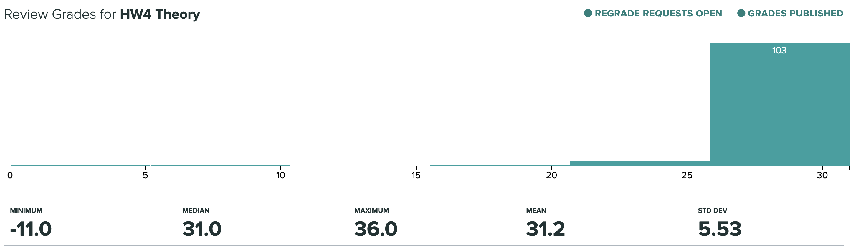
Administrativia
HW4 Grades Released
  Regrade requests close: 11/25, 11:59pm
Grade histogram: 7643
  Max possible: 42 (22+20) (regular credit) + 5 (extra credit)

Slide 3
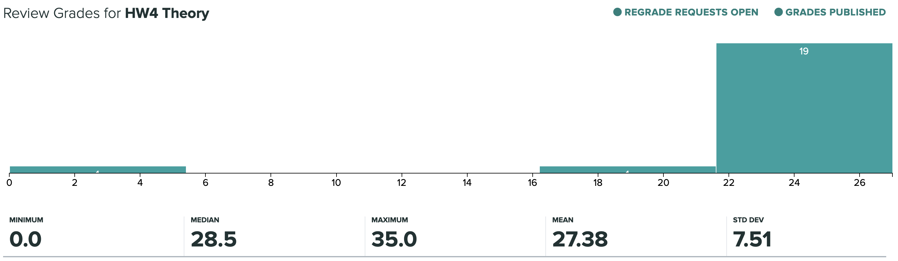
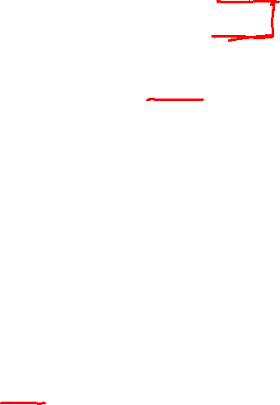
Administrativia
HW4 Grades Released
  Regrade requests close: 11/25, 11:59pm
Grade histogram: 4803
  Max possible: 38 (18+20) (regular credit) + 9 (extra credit)

Slide 4
Administrativia
Project submission instructions
  Due: 11/24, 11:59pm
  Last deliverable in the class
  Can’t use late days
  https://www.cc.gatech.edu/classes/AY2021/cs7643_fall/

Slide 5

Overview
Unsupervised Learning
Generative Models
  PixelRNN
  Variational Autoencoders (VAE)
  Generative Adversarial Networks (GAN)
Slide Credit: Fei-Fei Li, Justin Johnson, Serena Yeung, CS 231n
Notes:
Unsupervised learning problem
Generative models, type of unsupervised learning
3 types of generative models
PixelRNN and PixelCNN, type of fully visible belief networks

Slide 6
Supervised vs Reinforcement vs Unsupervised Learning
Slide Credit: Fei-Fei Li, Justin Johnson, Serena Yeung, CS 231n
Notes:
In this class so far, have talked about a lot of sup. Learning problems
Data x, y is a label, and label can take many different forms

Slide 7
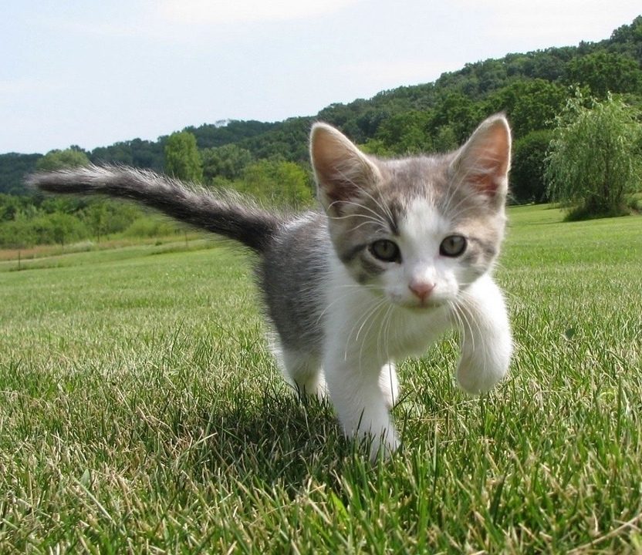
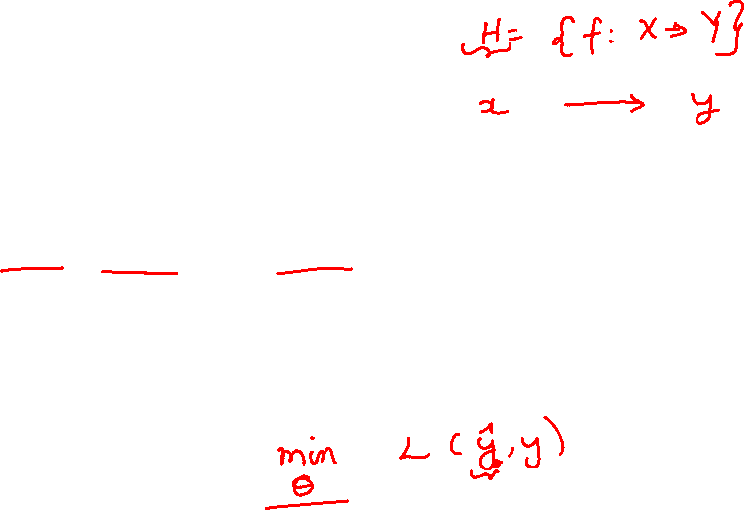
Supervised vs Reinforcement vs Unsupervised Learning
Supervised Learning
Data: (x, y)
x is data, y is label
Goal: Learn a function to map x → y
Examples: Classification, regression, object detection, semantic segmentation, image captioning, etc.
Cat
Classification
This image is CC0 public domain
Slide Credit: Fei-Fei Li, Justin Johnson, Serena Yeung, CS 231n
Notes:
So far talked about SL
Type of problem where have Data X, Labels Y, goals is to learn a function mapping from x to y

Slide 8
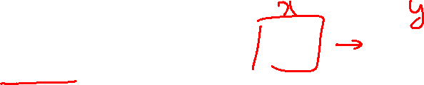
Supervised vs Unsupervised Learning
Supervised Learning
Data: (x, y)
x is data, y is label
Goal: Learn a function to map x → y
Examples: Classification, regression, object detection, semantic segmentation, image captioning, etc.
GRASS, CAT, TREE, SKY
Semantic Segmentation
Slide Credit: Fei-Fei Li, Justin Johnson, Serena Yeung, CS 231n

Slide 9

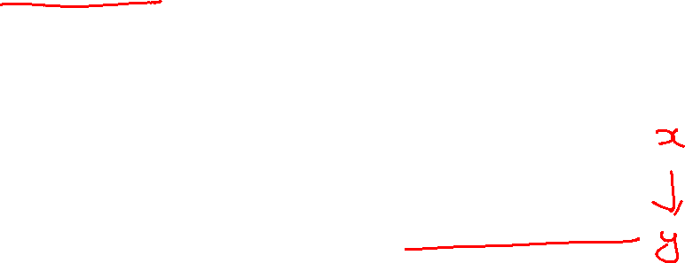
Supervised vs Unsupervised Learning
Supervised Learning
Data: (x, y)
x is data, y is label
Goal: Learn a function to map x → y
Examples: Classification, regression, object detection, semantic segmentation, image captioning, etc.
A cat sitting on a suitcase on the floor
Image captioning
Caption generated using neuraltalk2
Image is CC0 Public domain.
Slide Credit: Fei-Fei Li, Justin Johnson, Serena Yeung, CS 231n

Slide 10
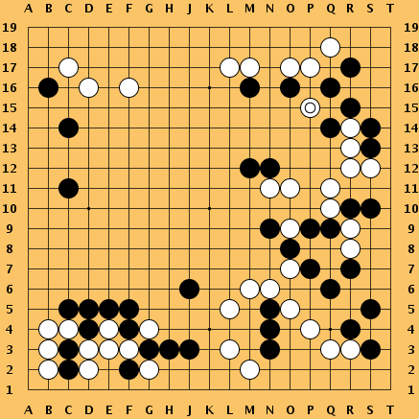
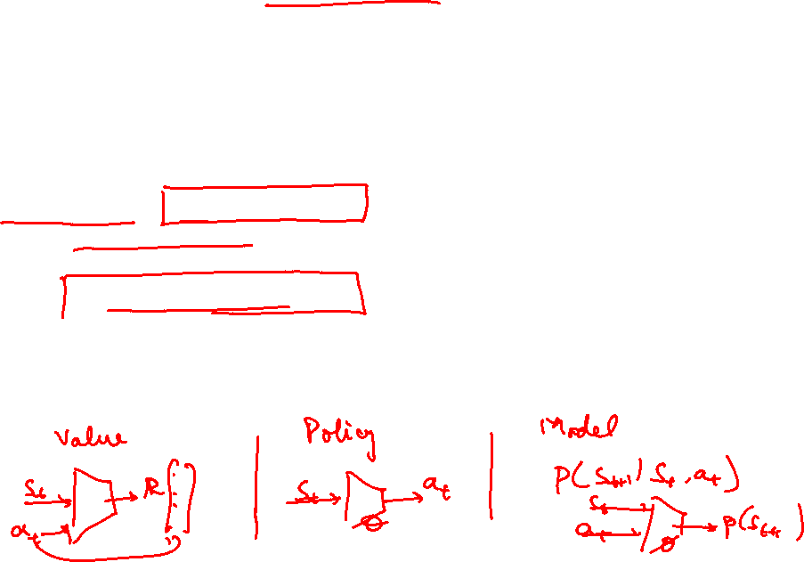
Supervised vs Reinforcement vs Unsupervised Learning
Reinforcement Learning
Given: (e, r)
Environment e, Reward function r (evaluative feedback)
Goal: Maximize expected reward
Examples: Robotic control, video games, board games, etc.
Slide Credit: Fei-Fei Li, Justin Johnson, Serena Yeung, CS 231n
Notes:
So far talked about SL
Type of problem where have Data X, Labels Y, goals is to learn a function mapping from x to y

Slide 11
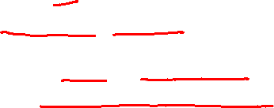
Supervised vs Reinforcement vs Unsupervised Learning
Unsupervised Learning
Data: x
Just data, no labels!
Goal: Learn some underlying hidden structure of the data
Examples: Clustering, dimensionality reduction, feature learning, density estimation, etc.
Slide Credit: Fei-Fei Li, Justin Johnson, Serena Yeung, CS 231n
Notes:
Unsupervised learning is a type of learning where we have unlabeled training data, and we want to learn some underlying hidden structure of the data

Slide 12

Supervised vs Reinforcement vs Unsupervised Learning
Supervised Learning
Data: (x, y)
x is data, y is label
Goal: Learn a function to map x → y
Examples: Classification, regression, object detection, semantic segmentation, image captioning, etc.
Unsupervised Learning
Data: x
Just data, no labels!
Goal: Learn some underlying hidden structure of the data
Examples: Clustering, dimensionality reduction, feature learning, density estimation, etc.
Slide Credit: Fei-Fei Li, Justin Johnson, Serena Yeung, CS 231n
Notes:
To summarize differences, sup uses labeled data to learn a function mapping from x to y
Unsup uses no labels, tries to learn some underlying hidden structure of the data, whether grouping, axes of variation, underlying density

Slide 13

Supervised vs Reinforcement vs Unsupervised Learning
Supervised Learning
Data: (x, y)
x is data, y is label
Goal: Learn a function to map x → y
Examples: Classification, regression, object detection, semantic segmentation, image captioning, etc.
Unsupervised Learning
Data: x
Just data, no labels!
Goal: Learn some underlying hidden structure of the data
Examples: Clustering, dimensionality reduction, feature learning, density estimation, etc.
Training data is cheap
Holy grail: Solve unsupervised learning
=> understand structure of visual world
Slide Credit: Fei-Fei Li, Justin Johnson, Serena Yeung, CS 231n
Notes:
To summarize differences, sup uses labeled data to learn a function mapping from x to y
Unsup uses no labels, tries to learn some underlying hidden structure of the data, whether grouping, axes of variation, underlying density

Slide 14
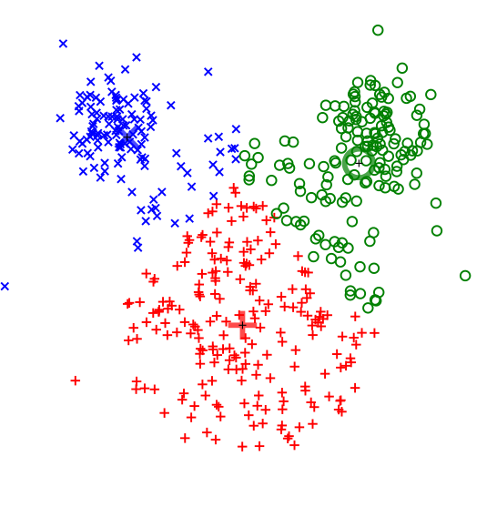
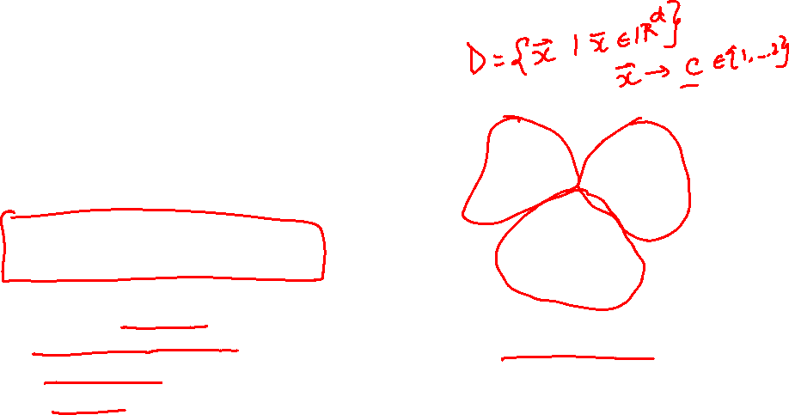
Supervised vs Reinforcement vs Unsupervised Learning
Unsupervised Learning
Data: x
Just data, no labels!
Goal: Learn some underlying hidden structure of the data
Examples: Clustering, dimensionality reduction, feature learning, density estimation, etc.
K-means clustering
This image is CC0 public domain
Slide Credit: Fei-Fei Li, Justin Johnson, Serena Yeung, CS 231n
Notes:
Clustering - find groups within the data that are similar through some metric

Slide 15
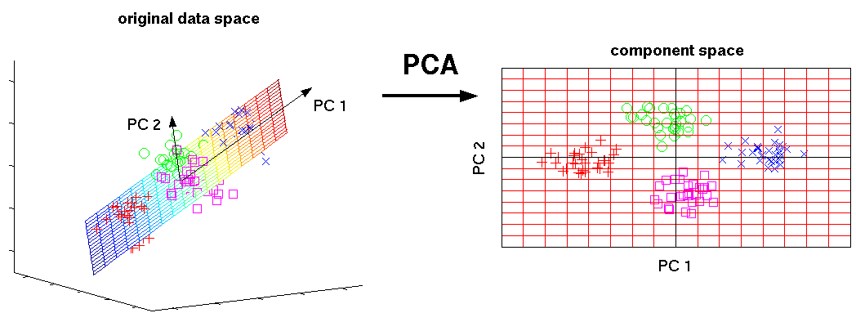
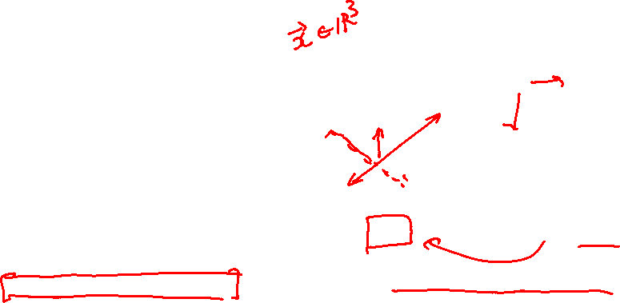
Supervised vs Reinforcement vs Unsupervised Learning
Unsupervised Learning
Data: x
Just data, no labels!
Goal: Learn some underlying hidden structure of the data
Examples: Clustering, dimensionality reduction, feature learning, density estimation, etc.
3-d
2-d
Principal Component Analysis
(Dimensionality reduction)
This image from Matthias Scholz is CC0 public domain
Slide Credit: Fei-Fei Li, Justin Johnson, Serena Yeung, CS 231n
Notes:
Find axes along which the data has most variation, this is part of the underlying structure of the data
Use this to reduce the dimensionality of the data such that the data has significant variation among each remaining dimension
Here is an example, take 3d data, finding 2 axes of variatiation and reducing dimensionality to 2d

Slide 16
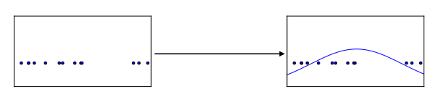
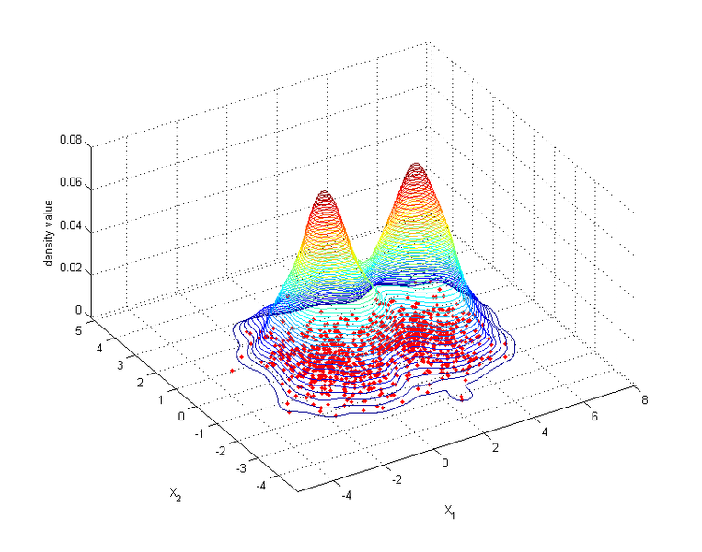
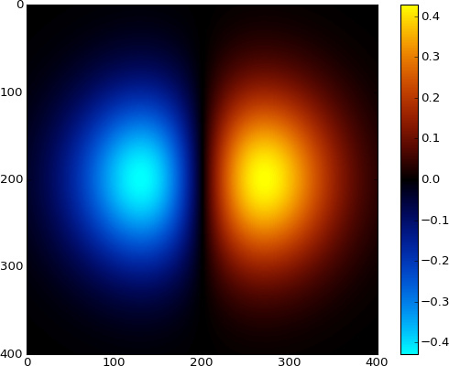
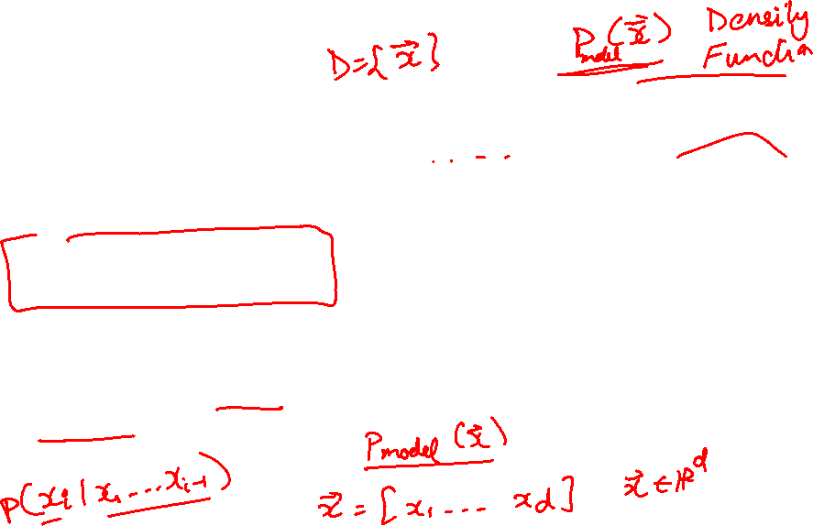
Supervised vs Reinforcement vs Unsupervised Learning
Unsupervised Learning
Data: x
Just data, no labels!
Goal: Learn some underlying hidden structure of the data
Examples: Clustering, dimensionality reduction, feature learning, density estimation, etc.
Figure copyright Ian Goodfellow, 2016. Reproduced with permission.
1-d density estimation
2-d density estimation
2-d density images left and right are CC0 public domain
Slide Credit: Fei-Fei Li, Justin Johnson, Serena Yeung, CS 231n
Notes:
Finally, another example is density estimation, which is estimating the underlying distribution of your data.
For example, in top example, have points in 1-d, and we can try to fit a gaussian to the density
In the bottom example, have 2d data. Again trying to estimate the density, and we model the density to be higher where more points are concentrated

Slide 17
Tasks
Supervised Learning
x
Classification
y
Discrete
x
Regression
y
Continuous
Unsupervised Learning
x
Clustering
c
Discrete
x
Dimensionality
Reduction
z
Continuous
x
Density
Estimation
p(x)
On simplex

Slide 18






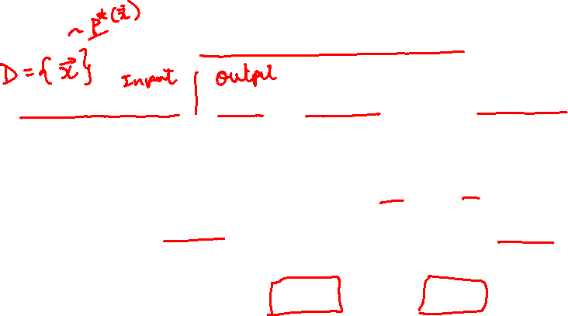
Generative Models
Given training data, generate new samples from same distribution
Training data ~ p_{data}(x)
Generated samples ~ p_{model}(x)
Want to learn p_{model}(x) similar to p_{data}(x)
Slide Credit: Fei-Fei Li, Justin Johnson, Serena Yeung, CS 231n
Notes:
Today we’ll focus on generative models, a class of models for unsupervised learning that given training data, tries to generate new samples from the same distribution

Slide 19
Generative Classification vs Discriminative Classification vs
Density Estimation
Generative Classification
  Model p(x, y); estimate p(x|y) and p(y)
  Use Bayes Rule to predict y
  E.g Naïve Bayes
Discriminative Classification
  Estimate p(y|x) directly
  E.g. Logistic Regression
Density Estimation
  Model p(x)
  E.g. VAEs

Slide 20
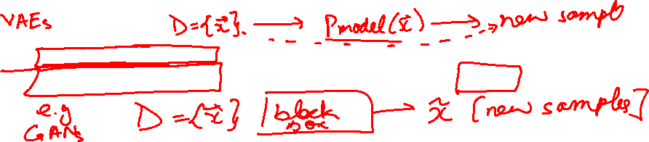
Generative Models
Given training data, generate new samples from same distribution
Training data ~ p_{data}(x)
Generated samples ~ p_{model}(x)
Want to learn p_{model}(x) similar to p_{data}(x)
Addresses density estimation, a core problem in unsupervised learning
Several flavors:
Explicit density estimation: explicitly define and solve for p_{model}(x)
Implicit density estimation: learn model that can sample from p_{model}(x) w/o explicitly defining it
Slide Credit: Fei-Fei Li, Justin Johnson, Serena Yeung, CS 231n
Notes:
Addresses the problem of density estimation, which is a core problem in unsup learning

Slide 21
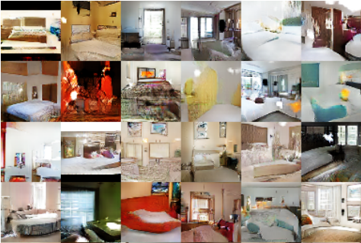
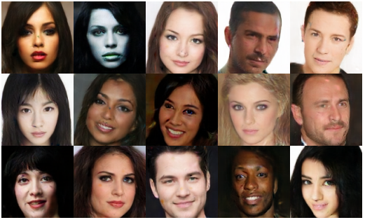
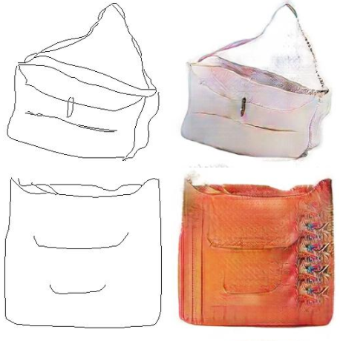
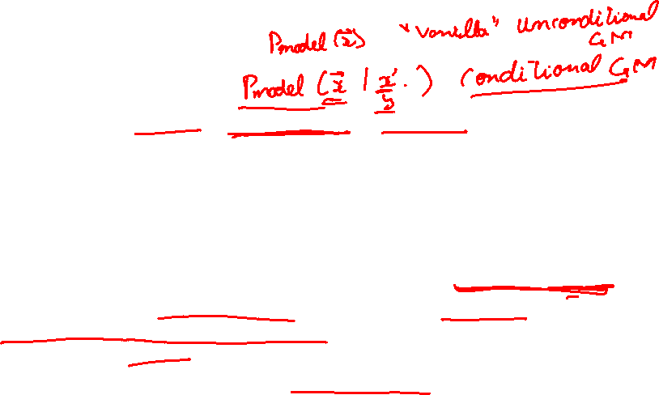
Why Generative Models?
Realistic samples for artwork, super-resolution, colorization, etc.
Generative models of time-series data can be used for simulation and planning (reinforcement learning applications!)
Training generative models can also enable inference of latent representations that can be useful as general features
FIgures from L-R are copyright: (1) Alec Radford et al. 2016; (2) David Berthelot et al. 2017; Phillip Isola et al. 2017. Reproduced with authors permission.
Slide Credit: Fei-Fei Li, Justin Johnson, Serena Yeung, CS 231n

Slide 22
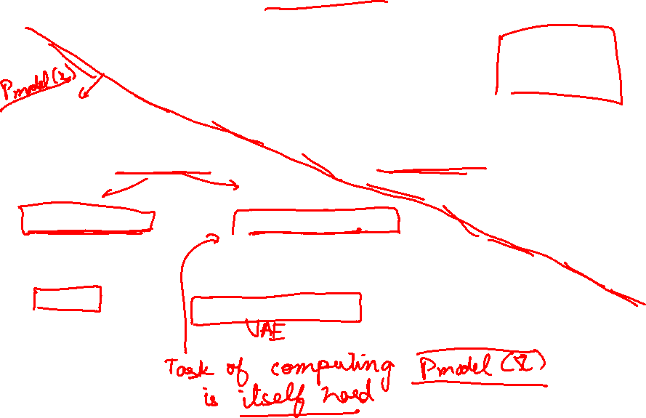
Taxonomy of Generative Models
Direct
GAN
Generative models
Explicit density
Implicit density
Tractable density
Approximate density
Markov Chain
Fully Visible Belief Nets
NADE
MADE
PixelRNN/CNN
Change of variables models (nonlinear ICA)
GSN
Variational
Markov Chain
Variational Autoencoder
Boltzmann Machine
Figure copyright and adapted from Ian Goodfellow, Tutorial on Generative Adversarial Networks, 2017.
Slide Credit: Fei-Fei Li, Justin Johnson, Serena Yeung, CS 231n
Notes:
If we look at types of generative models, can be organized into this taxonomy, where 2 major branches are, as mentioned earlier, explicit density models that explicitly define and solve for the underlying density function, and implicit density models that represent the underlying distribution implicitly through its samples

Slide 23

Taxonomy of Generative Models
Direct
We will discuss 3 most popular types of generative models
GAN
Generative models
Explicit density
Implicit density
Tractable density
Approximate density
Markov Chain
Fully Visible Belief Nets
NADE
MADE
PixelRNN/CNN
Change of variables models (nonlinear ICA)
GSN
Variational
Markov Chain
Variational Autoencoder
Boltzmann Machine
Figure copyright and adapted from Ian Goodfellow, Tutorial on Generative Adversarial Networks, 2017.
Slide Credit: Fei-Fei Li, Justin Johnson, Serena Yeung, CS 231n
Notes:
Refer to goodfellow tutorial which has a good overview of this
Today discuss 3 most popular types of generative models

Slide 24
PixelRNN

Slide 25

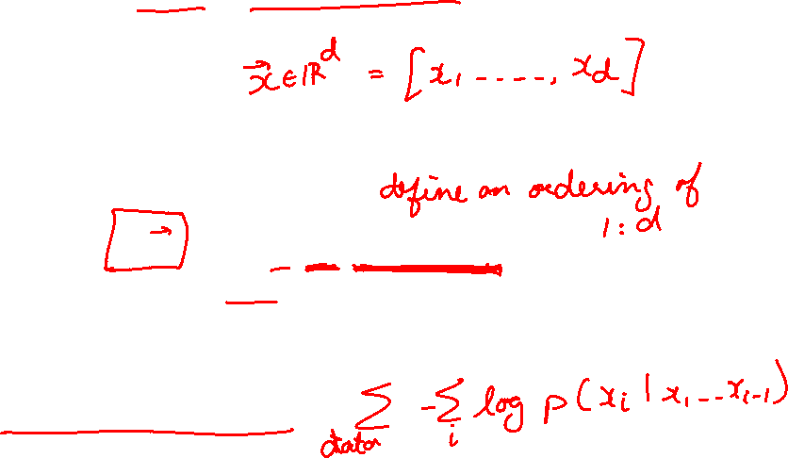
Fully Observable Model
Explicit density model
Use chain rule to decompose likelihood of an image x into product of 1-d distributions:
Likelihood of image x
Probability of i’th pixel value given all previous pixels
Then maximize likelihood of training data
Slide Credit: Fei-Fei Li, Justin Johnson, Serena Yeung, CS 231n
Notes:
Pielrnn and cnn type of fully visible belief network

Slide 26
Fully Observable Model
Explicit density model
Use chain rule to decompose likelihood of an image x into product of 1-d distributions:
Likelihood of image x
Probability of i’th pixel value given all previous pixels
Then maximize likelihood of training data
Complex distribution over pixel values => Express using a neural network!
Slide Credit: Fei-Fei Li, Justin Johnson, Serena Yeung, CS 231n

Slide 27
Fully Observable Model
Explicit density model
Use chain rule to decompose likelihood of an image x into product of 1-d distributions:
Will need to define ordering of “previous pixels”
Likelihood of image x
Probability of i’th pixel value given all previous pixels
Then maximize likelihood of training data
Complex distribution over pixel values => Express using a neural network!
Slide Credit: Fei-Fei Li, Justin Johnson, Serena Yeung, CS 231n

Slide 28
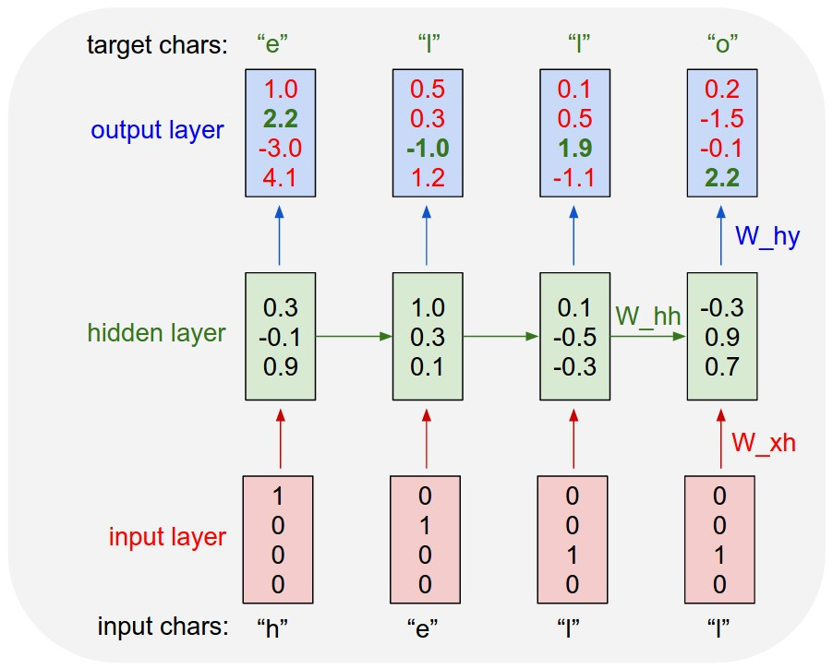
Example: Character-level
Language Model
Vocabulary:
[h,e,l,o]
Example training
sequence:
“hello”
Slide Credit: Fei-Fei Li, Justin Johnson, Serena Yeung, CS 231n

Slide 29
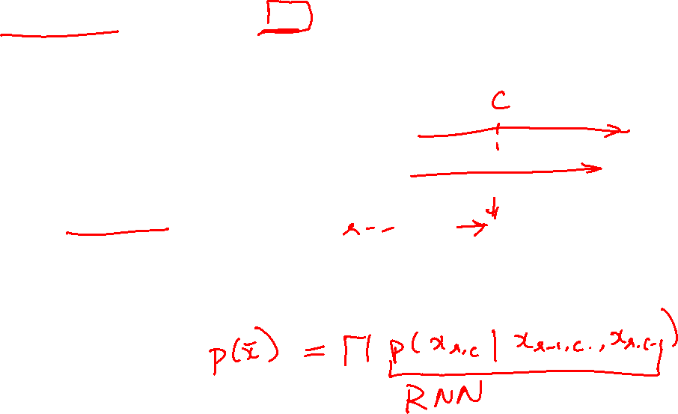
PixelRNN [van der Oord et al. 2016]
Generate image pixels starting from corner
Dependency on previous pixels modeled using an RNN (LSTM)
Slide Credit: Fei-Fei Li, Justin Johnson, Serena Yeung, CS 231n

Slide 30
PixelRNN [van der Oord et al. 2016]
Generate image pixels starting from corner
Dependency on previous pixels modeled using an RNN (LSTM)
Slide Credit: Fei-Fei Li, Justin Johnson, Serena Yeung, CS 231n

Slide 31
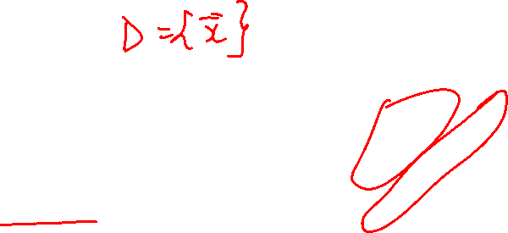
PixelRNN [van der Oord et al. 2016]
Generate image pixels starting from corner
Dependency on previous pixels modeled using an RNN (LSTM)
Slide Credit: Fei-Fei Li, Justin Johnson, Serena Yeung, CS 231n

Slide 32
Test Time: Sample / Argmax / Beam Search
Example: Character-level
Language Model
Sampling
Vocabulary:
[h,e,l,o]
At test-time sample characters one at a time, feed back to model
“e”
“l”
“l”
“o”
Sample
.03
.13
.00
.84
.25
.20
.05
.50
.11
.17
.68
.03
.11
.02.08
.79
Softmax
Slide Credit: Fei-Fei Li, Justin Johnson, Serena Yeung, CS 231n

Slide 33
Test Time: Sample / Argmax / Beam Search
Example: Character-level
Language Model
Sampling
Vocabulary:
[h,e,l,o]
At test-time sample characters one at a time, feed back to model
“e”
“l”
“l”
“o”
Sample
.03
.13
.00
.84
.25
.20
.05
.50
.11
.17
.68
.03
.11
.02.08
.79
Softmax
Slide Credit: Fei-Fei Li, Justin Johnson, Serena Yeung, CS 231n

Slide 34
Test Time: Sample / Argmax / Beam Search
Example: Character-level
Language Model
Sampling
Vocabulary:
[h,e,l,o]
At test-time sample characters one at a time, feed back to model
“e”
“l”
“l”
“o”
Sample
.03
.13
.00
.84
.25
.20
.05
.50
.11
.17
.68
.03
.11
.02.08
.79
Softmax
Slide Credit: Fei-Fei Li, Justin Johnson, Serena Yeung, CS 231n

Slide 35
Test Time: Sample / Argmax / Beam Search
Example: Character-level
Language Model
Sampling
Vocabulary:
[h,e,l,o]
At test-time sample characters one at a time, feed back to model
“e”
“l”
“l”
“o”
Sample
.03
.13
.00
.84
.25
.20
.05
.50
.11
.17
.68
.03
.11
.02.08
.79
Softmax
Slide Credit: Fei-Fei Li, Justin Johnson, Serena Yeung, CS 231n

Slide 36
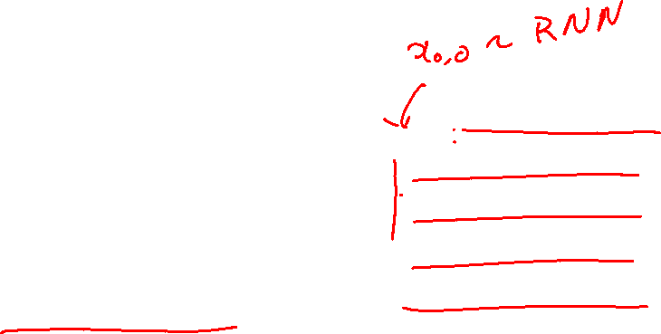
PixelRNN [van der Oord et al. 2016]
Generate image pixels starting from corner
Dependency on previous pixels modeled using an RNN (LSTM)
Drawback: sequential generation is slow!
Slide Credit: Fei-Fei Li, Justin Johnson, Serena Yeung, CS 231n

Slide 37
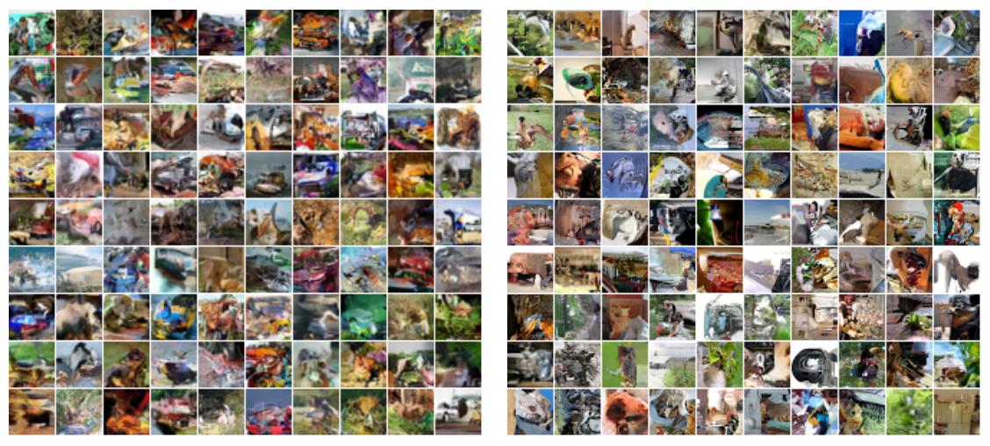
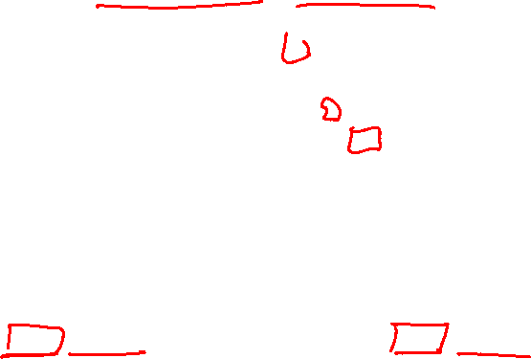
Generation Samples
32x32 CIFAR-10
32x32 ImageNet
Figures copyright Aaron van der Oord et al., 2016. Reproduced with permission.
Slide Credit: Fei-Fei Li, Justin Johnson, Serena Yeung, CS 231n

Slide 38
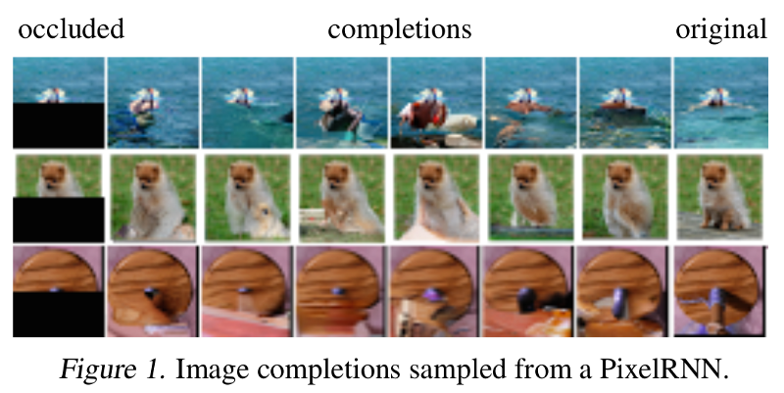
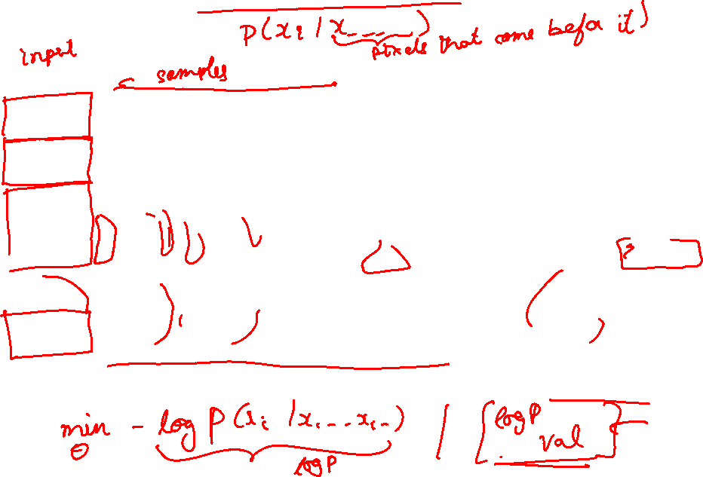
Image Completion

Slide 39
Results from generating sounds
https://deepmind.com/blog/wavenet-generative-model-raw-audio/

Slide 40
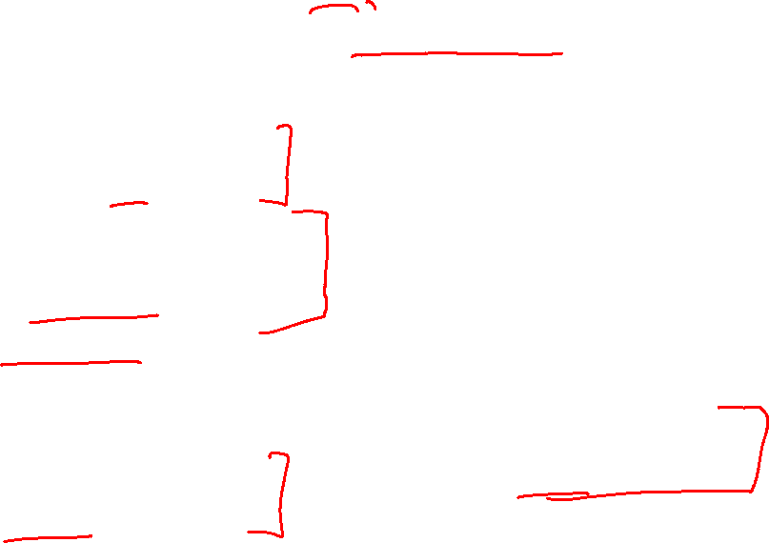
PixelRNN (and PixelCNN)
Pros:
Can explicitly compute likelihood p(x)
Explicit likelihood of training data gives good evaluation metric
Good samples
Con:
Sequential generation => slow
Improving PixelCNN performance
Gated convolutional layers
Short-cut connections
Discretized logistic loss
Multi-scale
Training tricks
Etc…
See
Van der Oord et al. NIPS 2016
Salimans et al. 2017 (PixelCNN++)
Slide Credit: Fei-Fei Li, Justin Johnson, Serena Yeung, CS 231n
Notes:
When is it not computationally tractable?

Slide 41
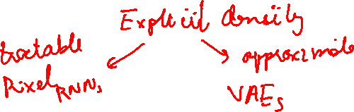
Variational Autoencoders (VAE)

Slide 42
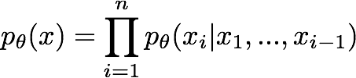
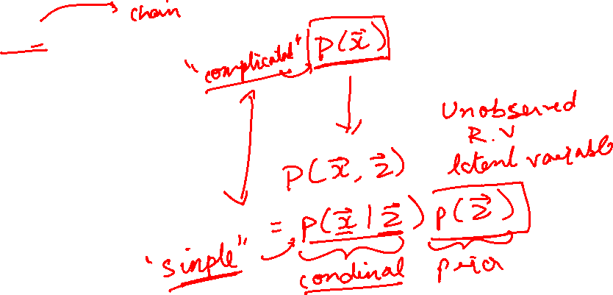
So far...
PixelCNNs define tractable density function, optimize likelihood of training data:
Slide Credit: Fei-Fei Li, Justin Johnson, Serena Yeung, CS 231n

Slide 43

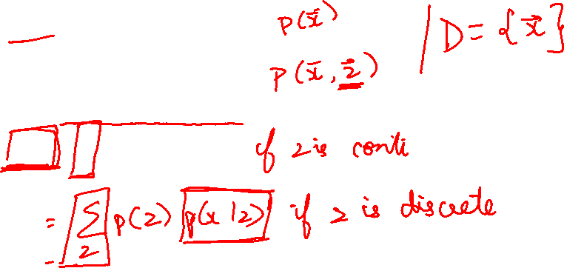
So far...
PixelCNNs define tractable density function, optimize likelihood of training data:
VAEs define intractable density function with latent z:
Slide Credit: Fei-Fei Li, Justin Johnson, Serena Yeung, CS 231n

Slide 44
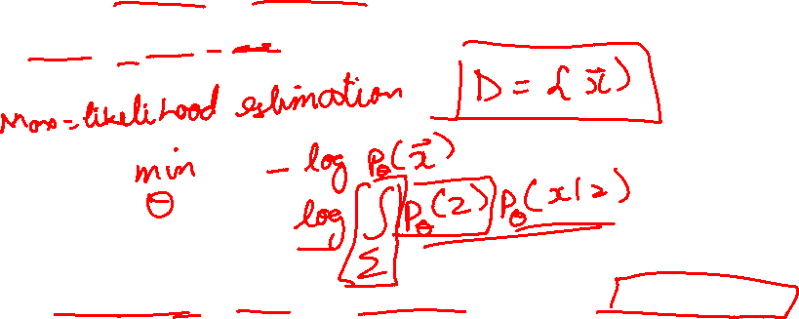
So far...
PixelCNNs define tractable density function, optimize likelihood of training data:
VAEs define intractable density function with latent z:
Cannot optimize directly, derive and optimize lower bound on likelihood instead
Slide Credit: Fei-Fei Li, Justin Johnson, Serena Yeung, CS 231n

Slide 45
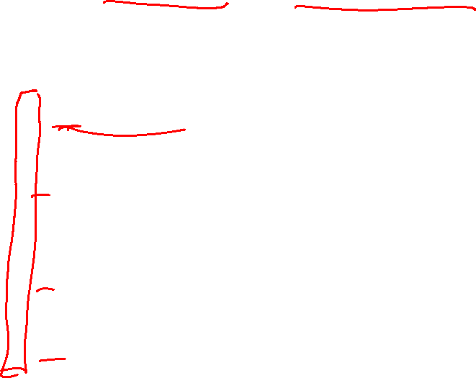
Variational Auto Encoders
VAEs are a combination of the following ideas:
Auto Encoders
Variational Approximation
  Variational Lower Bound / ELBO
Amortized Inference Neural Networks
“Reparameterization” Trick

Slide 46
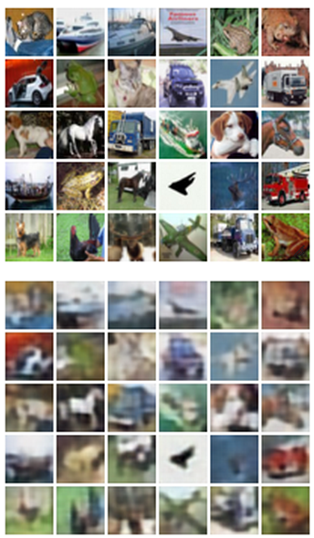
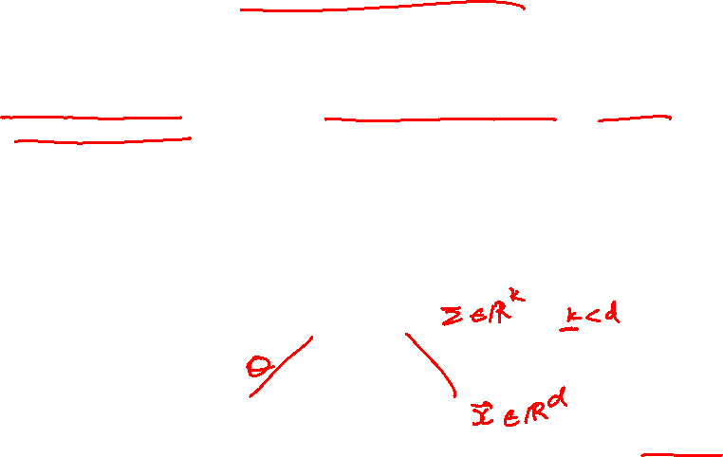
Autoencoders
Unsupervised approach for learning a lower-dimensional feature representation from unlabeled training data
Features
Encoder
Input data
Slide Credit: Fei-Fei Li, Justin Johnson, Serena Yeung, CS 231n
Notes:
Generative model with latent variables to maximize training data
What is unsupervised learning? Learning feature representations with unsupervised objectives, vs. learning generative models for data, etc…
Explicit density estimation (PixelCNN) vs. Autoencoder vs. VAE vs. GANs. Compare and contrast. In particular, VAE vs. GAN. What are advantages of VAE? Are Autoencoders still used? In what context? Or why not?
What is current research, pros / cons of each?

Slide 47

Autoencoders
Unsupervised approach for learning a lower-dimensional feature representation from unlabeled training data
Originally: Linear + nonlinearity (sigmoid)
Later: Deep, fully-connected
Later: ReLU CNN
Features
Encoder
Input data
Slide Credit: Fei-Fei Li, Justin Johnson, Serena Yeung, CS 231n

Slide 48

Autoencoders
Unsupervised approach for learning a lower-dimensional feature representation from unlabeled training data
z usually smaller than x
(dimensionality reduction)
Originally: Linear + nonlinearity (sigmoid)
Later: Deep, fully-connected
Later: ReLU CNN
Q: Why dimensionality reduction?
Features
Encoder
Input data
Slide Credit: Fei-Fei Li, Justin Johnson, Serena Yeung, CS 231n

Slide 49
Autoencoders
Unsupervised approach for learning a lower-dimensional feature representation from unlabeled training data
z usually smaller than x
(dimensionality reduction)
Originally: Linear + nonlinearity (sigmoid)
Later: Deep, fully-connected
Later: ReLU CNN
Q: Why dimensionality reduction?
A: Want features to capture meaningful factors of variation in data
Features
Encoder
Input data
Slide Credit: Fei-Fei Li, Justin Johnson, Serena Yeung, CS 231n

Slide 50
Autoencoders
How to learn this feature representation?
Features
Encoder
Input data
Slide Credit: Fei-Fei Li, Justin Johnson, Serena Yeung, CS 231n

Slide 51
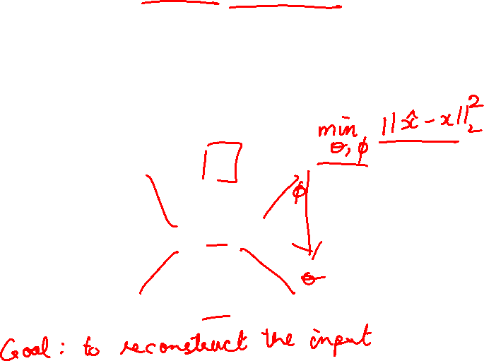
Autoencoders
How to learn this feature representation?
Train such that features can be used to reconstruct original data
“Autoencoding” - encoding itself
Reconstructed input data
Decoder
Features
Encoder
Input data
Slide Credit: Fei-Fei Li, Justin Johnson, Serena Yeung, CS 231n

Slide 52
Autoencoders
How to learn this feature representation?
Train such that features can be used to reconstruct original data
“Autoencoding” - encoding itself
Originally: Linear + nonlinearity (sigmoid)
Later: Deep, fully-connected
Later: ReLU CNN (upconv)
Reconstructed input data
Decoder
Features
Encoder
Input data
Slide Credit: Fei-Fei Li, Justin Johnson, Serena Yeung, CS 231n

Slide 53
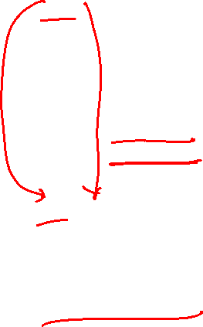
Autoencoders
Reconstructed data
How to learn this feature representation?
Train such that features can be used to reconstruct original data
“Autoencoding” - encoding itself
Reconstructed input data
Encoder: 4-layer conv
Decoder: 4-layer upconv
Decoder
Input data
Features
Encoder
Input data
Slide Credit: Fei-Fei Li, Justin Johnson, Serena Yeung, CS 231n

Slide 54

Autoencoders
Reconstructed data
Train such that features can be used to reconstruct original data
L2 Loss function:
Reconstructed input data
Encoder: 4-layer conv
Decoder: 4-layer upconv
Decoder
Input data
Features
Encoder
Input data
Slide Credit: Fei-Fei Li, Justin Johnson, Serena Yeung, CS 231n

Slide 55
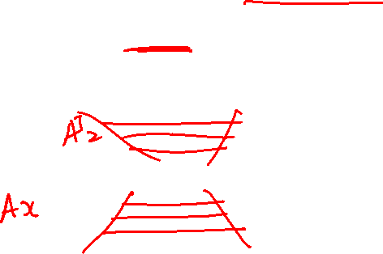
Autoencoders
Reconstructed data
Train such that features can be used to reconstruct original data
Doesn’t use labels!
L2 Loss function:
Reconstructed input data
Encoder: 4-layer conv
Decoder: 4-layer upconv
Decoder
Input data
Features
Encoder
Input data
Slide Credit: Fei-Fei Li, Justin Johnson, Serena Yeung, CS 231n

Slide 56
Autoencoders
Demo
  https://cs.stanford.edu/people/karpathy/convnetjs/demo/autoencoder.html

Slide 57
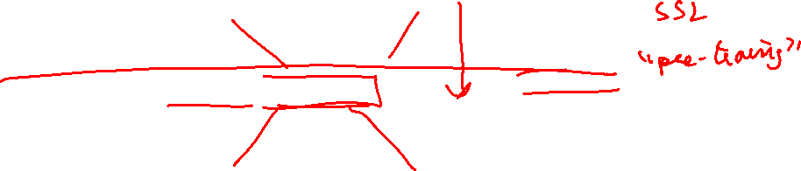
Autoencoders
Reconstructed input data
Decoder
Features
After training,
throw away decoder
Encoder
Input data
Slide Credit: Fei-Fei Li, Justin Johnson, Serena Yeung, CS 231n

Slide 58
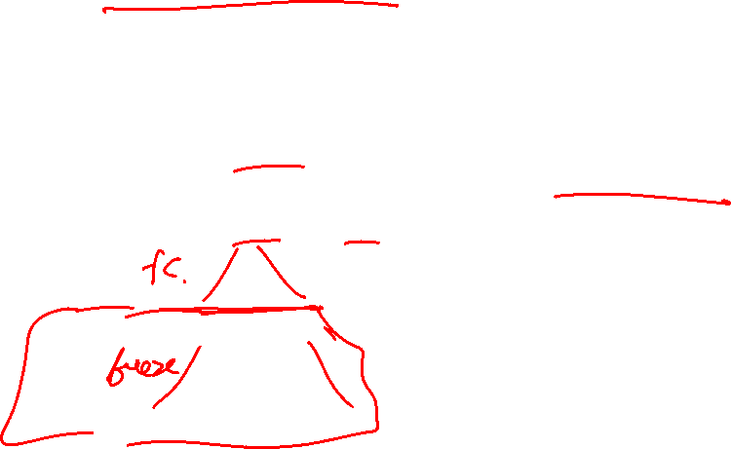
Autoencoders
Loss function (Softmax, etc)
bird
plane
dog
deer
truck
Predicted Label
Train for final task (sometimes with small data)
Classifier
Fine-tune
encoder
jointly with
classifier
Encoder can be used to initialize a supervised model
Features
Encoder
Input data
Slide Credit: Fei-Fei Li, Justin Johnson, Serena Yeung, CS 231n

Slide 59
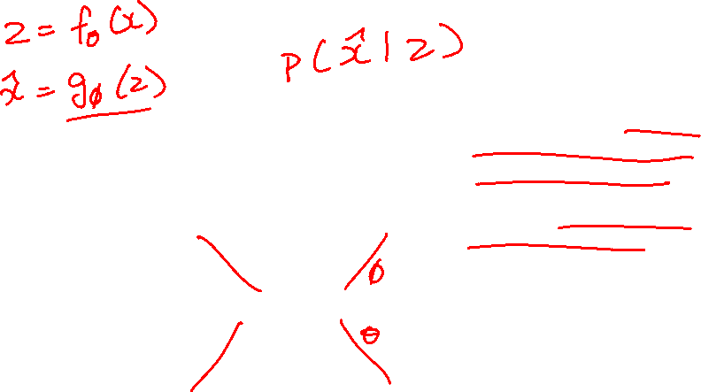
Autoencoders
Autoencoders can reconstruct data, and can learn features to initialize a supervised model
Features capture factors of variation in training data. Can we generate new images from an autoencoder?
Reconstructed input data
Decoder
Features
Encoder
Input data
Slide Credit: Fei-Fei Li, Justin Johnson, Serena Yeung, CS 231n

Slide 60
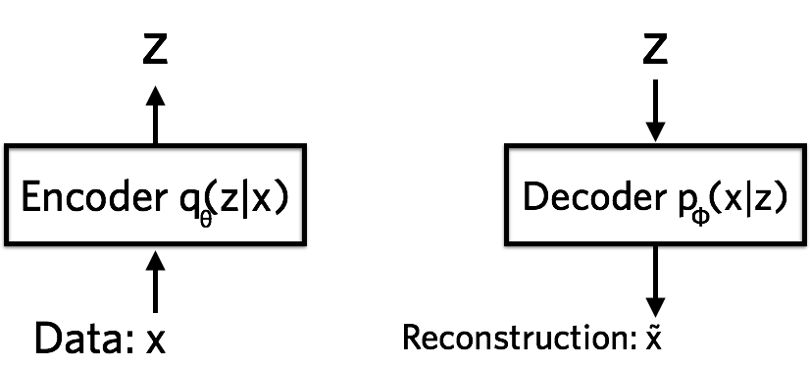



Variational Autoencoders
Probabilistic spin on autoencoders - will let us sample from the model to generate data!
$$qφ\left(z | x\right)$$
$$pθ\left(x | z\right)$$
Image Credit: https://jaan.io/what-is-variational-autoencoder-vae-tutorial/

Slide 61

Variational Auto Encoders
VAEs are a combination of the following ideas:
Auto Encoders
Variational Approximation
  Variational Lower Bound / ELBO
Amortized Inference Neural Networks
“Reparameterization” Trick

Slide 62

Key problem
P(z|x)

Slide 63
What is Variational Inference?
A class of methods for
  approximate inference, parameter learning
  and approximating integrals basically..
Key idea
  Reality is complex
  Instead of performing approximate computation in something complex,
  Can we perform exact computation in something “simple”?
  Just need to make sure the simple thing is “close” to the complex thing.

Slide 64

Intuition

Slide 65
KL divergence:
Distance between distributions
Given two distributions p and q KL divergence:
D(p||q) = 0 iff p=q
Not symmetric – p determines where difference is important
Slide Credit: Carlos Guestrin

Slide 66

Find simple approximate distribution
Suppose p is intractable posterior
Want to find simple q that approximates p
KL divergence not symmetric
D(p||q)
  true distribution p defines support of diff.
  the “correct” direction
  will be intractable to compute
D(q||p)
  approximate distribution defines support
  tends to give overconfident results
  will be tractable
Slide Credit: Carlos Guestrin

Slide 67

Example 1
p = 2D Gaussian with arbitrary co-variance
q = 2D Gaussian with diagonal co-variance
argmin_q KL (p || q)
argmin_q KL (q || p)
p = Green; q = Red

Slide 68

Example 2
p = Mixture of Two Gaussians
q = Single Gaussian
argmin_q KL (p || q)
argmin_q KL (q || p)
p = Blue; q = Red

