Slide 1
CS 4803 / 7643: Deep Learning
Topics:
  Generative Adversarial Networks (GANs)
  Closing time
Dhruv Batra
Georgia Tech

Slide 2

Administrativia
Last class today
Project submission
  Due: 11/24, 11:59pm
  Last deliverable in the class
  Can’t use late days 8 free late days
  https://www.cc.gatech.edu/classes/AY2021/cs7643_fall/

Slide 3
Generative Adversarial Networks (GAN)

Slide 4
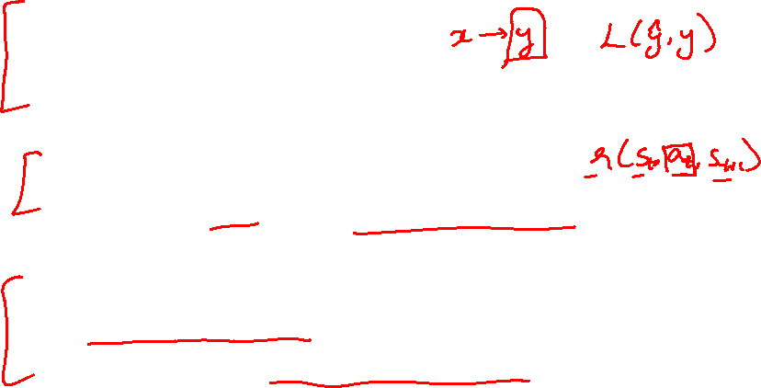
Types of Learning
Supervised learning
  Learning from a “teacher”
  Training data includes desired outputs
Reinforcement learning
  Learning to act under evaluative feedback (rewards)
Unsupervised learning
  Discover structure in data
  Training data does not include desired outputs

Slide 5
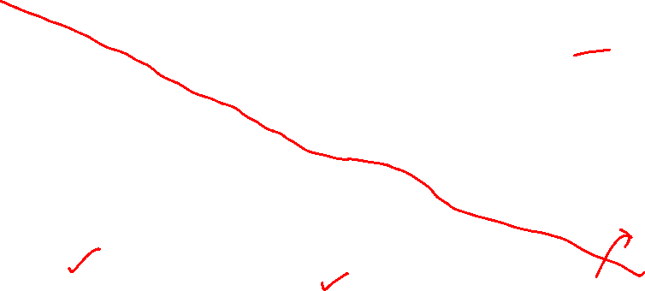
Taxonomy of Generative Models
Direct
GAN
Generative models
Explicit density
Implicit density
Tractable density
Approximate density
Markov Chain
Fully Visible Belief Nets
NADE
MADE
PixelRNN/CNN
Change of variables models (nonlinear ICA)
GSN
Variational
Markov Chain
Variational Autoencoder
Boltzmann Machine
Figure copyright and adapted from Ian Goodfellow, Tutorial on Generative Adversarial Networks, 2017.
Slide Credit: Fei-Fei Li, Justin Johnson, Serena Yeung, CS 231n
Notes:
Refer to goodfellow tutorial which has a good overview of this
Today discuss 3 most popular types of generative models

Slide 6
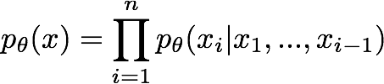

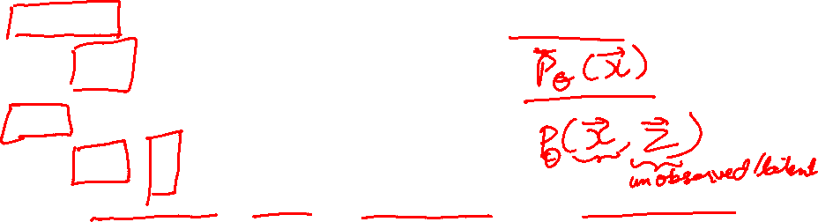
So far...
PixelCNNs define tractable density function, optimize likelihood of training data:
VAEs define intractable density function with latent z:
Cannot optimize directly, derive and optimize lower bound on likelihood instead
Slide Credit: Fei-Fei Li, Justin Johnson, Serena Yeung, CS 231n

Slide 7
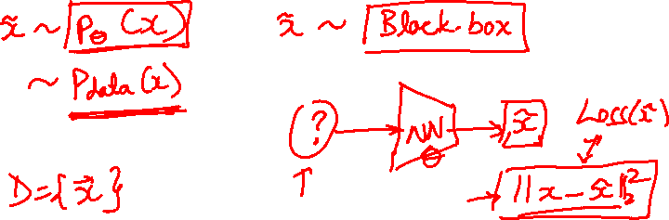
So far...
PixelCNNs define tractable density function, optimize likelihood of training data:
VAEs define intractable density function with latent z:
Cannot optimize directly, derive and optimize lower bound on likelihood instead
What if we give up on explicitly modeling density, and just want ability to sample?
Slide Credit: Fei-Fei Li, Justin Johnson, Serena Yeung, CS 231n

Slide 8
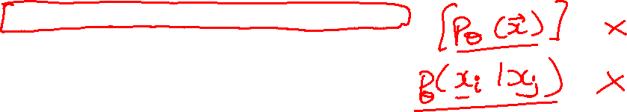
So far...
PixelCNNs define tractable density function, optimize likelihood of training data:
VAEs define intractable density function with latent z:
Cannot optimize directly, derive and optimize lower bound on likelihood instead
What if we give up on explicitly modeling density, and just want ability to sample?
GANs: don’t work with any explicit density function!
Slide Credit: Fei-Fei Li, Justin Johnson, Serena Yeung, CS 231n

Slide 9
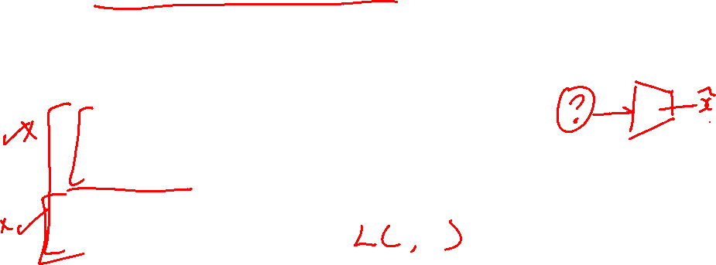
Generative Adversarial Networks (GANs)
GANs are a combination of the following ideas:
Learning to Sample
  (High-level) Connection to Inverse Transform Sampling
Adversarial Training

Slide 10

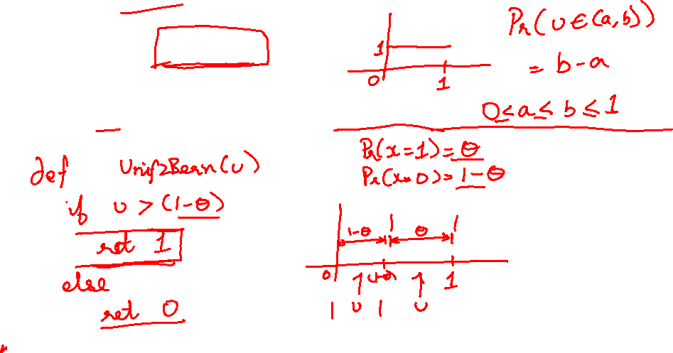
Easy Interview Question
I give you u ~ U(0,1)
Use u to produce a sample x ~ Bern($θ$)

Slide 11

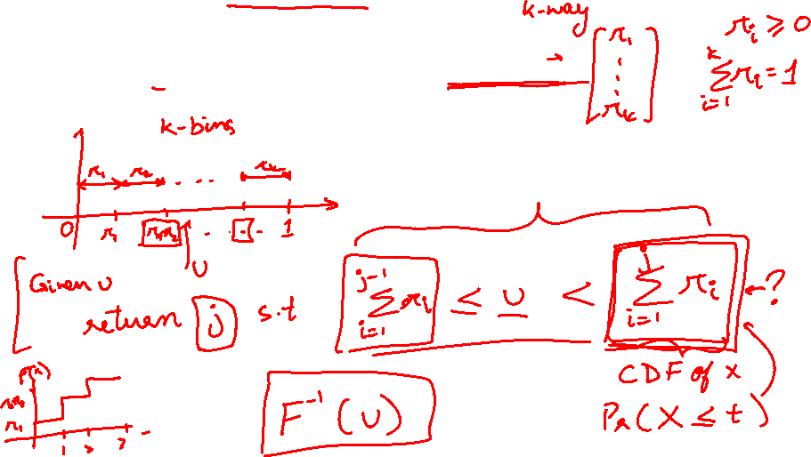
Slightly Harder Interview Question
I give you u ~ U(0,1)
Use u to produce a sample x ~ Cat($π$)

Slide 12
Slightly Harder Interview Question
I give you u ~ U(0,1)
Use u to produce a sample x ~ Cat($π$)

Slide 13
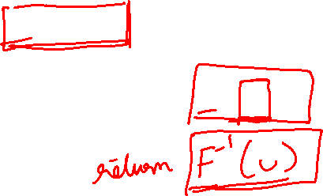
Harder Interview Question
I give you u ~ U(0,1)
Use u to produce a sample x ~ F_{X}(x)

Slide 14
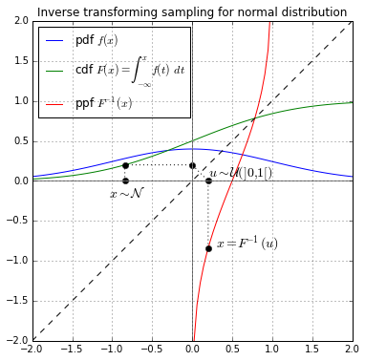
Inverse Transform Sampling

Slide 15
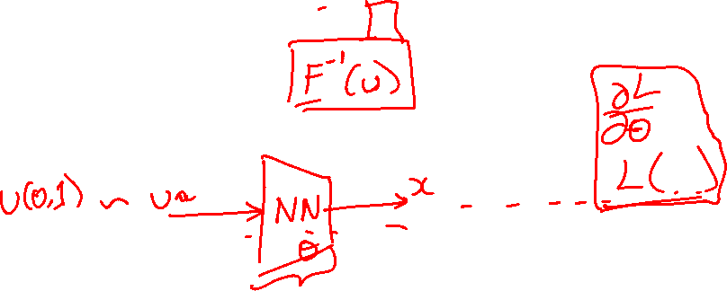
Harder Interview Question
I give you u ~ U(0,1)
Use u to produce a sample x ~ F_{X}(x)

Slide 16
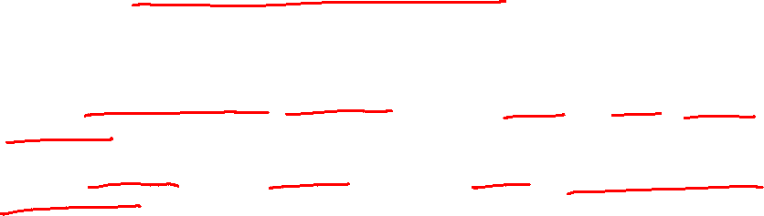
Generative Adversarial Networks
Ian Goodfellow et al., “Generative Adversarial Nets”, NIPS 2014
Problem: Want to sample from complex, high-dimensional training distribution. No direct way to do this!
Solution: Sample from a simple distribution, e.g. random noise. Learn transformation to training distribution.
Q: What can we use to represent this complex transformation?
Slide Credit: Fei-Fei Li, Justin Johnson, Serena Yeung, CS 231n
Notes:
Mapping z to data manifold?
Hard to sample from high dimensional distribution. Take random noise, transform to real distribution

Slide 17
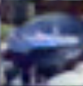
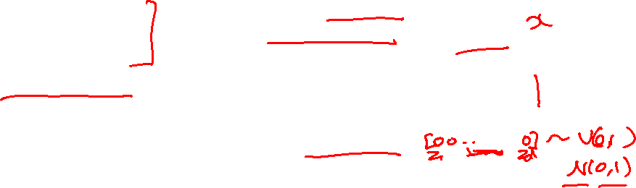
Generative Adversarial Networks
Ian Goodfellow et al., “Generative Adversarial Nets”, NIPS 2014
Problem: Want to sample from complex, high-dimensional training distribution. No direct way to do this!
Solution: Sample from a simple distribution, e.g. random noise. Learn transformation to training distribution.
Q: What can we use to represent this complex transformation?
Output: Sample from training distribution
A: A neural network!
Generator Network
Input: Random noise
z
Slide Credit: Fei-Fei Li, Justin Johnson, Serena Yeung, CS 231n
Notes:
Mapping z to data manifold?
Hard to sample from high dimensional distribution. Take random noise, transform to real distribution

Slide 18
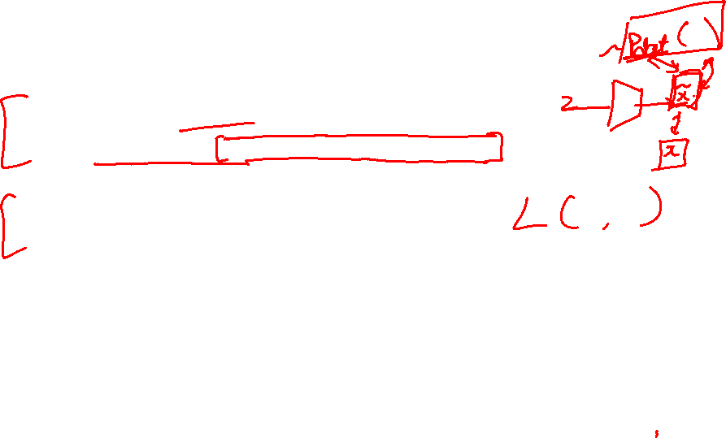
Generative Adversarial Networks (GANs)
GANs are a combination of the following ideas:
Learning to Sample
  Connection to Inverse Transform Sampling
Adversarial Training

Slide 19
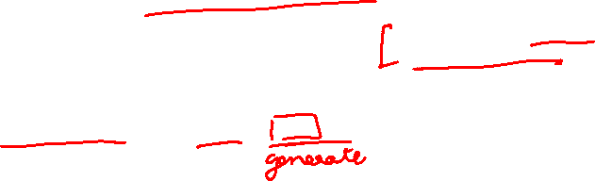
Training GANs: Two-player game
Ian Goodfellow et al., “Generative Adversarial Nets”, NIPS 2014
Generator network: try to fool the discriminator by generating real-looking images
Discriminator network: try to distinguish between real and fake images
Slide Credit: Fei-Fei Li, Justin Johnson, Serena Yeung, CS 231n
Notes:
Mapping z to data manifold?

Slide 20





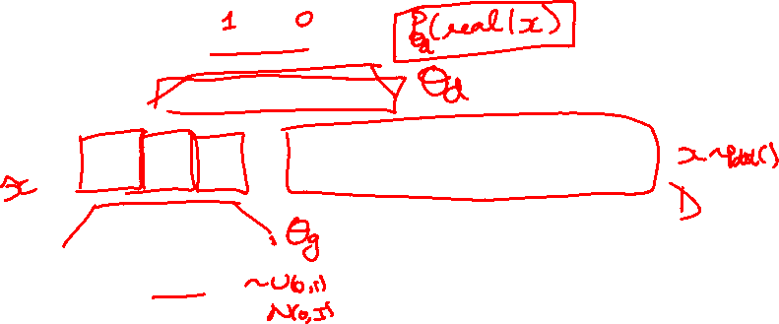
Training GANs: Two-player game
Ian Goodfellow et al., “Generative Adversarial Nets”, NIPS 2014
Generator network: try to fool the discriminator by generating real-looking images
Discriminator network: try to distinguish between real and fake images
Real or Fake
Discriminator Network
Fake Images
(from generator)
Real Images
(from training set)
Generator Network
Random noise
z
Fake and real images copyright Emily Denton et al. 2015. Reproduced with permission.
Slide Credit: Fei-Fei Li, Justin Johnson, Serena Yeung, CS 231n
Notes:
Mapping z to data manifold?

Slide 21
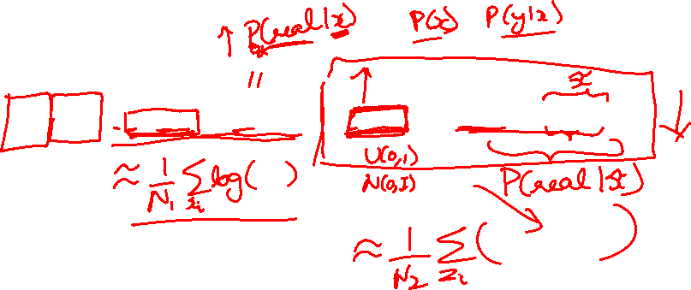
Training GANs: Two-player game
Ian Goodfellow et al., “Generative Adversarial Nets”, NIPS 2014
Generator network: try to fool the discriminator by generating real-looking images
Discriminator network: try to distinguish between real and fake images
Train jointly in minimax game
Minimax objective function:
Slide Credit: Fei-Fei Li, Justin Johnson, Serena Yeung, CS 231n
Notes:
Mapping z to data manifold?

Slide 22
Training GANs: Two-player game
Ian Goodfellow et al., “Generative Adversarial Nets”, NIPS 2014
Generator network: try to fool the discriminator by generating real-looking images
Discriminator network: try to distinguish between real and fake images
Train jointly in minimax game
Minimax objective function:
Discriminator outputs likelihood in (0,1) of real image
Discriminator output for real data x
Discriminator output for generated fake data G(z)
Slide Credit: Fei-Fei Li, Justin Johnson, Serena Yeung, CS 231n
Notes:
Mapping z to data manifold?

Slide 23
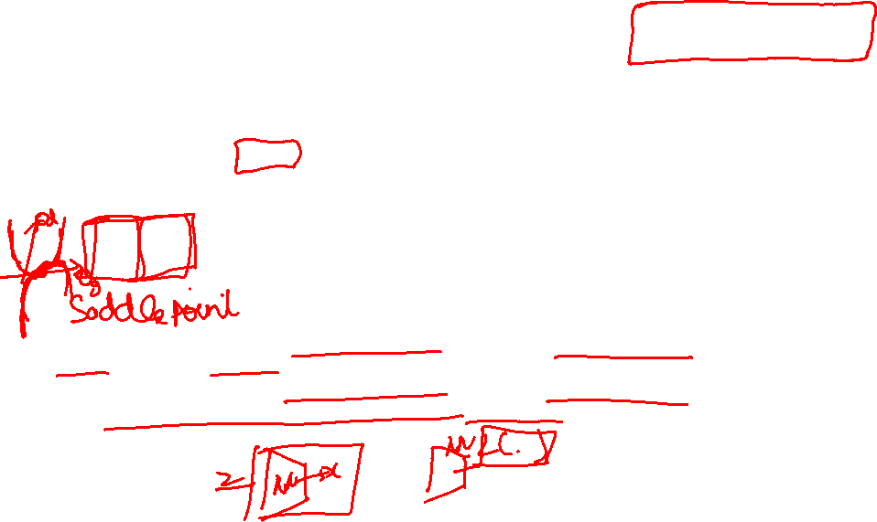
Training GANs: Two-player game
Ian Goodfellow et al., “Generative Adversarial Nets”, NIPS 2014
Generator network: try to fool the discriminator by generating real-looking images
Discriminator network: try to distinguish between real and fake images
Train jointly in minimax game
Minimax objective function:
Discriminator outputs likelihood in (0,1) of real image
Discriminator output for real data x
Discriminator output for generated fake data G(z)
Discriminator (θ_{d}) wants to maximize objective such that D(x) is close to 1 (real) and D(G(z)) is close to 0 (fake)
Generator (θ_{g}) wants to minimize objective such that D(G(z)) is close to 1 (discriminator is fooled into thinking generated G(z) is real)
Slide Credit: Fei-Fei Li, Justin Johnson, Serena Yeung, CS 231n
Notes:
Mapping z to data manifold?

Slide 24

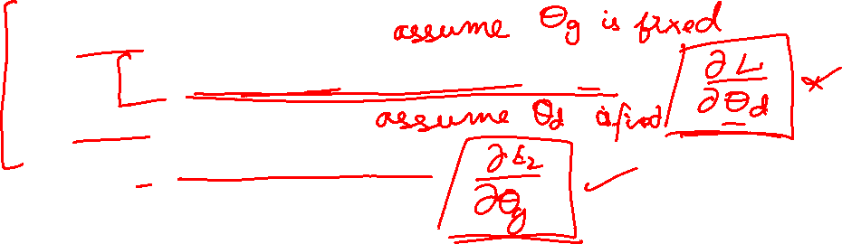
Training GANs: Two-player game
Ian Goodfellow et al., “Generative Adversarial Nets”, NIPS 2014
Minimax objective function:
Alternate between:
Gradient ascent on discriminator
2. Gradient descent on generator
Slide Credit: Fei-Fei Li, Justin Johnson, Serena Yeung, CS 231n
Notes:
Mapping z to data manifold?

Slide 25
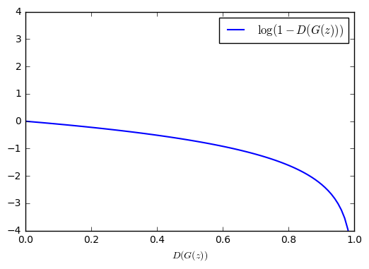
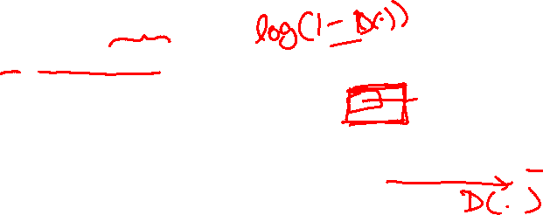
Training GANs: Two-player game
Ian Goodfellow et al., “Generative Adversarial Nets”, NIPS 2014
Minimax objective function:
Gradient signal dominated by region where sample is already good
Alternate between:
Gradient ascent on discriminator
2. Gradient descent on generator
When sample is likely fake, want to learn from it to improve generator. But gradient in this region is relatively flat!
In practice, optimizing this generator objective does not work well!
Slide Credit: Fei-Fei Li, Justin Johnson, Serena Yeung, CS 231n
Notes:
Mapping z to data manifold?

Slide 26
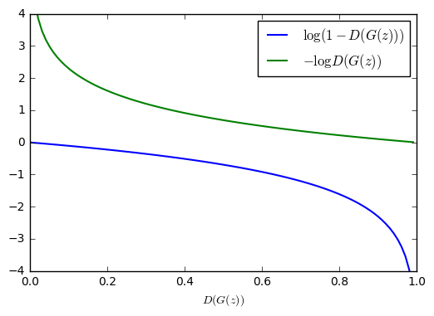


Training GANs: Two-player game
Ian Goodfellow et al., “Generative Adversarial Nets”, NIPS 2014
Minimax objective function:
Alternate between:
Gradient ascent on discriminator
2. Instead: Gradient ascent on generator, different objective
Instead of minimizing likelihood of discriminator being correct, now maximize likelihood of discriminator being wrong.
Same objective of fooling discriminator, but now higher gradient signal for bad samples => works much better! Standard in practice.
High gradient signal
Low gradient signal
Slide Credit: Fei-Fei Li, Justin Johnson, Serena Yeung, CS 231n
Notes:
Mapping z to data manifold?

Slide 27
Training GANs: Two-player game
Ian Goodfellow et al., “Generative Adversarial Nets”, NIPS 2014
Minimax objective function:
Aside: Jointly training two networks is challenging, can be unstable. Choosing objectives with better loss landscapes helps training, is an active area of research.
Alternate between:
Gradient ascent on discriminator
2. Instead: Gradient ascent on generator, different objective
Instead of minimizing likelihood of discriminator being correct, now maximize likelihood of discriminator being wrong.
Same objective of fooling discriminator, but now higher gradient signal for bad samples => works much better! Standard in practice.
High gradient signal
Low gradient signal
Slide Credit: Fei-Fei Li, Justin Johnson, Serena Yeung, CS 231n
Notes:
Mapping z to data manifold?

Slide 28
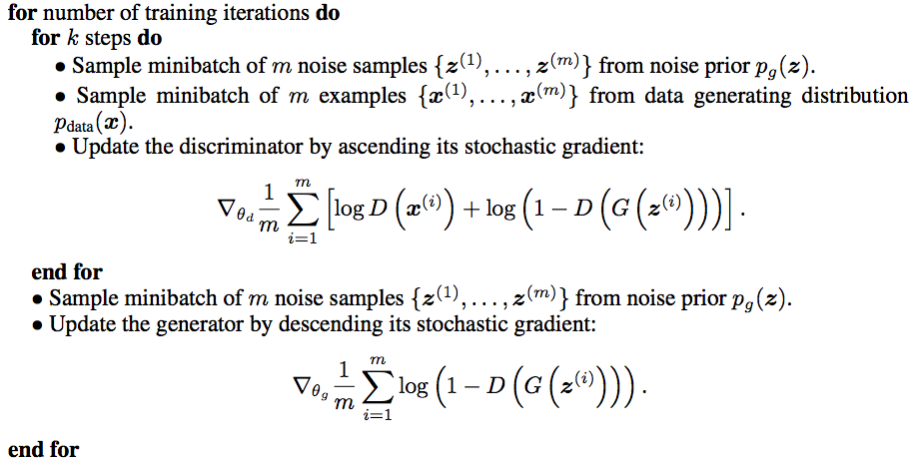
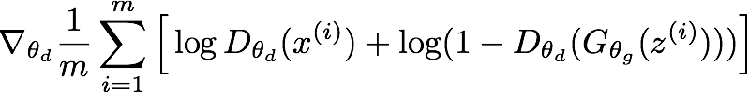
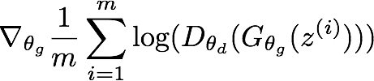
Training GANs: Two-player game
Ian Goodfellow et al., “Generative Adversarial Nets”, NIPS 2014
Putting it together: GAN training algorithm
Slide Credit: Fei-Fei Li, Justin Johnson, Serena Yeung, CS 231n
Notes:
Train discriminator for a bit
Then train generator for a bit

Slide 29
Training GANs: Two-player game
Ian Goodfellow et al., “Generative Adversarial Nets”, NIPS 2014
Putting it together: GAN training algorithm
Some find k=1 more stable, others use k > 1, no best rule.
Recent work (e.g. Wasserstein GAN) alleviates this problem, better stability!
Slide Credit: Fei-Fei Li, Justin Johnson, Serena Yeung, CS 231n
Notes:
Mapping z to data manifold?
**No clear rule. Sometimes train 1 step discriminator, 1 step gen. Some train disc. More

Slide 30
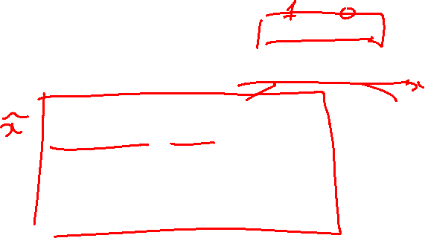
Training GANs: Two-player game
Ian Goodfellow et al., “Generative Adversarial Nets”, NIPS 2014
Generator network: try to fool the discriminator by generating real-looking images
Discriminator network: try to distinguish between real and fake images
Real or Fake
Discriminator Network
Fake Images
(from generator)
Real Images
(from training set)
Generator Network
After training, use generator network to generate new images
Random noise
z
Fake and real images copyright Emily Denton et al. 2015. Reproduced with permission.
Slide Credit: Fei-Fei Li, Justin Johnson, Serena Yeung, CS 231n
Notes:
Mapping z to data manifold?

Slide 31
GANs
Demo
  https://poloclub.github.io/ganlab/

Slide 32
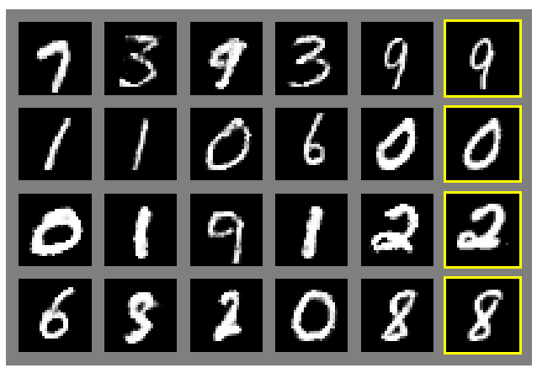
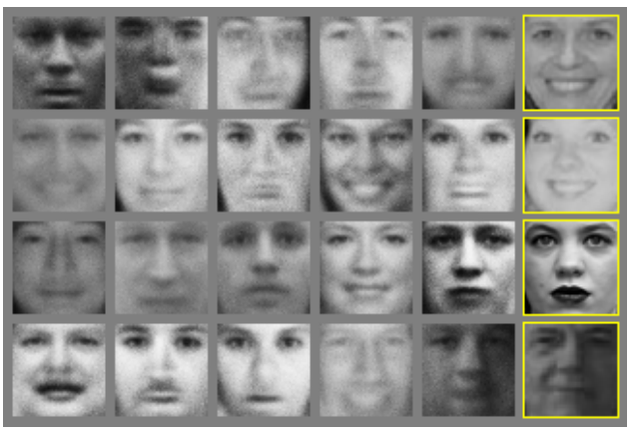
Generative Adversarial Nets
Ian Goodfellow et al., “Generative Adversarial Nets”, NIPS 2014
Generated samples
Nearest neighbor from training set
Figures copyright Ian Goodfellow et al., 2014. Reproduced with permission.
Slide Credit: Fei-Fei Li, Justin Johnson, Serena Yeung, CS 231n
Notes:
Realistic samples, never directly memorizes training set

Slide 33
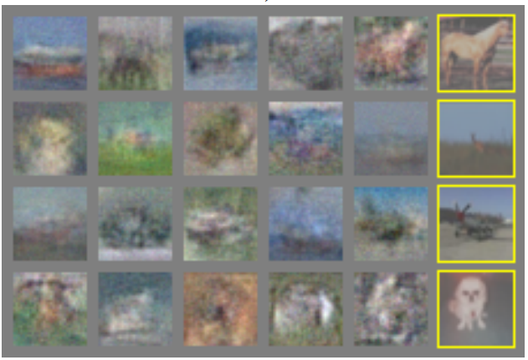
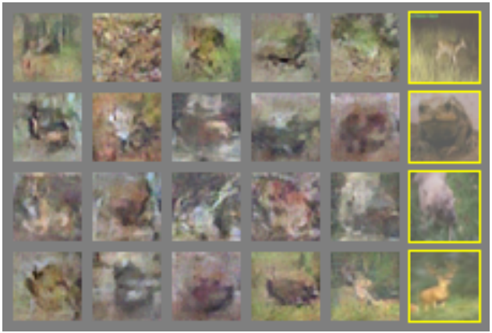
Generative Adversarial Nets
Ian Goodfellow et al., “Generative Adversarial Nets”, NIPS 2014
Generated samples (CIFAR-10)
Nearest neighbor from training set
Figures copyright Ian Goodfellow et al., 2014. Reproduced with permission.
Slide Credit: Fei-Fei Li, Justin Johnson, Serena Yeung, CS 231n
Notes:
Original work from 2014, not such great quality yet

Slide 34
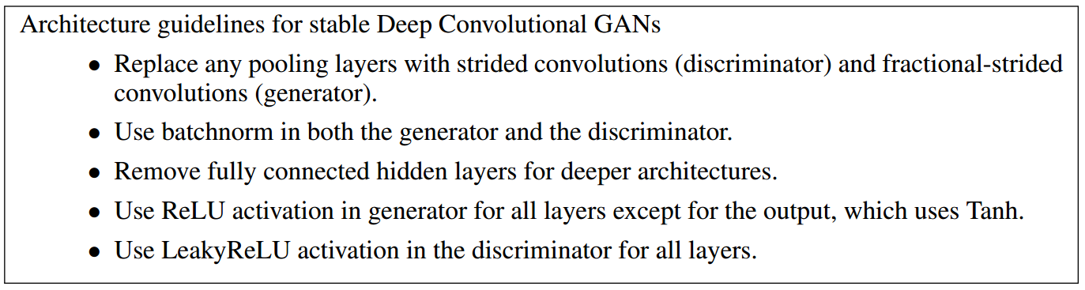
Generative Adversarial Nets: Convolutional Architectures
Generator is an upsampling network with fractionally-strided convolutions
Discriminator is a convolutional network
Radford et al, “Unsupervised Representation Learning with Deep Convolutional Generative Adversarial Networks”, ICLR 2016
Slide Credit: Fei-Fei Li, Justin Johnson, Serena Yeung, CS 231n
Notes:
Since this time, a lot of work on improving GANs.
This work ICLR2016 on adding convolutional architectures to GANs

Slide 35
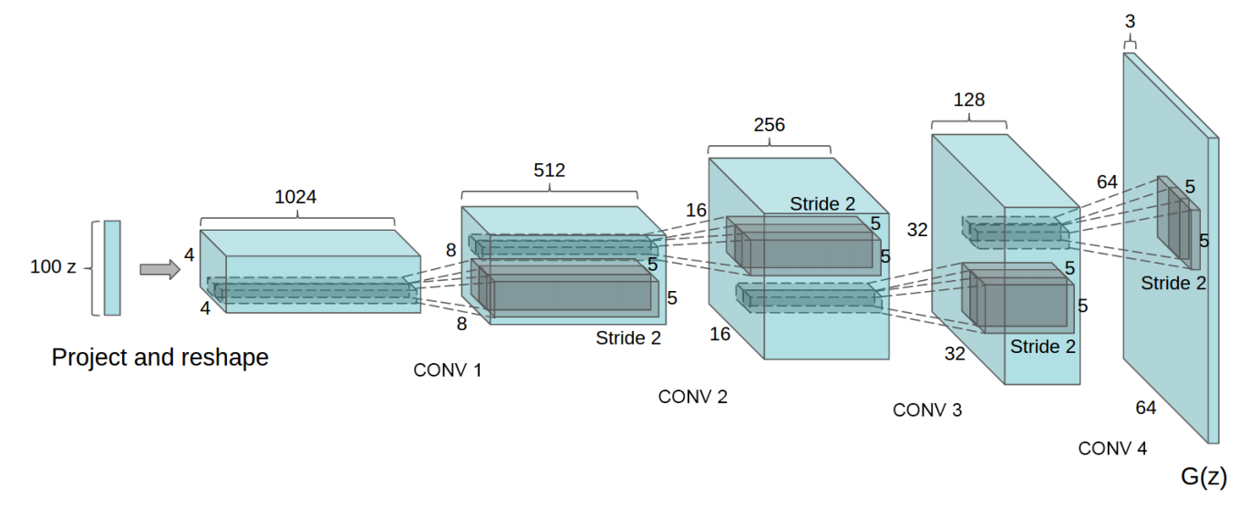
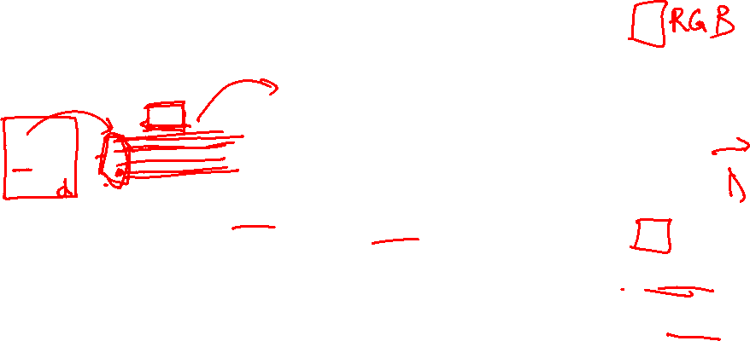
Generative Adversarial Nets: Convolutional Architectures
Generator
Radford et al, “Unsupervised Representation Learning with Deep Convolutional Generative Adversarial Networks”, ICLR 2016
Slide Credit: Fei-Fei Li, Justin Johnson, Serena Yeung, CS 231n

Slide 36
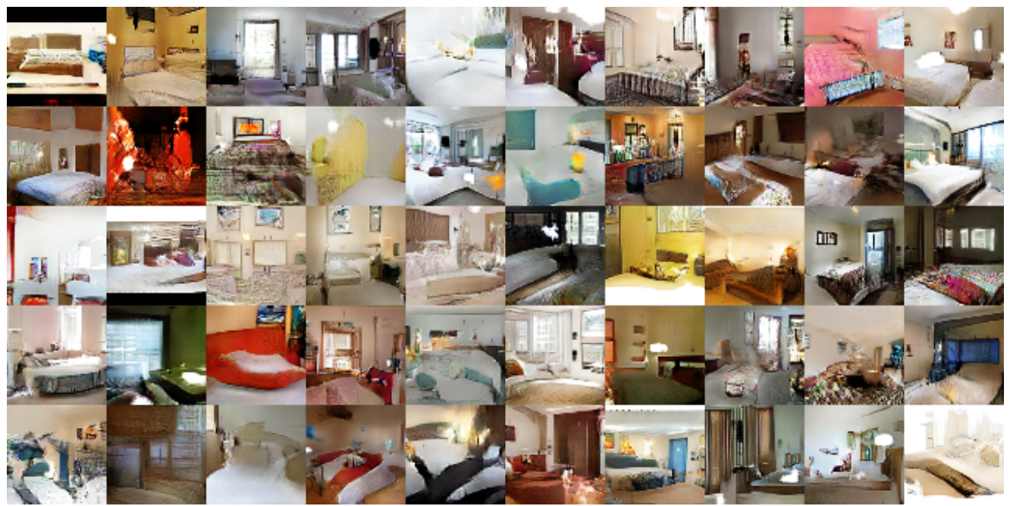

Generative Adversarial Nets: Convolutional Architectures
Samples from the model look much better!
Radford et al,
ICLR 2016
Slide Credit: Fei-Fei Li, Justin Johnson, Serena Yeung, CS 231n

Slide 37
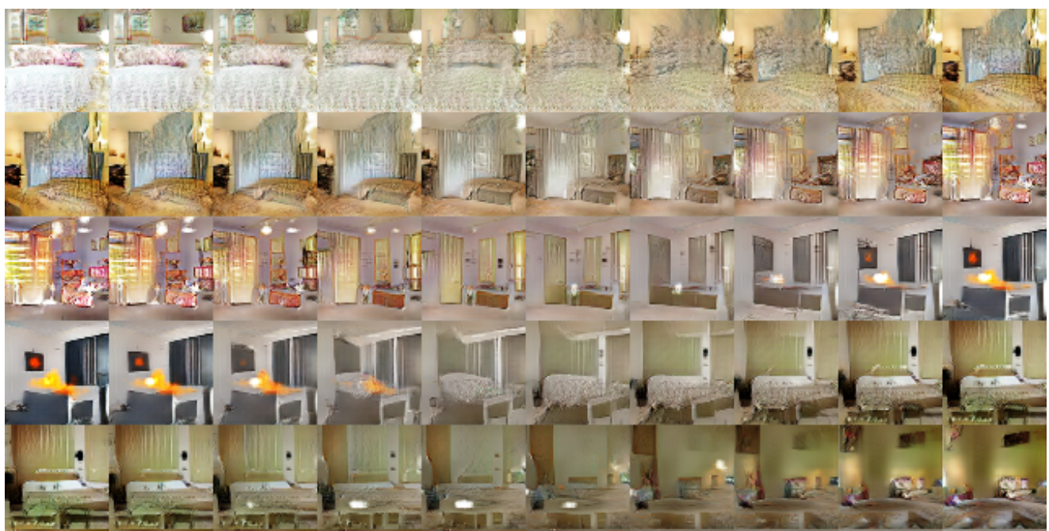
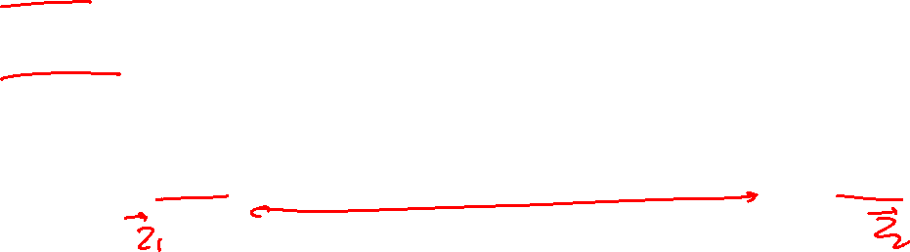
Generative Adversarial Nets: Convolutional Architectures
Interpolating between random
points in latent space
Radford et al,
ICLR 2016
Slide Credit: Fei-Fei Li, Justin Johnson, Serena Yeung, CS 231n
Notes:
Take 2 points of z (2 random vectors), and interpolate between these points

Slide 38
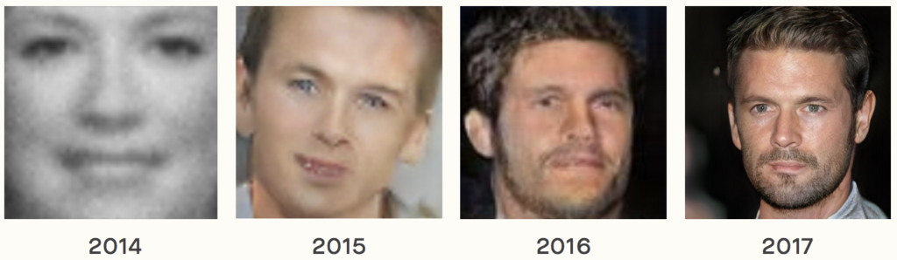
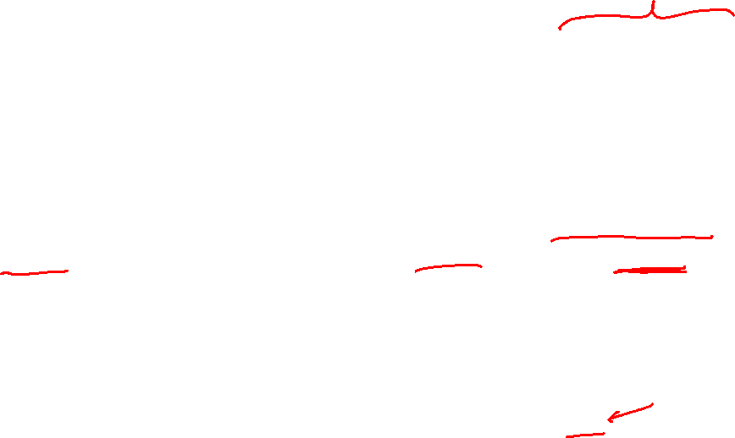
Results over the years
The Malicious Use of Artificial Intelligence: Forecasting, Prevention, and Mitigation, 2018.
https://arxiv.org/abs/1802.07228

Slide 39
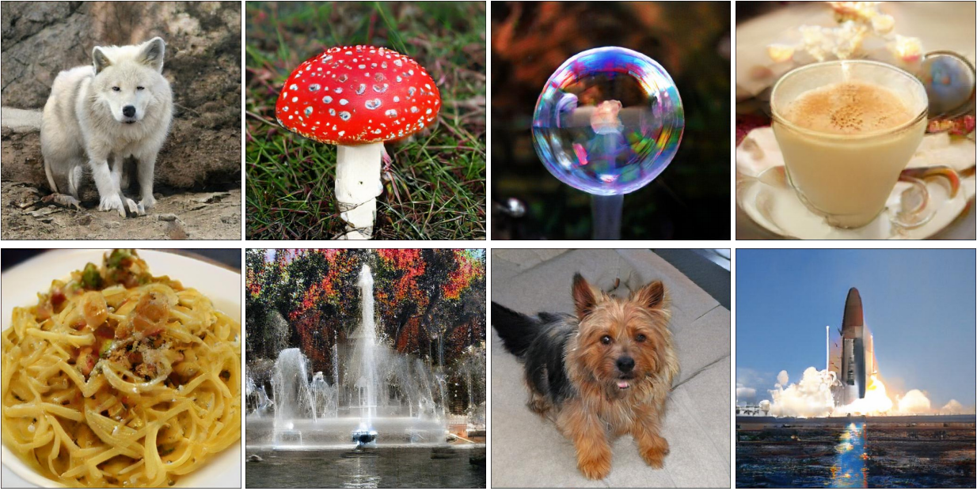
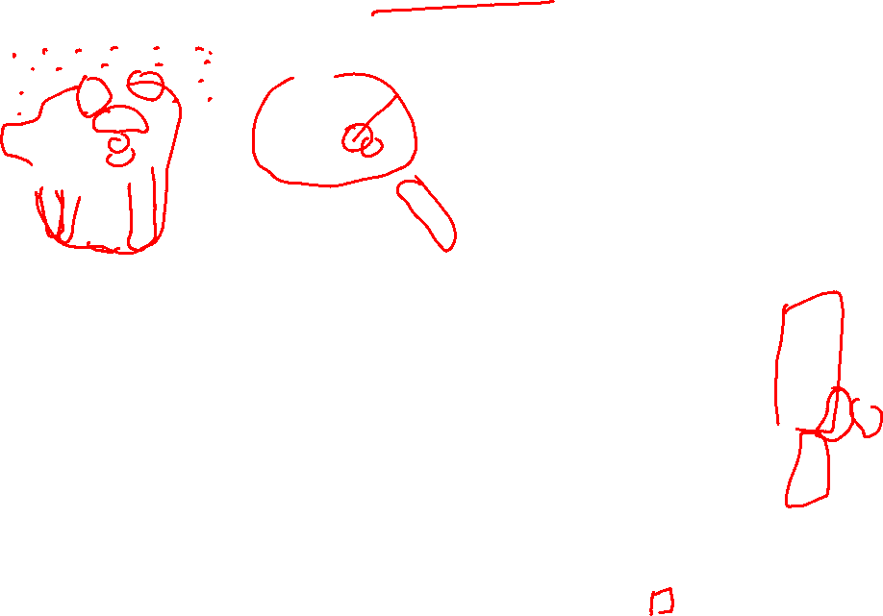
BigGAN
Large Scale GAN Training for High Fidelity Natural Image Synthesis
Andrew Brock, Jeff Donahue, Karen Simonyan https://arxiv.org/abs/1809.11096

Slide 40
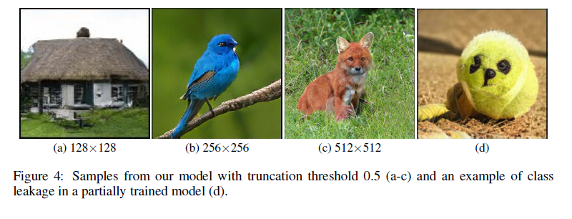
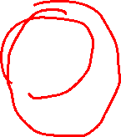
BigGAN
Large Scale GAN Training for High Fidelity Natural Image Synthesis
Andrew Brock, Jeff Donahue, Karen Simonyan https://arxiv.org/abs/1809.11096

Slide 41
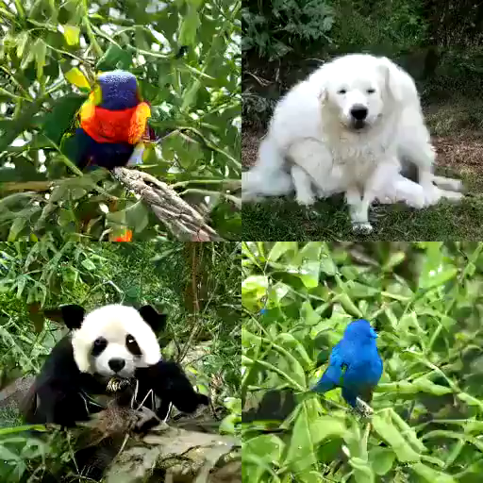
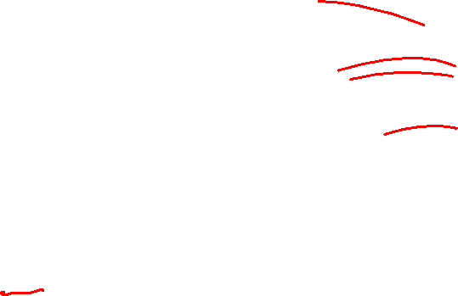
BigGAN
https://gist.github.com/phillipi/d2921f2d4726d7e3cdac7a4780c6050a

Slide 42
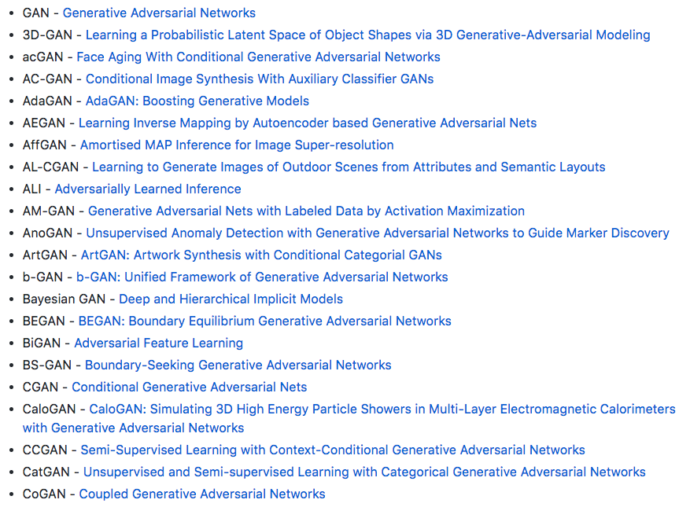
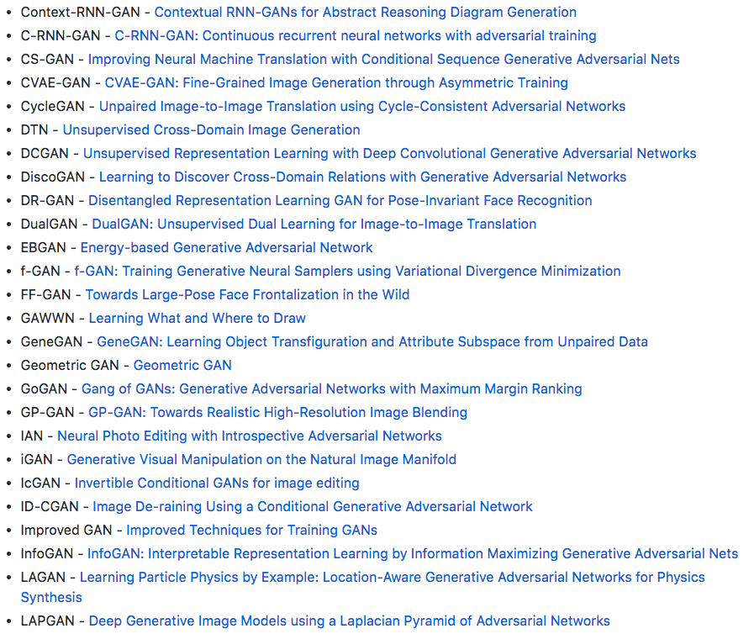

Explosion of GANs
“The GAN Zoo”
“The GAN Zoo”
https://github.com/hindupuravinash/the-gan-zoo
Also see https://paperswithcode.com/task/image-generation/latest
Slide Credit: Fei-Fei Li, Justin Johnson, Serena Yeung, CS 231n

Slide 43
“The GAN Zoo”
Explosion of GANs
See also: https://github.com/soumith/ganhacks for tips and tricks for trainings GANs
https://github.com/hindupuravinash/the-gan-zoo
Slide Credit: Fei-Fei Li, Justin Johnson, Serena Yeung, CS 231n

Slide 44

GANs
Don’t work with an explicit density function
Take game-theoretic approach: learn to generate from training distribution through 2-player game
Pros:
Beautiful, state-of-the-art samples!
Cons:
Trickier / more unstable to train
Can’t solve inference queries such as p(x), p(z|x)
Active areas of research:
Better loss functions, more stable training (Wasserstein GAN, LSGAN, many others)
Conditional GANs, GANs for all kinds of applications
Slide Credit: Fei-Fei Li, Justin Johnson, Serena Yeung, CS 231n

Slide 45

Plan for Today
Generative Adversarial Networks (GANs)
Closing the loop

Slide 46

So what is Deep (Machine) Learning?
A few different ideas:
(Hierarchical) Compositionality
  Cascade of non-linear transformations
  Multiple layers of representations
End-to-End Learning
  Learning (goal-driven) representations
  Learning to feature extraction
Distributed Representations
  No single neuron “encodes” everything
  Groups of neurons work together

Slide 47


Building A Complicated Function
Given a library of simple functions
Idea 2: Compositions
Deep Learning
Grammar models
Scattering transforms…
Compose into a
complicate function
Slide Credit: Marc'Aurelio Ranzato, Yann LeCun

Slide 48

Differentiable Computation Graph
Any DAG of differentialble modules is allowed!
Slide Credit: Marc'Aurelio Ranzato

Slide 49
So what is Deep (Machine) Learning?
A few different ideas:
(Hierarchical) Compositionality
  Cascade of non-linear transformations
  Multiple layers of representations
End-to-End Learning
  Learning (goal-driven) representations
  Learning to feature extraction
Distributed Representations
  No single neuron “encodes” everything
  Groups of neurons work together

Slide 50


“Shallow” vs Deep Learning
“Shallow” models
Deep models
hand-crafted
Feature Extractor
“Simple” Trainable
Classifier
fixed
learned
Trainable
Feature-Transform /
Classifier
Trainable
Feature-Transform /
Classifier
Trainable
Feature-Transform /
Classifier
Learned Internal Representations
Slide Credit: Marc'Aurelio Ranzato, Yann LeCun

Slide 51


Key Computation: Forward-Prop
Slide Credit: Marc'Aurelio Ranzato, Yann LeCun

Slide 52


Key Computation: Back-Prop
Slide Credit: Marc'Aurelio Ranzato, Yann LeCun

Slide 53
So what is Deep (Machine) Learning?
A few different ideas:
(Hierarchical) Compositionality
  Cascade of non-linear transformations
  Multiple layers of representations
End-to-End Learning
  Learning (goal-driven) representations
  Learning to feature extraction
Distributed Representations
  No single neuron “encodes” everything
  Groups of neurons work together

Slide 54


Distributed Representations Toy Example
Can we interpret each dimension?
Slide Credit: Moontae Lee

Slide 55


Power of distributed representations!
Local
Distributed
Slide Credit: Moontae Lee

Slide 56
What is this class about?

Slide 57

What is this class about?
Introduction to Deep Learning
Goal:
  After finishing this class, you should be ready to get started on your first DL research project.
    CNNs
    RNNs
    Deep Reinforcement Learning
    Generative Models (VAEs, GANs)

Slide 58

What did we learn?
Background & Basics
    Neural Networks, Backprop, Optimization (SGD)
Module 1: Convolutional Neural Networks (CNNs)
    Architectures, Pre-training, Fine-tuning
    Visualizations, Fooling CNSS, Adversarial examples
    Different tasks: detection CNNs, segmentation CNNs
Module 2: Recurrent Neural Networks (RNNs)
    Difficulty of learning; “Vanilla” RNNs, LSTMs, GRU
    RNNs for Sequence-to-Sequence (machine translation & image captioning, VQA, Visual Dialog)
Module 3: Deep Reinforcement Learning
    Overview, policy gradients
    Optimizing Neural Sequence Models for goal-driven rewards
Module 4: Deep Unsupervised Learning
    Variational Inference
    Variational Auto Encoders (VAEs)
    GANs, Adversarial Learning

Slide 59



Arxiv Fire Hose
PhD Student
Deep Learning papers

Slide 60

Feedback
http://b.gatech.edu/cios

Slide 61

Thanks!
(We hope your future learnings are deep)

