Slide 1
CS 4803 / 7643: Deep Learning
Topics:
  Analytical Gradients
  Automatic Differentiation
    Computational Graphs
    Forward mode vs Reverse mode AD
Dhruv Batra
Georgia Tech

Slide 2
Administrativia
HW1 Reminder
  Due: 09/09, 11:59pm

Slide 3
Recap from last time

Slide 4


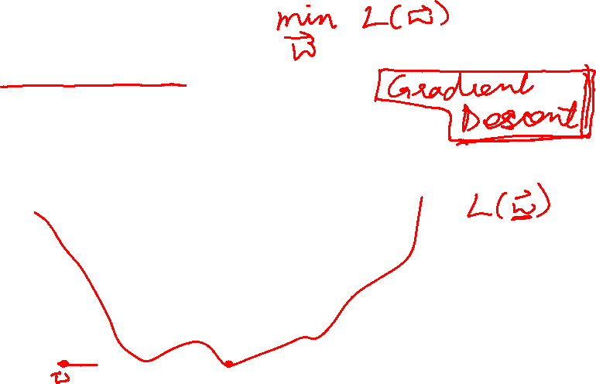
Strategy: Follow the slope
Slide Credit: Fei-Fei Li, Justin Johnson, Serena Yeung, CS 231n

Slide 5
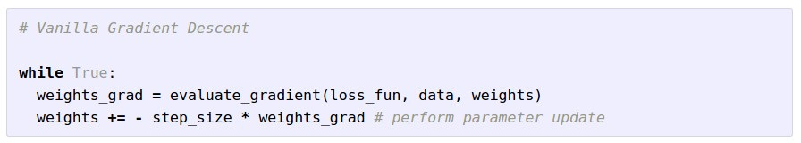
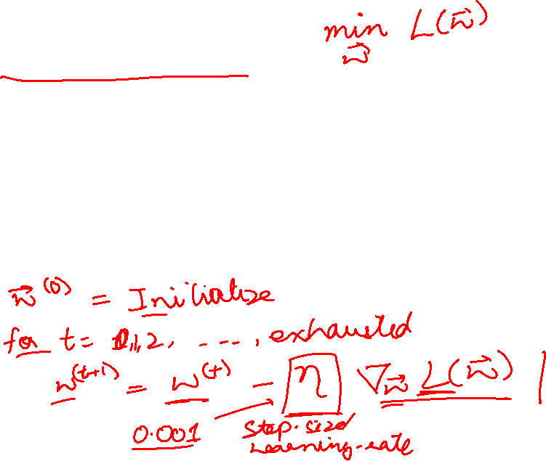
Gradient Descent
Slide Credit: Fei-Fei Li, Justin Johnson, Serena Yeung, CS 231n

Slide 6
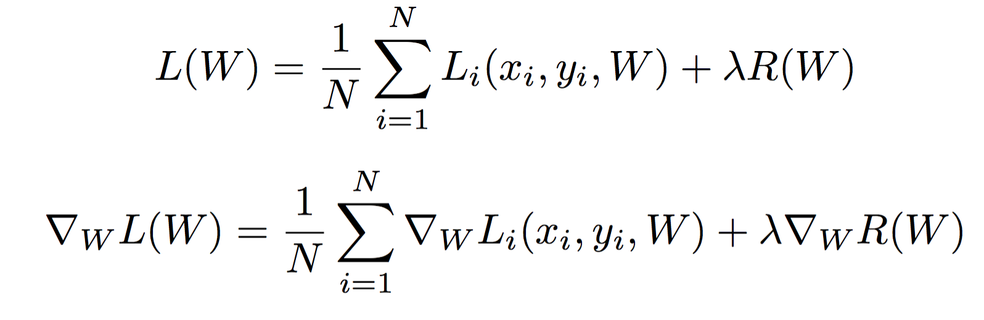
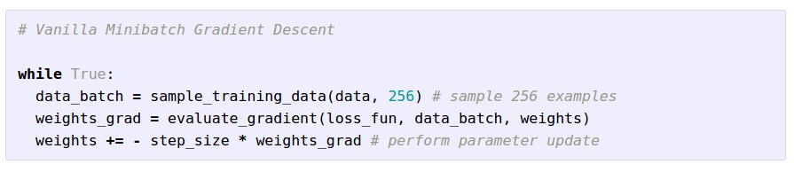


Stochastic Gradient Descent (SGD)
Full sum expensive when N is large!
Approximate sum using a minibatch of examples
32 / 64 / 128 common
Slide Credit: Fei-Fei Li, Justin Johnson, Serena Yeung, CS 231n

Slide 7
How do we compute gradients?
Analytic or “Manual” Differentiation
Symbolic Differentiation
Numerical Differentiation
Automatic Differentiation
  Forward mode AD
  Reverse mode AD
    aka “backprop”

Slide 8
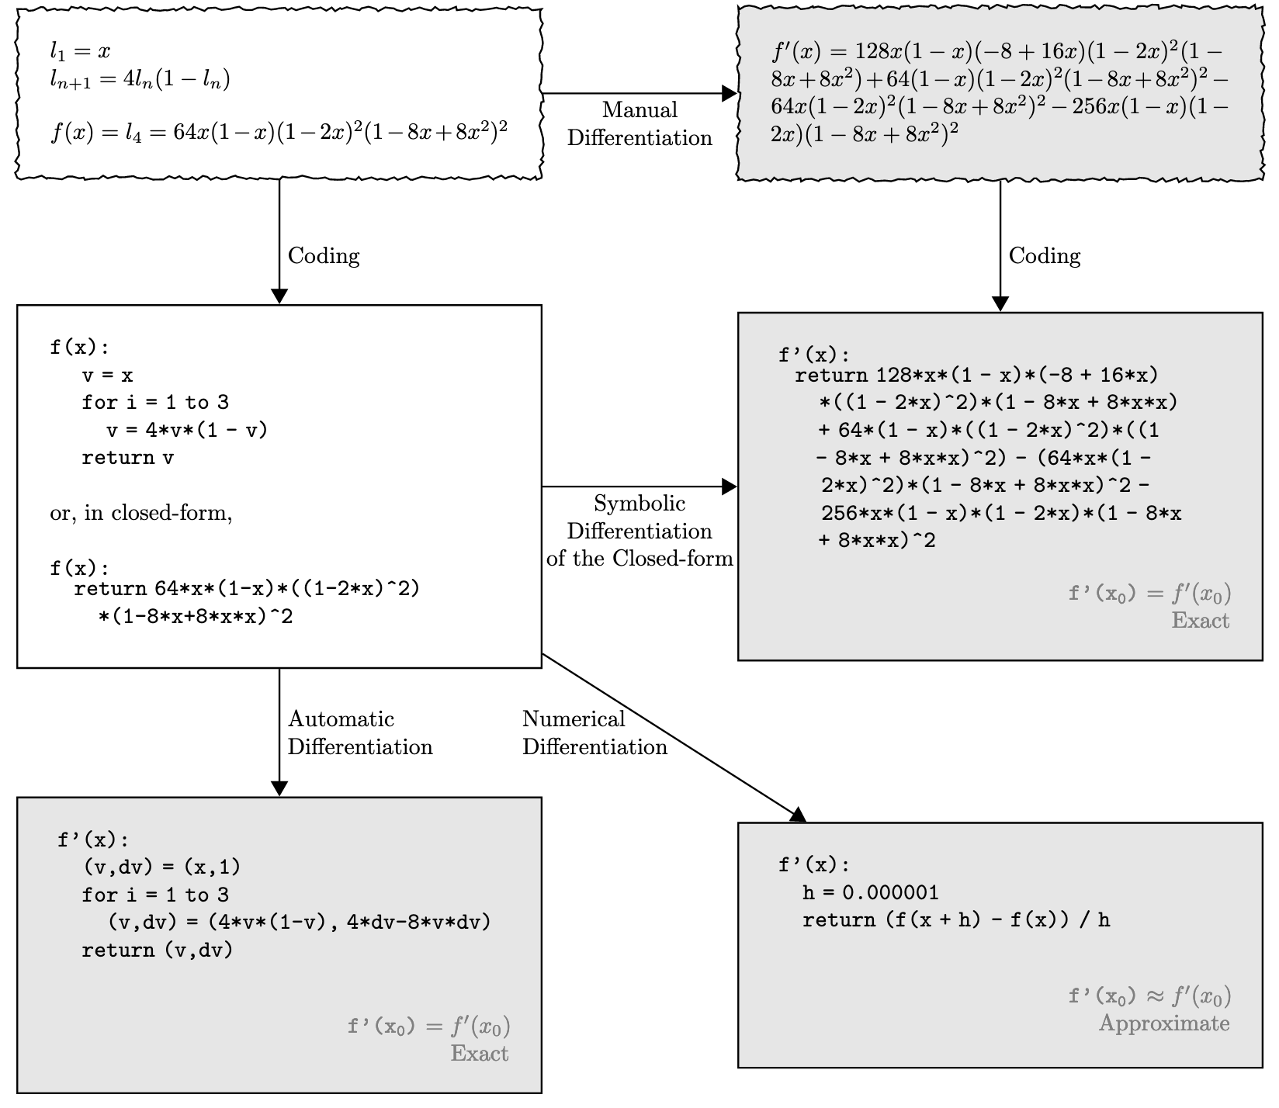
Figure Credit: Baydin et al. https://arxiv.org/abs/1502.05767

Slide 9
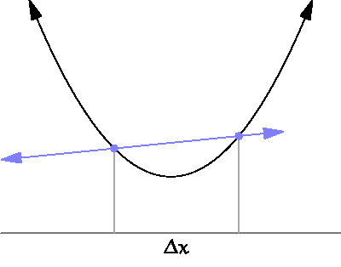
By Brnbrnz (Own work) [CC BY-SA 4.0 (http://creativecommons.org/licenses/by-sa/4.0)]

Slide 10

current W:
[0.34,
-1.11,
0.78,
0.12,
0.55,
2.81,
-3.1,
-1.5,
0.33,…]
loss 1.25347
W + h (first dim):
[0.34 + 0.0001,
-1.11,
0.78,
0.12,
0.55,
2.81,
-3.1,
-1.5,
0.33,…]
loss 1.25322
gradient dW:
[-2.5,
?,
?,
?,
?,
?,
?,
?,
?,…]
(1.25322 - 1.25347)/0.0001
= -2.5
Slide Credit: Fei-Fei Li, Justin Johnson, Serena Yeung, CS 231n

Slide 11
Numerical vs Analytic Gradients
Numerical gradient: slow :(, approximate :(, easy to write :)
Analytic gradient: fast :), exact :), error-prone :(
In practice: Derive analytic gradient, check your implementation with numerical gradient.
This is called a gradient check.
Slide Credit: Fei-Fei Li, Justin Johnson, Serena Yeung, CS 231n

Slide 12
Plan for Today
Analytical Gradients
Automatic Differentiation
  Computational Graphs
  Forward mode vs Reverse mode AD

Slide 13
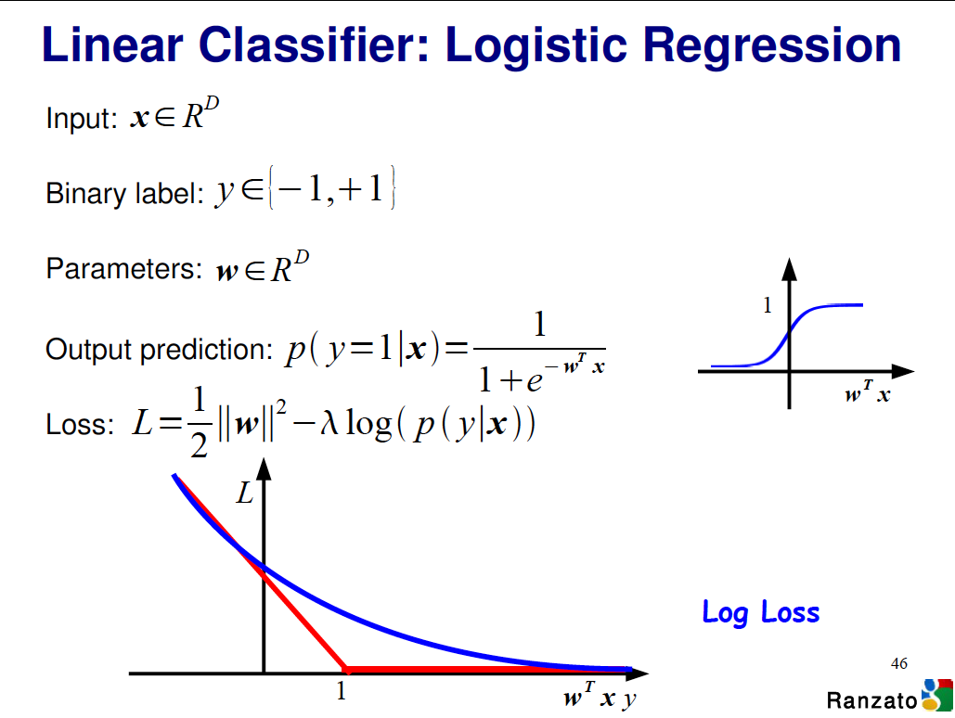
Example: Logistic Regression
Slide Credit: Marc’Aurelio Ranzato

Slide 14
Vector/Matrix Derivatives Notation

Slide 15
Vector/Matrix Derivatives Notation

Slide 16
Vector Derivative Example

Slide 17
Vector Derivative Example

Slide 18
Extension to Tensors

Slide 19
Chain Rule: Composite Functions

Slide 20
Chain Rule: Scalar Case

Slide 21
Chain Rule: Vector Case

Slide 22
Chain Rule: Jacobian view

Slide 23
Chain Rule: Graphical view

Slide 24
Chain Rule: Cascaded

Slide 25
Example: Logistic Regression
Slide Credit: Marc’Aurelio Ranzato

Slide 26
Logistic Regression Derivatives

Slide 27
Logistic Regression Derivatives

Slide 28
Chain Rule: How should we multiply?

Slide 29
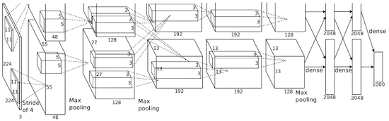
Convolutional network (AlexNet)
input image
weights
loss
Figure copyright Alex Krizhevsky, Ilya Sutskever, and Geoffrey Hinton, 2012. Reproduced with permission.
Slide Credit: Fei-Fei Li, Justin Johnson, Serena Yeung, CS 231n
Notes:
Becomes very useful when we work with complex functions

Slide 30
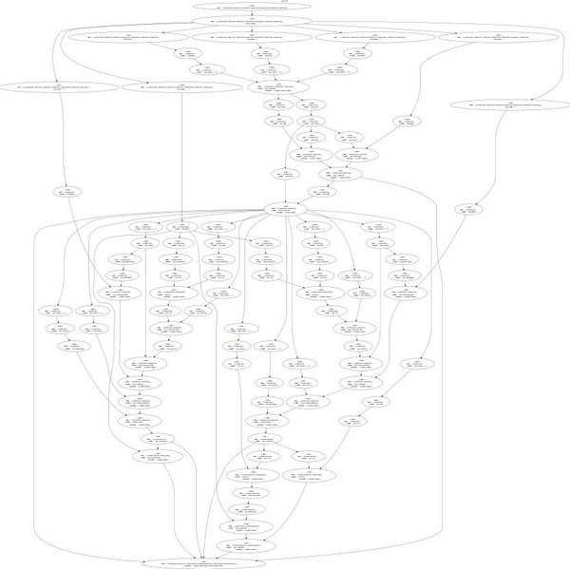
Neural Turing Machine
input image
loss
Figure reproduced with permission from a Twitter post by Andrej Karpathy.
Slide Credit: Fei-Fei Li, Justin Johnson, Serena Yeung, CS 231n
Notes:
Things get even crazier

Slide 31
How do we compute gradients?
Analytic or “Manual” Differentiation
Symbolic Differentiation
Numerical Differentiation
Automatic Differentiation
  Forward mode AD
  Reverse mode AD
    aka “backprop”

Slide 32
Deep Learning = Differentiable Programming
Computation = Graph
  Input = Data + Parameters
  Output = Loss
  Scheduling = Topological ordering
Auto-Diff
  A family of algorithms for
  implementing chain-rule on computation graphs

Slide 33



Computational Graph
x
*
s (scores)
hinge loss
+
L
W
R
Slide Credit: Fei-Fei Li, Justin Johnson, Serena Yeung, CS 231n
Notes:
How to compute the analytic gradient for arbitrarily complex functions using frame called computational graph
Can use computational graph to represent any function, where the nodes of the graph are steps of computation that we go through
Linear classifier example
Advantage is that once we express a function using a computational graph, can use a technique called backpropagation which recursively uses the chain rule to efficient compute gradient

Slide 34
Neural Network Computation Graph
Figure Credit: Andrea Vedaldi

Slide 35
Computational Graph
Any DAG of differentiable modules is allowed!
Slide Credit: Marc'Aurelio Ranzato

Slide 36
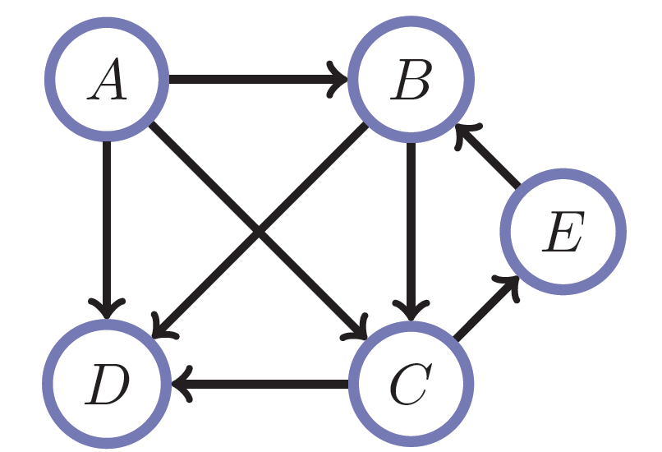
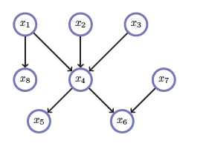
Directed Acyclic Graphs (DAGs)
Exactly what the name suggests
  Directed edges
  No (directed) cycles
  Underlying undirected cycles okay

Slide 37
Directed Acyclic Graphs (DAGs)
Concept
  Topological Ordering

Slide 38
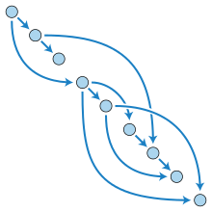
Directed Acyclic Graphs (DAGs)

Slide 39
Computational Graphs
Notation

Slide 40
Example
+
sin( )
*
x₁
x₂

Slide 41
HW0

Slide 42
HW0 Submission by Samyak Datta

Slide 43
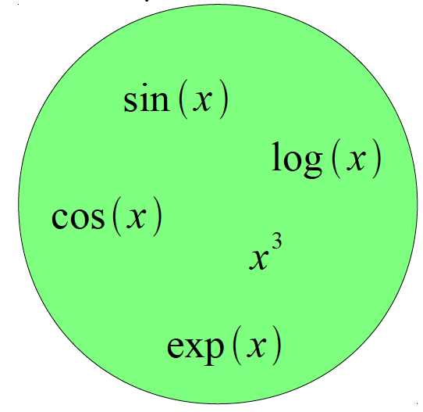
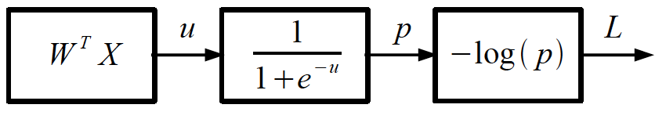
Logistic Regression as a Cascade
Given a library of simple functions
Compose into a
complicate function
Slide Credit: Marc'Aurelio Ranzato, Yann LeCun

Slide 44
Deep Learning = Differentiable Programming
Computation = Graph
  Input = Data + Parameters
  Output = Loss
  Scheduling = Topological ordering
Auto-Diff
  A family of algorithms for
  implementing chain-rule on computation graphs

Slide 45
Forward mode vs Reverse Mode
Key Computations

Slide 46
Forward mode AD
g
Notes:
What we’re doing in backprop is we have all these nodes in our computational graph, each node only aware of immediate surroundings
at each node have ...

Slide 47
Reverse mode AD
g
Notes:
What we’re doing in backprop is we have all these nodes in our computational graph, each node only aware of immediate surroundings
at each node have ...

Slide 48
Example: Forward mode AD
+
sin( )
*
x₁
x₂

Slide 49
Example: Forward mode AD
+
sin( )
*
x₁
x₂

Slide 50
Example: Forward mode AD
+
sin( )
*
x₁
x₂

Slide 51
Example: Forward mode AD
+
sin( )
*
x₁
x₂

Slide 52
Example: Forward mode AD
+
sin( )
*
x₁
x₂

Slide 53
Example: Forward mode AD
Q: What happens if there’s another input variable x₃?
+
sin( )
*
x₁
x₂

Slide 54
Example: Forward mode AD
Q: What happens if there’s another input variable x₃?
A: more sophisticated graph;
d “forward props” for d variables
+
sin( )
*
x₁
x₂

Slide 55
Example: Forward mode AD
Q: What happens if there’s another output variable f₂?
+
sin( )
*
x₁
x₂

Slide 56
Example: Forward mode AD
Q: What happens if there’s another output variable f₂?
A: more sophisticated graph;
single “forward prop”
+
sin( )
*
x₁
x₂

Slide 57
Example: Reverse mode AD
+
sin( )
*
x₁
x₂

Slide 58
Example: Reverse mode AD
+
sin( )
*
x₁
x₂

Slide 59
Example: Reverse mode AD
+
sin( )
*
x₁
x₂

Slide 60
Gradients add at branches
+
Slide Credit: Fei-Fei Li, Justin Johnson, Serena Yeung, CS 231n
Notes:
Gradients add at branches, from multivariate chain rule
Since wiggling this node affects both connected nodes in the forward pass, then at backprop the upstream gradient coming into this node is the sum of the gradients flowing back from both nodes

Slide 61
Example: Reverse mode AD
Q: What happens if there’s another input variable x₃?
+
sin( )
*
x₁
x₂

Slide 62
Example: Reverse mode AD
Q: What happens if there’s another input variable x₃?
A: more sophisticated graph;
single “backward prop”
+
sin( )
*
x₁
x₂

Slide 63
Example: Reverse mode AD
Q: What happens if there’s another output variable f₂?
+
sin( )
*
x₁
x₂

Slide 64
Example: Reverse mode AD
Q: What happens if there’s another output variable f₂?
A: more sophisticated graph;
c “backward props” for c vars
+
sin( )
*
x₁
x₂

Slide 65
Forward mode vs Reverse Mode
x → Graph → L
Intuition of Jacobian

Slide 66
Forward Pass vs
Forward mode AD vs Reverse Mode AD
+
sin( )
*
x₁
x₂
+
+
sin( )
*
sin( )
*
x₁
x₂
x₁
x₂

Slide 67
Forward mode vs Reverse Mode
What are the differences?
+
+
sin( )
*
sin( )
*
x₁
x₂
x₁
x₂

Slide 68
Forward mode vs Reverse Mode
What are the differences?
Which one is faster to compute?
  Forward or backward?

Slide 69
Forward mode vs Reverse Mode
What are the differences?
Which one is faster to compute?
  Forward or backward?
Which one is more memory efficient (less storage)?
  Forward or backward?

